Slide 1
Linear Algebra & Convex Optimization – Lecture 9
References : Introduction to Linear Algebra, Gilbert Strang; Online References

Slide 2



Positive Semi-Definite (PSD) Matrices
A matrix is positive semi-definite if it is symmetric and all eigen values are non-negative
A matrix $M$is positive semi definite if $x^{T}Mx≥0$ for all eigenvectors of $M.$
$x^{T}Mx= x^{T}λx= λx^{T}x$ (if $x$ is an eigen vector)
$λ{\left\|x\right\|}^{2}$ $≥0$ for all $x≠0$ & $λ≥0$
A matrix $M$is positive semi definite if $x^{T}Mx≥0$ for all v$ectors$
Poll:
If A & B are Positive definite matrices will A+B a positive definite matrix ?
Positive Definite Matrices:
A matrix is positive definite if it is symmetric and all eigen values are positive
$λ>0$ for all $λ$ of $B$
$x^{T}Bx>0$ for all $x≠0$

Slide 3




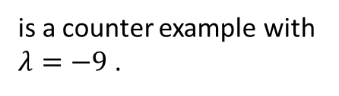




Rayleigh Quotient
$$R\left(A,x\right)=\frac{x^{T}Ax}{x^{T}x}$$
Given a symmetric Matrix $A$ and any vector $x$ , Rayleigh Quotient is defined as
Among all $x$ with $\left\|x\right\|=1$, the $x$ that maximizes , Rayleigh Quotient is the eigen vector , $v_{max}$ that corresponds to maximum eigen value, $λ_{max}$ of $A$
$$R\left(A,v_{max }\right)$$
$${= v}_{max}^{T}Aν_{max}$$
= $v_{max}^{T}λ_{max}ν_{max}$
= $λ_{max}$ $v_{max}^{T}ν_{max}$
= $λ_{max}$
$$R\left(A,x\right)∈\left[λ_{min},λ_{max}\right]$$
Poll:
If all the entries in a matrix A is positive will it be positive definite matrix ?
Poll:
Can positive definite matrices have negative diagonal entries?
is a counter example with $λ=−9$ .

Slide 4



Power Iteration Method to Find Maximum Eigen Value/Vector
How do we find eigen value of the dominant eigen vector?

Slide 5
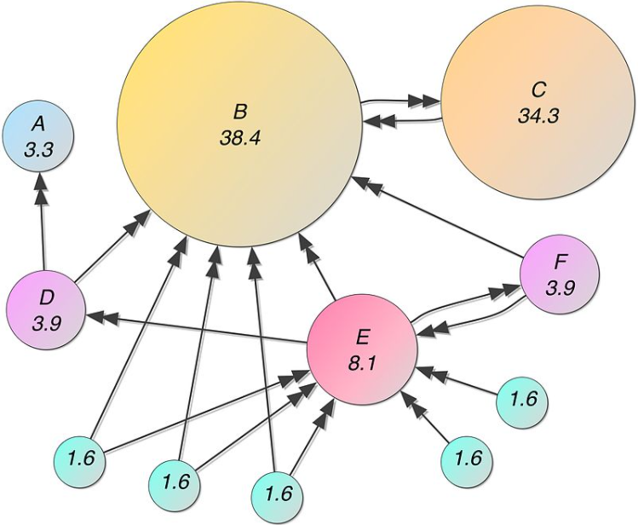
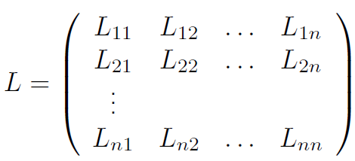


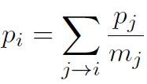
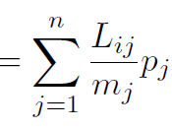
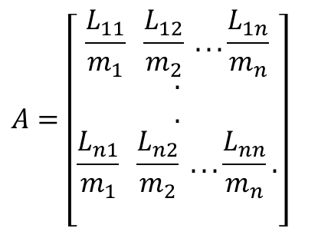



Dominant Eigen Vector Application : Page Rank Algorithm (Google)
Page Rank of Page i :
Importance Matrix
$$A=\left[\begin{aligned}\frac{L_{11}}{m_{1}} \frac{L_{12}}{m_{2}} . . .\frac{L_{1n}}{m_{n}} \\ . \\ . \\ \frac{L_{n1}}{m_{1}} \frac{L_{n2}}{m_{2}} . . .\frac{L_{nn}}{m_{n}}. \\ \end{aligned}\right]$$
Page Rank of Web pages
$$p_{i}$$
$A$ is a column stochastic Matrix with maximum eigen value $λ_{1}=1$
$$Ap=p$$
Proof : See Appendix

Slide 6
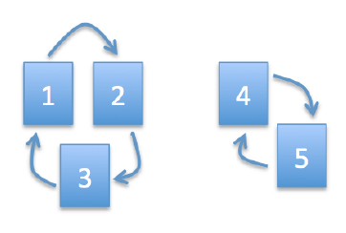
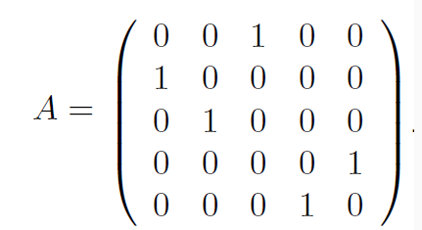
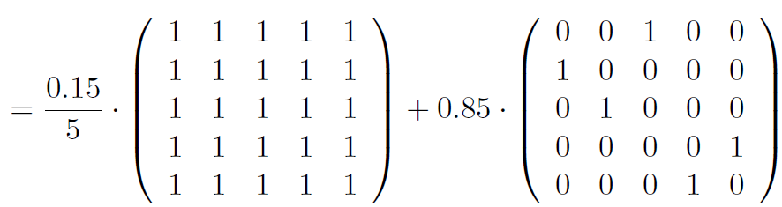

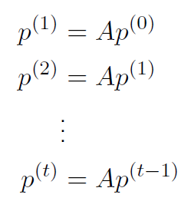
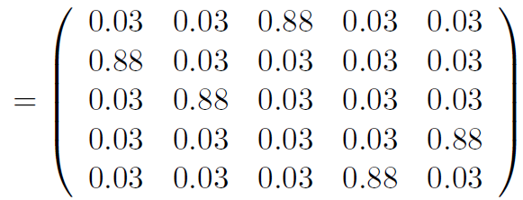





Dominant Eigen Vector Application : Page Rank Algorithm (Google)
Importance Matrix ($5×5)$
Let $p$ be the dominant eigen vector
Google Matrix:
$p$ is calculated using power iteration
$A$ is a column stochastic Matrix with maximum eigen value 1
$A$ has millions and millions of rows and columns.

Slide 7
Analysis of Rectangular Matrices

Slide 8


Four Fundamental Subspaces of $m×n$ Matrix A
$$ℝ^{n}$$
$$ℝ^{m}$$
Row Space
Column Space C(A)
dim( C(A)) = r
= #pivots
= no if independent columns
dim( Row Space) = r
= #pivots
= no if independent rows
Null Space N(A)
Left Null Space N(A^{T})
dim( Null Space) = n- r
= #free variables in Ax
dim( Left Null Space) = m- r
= #free variables in A^{T}x
Notes:
for

Slide 9
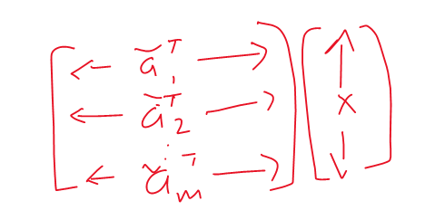
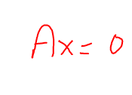




Orthogonal Sub-spaces
S , T are 2 sub-spaces of $ℝ^{n}$
We say $S⊥T$ when every vector $s∈S$ & $t∈T$ , s $⊥t$
$$RowSpace (A)⊥NullSpace(A)$$
$$ColumnSpace (A)⊥NullSpace(A^{T})$$

Slide 10
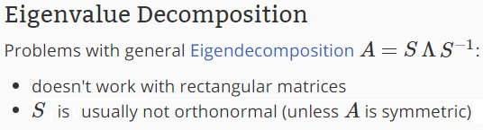
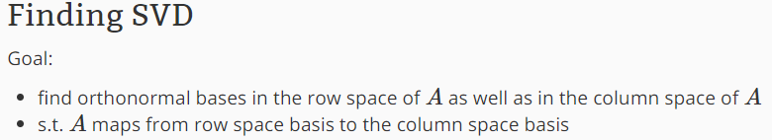
Singular Value Decomposition of $m×n$ Matrix A

Slide 11
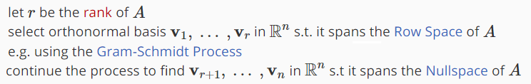

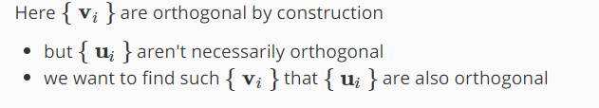
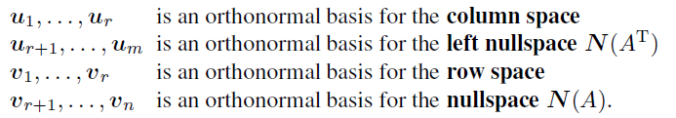

Orthogonalization of Rowspace of $m×n$ Matrix A
Objective:
Show $A=UΣV^{T}$

Slide 12

Orthogonal basis of Row Space using Eigen Vectors of A^{T}A

Slide 13









Orthogonal basis for Column Space of $m×n$ Matrix A
:
:

Slide 14
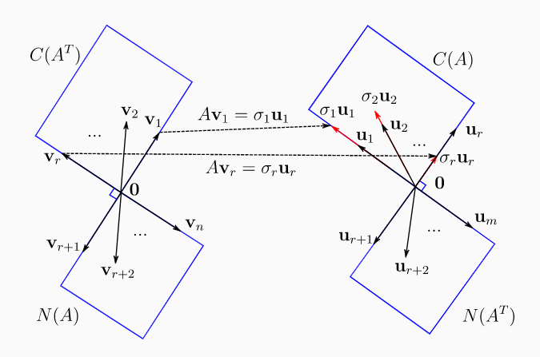


SVD Construction for $m×n$ Matrix A

Slide 15
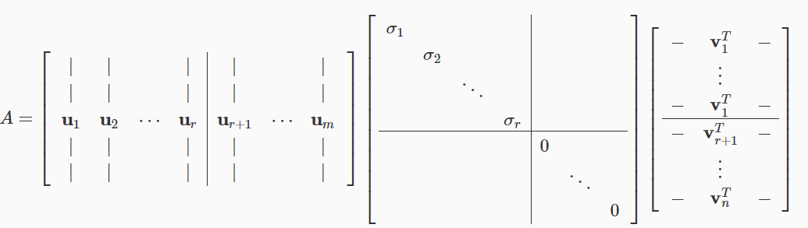
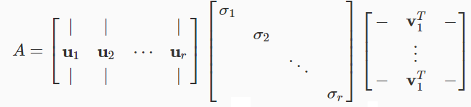
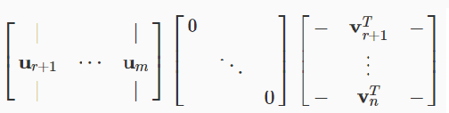
SVD Construction for $m×n$ Matrix A

Slide 16
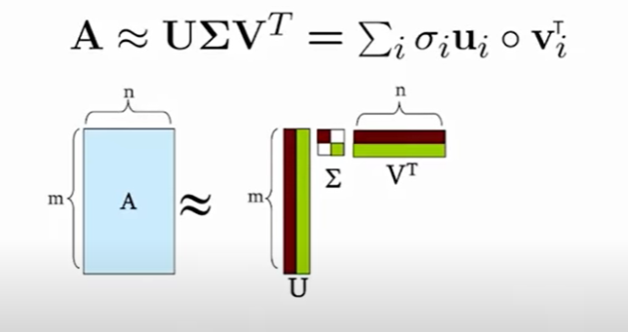
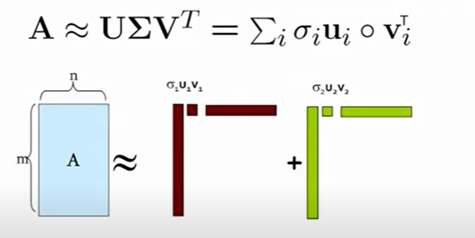


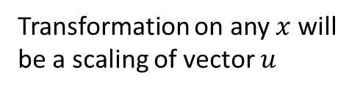
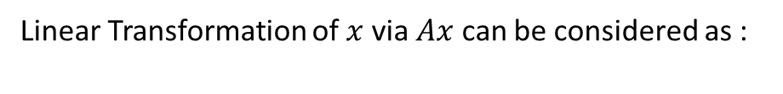

SVD : Sum of Linear Transformations
Linear Transformation of $x$ via $Ax$ can be considered as :
$$A=uv^{T}$$
Rank ($A$) = 1
1. Linear transformation using individual matrices $σ_{i}u_{i}v_{i}^{T}$.
$$Ax=uv^{T}x={(v}^{T}x)u$$
Transformation on any $x$ will be a scaling of vector $u$
2. Summation of linear transformation using rank-1 matrices $σ_{i}u_{i}v_{i}^{T}$.

Slide 17
Appendix
Proof: The maximum eigen value of a column stochastic matrix is 1
If A is a square matrix, then its eigenvalues are equal to the eigenvalues of its transpose, since they share the same characteristic polynomial.
So lets prove for row-stochastic matrix.

