Slide 1

School of Electronics and Communication Engineering
Senior Design Project VII semester
User-Friendly Interface for Dual Health Risk Prediction: Heart Failure and Diabetes
Under the guidance of: Kiran M R
Team members:
SL.NO | NAME | USN
1. | Shyam Desai | 01FE21BEC110
2. | Shridhar Naragund | 01FE21BEC116
3. | Shashidhar Angadi | 01FE21BEC275
4. | Aditya Wali | 01FE21BEC306

Slide 2

Overview
Introduction
Literature Survey
Problem statement
Objectives
Functional block diagram
Proposed Methodology
Demonstration of results
Conclusion
References
School of Electronics and Communication Engineering

Slide 3
Motivation :
Introduction
Nowadays Heart failure is becoming a more common and serious health issue due to modern dietary habits and sedentary lifestyles. The rising number of heart failure cases each year indicates a pressing need for tools that can predict and manage the condition early. Addressing this issue can potentially save lives and reduce healthcare costs.
While traditional machine learning models (such as KNN, SVM, Logistic Regression, and Gaussian Naive Bayes) have been used to predict heart failure, they may not always provide the highest accuracy. By applying a deep learning approach with Artificial Neural Networks (ANN), this research aims to enhance the prediction accuracy. ANN models have the potential to better capture complex patterns and relationships in the data, leading to more precise and reliable predictions compared to earlier models.
Enhanced Accessibility through GUI To make the advanced prediction model more practical and user-friendly, a graphical user interface (GUI) has been developed. This GUI simplifies the process for users by allowing them to input their health data and receive heart failure predictions quickly and easily. This makes the technology more accessible to both healthcare professionals and individuals, improving its usability in real-world settings and supporting better health management.
School of Electronics and Communication Engineering

Slide 4
Overview :
Introduction
Heart Failure Overview: Heart failure occurs when the heart cannot pump blood effectively, leading to inadequate blood circulation. It results from factors such as cardiovascular disease, high cholesterol, hypertension, lack of exercise, alcohol consumption, and smoking. Early detection is crucial as it can prevent fatalities and improve lifestyle outcomes.
Need for Early Detection: Early prediction of heart failure is essential to reduce the risk of death and improve treatment outcomes. Accurate and timely detection can significantly enhance patient care and reduce healthcare costs. Traditional diagnosis methods can be challenging due to the complex nature of the disease and its symptoms.
Role of Deep Learning: Deep learning, particularly through Artificial Neural Networks (ANN), can handle complex datasets more efficiently than traditional machine learning models. This capability allows for the development of more accurate predictive models, which can aid in early and precise diagnosis of heart failure.
Impact: The increasing prevalence of heart failure and its impact on quality of life and healthcare costs motivates the development of advanced prediction systems. Using machine learning and deep learning algorithms can improve decision-making, reduce diagnostic expenses, and provide more effective solutions for managing heart failure.
School of Electronics and Communication Engineering

Slide 5
Literature survey
Machine Learning Techniques for Heart Failure Prediction ( S. Angraal )
Dataset and Accuracy: This study utilized a dataset of 1001 samples and focused on various ML techniques, including Random Forest, SVM, Decision Tree Classifier, and K-Nearest Neighbors (KNN) Classifier, achieving accuracies of 69%, 93%, 86%, and 68% respectively.
Comparison and Findings: The research highlights that Random Forest, Decision Tree, and Naive Bayes classifiers outperform deep learning models in terms of accuracy. The use of Principal Component Analysis (PCA) and feature selection was found to improve accuracy and recall rates.
Future Directions: The study emphasizes the effectiveness of ML for early heart failure detection and suggests that it may help reduce global mortality rates in the future.
Heart Failure Prediction Using SVM and Deep Neural Network (Xiong Liu;Yu Chen;)
Implementation: The authors used SVM for heart failure prediction with a dataset of 1000 samples, achieving an accuracy of 86.5%.
Advancements: The paper explored deep neural networks (DNN) to enhance classification accuracy, demonstrating a significant improvement with a DNN accuracy of 95% .
Impact: The high accuracy of DNN is crucial for improving patient diagnosis, especially in emergency situations, and contributes to early disease prediction for better patient outcomes.
School of Electronics and Communication Engineering

Slide 6
Literature survey
An Explainable Transformer-Based Deep Learning Model for the Prediction of Incident Heart Failure
Model Overview: BEHRT, a transformer-based deep learning model, was developed to predict heart failure (HF) risk within six months.
Dataset: The study used longitudinal electronic health records (EHRs) from 100,071 patients, including 13,000+ HF cases.
Data Features: BEHRT incorporated diagnoses, medications, age, and calendar year to enhance prediction accuracy.
Performance: BEHRT outperformed state-of-the-art models like RETAINEX, highlighting its superior predictive capability and clinical relevance.
Predicting Heart Failure Readmission from Clinical Notes Using Deep Learning
Data and Methodology: The study uses the MIMIC III database, focusing on discharge summary notes to train a CNN model. This approach eliminates the need for extensive feature engineering by effectively processing unstructured text data.
Performance: The CNN model outperforms traditional machine learning models, achieving F1 scores of 0.756 for general readmission and 0.733 for 30-day readmission, compared to random forest scores of 0.674 and 0.656.
Healthcare Impact: The findings highlight that deep learning techniques applied to clinical notes can improve hospital readmission predictions. This helps healthcare providers better identify high-risk patients and allocate resources efficiently, reducing overall readmission rates.
School of Electronics and Communication Engineering

Slide 7
User-Friendly Interface for Dual Health Risk Prediction: Heart Failure and Diabetes
Problem statement
Usability and Accessibility: Design a user-friendly interface that is easily navigable by users of all ages and technical proficiency, ensuring accessibility for people with disabilities.
Personalized Health Insights: Provide personalized health insights and actionable recommendations based on individual risk factors and health data.
Predictive Accuracy: Enhance the predictive accuracy of the model to reliably assess the risk of both heart failure and diabetes.
School of Electronics and Communication Engineering

Slide 8
Objectives
Implement traditional machine learning algorithms (Logistic Regression, SVM, KNN, Naive Bayes, Random Forest) and a deep learning model (Artificial Neural Network) to predict heart failure.
Implement machine learning models including Random Forest (RF), XGBoost (XGB), and LightGBM for diabetes prediction.
Design and implement an intuitive graphical user interface (GUI) to facilitate seamless interaction with prediction models.
School of Electronics and Communication Engineering

Slide 9
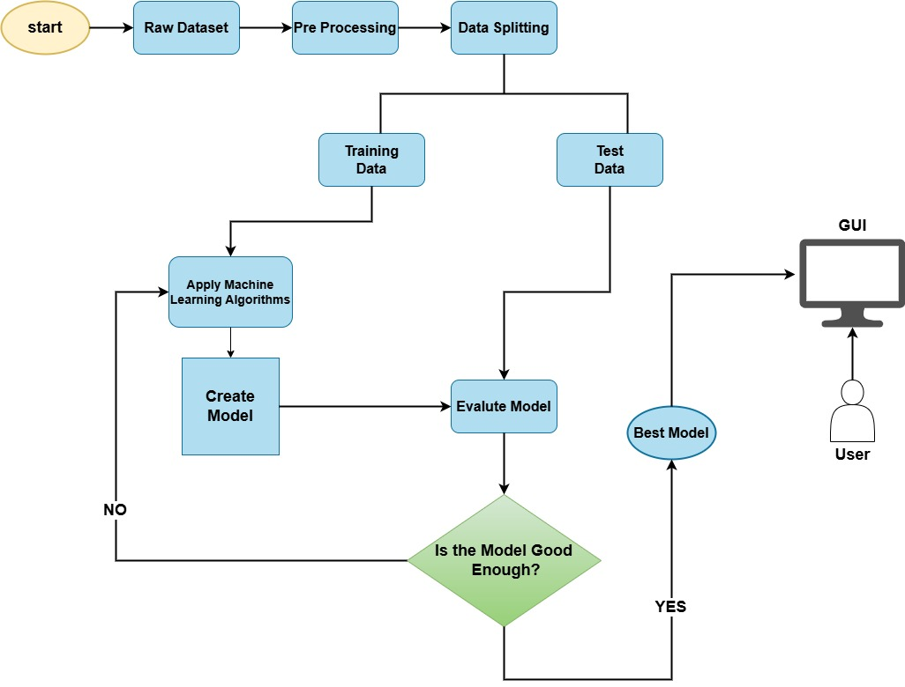
Functional block diagram
School of Electronics and Communication Engineering

Slide 10
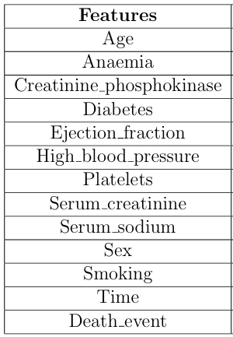
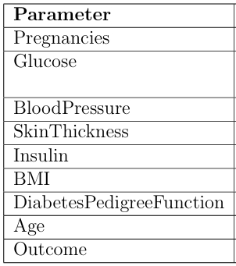
Dataset Details :
Proposed Methodology
The Heart Failure Clinical Records dataset from Rana Hospital in Ludhiana, Punjab. The objective of the data set is to predict whether a patient has Heart failure or not, It includes 1886 patient records with 13 features.
This dataset is originally from the National Institute of Diabetes and Digestive and Kidney Diseases, The objective of the data set is to diagnostically predict whether a patient has diabetes or not, It contains 768 patients’ data, and 268 of them have developed diabetes.
School of Electronics and Communication Engineering

Slide 11
Proposed Methodology
1. Preprocessing: The process starts with the collecting raw dataset and enhances data quality by handling missing values, outliers, feature selection, and normalization.
2. Data Splitting: Divides the dataset into training and test sets.
3. Model Training:
Heart Failure Prediction:
- Algorithms Tested: ANN, Random Forest, KNN, SVM, Logistic Regression, Naive Bayes.
- Best Model: ANN (achieved highest accuracy).
Diabetes Prediction:
- Algorithms Tested: Random Forest, XGBoost, LightGBM.
- Best Model: XGBoost (achieved highest accuracy).
4. Evaluation: Models are evaluated using metrics such as accuracy, precision, recall, and F1-score.
5. Refinement: Iterative adjustments are made to improve model performance.
6. Final Integration: The best models (ANN for heart failure and XGBoost for diabetes) are integrated into a user-friendly GUI. The interface allows healthcare professionals and patients to input health data and receive predictions.
School of Electronics and Communication Engineering

Slide 12
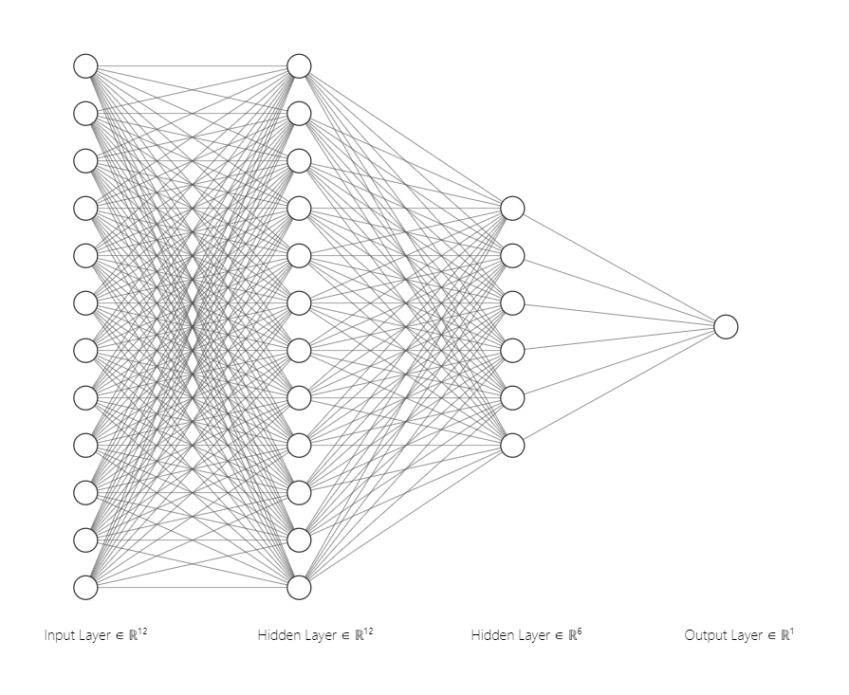
Proposed Methodology
Architecture of the proposed ANN :
Neural Network Configuration:
– Input layer: Twelve units
– First hidden layer: Twelve units
– Second hidden layer: Six units
– Final layer: One unit
– Epochs: 500
– Loss function: Binary cross-entropy
School of Electronics and Communication Engineering

Slide 13
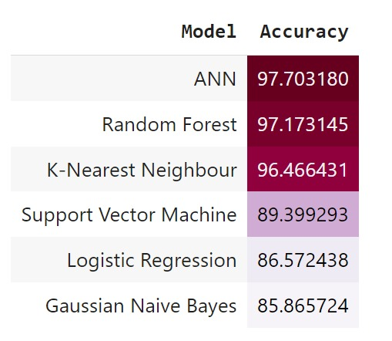
Results and discussions
Six distinct approaches were compared ANN, Random forest, K-Nearest Neighbour, SVM, Logistic regression and Naïve Bayes. After providing them with individualized training, the models were compared with their respective accuracy, which is shown in Table.
As a result, The Artificial Neural Network model is put to use because they have the best performance metrics out of the six.
In Diabetes prediction, XGBoost achieved the highest Cross Validation Score of 0.901316, indicating that it is the most effective model for predicting diabetes based on the dataset provided, the model's performance is stable and consistent across different folds of cross-validation.
School of Electronics and Communication Engineering

Slide 14
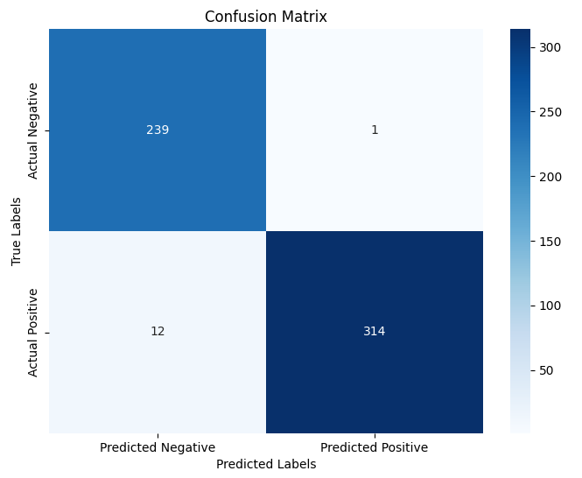
Results and discussions
For a training and testing split ratio of 7:3, 70% of the dataset is used to train the model, while the remaining 30% is used for testing its performance.
From the confusion matrix, we can conclude that:
True Positives (T.P.) = 314, True Negatives (T.N.) = 239, False Positives (F.P.) = 1, False Negatives (F.N.) = 12.
The accuracy is calculated as follows:
Accuracy = (T.P. + T.N.) / (F.P. + F.N. + T.P. + T.N.) Accuracy = (314 + 239) / (1 + 12 + 314 + 239) Accuracy = 553 / 566 ≈ 0.977
Errorrate=1-Accuracy ; Errorrate: 10.977=0.023
Precision=T.P./(T.P.+F.P.) ; Precision: 314/(314+1)=0.996
Recall = [T.P./(F.N.+T.P.)] ; Recall =314/(314+12)= 0.963
School of Electronics and Communication Engineering

Slide 15
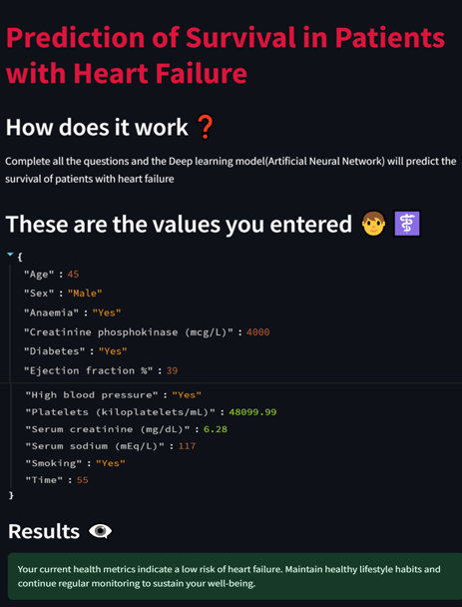
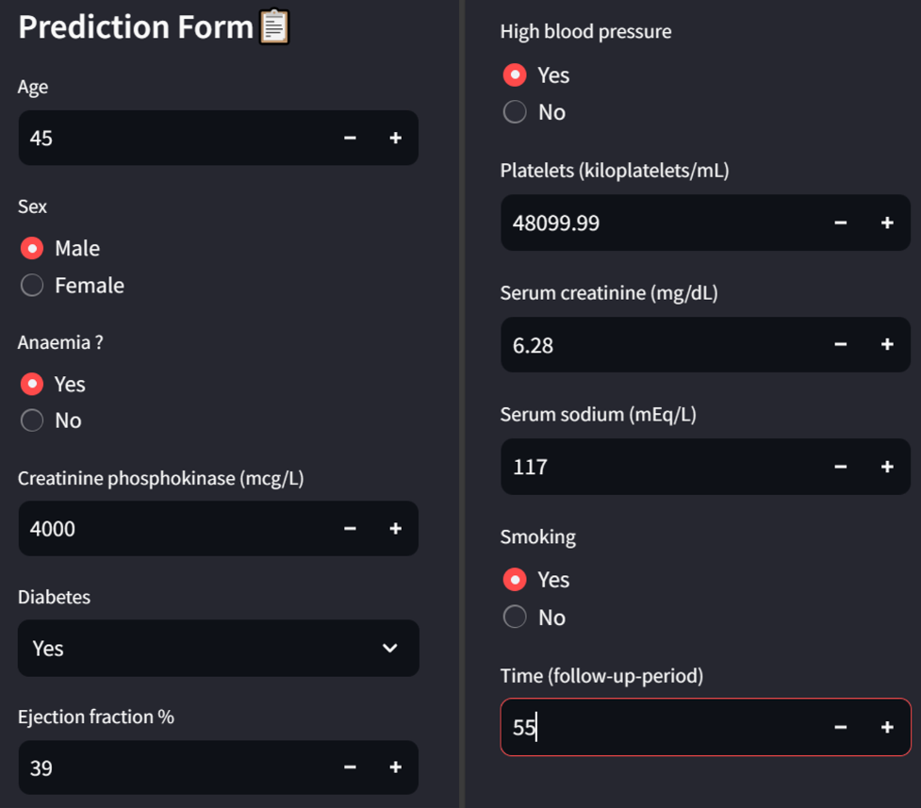
Results and discussions
School of Electronics and Communication Engineering

Slide 16
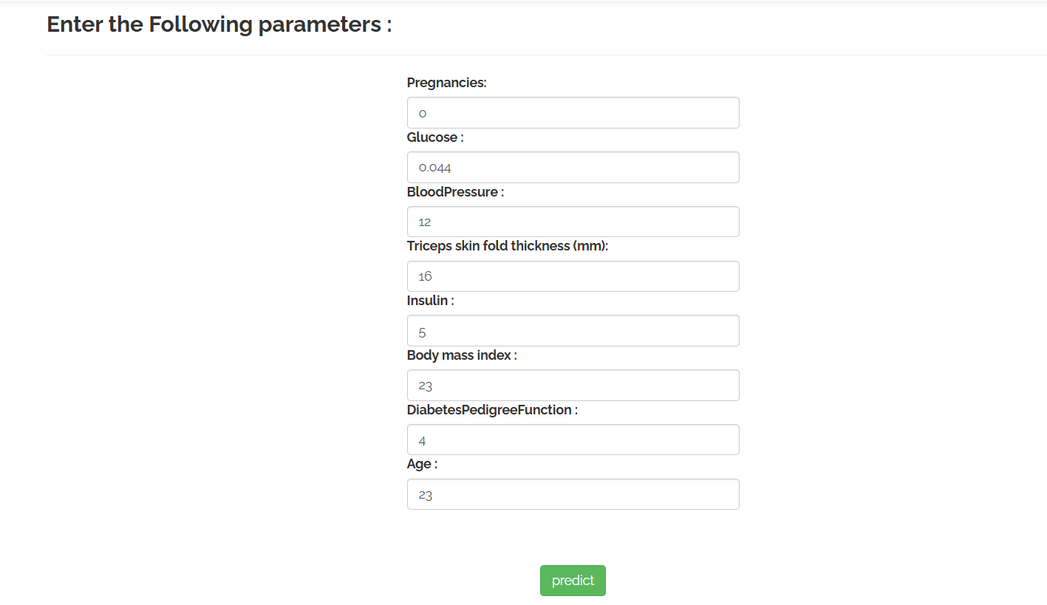
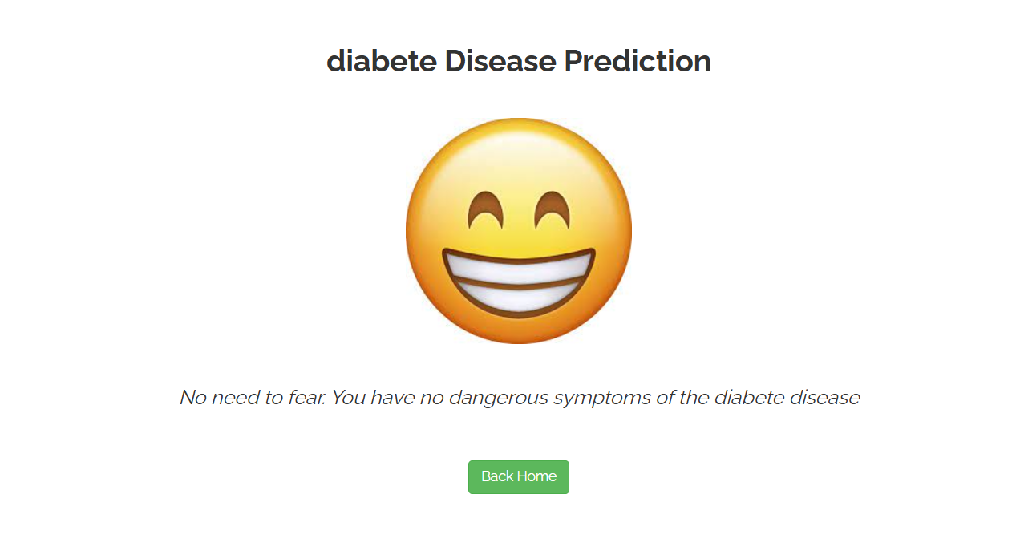
Results and discussions
School of Electronics and Communication Engineering

Slide 17
Conclusion
The project focuses on predicting the status of a patient's heart using real-time input data. By leveraging this predictive capability, the project aims to enhance medical practices. Real-time analysis allows for timely insights, which can lead to early interventions and more effective management of cardiovascular health.
Implementation of machine learning models such as Random Forest, XGBoost, and LightGBM effectively predicts diabetes, with XGBoost delivering the best performance among the three.
The project's graphical user interface (GUI) is designed to analyze user input data in real-time. This continuous monitoring and analysis help in predicting the current status of the patient's heart and Diabetes. The GUI processes various health metrics and data inputs to generate predictions about heart and Diabetes.
The system provides real-time feedback on heart health and diabetes risk, helping users make better lifestyle and dietary choices. Increased awareness of these risks encourages healthier habits like improved nutrition, regular exercise, and blood sugar control.
School of Electronics and Communication Engineering

Slide 18
References in IEEE format
"Predicting heart failure using deep neural network" Minh Tuan Le;Minh Thanh Vo;Linh Mai;Son V.T Dao 2020 International Conference on Advanced Technologies for Communications (ATC)Year: 2020 | Conference Paper | Publisher: IEEE
"Predicting Heart Failure Readmission from Clinical Notes Using Deep Learning" Xiong Liu;Yu Chen;Jay Bae;Hu Li;Joseph Johnston;Todd Sange2019 IEEE International Conference on Bioinformatics and Biomedicine (BIBM) Year: 2019 |
D. Chicco and G. Jurman, “Machine learning can predict survival of patients with heart failure from serum creatinine and ejection fraction alone,” 2020
G. Vinodhini and R. Chandrasekaran, “A comparative performance evaluation of neural network based approach for sentiment classification of online reviews,” Journal of King Saud University-Computer and Information Sciences, vol. 28, no. 1, pp. 2–12, 2016.
S. F. Weng, J. Reps, J. Kai, J. M. Garibaldi, and N. Qureshi, “Can machine learning improve cardiovascular risk prediction using routine clinical data?, ”PloS one, vol. 12, no. 4, p. e0174944, 2017.
E. E. Tripoliti, T. G. Papadopoulos, G. S. Karanasiou, K. K. Naka,and D. I.Fotiadis, “Heart failure: diagnosis, severity estimation and prediction of adverse events through machine learning techniques,”Computational and structural biotechnology journal, vol. 15, pp. 26–47, 2017.
I. V. Buzaev, V. V. Plechev, I. E. Nikolaeva, and R. M. Galimova,“Artificial intelligence: Neural network model as the multidisciplinary Team member in clinical decision support to avoid medical mistakes,”Chronic diseases and
T. Ahmad, A. Munir, S. H. Bhatti, M. Aftab, and M. A. Raza, “Survival analysis of heart failure patients: A case study,” PloS one, vol. 12, no. 7, pe0181001, 2017.
School of Electronics and Communication Engineering

Slide 19
THANK YOU
School of Electronics and Communication Engineering

