Slide 1

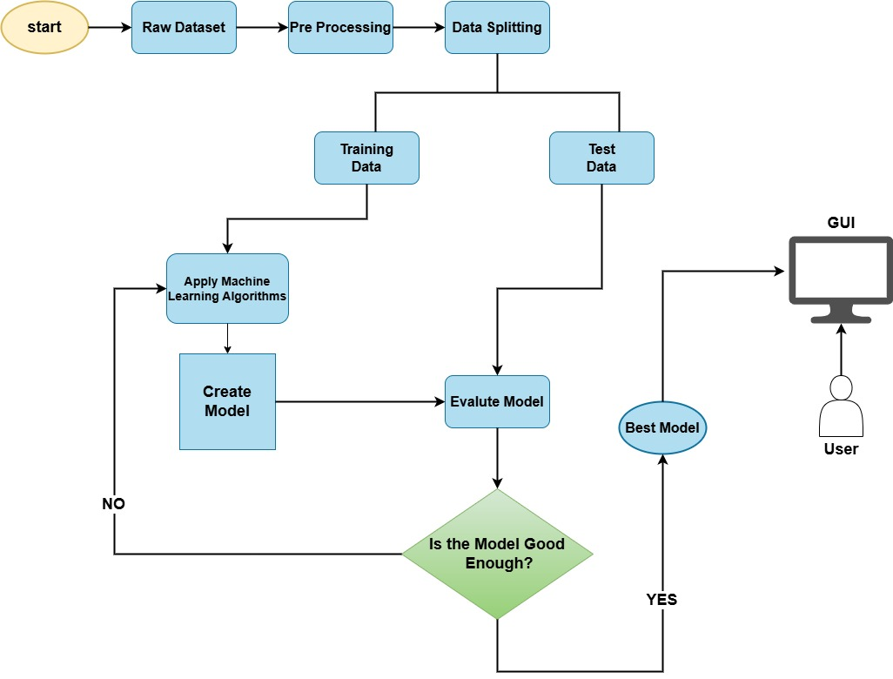
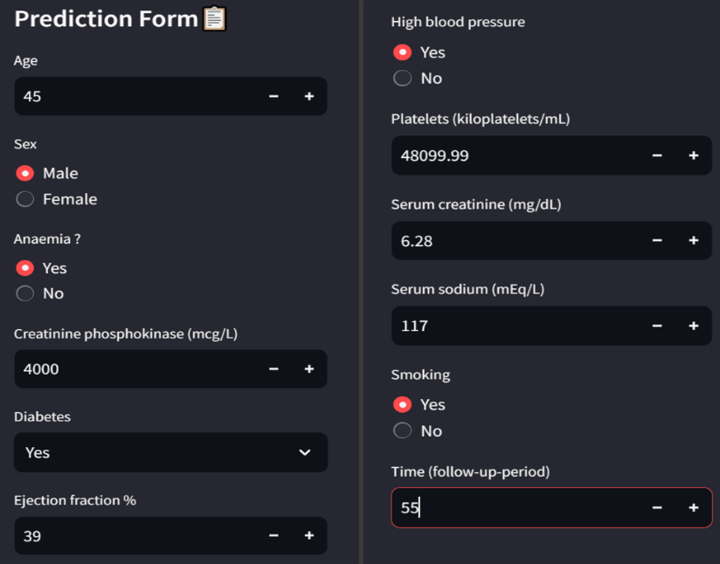
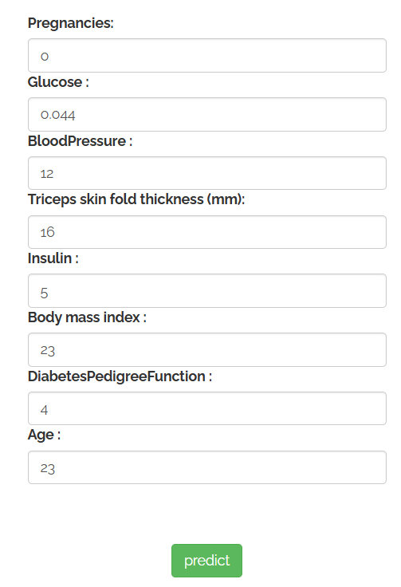
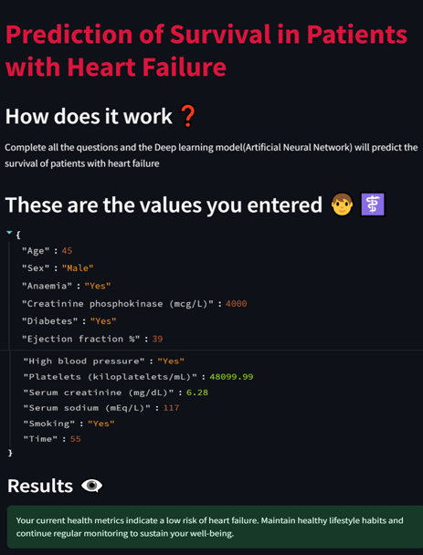
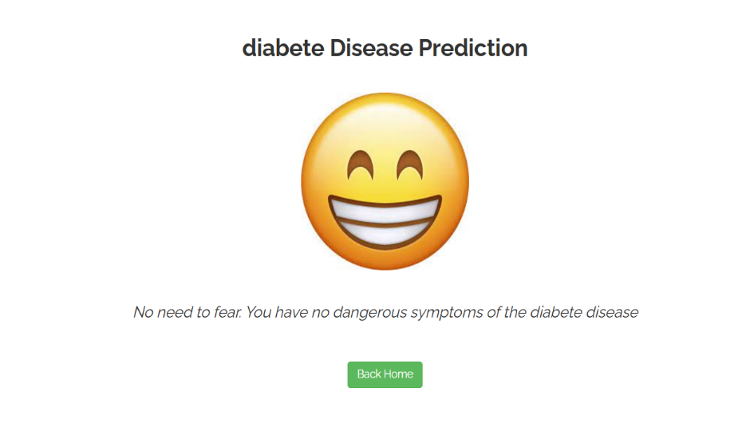
Project Title: User-Friendly Interface for Dual Health Risk Prediction:
Heart Failure and Diabetes
Students Team members list: Shashidhar, Aditya, Shyam, Shridhar
School of Electronics and Communication
Email id :01fe21bec275@kletech.ac.in, 01fe21bec306@kletech.ac.in, 01fe21bec110@kletech.ac.in ,01fe21bec116@kletech.ac.in
Senior Design Project-2024-25
Problem statement
Proposed Methodology
User-Friendly Interface for Dual Health Risk Prediction : Heart Failure and Diabetes
Objectives
Implement traditional machine learning algorithms and a deep learning model (Artificial Neural Network) to predict heart failure.
Implement machine learning models including Random Forest (RF), XGBoost (XGB), and LightGBM for diabetes prediction.
Design and implement an intuitive graphical user interface (GUI) to facilitate seamless interaction with the prediction models.
Results and inferences
Design and Optimization details
Literature survey
A user-friendly GUI was developed using an interactive web framework to allow users to input health details and receive predictions in an accessible format.
For the ANN model, parameters such as layers (12-6-1 units), activation function (ReLU), optimizer (Adam), and loss function (binary cross-entropy) were fine-tuned.
Deep Neural Networks (DNN) effectively detect heart failure using numerical and categorical patient data.
Advanced preprocessing (e.g., normalization, feature encoding) enhances model performance..
Contributions
Conclusions
Implemented models such as ANN for heart failure and XGBoost for diabetes, achieving high prediction accuracy.
Designed and implemented an intuitive graphical user interface (GUI) to facilitate seamless interaction with the prediction models.
The project delivers accurate predictions for heart failure and diabetes, integrating advanced models with a user-friendly interface for accessibility.
Semester: VII Under the guidance of: Kiran M R

