Slide 1
Project -02 Employees Data
Submitted by Shridhar Ramani

Slide 2
Contents
Problem Statement
Objective
Why Big Data
Technology Stack
Steps
Results
Recommendations
Limitations

Slide 3
Employee Data
Problem Statement
The company is looking how its data can be transformed to get some actionable insights and rights set of data engineering technology stack. The database contains a huge volume of employees data with both employee engagement survey results and exit data. This provides a massive, globally diverse, and statistically relevant dataset for conducting research specific to attrition.
Objective –To design an end-to-end data pipeline and analyze the data for the organization which is looking for updating its employees policies and dealing with the issues related to the attrition rates over the given time period.
Why it is a part of Bigdata - Since the data volume is high and analyzing the data by using traditional approaches is time consuming .

Slide 4
Technology Stack
-MySQL (to create database) and table schemas
- Linux Commands - Sqoop (Transfer data from MySQL Server to HDFS/Hive) - HDFS (to store the data) - Hive (to create database) - Impala (to perform the EDA) - SparkSQL (to perform the EDA) - SparkML (to perform model building)

Slide 5
Steps
Defining the business problem
Weighing the tools and technology to use which is the most appropriate technology stack
Mysql – Creating the tables on MySQL for the given data set which is CSV format. We create database ,schema and load the data on it.
Go to the HDFS and delete any pre existing tables with the same name.
Use the SQOOP and load on hdfs and data stored in paraquet file .
In hive create a schema for all the tables and perform analysis
Open Jupyter notebook and use Spark (sparksql and pyspark) for answering the business queries.
Exploratory data analysis
Create entire data pipeline

Slide 6
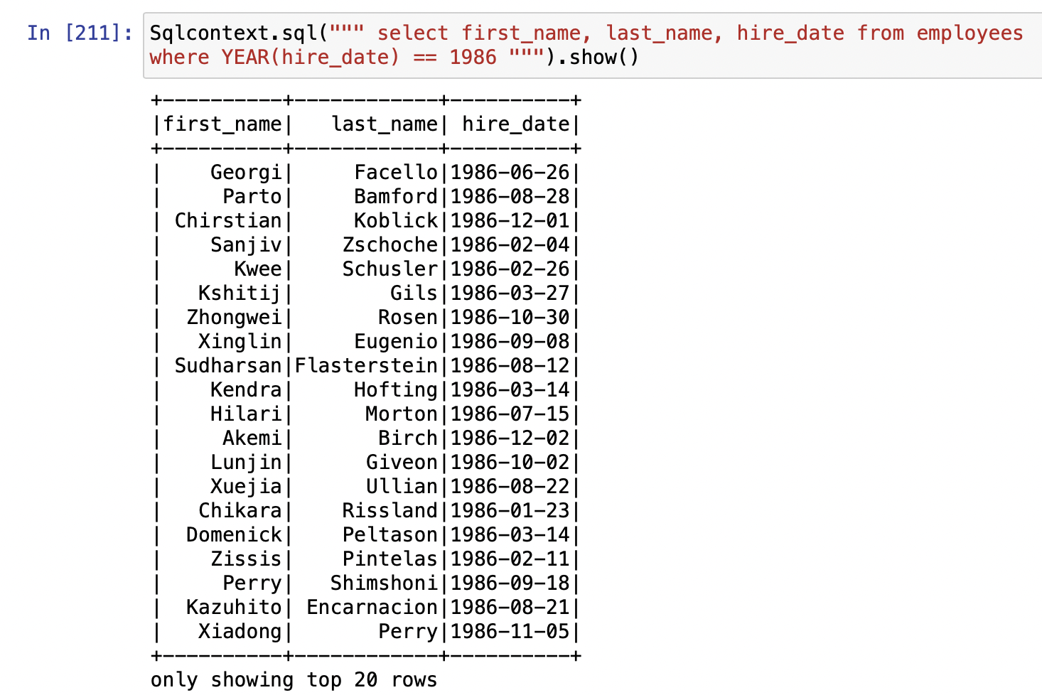
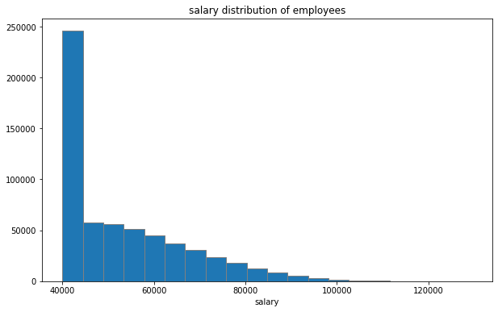
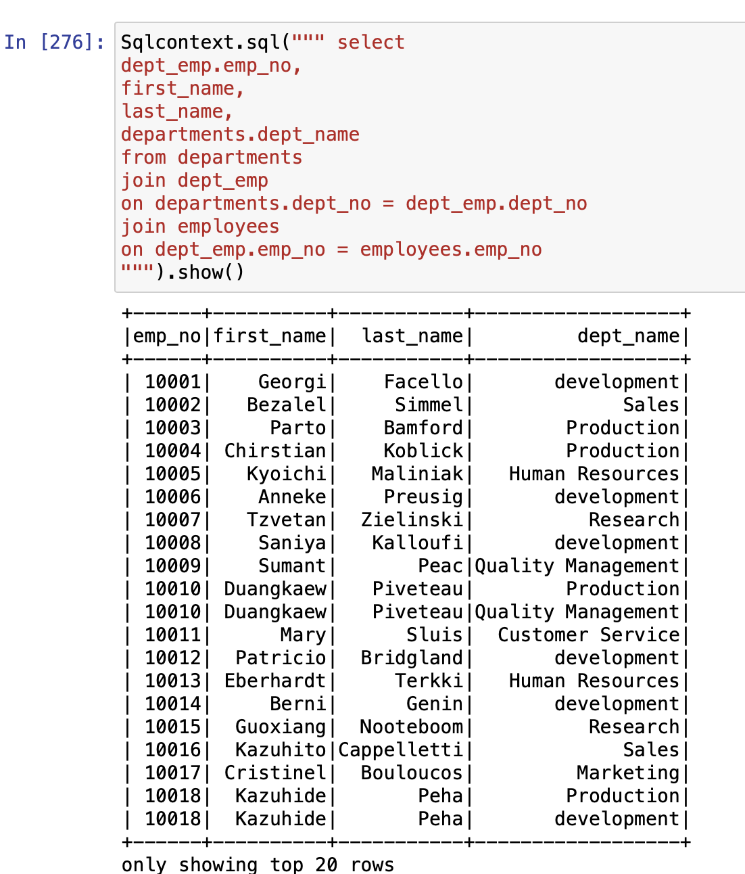
Results
Most of the employees salary is about 40k

Slide 7
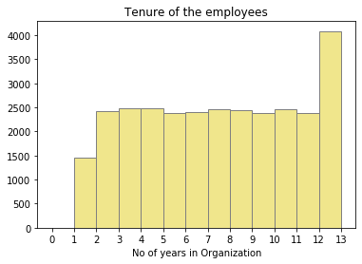
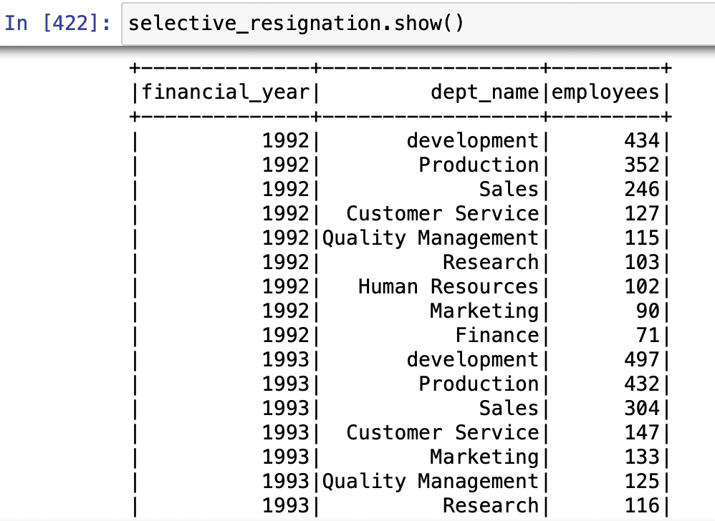
About 4000 employees are working in
the company for almost 13 years.
About 1500 employees are working
for about 1 to 2 years .
How many employees from respective departments
resigned the most
About 497 employees resigned from development department
hence it suggest some identification of issues and amendments
in the department.

Slide 8
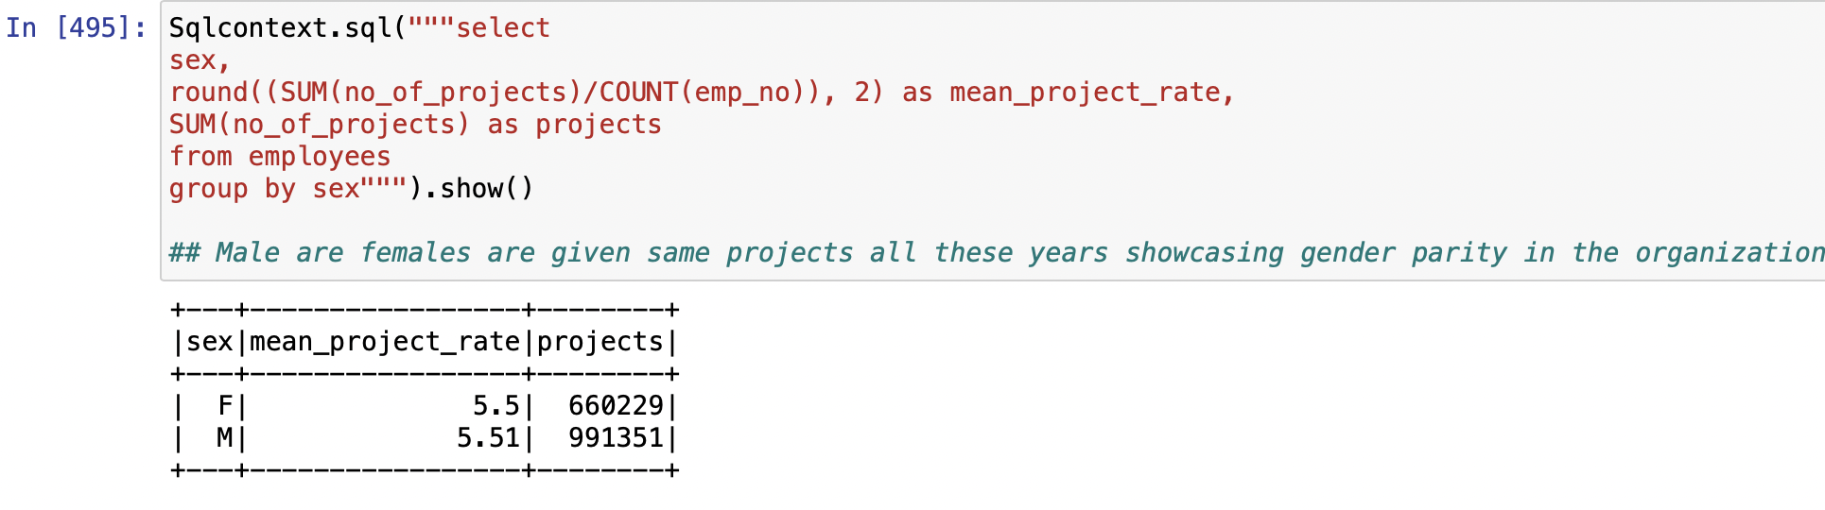
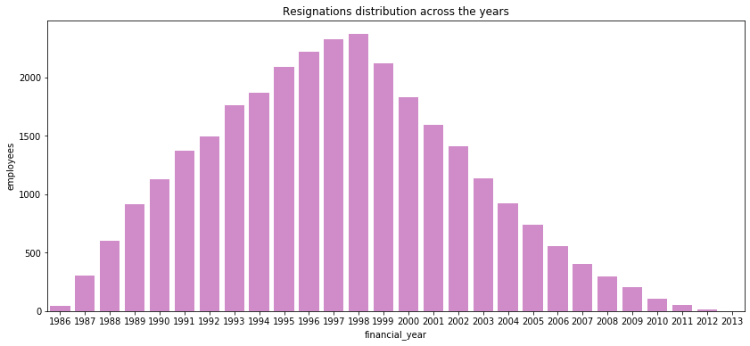
The mean project rate is almost equal for
Male and female employees
The employees resigned more and more from
1986 to 1998 due to poor employees policies .
But this was not the case after 1998 , the retention rate
Of the employees improved drastically from
1999 to 2013

Slide 9
Recommendations
→ Improve the onboarding process.
Maintain a favourable initial impression.
Set clear expectations for their job and the company's future.
Explain what to expect over the first week.
Assist new personnel in integrating into the team and developing relationships with coworkers and colleagues.
Allow new hires to just provide organised feedback on their jobs, corporate processes, and culture.
→Act on insights from exit surveys.
Some employment turnover is unavoidable. Regardless of whether you have a high or low turnover rate, you may learn a lot from employees on their way out the door.
Exit surveys are a great way to obtain direct feedback from your soon-to-be ex-employees about why they're leaving and any suggestions they might have for improving the company. What you learn could surprise you.

Slide 10
Limitations
Some challenges with the formats of the data .
Since the volume of the data is high it is ought to have some null values and errors .

