Slide 1
SEMINAR(IS0117)
NAME: SHRIESHA SHRIDHAR NASIK
USN: 4NI17IS077
SEM & SEC: 6th & ‘B’
GUIDE NAME:Ms. MONIKA NAG K J

Slide 2
An Android Application for School Bus Tracking and Student Monitoring System Paper by Jisha R C, Mathews P Mathews, Sidharth P Kini , Vineeth Kumar, Harisankar U V, Shilpa M

Slide 3
SECTIONS
I.INTRODUCTION
II. RELATED WORK
III. PROPOSED WORK
IV. ALGORITHM
V. RESULTS
VI. CONCLUSION

Slide 4
1.INTRODUCTION
Nowadays Mobile Applications are very important in smartphones.
Even to perform small operations we require Apps(ex: calender, calculate or send mails).
At present area of Application Development is widely used and growing at faster rate(ex: Android Application).
To Develop Applications, Android Studio is the Platform that is being used.

Slide 5
Reason for Developing Safety App
Today, parents are worried about the safety of their children. There are a lot of issues like kidnapping children on their way home, or from home when they are sleeping or during a party.
Recent studies show that India is in 4th place in the number of child missing cases.
Nowadays, even the bus getting delayed due to a small reason makes the parents bothered about it. But today’s technology can provide a much better solution to ensure the children’s safety..

Slide 6
Contd…
To track and monitor their children, the proposed system provides an Android based bus tracking system.
All the registered users can view/collect and exchange data inside the android application.

Slide 7
2. RELATED WORK
Implementaion : In this Application we are using Radio-frequency identification(RFID) method. we are using using GPS tracking mechanism to track the vehicle position and finally predicting the arrival time using Kalmann filtering method.
Low cost GPS and GPRS

Slide 8
Contd...
Paper deals with Expectation Maximization algorithm to resolve traffic anomalies and it uses Hadoop map reduce method.
Main Purpose of this application is that it uses GPS and GPRS
technologies to predict the real – time location of the bus
and the arrival time of bus.

Slide 9
3.Proposed Work
The proposed system is an Android application which helps parents keep track of their ward(s).
This application is handled by four categories of users: Parents, Faculty/Teacher, Driver, and Admin.
Each child is identified by his/her own unique ID.

Slide 10
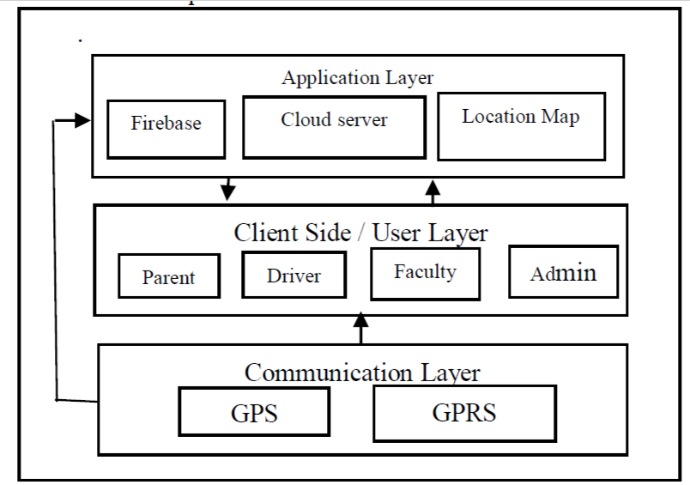
Contd…

Slide 11
Contd…
A. Communication Layer:-
This Layer is used to establish a connection between the User layer and the Application layer. It uses
GPS: Global Positioning System is used to locate the device.
GPRS: General Packet Radio Service is a wireless communication service based on packets and enables continuous connection to Internet to the mobile device.

Slide 12
Contd...
B. Client / User Layer
This layer mainly consists of all the users of this application. They Interact with the system to collect and give information.
Faculty: He/she is the one who is in charge of the whole children in the vehicle and their safety. They are given the authority to mark the attendance of the children in the to and fro journey and make sure that the children board the bus in time safely.
Driver: He would notify the vehicle is starting to move from the school. Once he notifies, the location starts transmitting from his device. It is sent to Firebase and stored there for later use.

Slide 13
Contd…
Parent: He/she can constantly watch over his child on his/her way to school and back home. They can watch all the small moves that the bus makes and can check if their child has boarded the bus or has gone missing or did he/she bunked the bus.
Administrator: He/she is the responsible for the management of all users, vehicles and routes in the system.

Slide 14
Contd..
C. Application Layer:
This layer contains all the important technologies that are working mainly in the back end.
Firebase: In Firebase, GPS location is saved in Real time database which will be ready for updating in the other end. It only takes a few milliseconds to save and make the same changes where it is being called upon.
Cloud Server: A server is used to store the details of the users and all the information about the buses, routes and attendance of the children.

Slide 15
Contd…
Location Map: It is shown in parent’s device using Google Maps API. Once a change in location data is found in the Firebase, the same will be updated in the Map.

Slide 16
4.ALGORITHMS
This section contains the various algorithms in different user’s device/ server.
Here we are identifying vehicles position using Google Map API.
The code will capture vehicles position and send it to Firebase cloud database.
The driver is responsible to enable this module using his login credentials.

Slide 17
Contd...
A. Starting Journey in the Driver Module
Input: Login Credentials of the Driver.
Output: Live GPS location of the vehicle
1. Login to Driver Portal
2. Click on “Start Journey” once it is time to leave the school.
3. Read Latitude and Latitude of the device from GPS.
4. Google Map loads showing the vehicle’s location.
5. Start sending the location data to Firebase until the destination is reached.

Slide 18
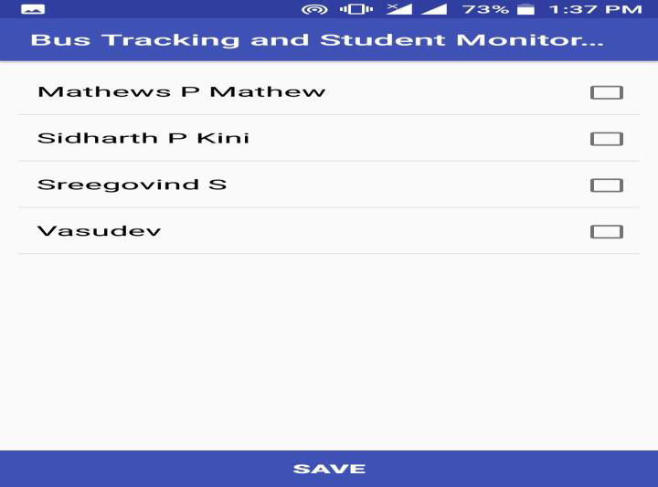
Contd...
The attendance module will capture the attendance of the students in the bus with time and send to the cloud server for further processing.
B. Taking Attendance in the Faculty Module
Input: Login Credentials of the Faculty.
Output: Attendance list of the children in the
vehicle.
1. Login to Faculty Portal.
2. Click on “Take Attendance” once the vehicle leaves
the school.
3. Mark the set of students that are present in the
bus.
4. The final data is sent to the cloud server.

Slide 19
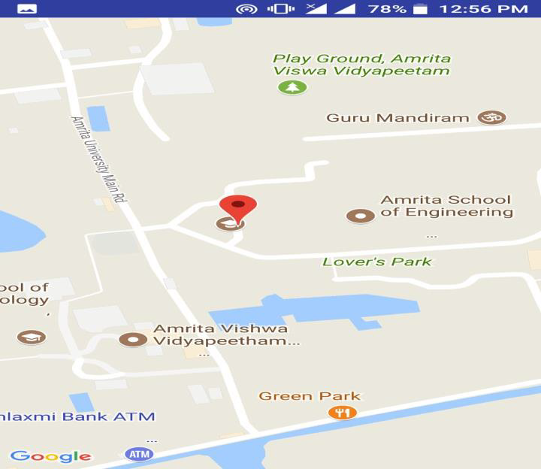
Contd…
Whenever a route change or delay in reaching the intermediate stops has been recorded and stored in the firebase cloud server and plot the data in Google Map.
C. Tracking Bus in the Parent Module
Input: Login Credentials of the Parent.
Output: Live location of the vehicle.
1. Login to Parent Portal.
2. Click on “Track bus” to see the current location of the bus.
3. Fetch data from Firebase for every changes that occurs.
4. Plot the data in Google Map.

Slide 20
Contd…
This pseudo code will allow the parents to view the attendance of their ward and hence they can ensure the security.
D. Viewing Attendance in the Parent Module
Input: Login Credentials of the Parent.
Output: Status of their child.
1. Login to Parent Portal.
2. Click on “View Attendance” to see if the child has boarded the bus.
3. Fetch data from server.
4. View/Show the attendance status.

Slide 21
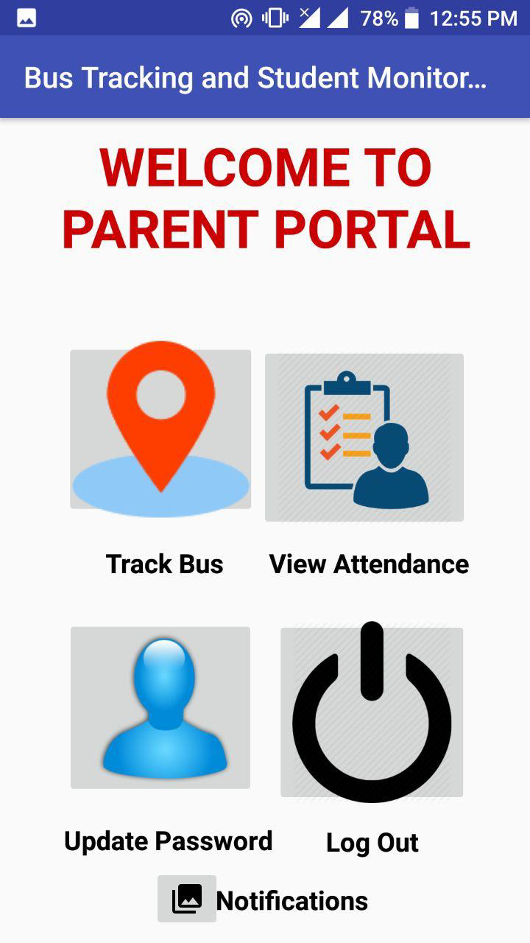
5.RESULTS
The system was developed using Android studio.
The webserver is xampp.
The database used is phpmyadmin and firebase.
The application is basically installed in android tabs and
phones.
GUI shows opening of app. Different button are used
based on the operation we wish to perform.

Slide 22
6.Conclusion
We developed an Android application for school bus tracking and to monitor children. It was with the use of wireless technologies like GPS and GPRS and some good platforms like Firebase. With the help of this application parents need not worry about their child. This might not be 100% efficient as it depends on the speed of the mobile and the connectivity of the GPS. This would be a great relief for the parents who are really worried about their child’s safety

Slide 23
REFERENCES
[1] globalmissing.org, “Missing Children’s Statistics”
[2] Jisha R.C, Aiswarya Jyothindranath, Sajitha Kumary L “IoT Based School Bus Tracking and Arrival Time Prediction” 978-1-5090-6367- 3/17 ©2017 IEEE.
[3] Khondker Shajadul Hasan, Mashiur Rahman, Abul L. Haque, M Abdur Rahman, Tanzil Rahman and M Mahbubur Rasheed,” Cost Effective GPS GPRS Based Object Tracking System”, Proceedings of the International MultiConference of Engineers and Computer Scientists ,Vol I IMECS March 18 - 20, 2009, Hong Kong.
[4] Sumit S. Dukare, Dattatray A. Patil, Kantilal P. Rane,” Vehicle Tracking,Monitoring and Alerting System: A Review”, International Journal of Computer Applications (0975 – 8887) Volume 119 – No.10, June 2015.
[5] A. Sai, S. Salim, P. K. Binu, and R. C. Jisha, “A Hadoop Based Architecture Using Recursive Expectation Maximization Algorithm for Effective and Foolproof Traffic Anomaly Detection and Reporting,”International Journal of Applied Engineering Reasrch, vol. 10, no. 55, pp. 2101–2106, 2015.

Slide 24
Contd…
[6] L. Singla, “GPS Based Bus Tracking System,” (2016) IEEE International Conference on Computer Communication and Control, IC4 2015, art. no. 7375712.
[7] T. Liu, J. Ma, W. Guan, Y. Song, and H. Niu, “Bus Arrival Time Prediction Based on the k-Nearest Neighbor Method,” 2012 Fifth Int. Jt. Conf. Comput. Sci. Optim., pp. 480–483, 2012.
[8]A. F. Abidin and M. Kolberg, “Towards Improved Vehicle Arrival Time Prediction in Public Transportation: Integrating SUMO and Kalman Filter Models,” Proc. - UKSim-AMSS 17th Int. Conf. Comput. Model. Simulation.
[9] H. Yaling, “The Design of Monitoring System Based on GPRS,” 2016 Int. Conf. Robot. Intell. Syst., pp. 432–435, 2016.
[10] N. R. Nair, “2-D Airborne Vehicle Tracking Using Kalman Filter,”Proceedings of IEEE International Conference on Circuit, Power and
Computing Technologies, ICCPCT 2016.

Slide 25
THANK YOU

