Slide 1
GIT
Pwd:-To get location of file
Cd :-To change to any folder
git config --global user.name ”name”(declare name global )
git config –global user.email”ur mail(declare email)
git config user:(name,email) to display
Working Directory
Staging area
GIT Directory
Checkout the project
Stage Files
Commit

Slide 2
git file uses
git Status :-To check the current work
git init:-To create repo of the folder
git add . :-To stage all the created files(git add<file name> for particular file)
or git add –a :-TO stage all at once
git commit -m ”reason” to commit(stage)
git log –To see all the commits(name,reason)
rm –rf .git:-To stop tracking the files(dangerous)
git clone –To copy the web or to dup it using it’s URL
FILE
Untracked
Unmodified
Modified
Staged
Edit the file
Stage the file
Add the file
Remove file
Commit

Slide 3
.
touch – To create any file with it’s extension
Extension(.txt,.py,.java,.c,.xls,etc)
.gitignore –This will ignore the file which are written in it
/- for folder
/ /-outer
-/- inner
git diff :-diff staged and modified
git diff -- staged :- compare all the previous commit change
git commit -a -m “reason”:(skipping stage (only tracked files not un tracked))
git rm <file> :to delete particular files
git mv file_name –file new name (To rename)
git rm - -cached file name (To untrack a file)
git log :To see history
git log - -state : short all the changes(short summary)
git log –p(particular num) which has removed
git log - -pretty =all commit in oneline
short short commit
git log - -since =2 days :To check date commit

Slide 4
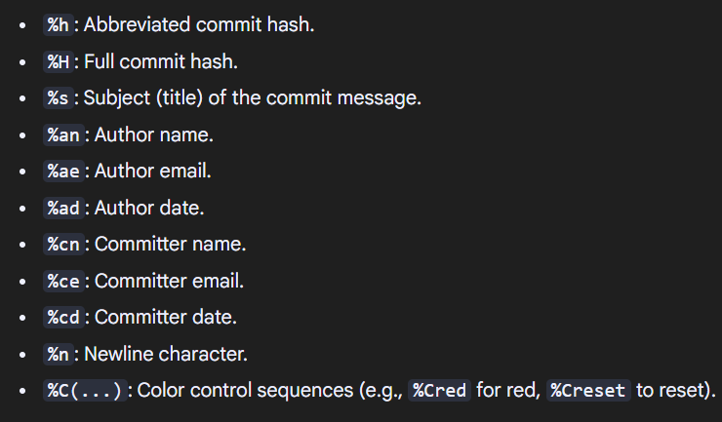
.
git log - -pretty=format →
git restore - -staged file name(Restore)
git checkout - -filename
git checkout -b name (new branch creation)
git checkout “original”(return)
git checkout - a(To check all branchs)
git merge branch name (To merge)
git push origin name(To push)

