Slide 1
Department Of Motor
Vehicle

Slide 2
System Requirements
Hardware requirements
1. processor -> Intel Inside core i5
2. Ram -> 2 GB
Software requirements
OS -> Windows
Database -> Mysql ,MongoDB

Slide 3
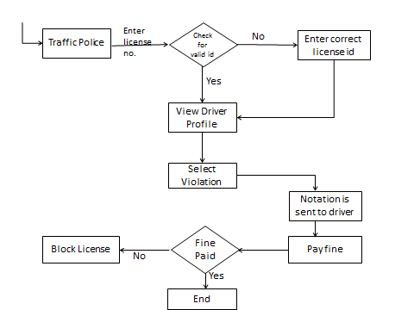
Flow Chart

Slide 4
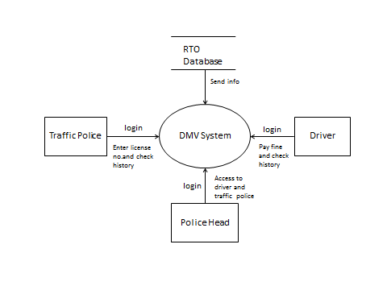
DFD(Level 0)

Slide 5
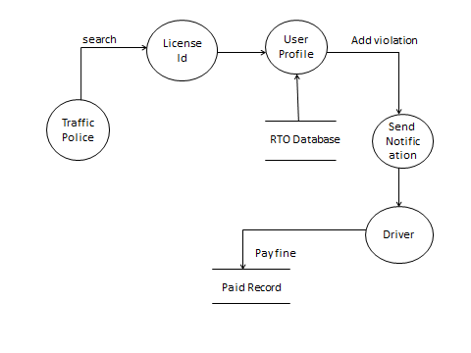
DFD Level 1

Slide 6
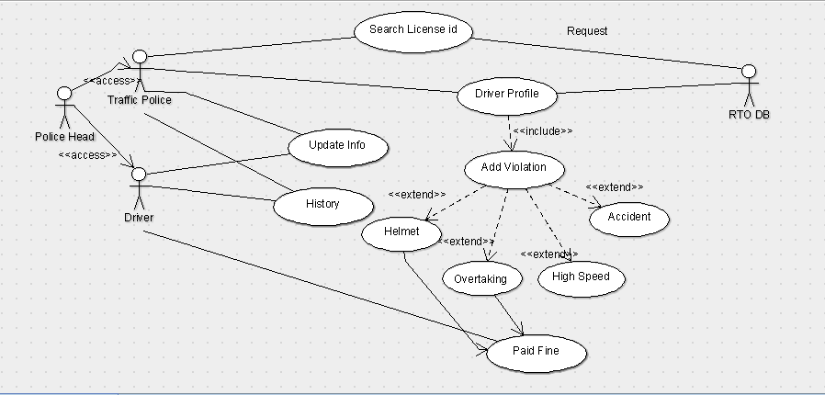
Use Case Diagram

Slide 7
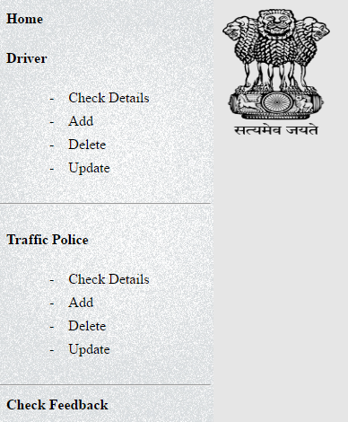
Admin Dashboard
Check Detail :Admin can check the drivers and Traffic police details.
Add :Admin can add the drivers and Traffic police record.
Delete :Admin can Delete the drivers as well as Traffic police record in worst case.
Update :Admin can update the drivers as well as Traffic police record .

Slide 8
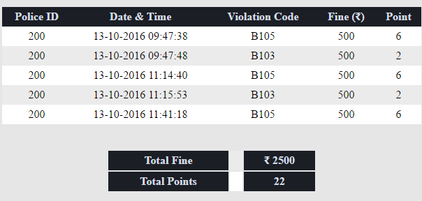

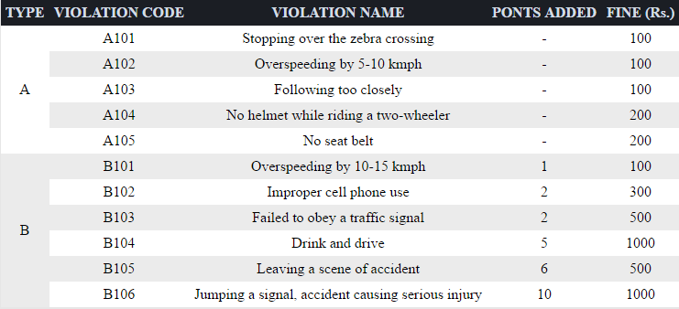
Profile:
Driver can check his profile.
Rules:
Driver as well as traffic police can read rules of DMV.
History:
Driver as well as traffic police can check his history.

Slide 9
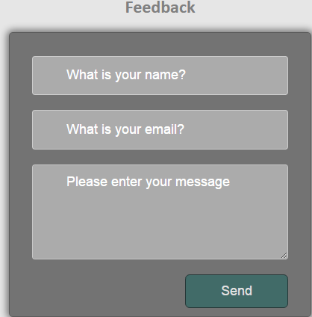
Feedback
Anyone can submit the feedback without log in .Only admin can read it.

Slide 10
Thank You

