Slide 1


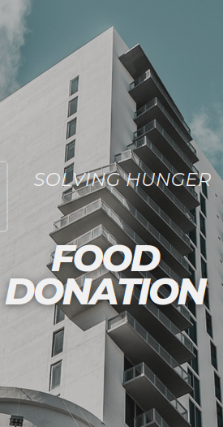
FOOD DONATION APPLICATION

Slide 2
Problem Statement
To create an platform for overcoming wastage of food.
To help the NGO’s to provide food for the needy.

Slide 3
Did you know that about 40 % of the food produced in India is wasted?
As per one data, the average person in India wastes 137 grams of food every single day. That’s 0.96 kg per week or 50 kg per year. In India, 40% of the food is wasted which is equivalent to Rs 92,000 crores a year.
In 2019 the total food wastage in India was 931 million tonnes out of which 61% came directly from households, 26% from food services, and 13% from retail.

Slide 4
User side:
Donar
Food Donation
DATABASE
✔ Donar’s can visit the website and fill in the donation form
Like:
1) type of food
2) shell time
3) cooked or not
4) donors address

Slide 5
On backend side:
NGO
Food Donation
DATABASE
Needy one
Ashram
✔ Notification/email will be sent to the registered users
Our reach and beyond
✔ as well as the content will be displayed so the person who need it can accept it
Once accepted the accept button for others will disappear

Slide 6

Tie up with NGOs and other organizations
For better reach
NGOs and other marketing team will spread awareness about this project and the needy once and download the app/ visit site/ or get direct contact with NGOs

Slide 7
Our Approach
The User side
A website where there is option for the particular person to put the details of the food remaining with him/her.
The information he/she puts there will be sended to all the nearby NGOs registered in that region.
The users needs to only scan a QR code or go to website, which will be circulated by the NGOs and fill the details and submit it.
The NGO side
It will be a application where the user entered details will be notified.
If the NGO is able to collect the food they can select the accept button and all the details entered by the user will be forwarded to respective NGO.
Once a NGO accepts the request the accept button will be disabled and the user request vanishes.

Slide 8
DESKTOP PROJECT
Here the user can upload the details of the food available with him ready to donate

Slide 9
MOBILE PROJECT
Here the NGO can get the the details of the food available via notification.

Slide 10
Team Members
Shadwal C Rao
Sheikh Mohammed Shuhood
Shravya
Shridhar

Slide 11
Thanks

