Slide 1
Netflix Dataset Analysis
Auto-generated on 2025-10-12 18:59
Source: Netflix Dataset (7,789 rows)

Slide 2
Executive Summary
Total titles: 7,786
Movies vs TV Shows: 5,376 vs 2,410
Top Genre: International Movies
Top Content Country: United States
Growth: Strong increase in content additions in recent years
Recommendation: Invest in top genres and expand regional originals

Slide 3
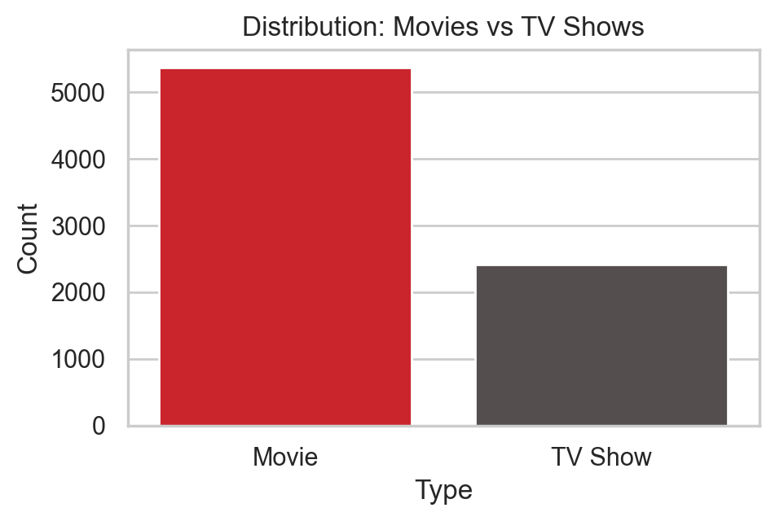
Movies vs TV Shows

Slide 4
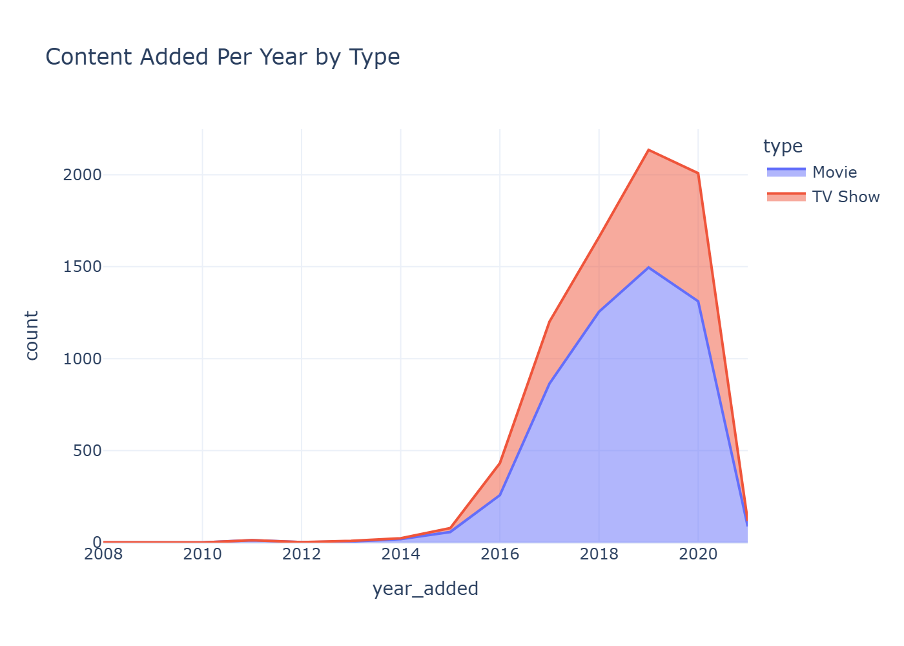
Content Added Per Year by Type

Slide 5
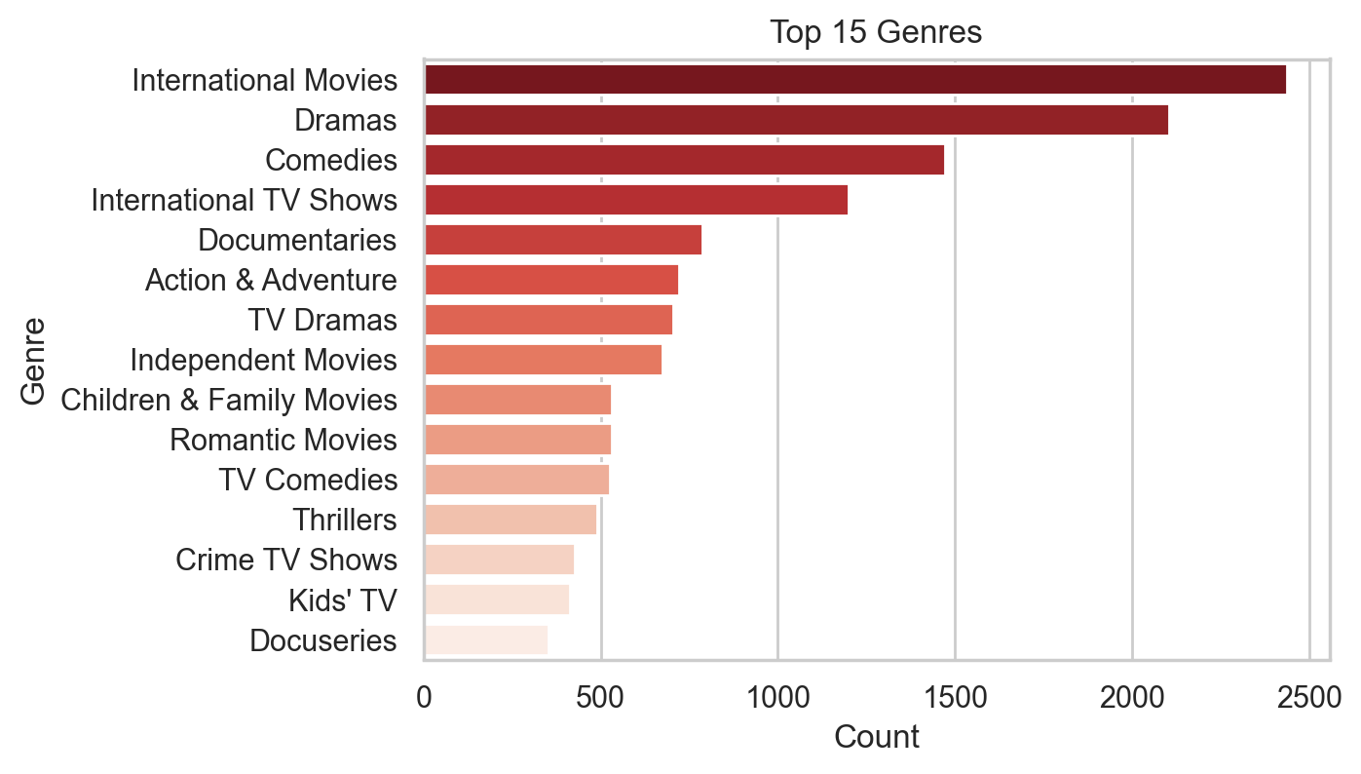
Top Genres

Slide 6
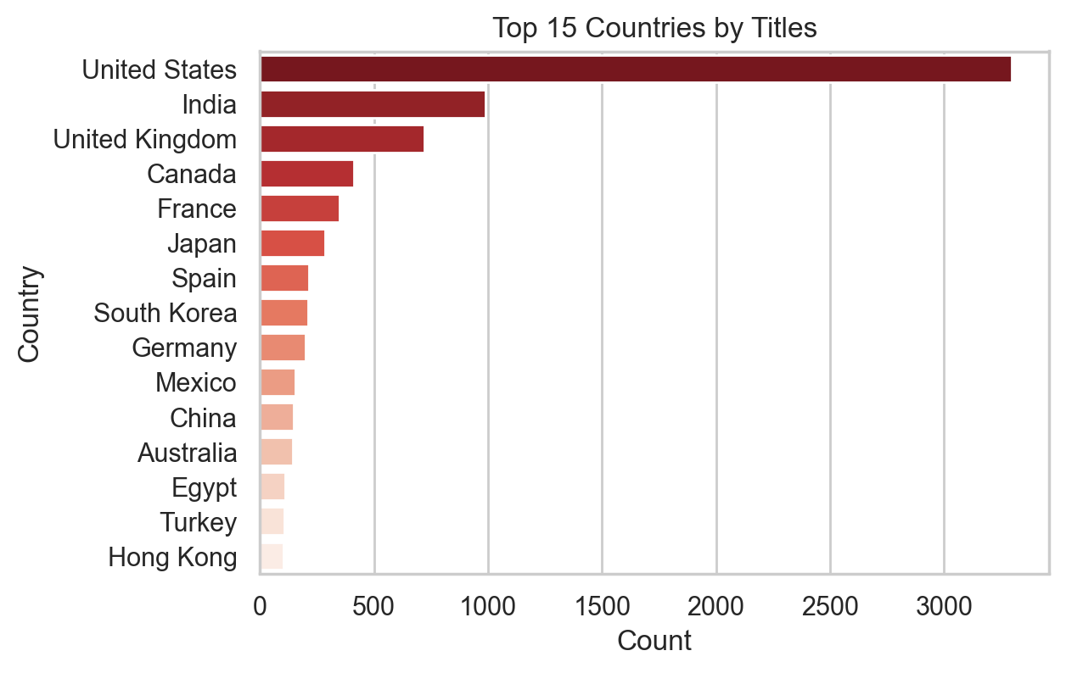
Top Countries by Titles

Slide 7
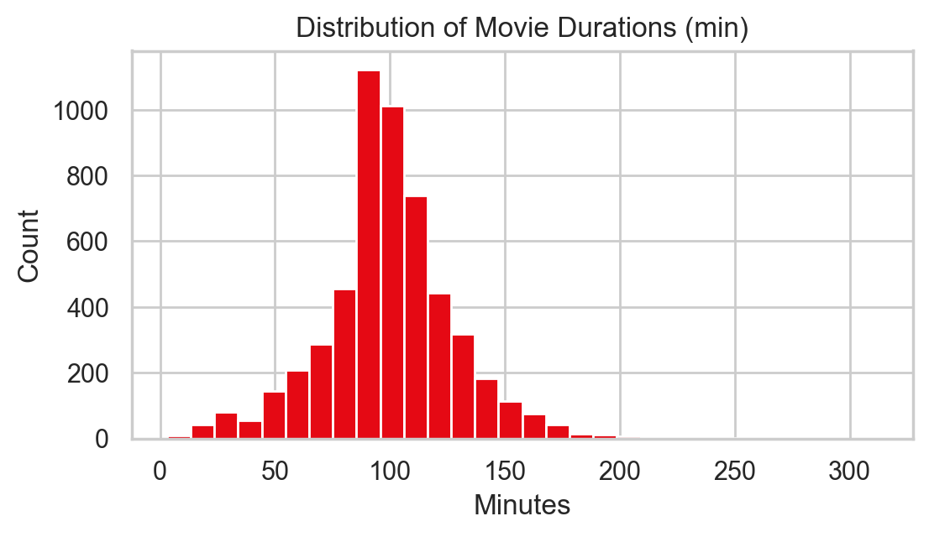
Distribution of Movie Durations

Slide 8
Strategic Recommendations
Increase investment in TV Shows to boost retention
Prioritize top-performing genres (Drama, Comedy, Documentary)
Expand regional originals in underrepresented markets
Maintain movie durations around 90–120 minutes
Monitor quarterly trends; adjust acquisition strategy accordingly

