Slide 1
Group Portfolio
Group Members
Aryan Guragain
Sameer Man Shrestha
Shrijal Pandey

Slide 2
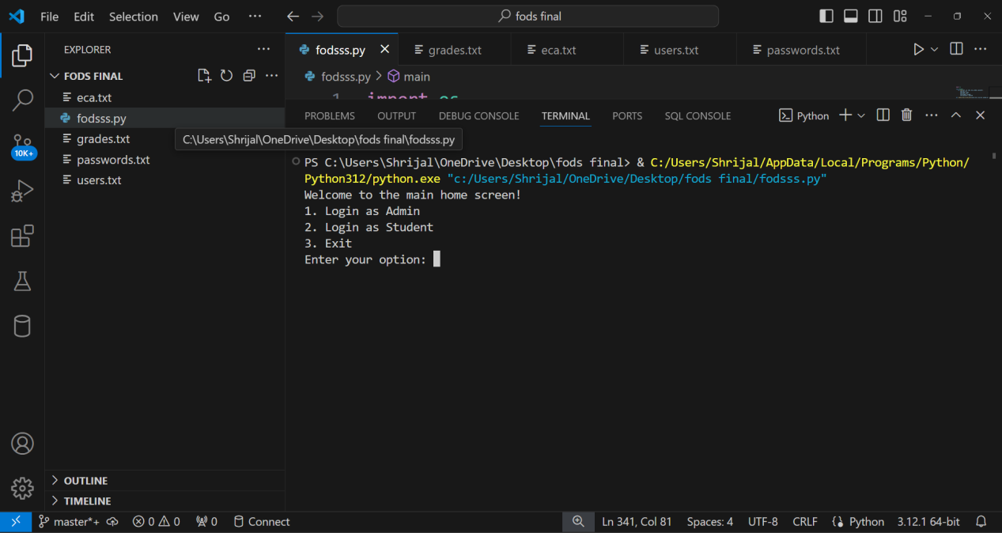
Home Screen

Slide 3
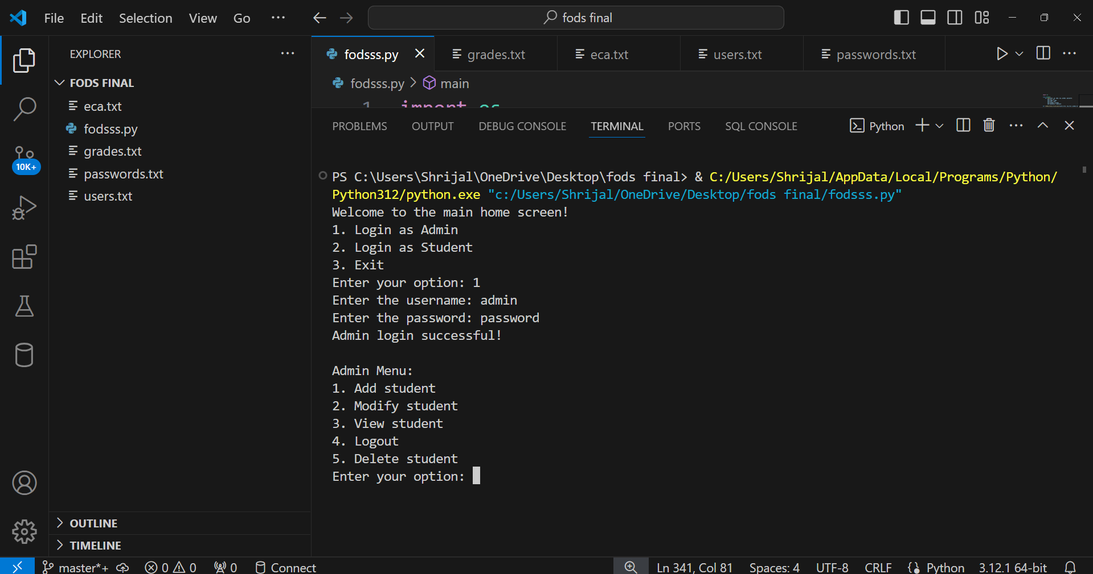
Admin login

Slide 4
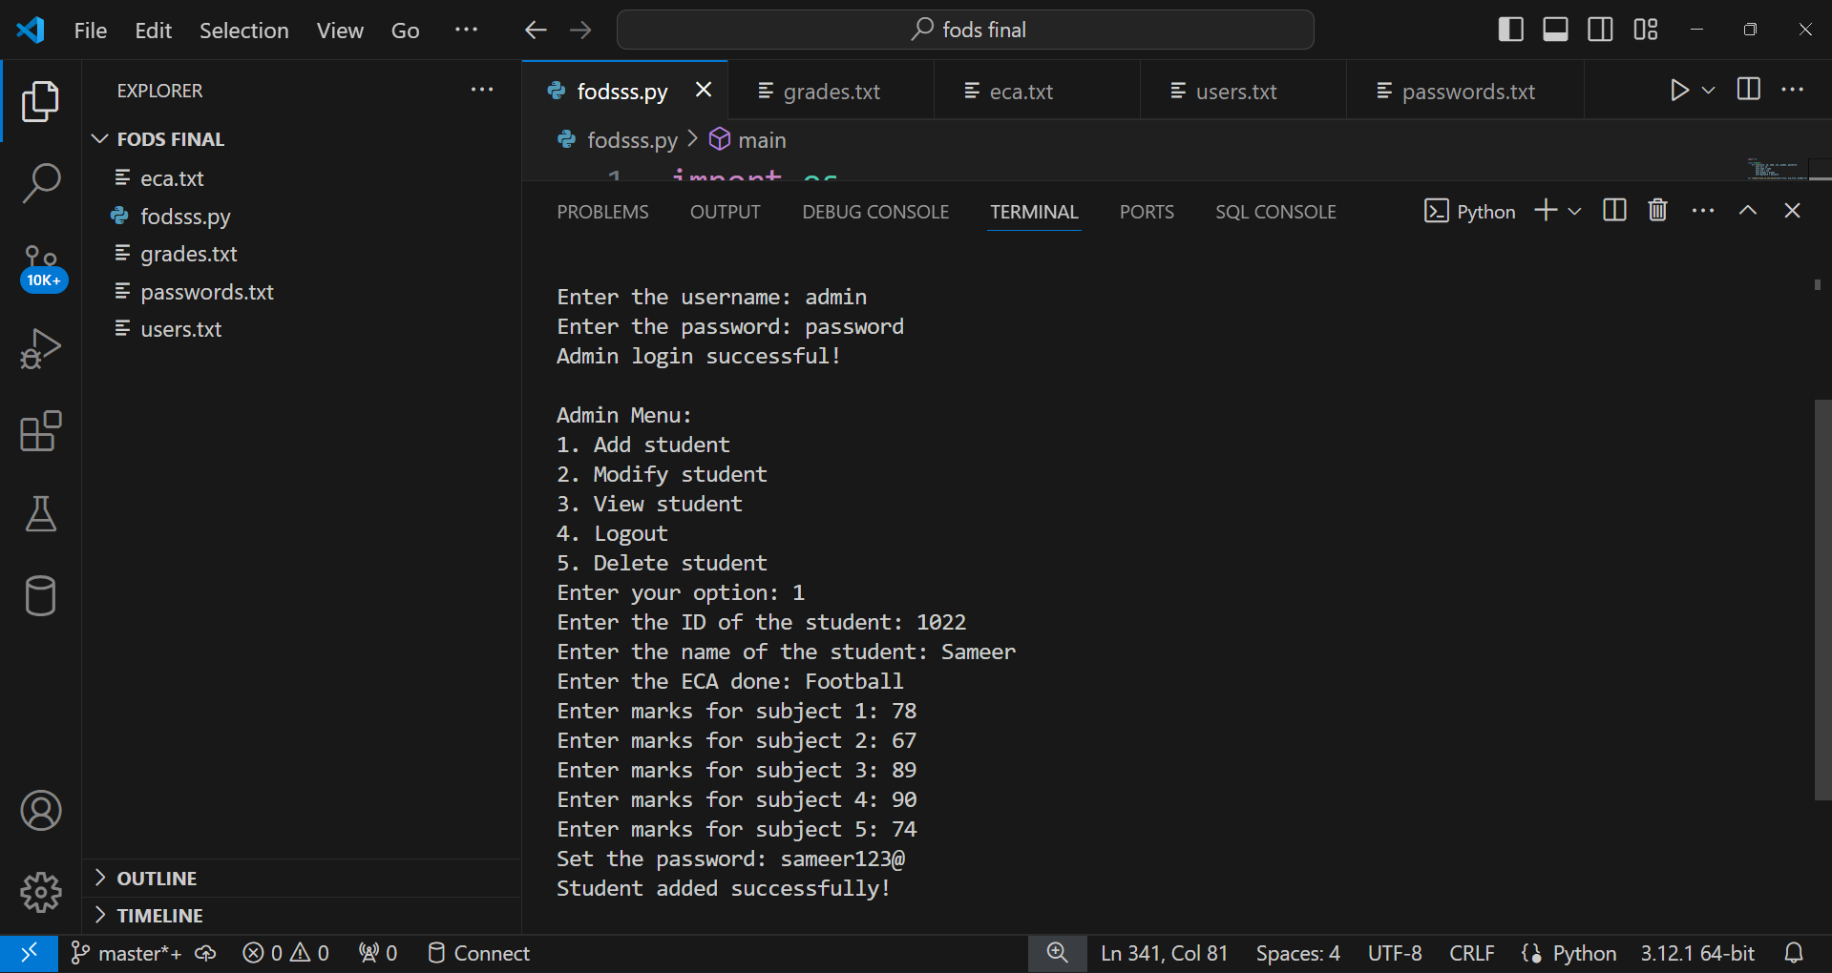
Admin Menu
Adding a student

Slide 5




Student data added in files

Slide 6
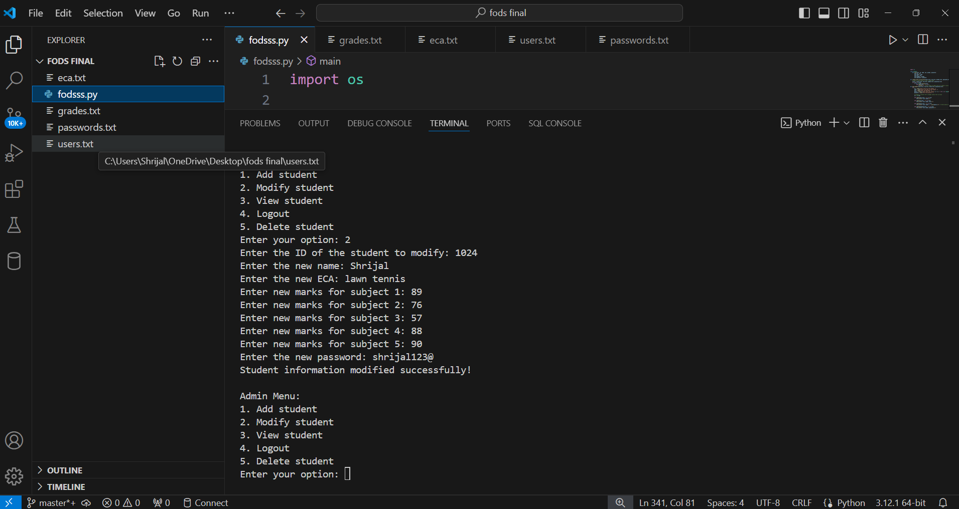
Admin Menu
Modify Student

Slide 7




Modified data

Slide 8
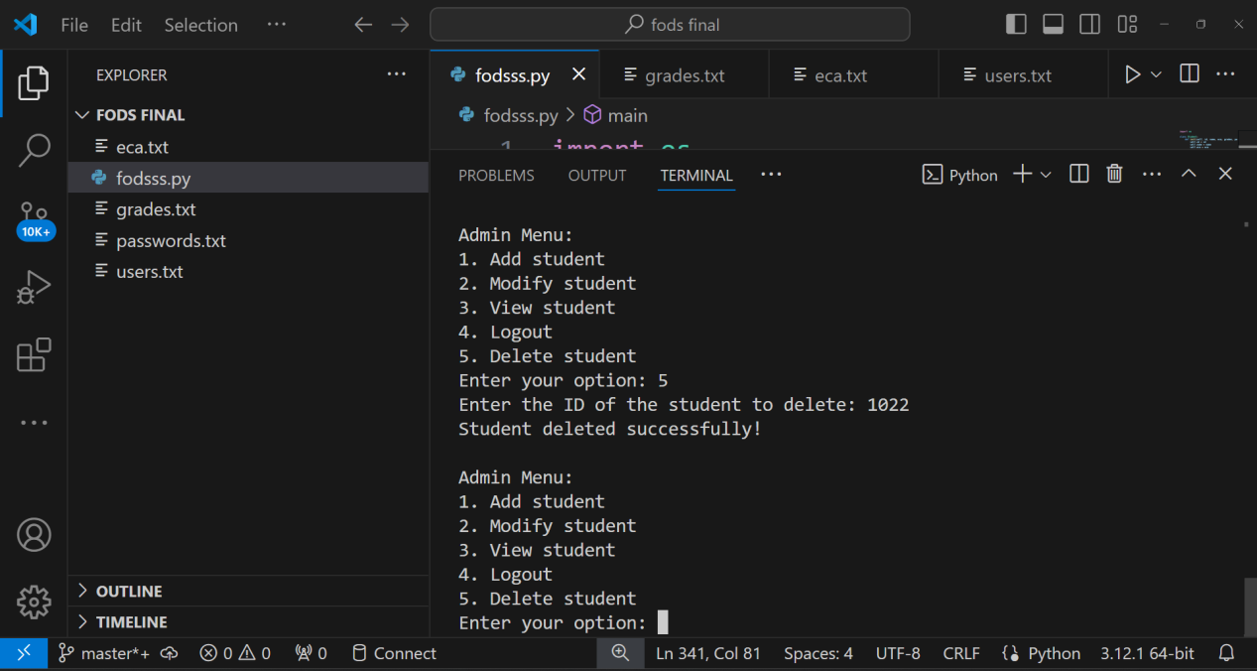
Admin Menu
Deleting a student

Slide 9

File data removed

Slide 10
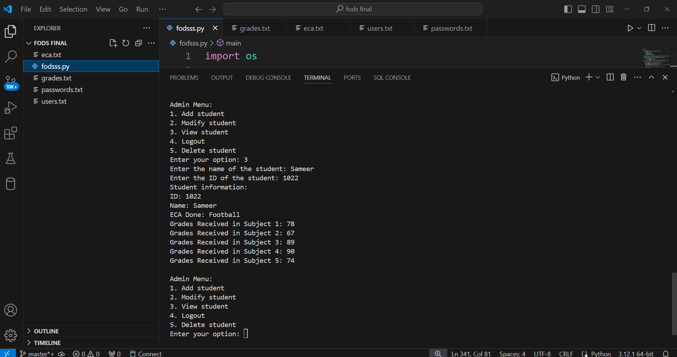
Admin Menu
View Student

Slide 11
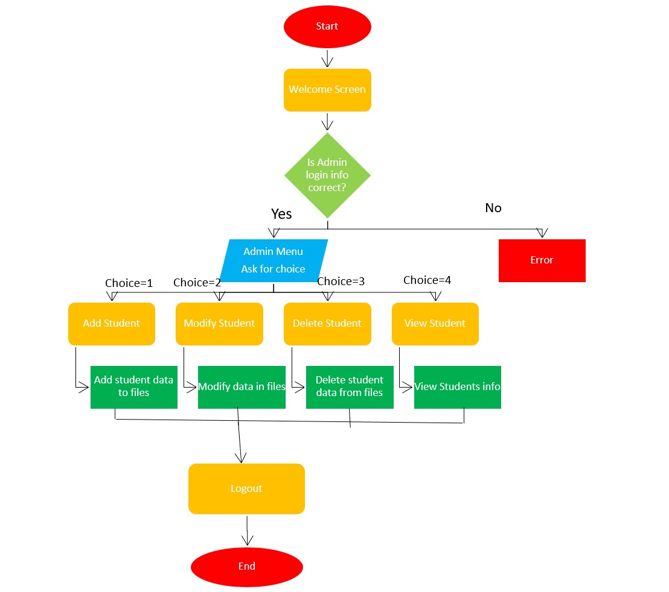

Slide 12
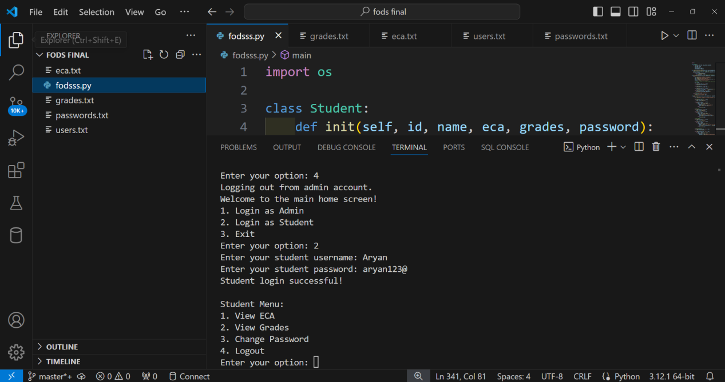
Student Login

Slide 13
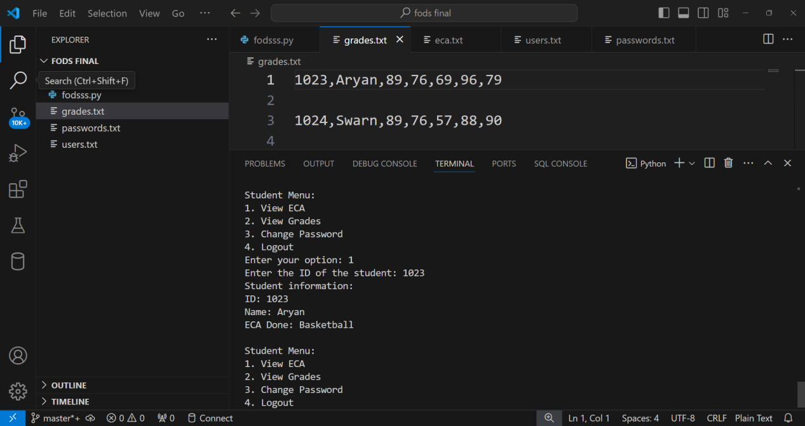
Student Menu
View ECA

Slide 14
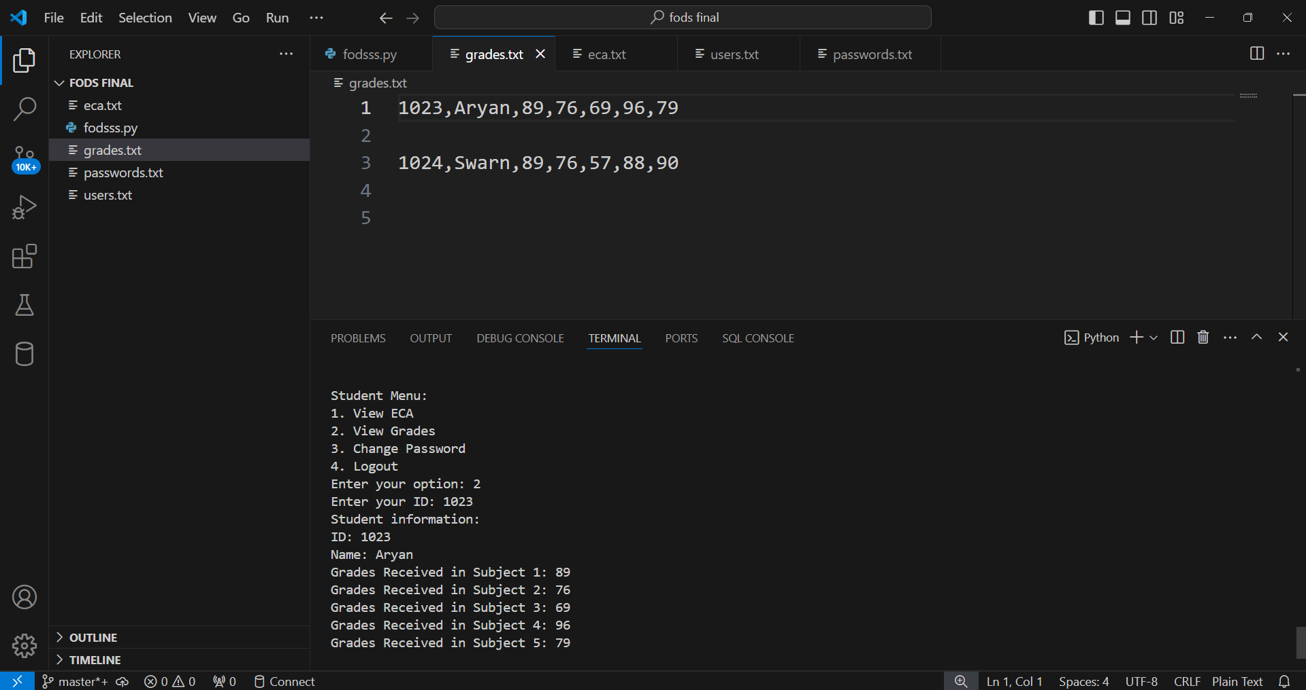
Student Menu
View Grades

Slide 15


Student Menu
Change Password

Slide 16
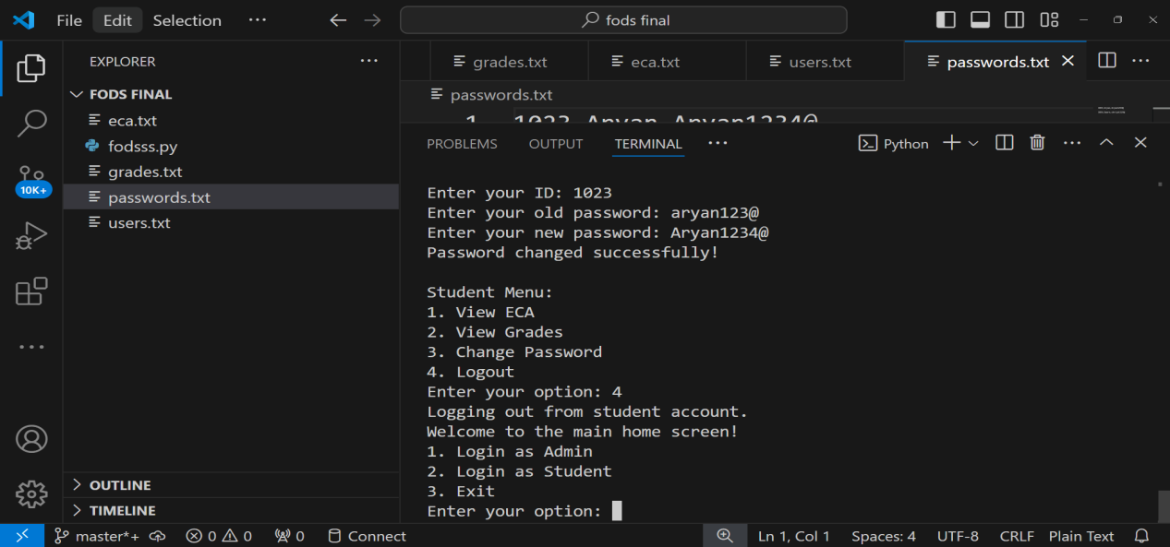
Student Menu

Slide 17
