Slide 1
GPU PROGRAMMING • PROJECT WALKTHROUGH
2D Heat Diffusion
with CUDA
Convergence detection • Global memory • Shared-memory tiling
Heat flows from hot to cold
Rodosi Biswas G25AIT2088
The GPU updates many grid cells in parallel —
then checks whether the system has settled.
Shrijaya Chauhan G25AIT2146
Jahanvee Yadav G25AIT2043
OPEN AGENDA
IIT Jodhpur | October 2026
Start with the clickable agenda →

Slide 2
START HERE
Choose your route
This deck is designed for a live walkthrough. Click a topic to jump directly to it.
01
Problem & physical intuition
02
Equation & stopping rule
03
Algorithm and CUDA execution
04
Global memory implementation
05
Shared-memory tiling
06
Correctness evidence
07
Performance comparison
08
Limitations & future work
09
Quick knowledge check
Presenter tip: ask the audience to predict which memory strategy will be faster before revealing the benchmark.
GPU PROGRAMMING • IIT JODHPUR
02

Slide 3
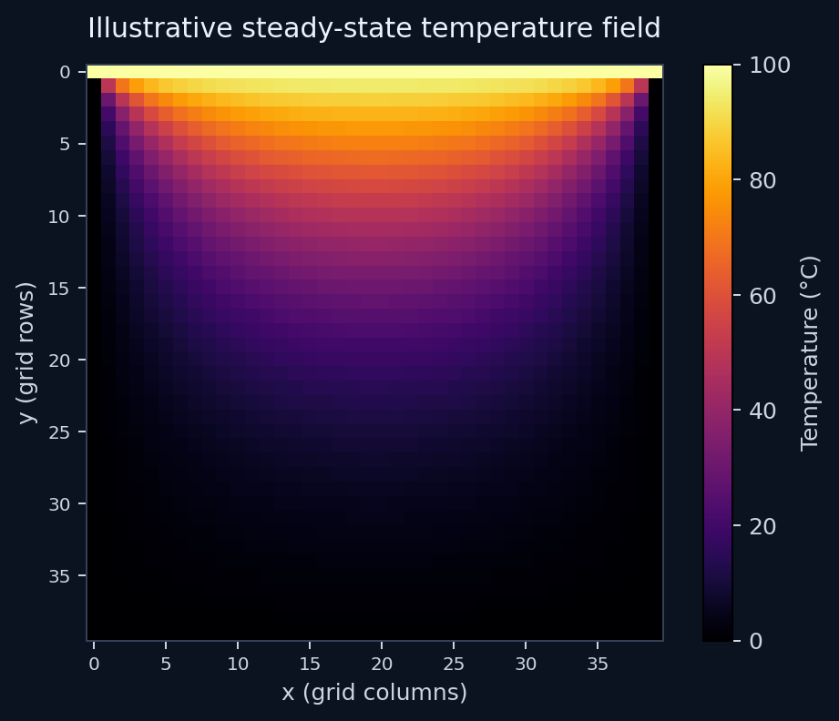
01 • PROBLEM
What does the simulation model?
Imagine a thin plate heated along its top edge while the other edges are held cold.
Hot edge
Cold edges
Top boundary stays at 100°C.
Bottom and sides stay at 0°C.
Interior cells
Each cell gradually takes on a temperature influenced by its four neighbours.
Goal
Find a stable temperature field without updating cells one-by-one on the CPU.
Heatmap is illustrative; the report's numerical validation uses a 10 × 10 grid.
AGENDA ↗
GPU PROGRAMMING • IIT JODHPUR
03

Slide 4
02 • MATHEMATICS
One simple rule, repeated many times
The project uses an explicit five-point Jacobi stencil on a square grid.
top
Tᵗ⁺¹ᵢ,ⱼ = (Tᵗᵢ₋₁,ⱼ + Tᵗᵢ₊₁,ⱼ + Tᵗᵢ,ⱼ₋₁ + Tᵗᵢ,ⱼ₊₁) / 4
left
cell
right
Only interior cells are updated; boundary cells are copied unchanged.
bottom
Five-point stencil
The next grid is computed from the previous grid (Jacobi update).
Convergence = changes become small,
not necessarily exactly zero.
Stop when max |new − old| < ε, with ε = 10⁻⁴.
AGENDA ↗
GPU PROGRAMMING • IIT JODHPUR
04

Slide 5
03 • ALGORITHM
The iteration loop
The CPU sets up the run; CUDA performs each grid update and returns only the convergence scalar.
1. Initialize
2. Reset metric
3. Launch kernel
Top row = 100°C; other boundaries = 0°C; interior = 0°C.
Set device-side maximum-change accumulator to zero.
One thread handles one grid cell; interior cells apply the stencil.
4. Measure change
5. Check stop rule
6. Swap grids
Each updated cell contributes |new − old| to the maximum.
Copy one 4-byte scalar to host; stop if it is below ε.
Use new grid as old grid and repeat if not converged.
Important distinction: full temperature grids stay on the GPU during iteration; the host still checks a small scalar every iteration.
AGENDA ↗
GPU PROGRAMMING • IIT JODHPUR
05

Slide 6
03 • CUDA
How the grid maps to GPU threads
The code uses a 2D CUDA launch with 16 × 16 threads per block.
block
block
block
block
Thread coordinates
Linear memory index
x = blockIdx.x × blockDim.x + threadIdx.x
y = blockIdx.y × blockDim.y + threadIdx.y
idx = y × N + x
Rows are stored consecutively in a 1D array.
block
block
block
block
block
block
block
block
Bounds check
Boundary check
Threads outside N × N return without accessing the grid.
Edge cells copy their previous value and skip the stencil.
Grid of thread blocks
Why parallelize? A large number of independent interior cells can be updated simultaneously.
AGENDA ↗
GPU PROGRAMMING • IIT JODHPUR
06

Slide 7
04 • IMPLEMENTATION A
Baseline: global-memory stencil
Simple and direct: every thread reads its four neighbours from the grid in global memory.
x, y ← CUDA thread coordinates
if outside grid: return
if boundary cell:
new[idx] ← old[idx]
else:
newTemp ← (up + down + left + right) / 4
new[idx] ← newTemp
change ← abs(newTemp − old[idx])
atomicMax(maxChange, change)
Strength
Low complexity; straightforward indexing and control flow.
Memory behaviour
Neighbour values are read through cached global-memory access.
Convergence
Atomic maximum tracks the largest absolute cell change.
Atomic detail from the report: non-negative float changes are bit-reinterpreted for integer atomicMax.
AGENDA ↗
GPU PROGRAMMING • IIT JODHPUR
07

Slide 8
05 • IMPLEMENTATION B
Optimization: shared-memory tiling
Stage a block's working region plus a one-cell halo into fast on-chip shared memory.
H
H
H
H
H
H
Tile shape
Cooperative loading
16 × 16 core with 1-cell halo → 18 × 18 shared array.
Threads load core cells; perimeter threads load halo neighbours.
H
C
C
C
C
H
H
C
C
C
C
H
Barrier
Expected benefit
H
C
C
C
C
H
__syncthreads() ensures tile data is ready before reads.
Reuse neighbor values from shared memory rather than repeatedly fetching them globally.
H
C
C
C
C
H
H
H
H
H
H
H
Trade-off: extra halo loads + branches + a block-wide barrier.
Concept sketch: core + halo
AGENDA ↗
GPU PROGRAMMING • IIT JODHPUR
08

Slide 9
06 • VALIDATION
Do both implementations compute the same thing?
The report compares CUDA results with a NumPy CPU reference and checks the fixed boundaries.
163 iterations
ε = 10⁻⁴
< 0.001
0 difference
All three implementations converged on the 10 × 10 validation case.
Final max change ≈ 9.72748 × 10⁻⁵.
Maximum absolute difference vs CPU ≈ 4.9719 × 10⁻⁵.
Global vs shared output reported exact match at 256 × 256.
TOP EDGE: 100°C
INTERIOR: updated by stencil
BOTTOM + SIDE EDGES: 0°C (side rule excludes top corners)
Validation shows numerical agreement; it does not by itself prove the fastest implementation.
AGENDA ↗
GPU PROGRAMMING • IIT JODHPUR
09

Slide 10
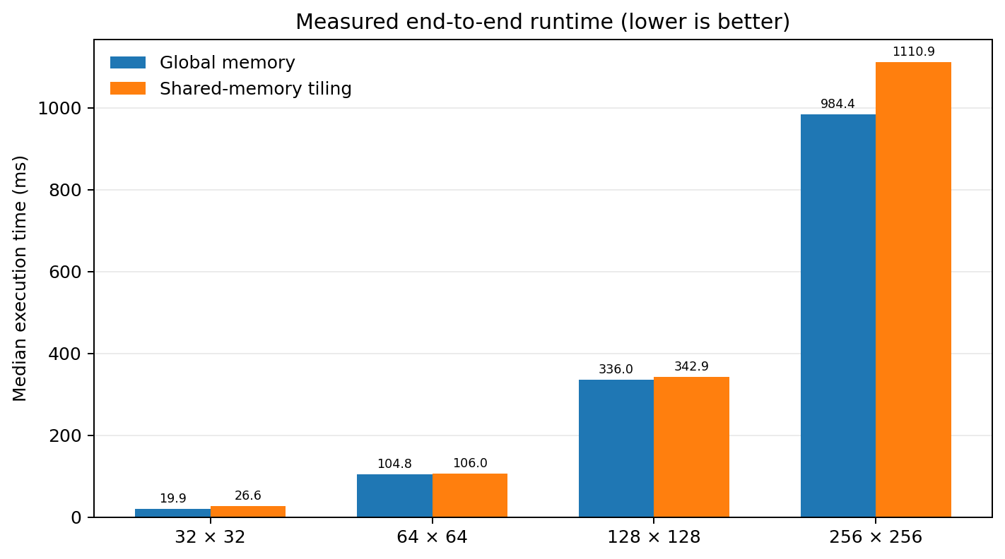
07 • PERFORMANCE
Measured runtime: global memory wins in this setup
Google Colab • NVIDIA Tesla T4 • three runs after warm-up • median reported
32 × 32
19.86 ms global vs 26.64 ms shared
64 × 64
104.76 ms vs 106.02 ms — nearly tied
128 × 128
336.01 ms vs 342.88 ms
256 × 256
984.36 ms vs 1,110.86 ms
AGENDA ↗
GPU PROGRAMMING • IIT JODHPUR
10

Slide 11
07 • PERFORMANCE
Read the ratio correctly
Global / Shared < 1 means the global-memory version took less time.
Grid size
Global (ms)
Shared (ms)
Global/Shared
Interpretation
32 × 32
19.8593
26.6397
0.745×
Global faster by ~25.5%
64 × 64
104.7550
106.0160
0.988×
Global faster by ~1.2%
128 × 128
336.0070
342.8780
0.980×
Global faster by ~2.0%
256 × 256
984.3600
1,110.8600
0.886×
Global faster by ~11.4%
No measured grid size showed a shared-memory speedup. The 64² and 128² results are close.
AGENDA ↗
GPU PROGRAMMING • IIT JODHPUR
11

Slide 12
08 • INTERPRETATION
Why didn't shared memory help?
An optimization can reduce memory reads yet still increase total runtime.
1 • Hardware caches
2 • Halo overhead
3 • Synchronization
T4 L1/L2 caches can serve the stencil's regular neighbour accesses efficiently.
Extra conditional loads and indexing are needed to fill the 18 × 18 tile.
Every block waits at __syncthreads() before it can compute.
4 • Convergence overhead
5 • Small workloads
A scalar device-to-host copy and host decision occur each iteration.
For these grid sizes, setup and synchronization costs can outweigh reuse benefits.
Takeaway: shared memory is a tool, not a guarantee. Measure end-to-end behaviour on the target GPU.
AGENDA ↗
GPU PROGRAMMING • IIT JODHPUR
12

Slide 13
09 • LIMITATIONS
What this experiment does — and doesn't — establish
Keep the scope of the evidence clear.
Only four grid sizes were benchmarked: 32² through 256².
Three measured runs per configuration; medians reduce noise but are still a small sample.
Reported timings include iterative convergence handling, so per-kernel memory effects are not isolated.
A scalar host check every iteration can dominate runtime; it is not the same as copying the full grid.
The interactive notebook heatmap runs a CPU/NumPy simulation; its benchmark panel displays recorded CUDA timings.
Therefore: results support a conclusion for this setup, not a universal claim about all GPUs or grid sizes.
AGENDA ↗
GPU PROGRAMMING • IIT JODHPUR
13

Slide 14
10 • TAKEAWAYS
Conclusion and next experiments
The implementation is correct; the performance lesson is to profile the whole workflow.
What worked
What we learned
What to try next
CUDA parallel stencil, fixed boundaries, convergence tracking, and CPU/GPU validation.
Shared-memory tiling was slower in all four tested cases on the T4 setup.
Reduce synchronization and measure kernels separately.
A
Check every K iterations
Try K = 100; report the convergence-check trade-off.
B
Profile kernel-only time
Separate kernel execution from scalar copies and host loop overhead.
C
Scale up
Benchmark 1024 × 1024 and larger domains.
D
Tune the design
Explore cooperative groups, block sizes, and alternate tiling strategies.
AGENDA ↗
GPU PROGRAMMING • IIT JODHPUR
14

Slide 15
INTERACTIVE CHECK
Before the answer: make a prediction
Click one option. The deck will jump to feedback explaining the choice.
Question 1: Which implementation was faster at every tested grid size?
A
Global memory
B
Shared memory
C
They were identical
Tip: compare the measured medians, not the theoretical promise of an optimization.
AGENDA ↗
GPU PROGRAMMING • IIT JODHPUR
15

Slide 16
ANSWER REVEAL
Correct: A — Global memory
All four reported global-memory medians are lower than their shared-memory counterparts.
Global/shared ratios: 0.745× • 0.988× • 0.980× • 0.886×
Why?
What not to conclude
Cached global-memory reads were efficient enough that tile-loading and barrier costs were not recovered.
This does not prove shared memory is always slower. Different hardware, tile sizes, or workloads may change the result.
Click “Back to quiz” to continue or return to the agenda.
← Back to quiz
AGENDA ↗
GPU PROGRAMMING • IIT JODHPUR
16

Slide 17
INTERACTIVE CHECK
One more: what does convergence mean?
Choose the most accurate description.
The simulation stops when…
A
Every cell is exactly 0°C
B
Maximum cell-to-cell time-step change is below ε
C
A fixed number of iterations has elapsed
Convergence is a numerical stopping condition based on change, not a requirement that all temperatures be equal.
AGENDA ↗
GPU PROGRAMMING • IIT JODHPUR
17

Slide 18
ANSWER REVEAL
Correct: B — the maximum change is below ε
The stopping condition in the report is max |Tᵗ⁺¹ − Tᵗ| < 10⁻⁴.
Why this matters
Implementation detail
A stable solution can still have a temperature gradient from the hot edge to the cold edges.
The GPU tracks the maximum absolute update; the host checks that scalar against tolerance.
End of walkthrough • Questions?
← Back to quiz
AGENDA ↗
GPU PROGRAMMING • IIT JODHPUR
18

