Slide 1
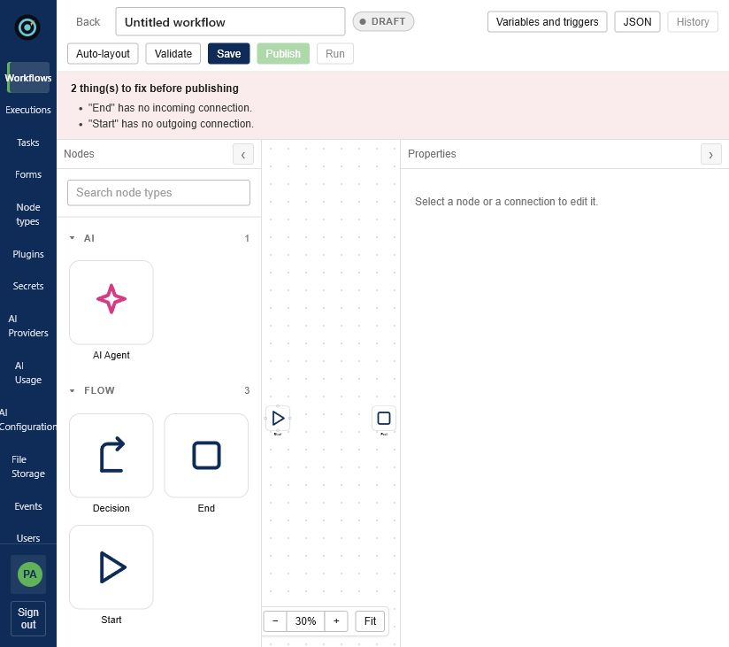
ORCHPILOT
The governed orchestration layer for people, systems and AI
Durable workflows. Human accountability. Runtime-extensible integrations.
INVESTOR BRIEF • AUGUST 2026
Notes:
Open with the category: governed orchestration, not task automation.
The product is working locally; the screenshot is from the authenticated application.
[Sources]
- Local OrchPilot application screenshot, captured 2026-08-26.

Slide 2
THE PROBLEM
Enterprise automation fails at the handoffs
01
Systems
Point integrations move data but do not own the end-to-end outcome.
02
People
Approvals, exceptions and accountability are often bolted on after design.
03
AI
Agents add adaptability—but also nondeterminism, cost and governance risk.
04
Operations
Retries, versioning, audit and recovery become custom plumbing in every team.
02
Notes:
Frame the customer pain as fragmented ownership, not a shortage of automation tools.
The investor question this sets up: who governs the full journey when people, systems and AI all participate?
[Sources]
- Camunda platform positioning: https://camunda.com/platform/
- Gartner BOAT forecast: https://www.gartner.com/en/documents/6530402

Slide 3
THE PRODUCT
One canvas models the journey; one engine owns the outcome
Built-in control points
AI Agent
Human Form
Decision
Immutable publish
The UI is schema-driven: plugins can publish node definitions without a front-end release.
03
Notes:
Demonstrate that AI and human tasks are first-class nodes alongside deterministic control flow.
The schema-driven UI is the bridge from extensibility to product velocity.
[Sources]
- Local OrchPilot application screenshot, captured 2026-08-26.
- Repository README.md and ARCHITECTURE.md.

Slide 4
ARCHITECTURE
A control plane separates process intent from integration code
Design
Execute
Extend
Govern
Visual graph
Versions + triggers
→
Durable state
Retries + compensation
→
Isolated plugin JARs
Runtime registration
→
RBAC + audit
Encrypted secrets
MongoDB persistence • execution checkpoints • event and schedule entry points • REST API
04
Notes:
The architectural claim is separation: workflows remain stable while integrations evolve as plugins.
Checkpointed execution and immutable versions support long-running, auditable work.
[Sources]
- Repository ARCHITECTURE.md, SECURITY.md, WORKFLOW_INSTANCE_LIFECYCLE.md.

Slide 5
WHAT IS BUILT
This is a platform foundation—not a prototype shell
Architecture-wide review of source-only files (excluding generated targets and dependencies).
80K+
160
13
Java production lines
REST handlers
plugin modules
Also: 73 core-engine test classes • 28.6K Angular source lines • 27 REST controllers
05
Notes:
Use these as engineering-evidence metrics, not traction metrics.
Avoid implying code volume equals product-market fit; it establishes implementation depth and raises the diligence baseline.
[Sources]
- Local source inventory from Workflow-OrchPilot/workflow-engine, counted 2026-08-26.

Slide 6
WHY IT CAN WIN
The moat compounds at the boundary between reliability and extensibility
Runtime plugin economy
Validated JARs load in isolated classloaders; new node types appear without engine restart.
Execution trust
Immutable published versions, checkpoint recovery, deterministic idempotency keys and compensation policies.
Human accountability
Server-validated forms, assignment rules, history and non-repudiable completion semantics.
AI with guardrails
Provider abstraction, encrypted credentials, usage visibility and deterministic workflow boundaries.
06
Notes:
The moat is not the canvas. It is the operational contract across plugins, state, humans and AI.
A future plugin marketplace can turn integration supply into a distribution and revenue loop.
[Sources]
- Repository ARCHITECTURE.md, PLUGIN_OPERATION_FRAMEWORK.md, AI_AGENT_NODE.md, SECURITY.md.

Slide 7
MARKET TIMING
Orchestration spending is consolidating into a strategic control layer
3×
projected expansion
in consolidated BOAT spending
Adjacent hyperautomation software is projected to reach $119.2B by 2028.
Market figures are third-party forecasts—not OrchPilot revenue projections.
07
Notes:
Lead with the smaller, more directly relevant BOAT market; use hyperautomation only as adjacent context.
The implied 2025–2029 growth is directionally strong; do not overstate addressable share.
[Sources]
- Gartner BOAT forecast: https://www.gartner.com/en/documents/6530402
- Gartner hyperautomation market map: https://www.gartner.com/en/documents/6165623

Slide 8
COMPETITIVE WEDGE
OrchPilot should own the governed middle—not compete on connector count
Capability
OrchPilot
n8n
Camunda
Temporal
Zapier
Visual business workflow
Strong
Strong
Strong
Code-first
Strong
Durable execution
Built
Partial
Strong
Category leader
Limited
Human tasks + forms
Built
Workflow step
Strong
Custom
Basic
Runtime plugin isolation
Differentiator
Node ecosystem
Connectors
Activities
App ecosystem
Self-host / control
Built
Available
Available
Available
Cloud-first
Positioning thesis: more governed than low-code automation; more accessible and extensible than developer-only orchestration.
08
Notes:
This is a strategic comparison, not a feature-completeness certification.
Do not attack established vendors. Use them to define the white space.
[Sources]
- n8n: https://n8n.io/pricing/
- Camunda: https://camunda.com/platform/
- Temporal: https://temporal.io/
- Zapier partner introduction: https://partnerportal.zapier.com/sys/document/openpdfpreview/Introduction%20to%20Zapier.pdf

Slide 9
BEACHHEAD CUSTOMERS
Start where workflows are long-lived, audited and integration-heavy
01
02
03
Platform engineering
Regulated operations
IT service delivery
Cloud provisioning, access approvals, environment lifecycle and safe rollback.
Customer onboarding, compliance review, exception handling and evidentiary audit.
Cross-system incidents, remediation, human escalation and post-action records.
Ideal design partner: 500–5,000 employees • hybrid infrastructure • recurring approval-heavy process • clear compliance owner
09
Notes:
Focus avoids the connector-count arms race and selects processes where governance and recovery are budget-worthy.
Design partners should bring one painful process, an executive owner and a measurable baseline.
[Sources]
- Temporal platform-engineering use cases: https://temporal.io/solutions/platform-engineering
- Camunda use cases: https://camunda.com/platform/use-cases/

Slide 10
PROPOSED BUSINESS MODEL
A hybrid platform model can align price with operational value
1
Platform subscription
Annual fee for environments, governance, collaboration, support and deployment choice.
2
Execution bands
Usage grows with completed workflow value—not seats or number of design drafts.
3
Private plugin marketplace
Paid certified integrations, partner revenue share and enterprise connector packs.
4
Implementation partners
Fixed-scope launch packages; services taper as partner capacity compounds.
Recommendation—not current pricing. Validate willingness-to-pay with five design partners before fixing tiers.
10
Notes:
Pricing is intentionally presented as a hypothesis.
Execution-based value metrics are legible, but large customers will still demand predictable commitments and overage protection.
[Sources]
- n8n pricing model context: https://n8n.io/pricing/

Slide 11
DE-RISKING PLAN
Eighteen months turns strong engineering into an investable company
0–3 months
4–9 months
10–18 months
Prove wedge
Enterprise readiness
Scale distribution
5 design partners
1 repeatable process
SSO/SCIM • HA
observability • policy
3 paid pilots
partner/plugin program
North-star validation: time-to-first-production workflow, successful execution rate, human wait time, and expansion to a second process.
11
Notes:
Tie spend to de-risking, not feature volume.
The second production process is the early signal that OrchPilot is becoming a platform rather than a project.
[Sources]
- Roadmap is a recommendation derived from repository assessment and competitor expectations.

Slide 12
RISKS AND ANSWERS
The biggest risk is breadth before proof—not technical feasibility
Crowded category
Anchor on governed, approval-heavy orchestration; avoid generic automation messaging.
Enterprise trust gap
Prioritize SSO/SCIM, HA benchmarks, deployment automation, security review and support SLAs.
Connector cold start
Ship certified packs for one vertical and expose a stable SDK/marketplace path.
Founder-market evidence
Run structured discovery; publish quantified before/after outcomes from pilots.
12
Notes:
Investors will find these gaps. Naming them builds credibility and shows capital discipline.
Do not claim enterprise readiness solely from feature presence; prove operational scale and procurement readiness.
[Sources]
- Repository assessment and current competitor positioning.

Slide 13
ORCHPILOT
Make every critical workflow recoverable, governable and extensible.
Seed objective
Convert a working orchestration platform into repeatable enterprise adoption.
Use of funds: enterprise readiness • 5 design partners • 3 paid pilots • partner-led integration supply
Funding amount and valuation: INSERT AFTER FOUNDER DECISION
Notes:
Close on the mission and the next proof points.
Insert the actual raise amount, runway, founder story and current traction before external distribution.
[Sources]
- Milestones are proposed; no funding amount or traction was provided.

