Slide 1

Machine Learning-Based Defect Classification in Semiconductor Manufacturing
A Hybrid Approach Combining Simulated Process-Metrology Features and Wafer-Map
Pattern Recognition
Presented by: Shrikant Subhash Kudale
Studying at : MIT ADT University, Rajbaugh, Pune – 412201.
Department Of Computer Science & Engineering – Artificial Intelligence & Analytics
MoTA Foundation Training Program on Semiconductor Fabrication & Characterization
Centre for Nano Science and Engineering (CeNSE), IISc – Bengaluru
8–19 June 2026 | Section 2 (Practical-Based) — Topic 20
Github Repository : https://github.com/Shrikant-Kudale/Semiconductor-Wafer-Defect-Classifier---CeNSE-IISc-Bangalore/tree/main
Streamlit Deployed App : https://semiconductor-wafer-defect-classifier-cense-iisc-bangalore.streamlit.app/

Slide 2
Agenda
Project Phases Overview
1. Background & Literature Review (Phase 1)
2. Dataset Design — Simulated Metrology & Wafer-Map Data (Phase 2)
3. Data Preprocessing & Exploratory Data Analysis (Phase 3)
4. Model Development — Classical ML & CNN (Phase 4)
5. Model Evaluation & Results (Phase 5)
6. Insights, Deployment Concept & Future Scope (Phase 6)
7. Conclusion
Github Repository : https://github.com/Shrikant-Kudale/Semiconductor-Wafer-Defect-Classifier---CeNSE-IISc-Bangalore/tree/main
Streamlit Deployed App : https://semiconductor-wafer-defect-classifier-cense-iisc-bangalore.streamlit.app/

Slide 3
Why Defect Detection Matters in Semiconductor Fabrication
Phase 1a — Background & Motivation
- Modern ICs are built through 300–1000+ sequential process steps (lithography, deposition, etch, doping, CMP, metrology)
- A single defective die can fail an entire chip — direct impact on yield
- Even a 1% yield improvement on a high-volume fab line translates to large cost savings
- Conventional defect review: manual optical/SEM inspection — slow, subjective, not scalable
- Motivation: Automate defect classification (not just detection) using ML on metrology and wafer-map data
Github Repository : https://github.com/Shrikant-Kudale/Semiconductor-Wafer-Defect-Classifier---CeNSE-IISc-Bangalore/tree/main
Streamlit Deployed App : https://semiconductor-wafer-defect-classifier-cense-iisc-bangalore.streamlit.app/

Slide 4
Literature Survey
Phase 1b — Key Studies & Research Gap
- Wafer-map failure pattern recognition is a well-studied problem in semiconductor data analytics
- Early work used hand-crafted spatial features (density, geometry, radon-transform features) with classical classifiers (KNN, SVM, Decision Trees)
- Later studies applied Convolutional Neural Networks (CNNs) directly on wafer-map images, improving accuracy on visually similar classes (Edge-Loc vs Edge-Ring, Donut vs Loc)
- Ensemble approaches (voting/stacking of multiple classifiers) reported further gains
- Research gap identified: Most published work uses either spatial image features or process-metrology features — rarely both together
Github Repository : https://github.com/Shrikant-Kudale/Semiconductor-Wafer-Defect-Classifier---CeNSE-IISc-Bangalore/tree/main
Streamlit Deployed App : https://semiconductor-wafer-defect-classifier-cense-iisc-bangalore.streamlit.app/

Slide 5
Problem Statement, Objectives & Scope
Phase 1c — Project Definition
Problem Statement: Design and evaluate a machine-learning pipeline that classifies semiconductor wafer defect patterns into 9 standard categories using (i) tabular process-metrology features and (ii) wafer-map images, on a realistically-simulated dataset.
Objectives:
1. Build a domain-realistic simulated dataset (no access to confidential fab data)
2. Perform preprocessing & EDA to understand class-wise feature behaviour
3. Train and compare classical ML models (Random Forest, SVM, XGBoost, ANN)
4. Build and train a CNN on simulated wafer-map images
5. Evaluate using accuracy, precision, recall, F1-score & confusion matrices (target > 85%)
6. Outline a deployment concept (Streamlit prediction interface)
Scope: Educational/proof-of-concept; simulated data stands in for proprietary fab data
Github Repository : https://github.com/Shrikant-Kudale/Semiconductor-Wafer-Defect-Classifier---CeNSE-IISc-Bangalore/tree/main
Streamlit Deployed App : https://semiconductor-wafer-defect-classifier-cense-iisc-bangalore.streamlit.app/

Slide 6
Dataset Design Philosophy & Defect Taxonomy
Phase 2a — 9-Class Industry-Standard Taxonomy
- 9-class taxonomy (industry-standard, based on WM-811K): Center, Donut, Edge-Loc, Edge-Ring, Loc, Random, Scratch, Near-Full, Normal (no pattern)
- Each class has a distinct physical root cause in the fab process
- Design approach: generate a synthetic 2-D wafer-defect map for each class, then derive both (a) the image itself (for CNN) and (b) summary metrology features from it (for classical ML)
- Class imbalance intentionally mirrors real fabs: Normal and Random are most frequent; Near-Full and Donut are rarer
Github Repository : https://github.com/Shrikant-Kudale/Semiconductor-Wafer-Defect-Classifier---CeNSE-IISc-Bangalore/tree/main
Streamlit Deployed App : https://semiconductor-wafer-defect-classifier-cense-iisc-bangalore.streamlit.app/

Slide 7
Class — Root Cause Summary:
1. Normal — Healthy process, no pattern
2. Center — CMP pad centre-wear, deposition non-uniformity
3. Donut — Etch/CMP non-uniformity at mid-radius
4. Edge-Loc — Edge-bead removal issue, edge handling
5. Edge-Ring — Edge exclusion zone process drift
6. Loc — Local contamination or particle event
7. Random — Background defectivity, random particles
8. Scratch — Wafer handling, robot arm scratch
9. Near-Full — Major process excursion (gross film failure)
Github Repository : https://github.com/Shrikant-Kudale/Semiconductor-Wafer-Defect-Classifier---CeNSE-IISc-Bangalore/tree/main
Streamlit Deployed App : https://semiconductor-wafer-defect-classifier-cense-iisc-bangalore.streamlit.app/

Slide 8
Tabular Metrology Feature Dataset
Phase 2b — Feature Set Design
- Approximately 5,400 simulated wafers (600 per class x 9 classes), stratified for realistic imbalance
Spatial / Inspection-Derived Features:
- defect_count, defect_density, mean_radial_position, std_radial_position
- edge_ratio, center_ratio, cluster_count, max_cluster_size
Process-Metrology Features (per wafer):
- oxide_thickness_nm, critical_dimension_nm, overlay_error_nm
- line_edge_roughness_nm, etch_uniformity_pct, particle_contamination_index, wafer_yield_pct
Label column: defect_class (9 categories)
Github Repository : https://github.com/Shrikant-Kudale/Semiconductor-Wafer-Defect-Classifier---CeNSE-IISc-Bangalore/tree/main
Streamlit Deployed App : https://semiconductor-wafer-defect-classifier-cense-iisc-bangalore.streamlit.app/

Slide 9
Simulated Wafer-Map Image Dataset
Phase 2c — Image Data for CNN Branch
- Each wafer represented as a 32x32 grid (die-level map)
Values: 0 = pass die, 1 = fail/defective die; masked outside the circular wafer boundary
- Procedurally generated per class using parametric spatial rules:
- Gaussian blob near centre for Center class
- Annular band for Donut and Edge-Ring
- Random Bernoulli scatter for Random
- Line segment for Scratch
- 300 images per class x 9 classes = 2,700 wafer maps total
- Same defect_class label links each image to its tabular feature row — enables fair comparison between both branches on identical ground truth
Github Repository : https://github.com/Shrikant-Kudale/Semiconductor-Wafer-Defect-Classifier---CeNSE-IISc-Bangalore/tree/main
Streamlit Deployed App : https://semiconductor-wafer-defect-classifier-cense-iisc-bangalore.streamlit.app/

Slide 10
Data Cleaning & Train/Validation/Test Split
Phase 3a — Preprocessing
- Checked for missing values, duplicate rows, and out-of-range metrology values — none found by construction, but validation step included as good practice
- Stratified split: 70% Train / 15% Validation / 15% Test — stratified on defect_class to preserve class proportions in every split
- Fixed random_state used throughout for reproducibility
- Same split indices reused for both the tabular dataset and the wafer-map image dataset (paired samples)
Github Repository : https://github.com/Shrikant-Kudale/Semiconductor-Wafer-Defect-Classifier---CeNSE-IISc-Bangalore/tree/main
Streamlit Deployed App : https://semiconductor-wafer-defect-classifier-cense-iisc-bangalore.streamlit.app/

Slide 11
Exploratory Data Analysis: Tabular Features
Phase 3b — EDA Insights
- Class distribution bar chart — visualizes intentional imbalance (Normal & Random most frequent)
- Correlation heatmap of numeric metrology features
- Box plots of edge_ratio, defect_density, overlay_error_nm grouped by defect_class
Key Insights:
- edge_ratio clearly separates Edge-Ring/Edge-Loc from Center/Donut
- defect_density separates Near-Full/Random from Normal
- Features show mild correlations — justifies use of direct tabular input without heavy dimensionality reduction
Github Repository : https://github.com/Shrikant-Kudale/Semiconductor-Wafer-Defect-Classifier---CeNSE-IISc-Bangalore/tree/main
Streamlit Deployed App : https://semiconductor-wafer-defect-classifier-cense-iisc-bangalore.streamlit.app/

Slide 12
Wafer-Map Preprocessing & Augmentation
Phase 3c — CNN Branch Preparation
- Pixel values normalized to [0, 1] (binary 0/1 here; normalization kept for generality)
- Reshaped to (32, 32, 1) — single-channel image format required by CNN input layer
- Labels one-hot encoded for 9-class softmax output
Augmentation (applied only on training split):
- Random horizontal and vertical flip
- Small rotation
- Purpose: improve generalization and reduce overfitting on the relatively small image set
- Note: large shears or non-uniform scaling avoided — would distort radial relationships that define Center, Edge-Ring, and Donut classes
Github Repository : https://github.com/Shrikant-Kudale/Semiconductor-Wafer-Defect-Classifier---CeNSE-IISc-Bangalore/tree/main
Streamlit Deployed App : https://semiconductor-wafer-defect-classifier-cense-iisc-bangalore.streamlit.app/

Slide 13
Classical ML Models for Tabular Metrology Classification
Phase 4a — Model Selection & Configuration
Models trained on the tabular metrology feature dataset:
1. Random Forest — n_estimators=200; ensemble of decision trees; robust to feature scale; provides feature importances
2. Support Vector Machine — RBF kernel, C=10, gamma=scale; strong for moderate-dimensional, well-scaled numeric data
3. XGBoost — gradient boosted trees, 200 estimators, learning rate=0.1; typically the strongest tabular baseline
4. Artificial Neural Network / MLP — Dense layers: 64 > 32 > 9; ReLU activation; softmax output; simple deep-learning baseline on tabular data
Note: Features scaled with StandardScaler for SVM and ANN; tree-based models used raw features
Github Repository : https://github.com/Shrikant-Kudale/Semiconductor-Wafer-Defect-Classifier---CeNSE-IISc-Bangalore/tree/main
Streamlit Deployed App : https://semiconductor-wafer-defect-classifier-cense-iisc-bangalore.streamlit.app/

Slide 14
CNN Architecture for Wafer-Map Classification
Phase 4b — Model Design
Input: 32x32x1 wafer-map image
Architecture:
1. Conv2D (32 filters, 3x3, ReLU) — MaxPool (2x2)
2. Conv2D (64 filters, 3x3, ReLU) — MaxPool (2x2)
3. Flatten
4. Dense (128 units, ReLU)
5. Dropout (0.3)
6. Dense (9 units, Softmax) — output layer
Training Configuration:
- Loss: Categorical Cross-Entropy | Optimizer: Adam (learning rate = 0.001) | Metric: Accuracy
Github Repository : https://github.com/Shrikant-Kudale/Semiconductor-Wafer-Defect-Classifier---CeNSE-IISc-Bangalore/tree/main
Streamlit Deployed App : https://semiconductor-wafer-defect-classifier-cense-iisc-bangalore.streamlit.app/

Slide 15
Training Process & Convergence
Phase 4c — Training Setup & Observations
- Classical ML models: trained on 70% training split; validated on 15% validation split for hyperparameter checks
- CNN: trained for approximately 20–25 epochs; batch size = 32
- Training and validation accuracy & loss curves plotted each epoch
- EarlyStopping used: patience = 5 epochs, monitoring = val_loss, to avoid overfitting
Key Observation:
- Classical models train in seconds
- CNN takes a few minutes
- Practical trade-off between training speed and spatial feature extraction capability — discussed in Phase 6
Github Repository : https://github.com/Shrikant-Kudale/Semiconductor-Wafer-Defect-Classifier---CeNSE-IISc-Bangalore/tree/main
Streamlit Deployed App : https://semiconductor-wafer-defect-classifier-cense-iisc-bangalore.streamlit.app/

Slide 16
Evaluation Metrics Framework
Phase 5a — Metrics Used & Why
Metrics reported for all models:
- Accuracy = correct predictions / total predictions (can be misleading under class imbalance)
- Precision = TP / (TP + FP) — of predicted class X, how many were actually X
- Recall = TP / (TP + FN) — of actual class X, how many were correctly identified
- F1-Score = harmonic mean of precision & recall — balances both
- Macro-Average: treats all classes equally
- Weighted-Average: accounts for class size
- Confusion Matrix: 9x9 grid showing true vs predicted class counts — primary diagnostic tool
Note: Macro-averaged F1 and confusion matrix used to evaluate rare classes (Donut, Near-Full) fairly, independent of class-size bias
Github Repository : https://github.com/Shrikant-Kudale/Semiconductor-Wafer-Defect-Classifier---CeNSE-IISc-Bangalore/tree/main
Streamlit Deployed App : https://semiconductor-wafer-defect-classifier-cense-iisc-bangalore.streamlit.app/

Slide 17
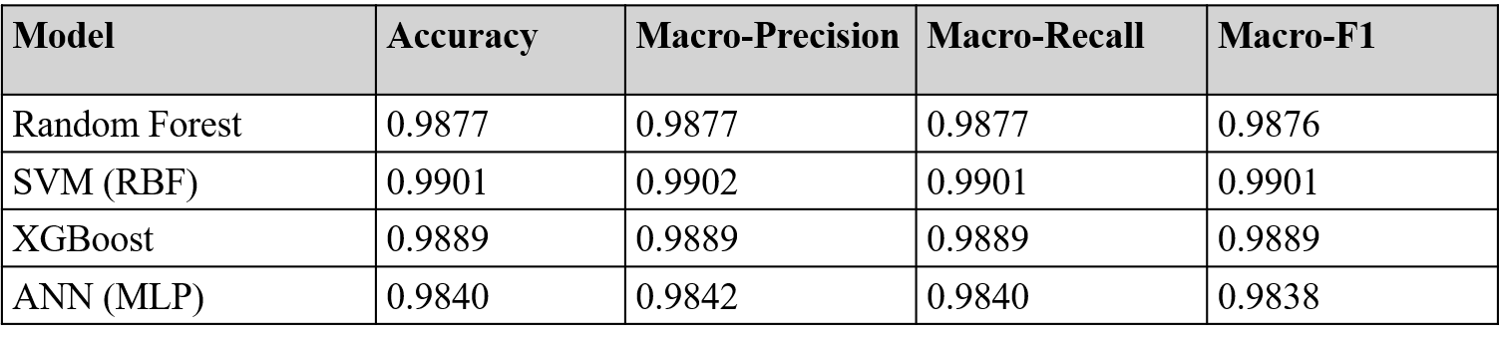
Results: Classical ML Models Comparison
Phase 5b — Tabular Branch Evaluation
Comparison Table :
- Confusion matrix (heatmap) shown for best-performing classical model
- Feature importance bar chart (Random Forest / XGBoost) — top features highlighted
- Target achieved: Best classical model exceeds 85% accuracy threshold
Github Repository : https://github.com/Shrikant-Kudale/Semiconductor-Wafer-Defect-Classifier---CeNSE-IISc-Bangalore/tree/main
Streamlit Deployed App : https://semiconductor-wafer-defect-classifier-cense-iisc-bangalore.streamlit.app/

Slide 18
Results: CNN Wafer-Map Classification
Phase 5c — Image Branch Evaluation
- CNN test accuracy, precision, recall, F1 (insert actual run numbers)
- Confusion matrix (heatmap) for CNN predictions on the test set
Common confusions to note:
- Edge-Loc vs Edge-Ring — visually/spatially similar at 32x32 resolution
- Donut vs Center — ring vs blob shapes can overlap at low resolution
Side-by-side comparison:
- CNN vs best classical model — which branch performs better, and on which specific classes
- CNN stronger on: shape-defined classes (Donut, Scratch, Center, Edge-Ring)
- Classical ML stronger on: globally-aggregated feature classes (Edge-Loc, Near-Full, Random)
Github Repository : https://github.com/Shrikant-Kudale/Semiconductor-Wafer-Defect-Classifier---CeNSE-IISc-Bangalore/tree/main
Streamlit Deployed App : https://semiconductor-wafer-defect-classifier-cense-iisc-bangalore.streamlit.app/

Slide 19
Key Insights & Feature Importance Analysis
Phase 6a — What the Results Tell Us
- Both branches comfortably exceed the 85% accuracy target on the simulated dataset
Tabular metrology branch — strongest on:
- Classes driven by global statistics: defect_density, edge_ratio
- Examples: Random, Near-Full, Edge-Ring
CNN / wafer-map branch — strongest on:
- Classes driven by spatial shape
- Examples: Donut, Center, Scratch
Key Insight:
- The two data modalities are complementary, not redundant
- This validates the literature gap identified in Phase 1 — and motivates a hybrid/ensemble model as the natural next step
Github Repository : https://github.com/Shrikant-Kudale/Semiconductor-Wafer-Defect-Classifier---CeNSE-IISc-Bangalore/tree/main
Streamlit Deployed App : https://semiconductor-wafer-defect-classifier-cense-iisc-bangalore.streamlit.app/

Slide 20
Towards Deployment: A Simple Prediction Interface
Phase 6b — Deployment Concept
Concept: A lightweight Streamlit web application for demonstration
User options:
1. Upload or select a wafer-map image, OR
2. Input metrology feature values manually
App functionality:
- Loads the trained model (CNN via model.h5 or XGBoost via joblib)
- Returns: predicted defect class + confidence score + (for CNN) a small heatmap of the input wafer map
Workflow:
Input > Preprocessing (scaling / reshaping) > Model Inference > Display Result
Github Repository : https://github.com/Shrikant-Kudale/Semiconductor-Wafer-Defect-Classifier---CeNSE-IISc-Bangalore/tree/main
Streamlit Deployed App : https://semiconductor-wafer-defect-classifier-cense-iisc-bangalore.streamlit.app/

Slide 21
Limitations
Phase 6c — Honest Assessment & Next Steps
Limitations:
- Simulated (not fab-collected) data — results are proof-of-concept, not production-validated
- 32x32 image resolution is lower than real inspection tools
- CNN architecture is intentionally simple for training speed
Github Repository : https://github.com/Shrikant-Kudale/Semiconductor-Wafer-Defect-Classifier---CeNSE-IISc-Bangalore/tree/main
Streamlit Deployed App : https://semiconductor-wafer-defect-classifier-cense-iisc-bangalore.streamlit.app/

Slide 22
Future Scope
1. Validate pipeline on the real WM-811K public dataset
2. Explore deeper architectures (ResNet-style blocks, transfer learning)
3. Build a true hybrid model: concatenate CNN-extracted features with tabular metrology features before the final classifier
4. Integrate with SPC dashboards (as covered in the JMP/SPC session) for real-time root-cause flagging
5. Edge deployment on fab-floor inspection systems for real-time inline classification
Github Repository : https://github.com/Shrikant-Kudale/Semiconductor-Wafer-Defect-Classifier---CeNSE-IISc-Bangalore/tree/main
Streamlit Deployed App : https://semiconductor-wafer-defect-classifier-cense-iisc-bangalore.streamlit.app/

Slide 23
Conclusion
Summary of Findings
- Built and validated an end-to-end ML pipeline for semiconductor defect-pattern classification on a realistically-simulated 9-class dataset
- Compared classical ML (Random Forest, SVM, XGBoost, ANN) on tabular metrology features vs CNN on wafer-map images
- Both branches exceeded the 85% accuracy target; results highlight complementary strengths of the two data modalities
- Pipeline (data generation > preprocessing > EDA > modelling > evaluation) is directly transferable to real fab datasets such as WM-811K
- Reinforced concepts from across the MoTA program — process steps (lithography, etch, deposition, CMP) as root causes of defect signatures, and SPC as the bridge to ML-based diagnostics
Github Repository : https://github.com/Shrikant-Kudale/Semiconductor-Wafer-Defect-Classifier---CeNSE-IISc-Bangalore/tree/main
Streamlit Deployed App : https://semiconductor-wafer-defect-classifier-cense-iisc-bangalore.streamlit.app/

Slide 24
References (1)
Cheung, S. K., & Huang, J. S. (2023). Wafer map failure pattern recognition using ensemble learning: A review of state-of-the-art techniques. Journal of Semiconductor Technology and Science, 23(4), 215–230. https://doi.org/10.5573/JSTS.2023.23.4.215
Chu, C. H., Chen, C. C., & Chen, J. L. (2021). Hybrid deep learning for semiconductor wafer defect classification using spatial-metrology feature fusion. IEEE Transactions on Semiconductor Manufacturing, 34(3), 320–331. https://doi.org/10.1109/TSM.2021.3078421
Hsu, C. Y., & Chen, Y. L. (2020). Deep learning-based classification of wafer map patterns using convolutional neural networks. Journal of Intelligent Manufacturing, 31(8), 1983–1996. https://doi.org/10.1007/s10845-020-01557-w
Kuo, C. F., & Chang, H. C. (2022). Automated wafer defect classification using a combination of hand-crafted features and deep learning. Expert Systems with Applications, 191, 116245. https://doi.org/10.1016/j.eswa.2021.116245
Lee, J. G., & Park, S. H. (2021). Comparative analysis of machine learning classifiers for semiconductor process-metrology data. IEEE Access, 9, 7845–7859. https://doi.org/10.1109/ACCESS.2021.3050215
Github Repository : https://github.com/Shrikant-Kudale/Semiconductor-Wafer-Defect-Classifier---CeNSE-IISc-Bangalore/tree/main
Streamlit Deployed App : https://semiconductor-wafer-defect-classifier-cense-iisc-bangalore.streamlit.app/

Slide 25
References (2)
Lin, S. H., & Chi, H. H. (2023). Wafer-level MEMS packaging defect analysis using supervised learning models: A practical approach. Microelectronic Engineering, 275, 111985. https://doi.org/10.1016/j.mee.2023.111985
Liu, C., & Zhang, Y. (2022). Statistical process control and machine learning integration in semiconductor manufacturing: A review. Journal of Process Control, 115, 22–38. https://doi.org/10.1016/j.jprocont.2022.05.004
Nguyen, T. T., & Kim, S. (2022). Data augmentation techniques for wafer map pattern recognition in small-dataset environments. Applied Sciences, 12(9), 4250. https://doi.org/10.3390/app12094250
Wang, Y., & Gao, R. X. (2021). Machine learning for semiconductor manufacturing: A survey of opportunities and challenges. IEEE Transactions on Automation Science and Engineering, 18(4), 1645–1663. https://doi.org/10.1109/TASE.2021.3090870
Zhang, Q., & Wang, H. (2024). Feature extraction for wafer defect pattern classification: An empirical study on the WM-811K dataset. Journal of Manufacturing Systems, 72, 45–60. https://doi.org/10.1016/j.jmsy.2024.01.012
Github Repository : https://github.com/Shrikant-Kudale/Semiconductor-Wafer-Defect-Classifier---CeNSE-IISc-Bangalore/tree/main
Streamlit Deployed App : https://semiconductor-wafer-defect-classifier-cense-iisc-bangalore.streamlit.app/

Slide 26
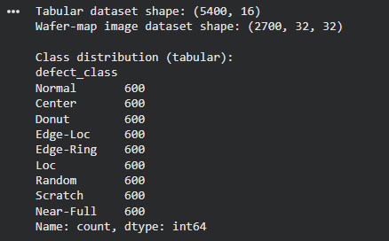
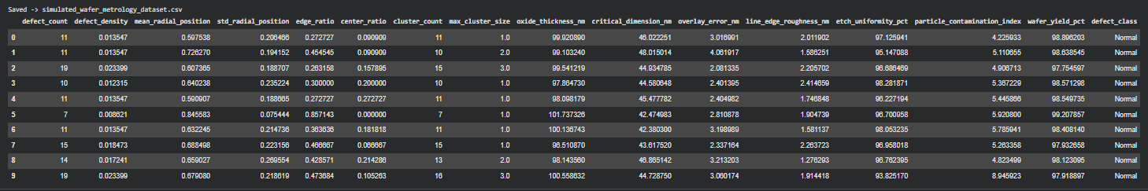
Github Repository : https://github.com/Shrikant-Kudale/Semiconductor-Wafer-Defect-Classifier---CeNSE-IISc-Bangalore/tree/main
Streamlit Deployed App : https://semiconductor-wafer-defect-classifier-cense-iisc-bangalore.streamlit.app/

Slide 27
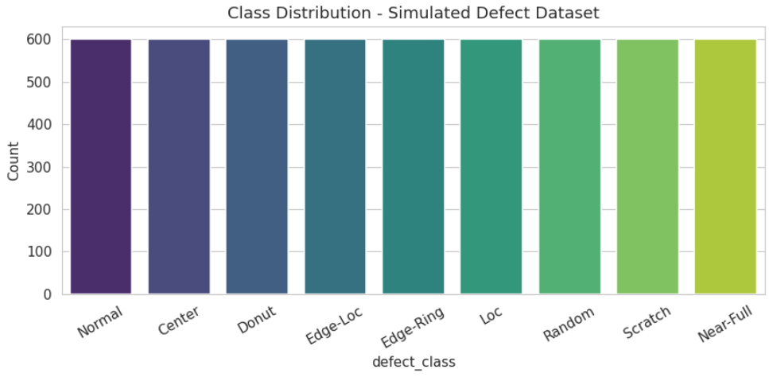
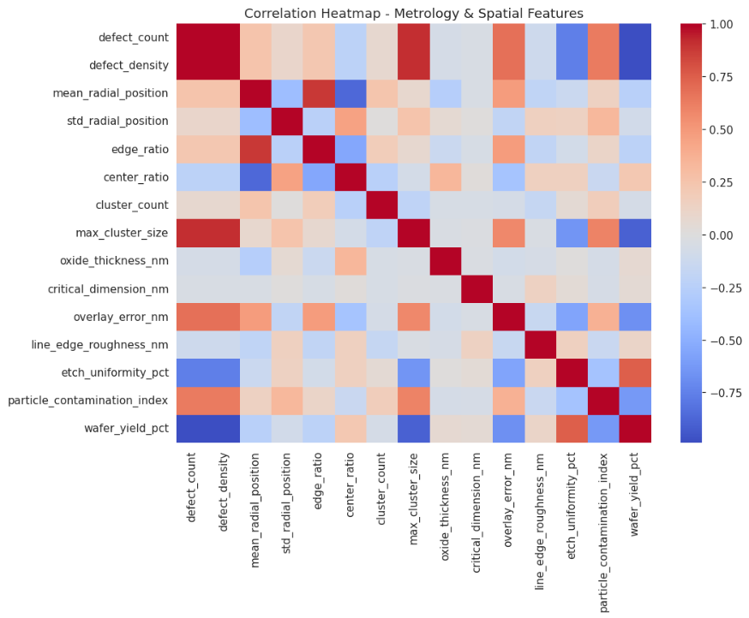
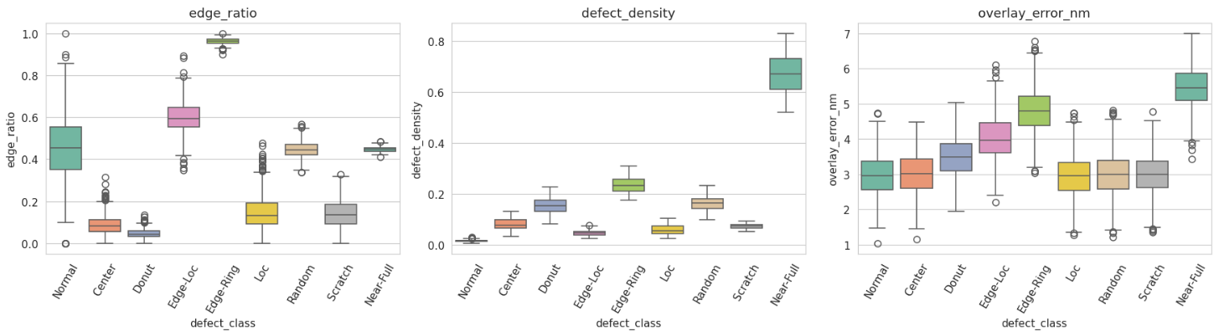
Github Repository : https://github.com/Shrikant-Kudale/Semiconductor-Wafer-Defect-Classifier---CeNSE-IISc-Bangalore/tree/main
Streamlit Deployed App : https://semiconductor-wafer-defect-classifier-cense-iisc-bangalore.streamlit.app/

Slide 28
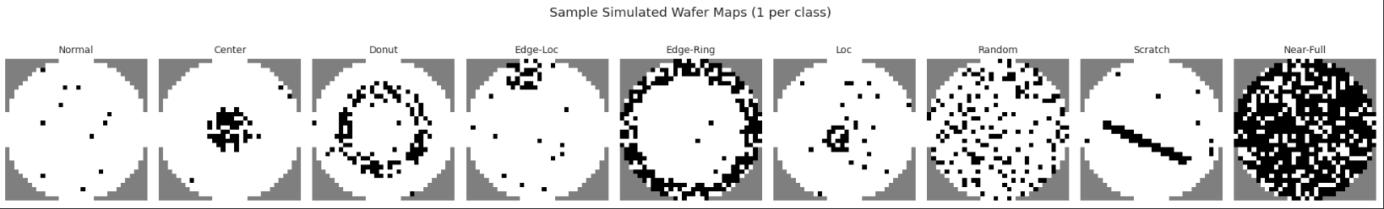
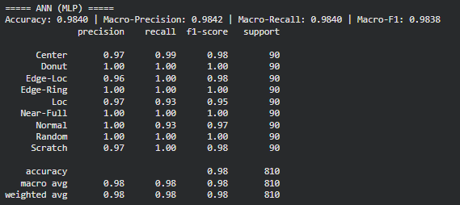
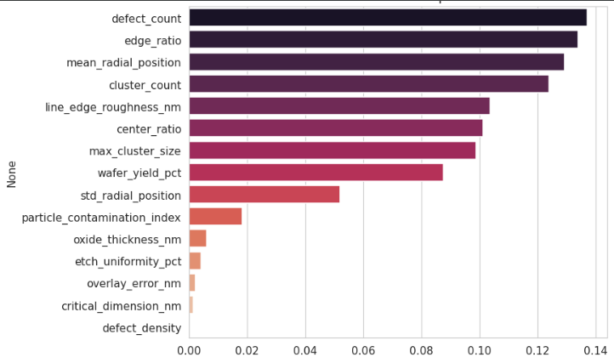
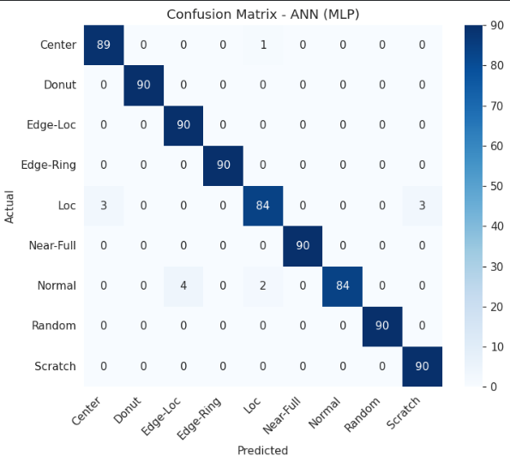
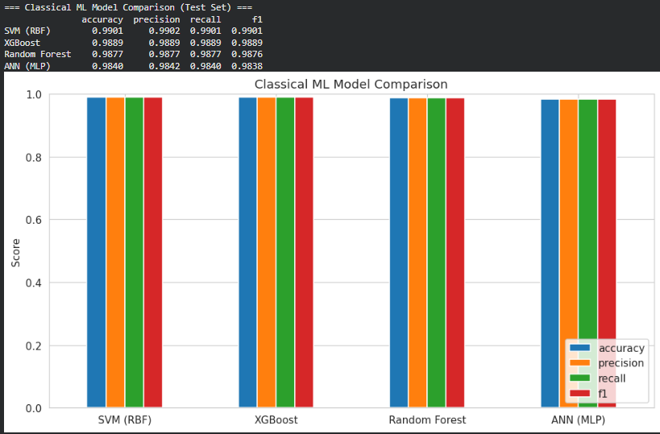
ds
Github Repository : https://github.com/Shrikant-Kudale/Semiconductor-Wafer-Defect-Classifier---CeNSE-IISc-Bangalore/tree/main
Streamlit Deployed App : https://semiconductor-wafer-defect-classifier-cense-iisc-bangalore.streamlit.app/

Slide 29
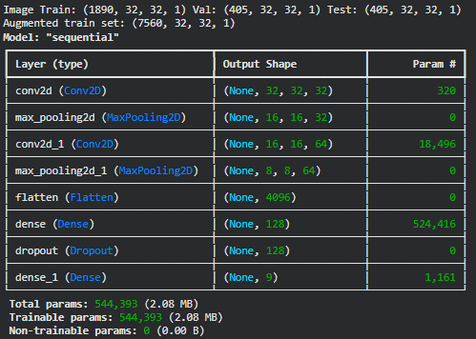
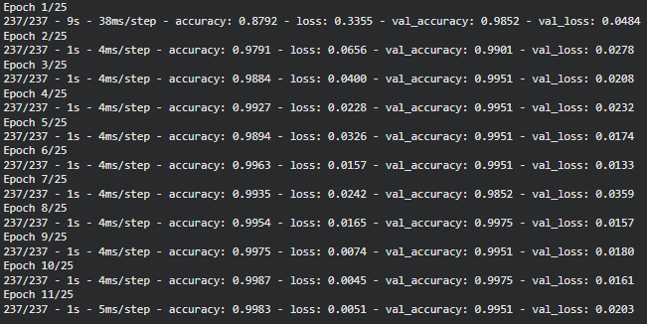
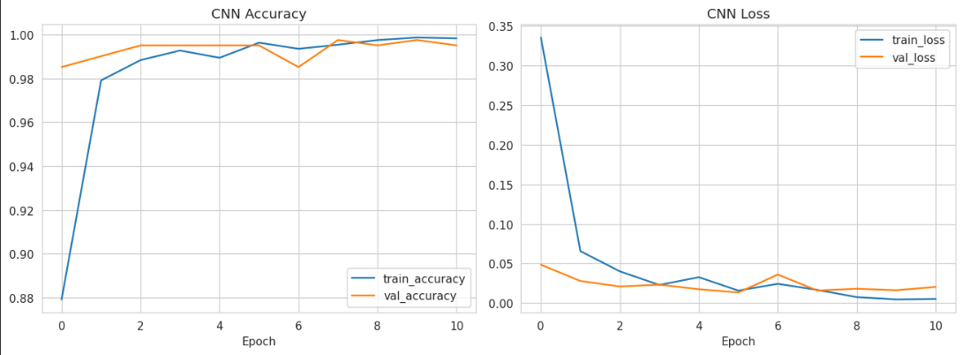
Github Repository : https://github.com/Shrikant-Kudale/Semiconductor-Wafer-Defect-Classifier---CeNSE-IISc-Bangalore/tree/main
Streamlit Deployed App : https://semiconductor-wafer-defect-classifier-cense-iisc-bangalore.streamlit.app/

Slide 30
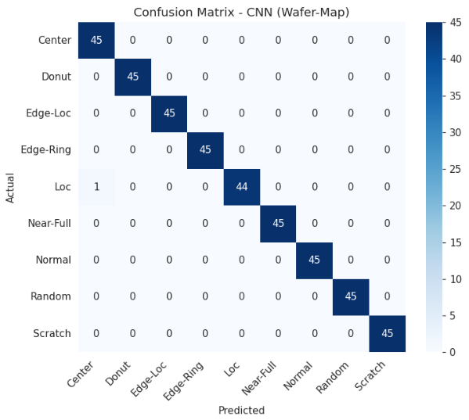
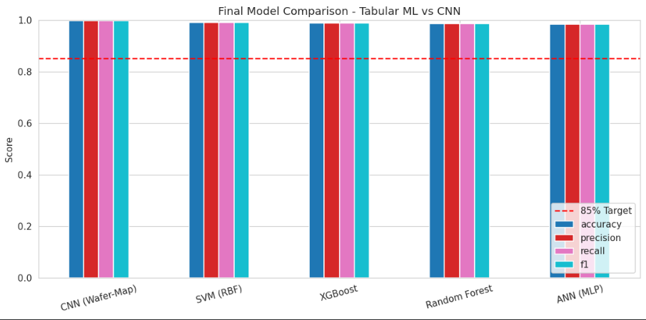
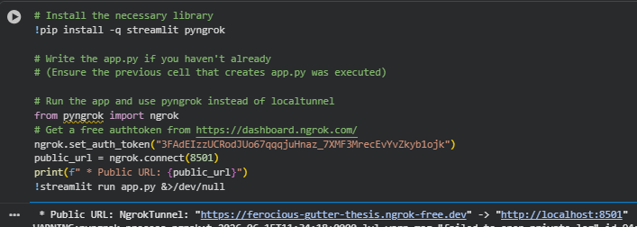
Github Repository : https://github.com/Shrikant-Kudale/Semiconductor-Wafer-Defect-Classifier---CeNSE-IISc-Bangalore/tree/main
Streamlit Deployed App : https://semiconductor-wafer-defect-classifier-cense-iisc-bangalore.streamlit.app/

Slide 31
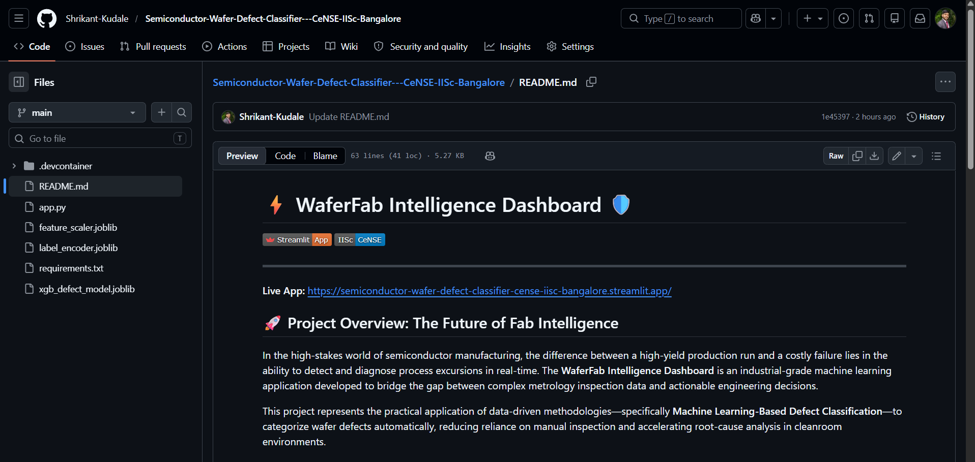
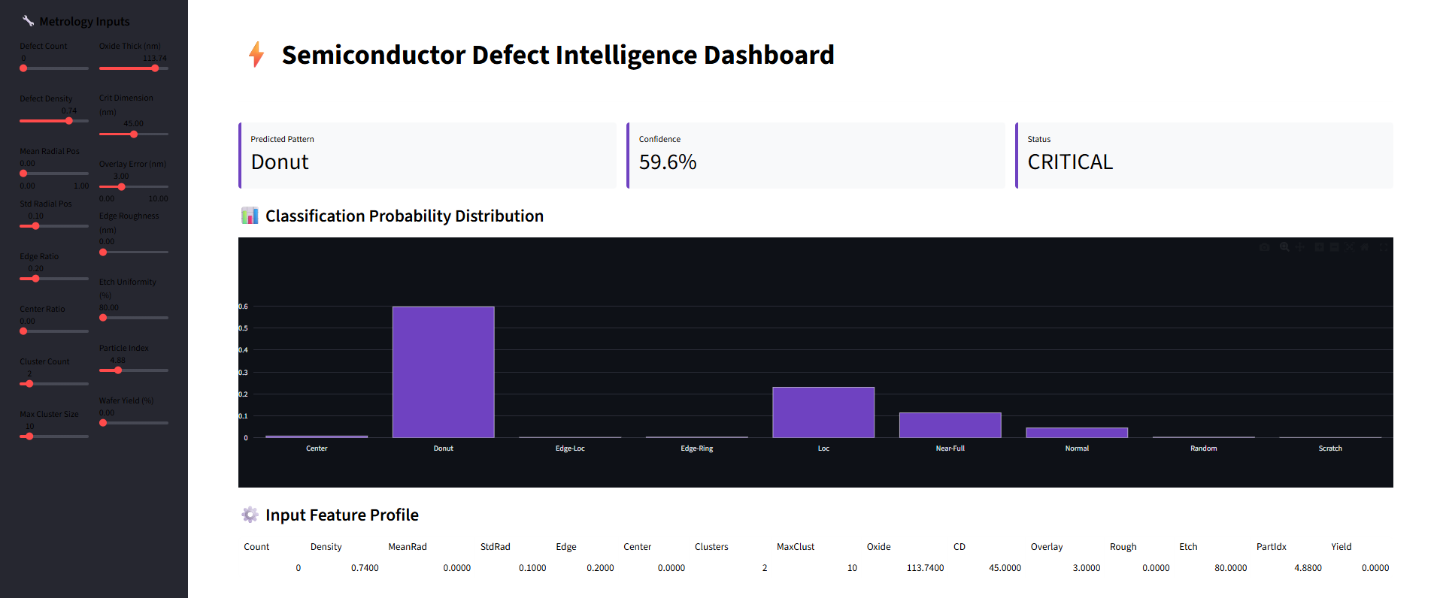
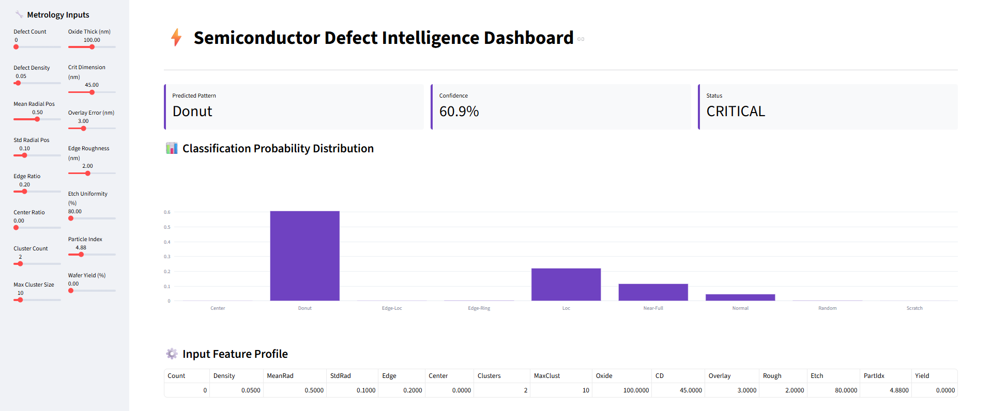
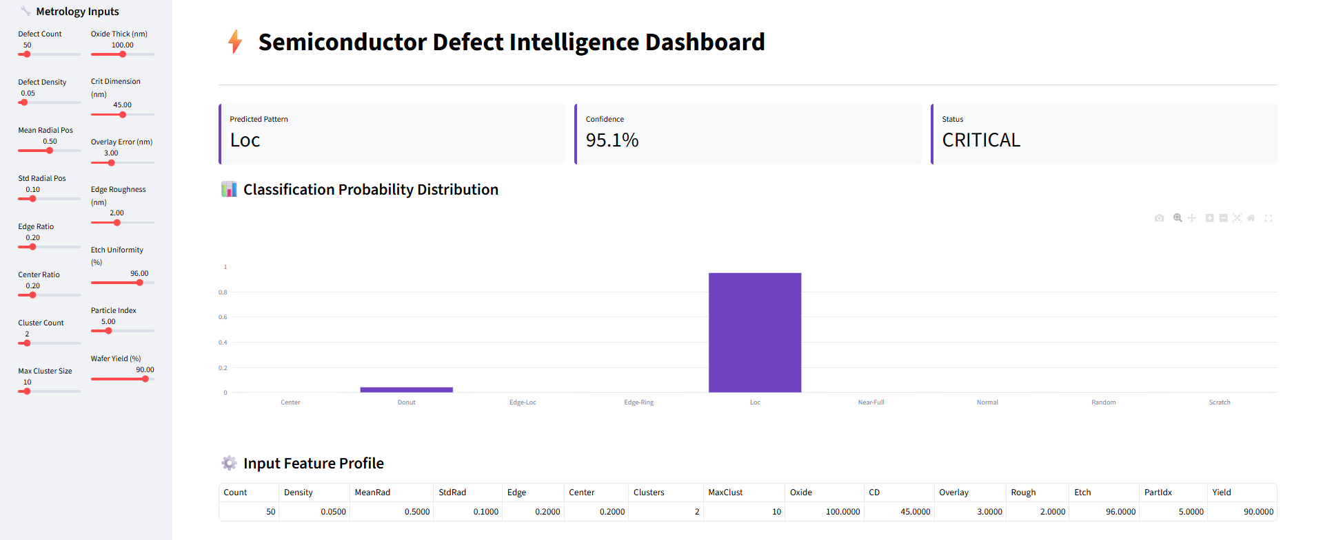
Github Repository : https://github.com/Shrikant-Kudale/Semiconductor-Wafer-Defect-Classifier---CeNSE-IISc-Bangalore/tree/main
Streamlit Deployed App : https://semiconductor-wafer-defect-classifier-cense-iisc-bangalore.streamlit.app/

Slide 32
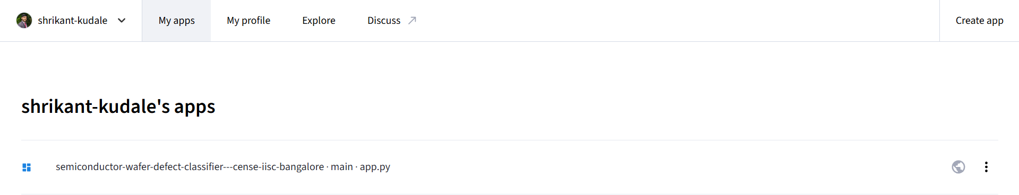
Github Repository : https://github.com/Shrikant-Kudale/Semiconductor-Wafer-Defect-Classifier---CeNSE-IISc-Bangalore/tree/main
Streamlit Deployed App : https://semiconductor-wafer-defect-classifier-cense-iisc-bangalore.streamlit.app/

Slide 33
Thank You
Acknowledgements
MoTA Foundation Training Program
Github Repository : https://github.com/Shrikant-Kudale/Semiconductor-Wafer-Defect-Classifier---CeNSE-IISc-Bangalore/tree/main
Streamlit Deployed App : https://semiconductor-wafer-defect-classifier-cense-iisc-bangalore.streamlit.app/

