Slide 1
Plant Leaf Image Pre-processing for Classification and Disease Detection
By
Shrikant M. Patil (SP024)
Under the guidance of
Dr. Shyam Lal

Slide 2
Content
Introduction
Literature Survey
Implementation Details
Results
Conclusion
References

Slide 3
Introduction
Plan classification and Disease detection with image processing is evolving rapidly.
Experts generally have access to the plant leaf images than actual plant leaf.
Field visits by experts are rare or not possible every time.
This approach seems more beneficial when people seek help from inter-state and even inter-national experts.
Though this problem is challenging, modern deep learning techniques are so powerful that this problem is solvable.
Efficiency of any deep learning algorithm at least in Plan classification and Disease detection problem is mostly depends on the feature set extracted from the image by image pre-processing.

Slide 4
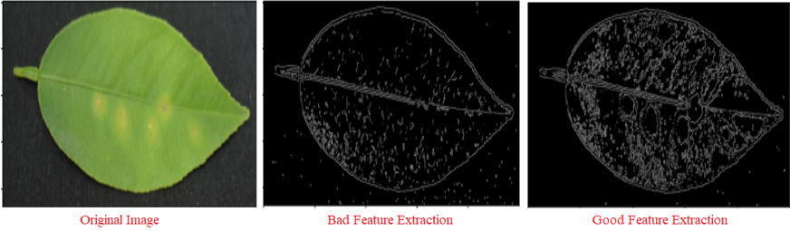
Fundamental aim of this project is to pre-process plant leaf images such that the further deep learning algorithms result into accurate and efficient outcomes.
Example: (Diseased Lemon Leaf)
From the above example, we can say that image with good feature extraction when processed by suitable deep learning algorithm with sufficient data set of healthy as well as diseased lemon leaf's will give accurate results.

Slide 5
Literature Survey
K-Means Clustering:
Unsupervised machine learning algorithm and generally used for data classification problems.
Edges in the images can be detected with two different approaches.
1] by detecting max changes from one pixel to another adjacent pixels.
2] by detecting and combining the similar pixels into separate groups.
Also used for image compression where only important no. of groups are considered for visual perception.
Good for image segmentation to highlight possible different regions in the image differed by one or more features.(Which is very much necessary for distinguishing two different diseases on plant leaf)
At least best at clearly distinguishing healthy and diseased portions of plant leaf.

Slide 6

Working:
1] Decides random centroids for defined no. of clusters or groups
2] calculates the Euclidean distance of each pixel from each centroid
3] Centroid at low Euclidian distance from the pixel accepts that pixel which in turn also changes centroid value of that cluster.
4] This process is continued till there is no comparison for Euclidean distance of any particular pixel or no. of iterations also can be specified for acceptable accuracy.
Purpose in this project:
By image segmentation it highlights the diseased spots and also distinguish the disease spots if different types are present.
Simply, it adds artificial edges to the disease spots so as to preserve them in further operations on image.
Interestingly, it does not affect the vein structure or texture of leaf but classifies it into different cluster.
It also helps to get rid of leaf image background as it clusters it into different group which can be removed any time.

Slide 7
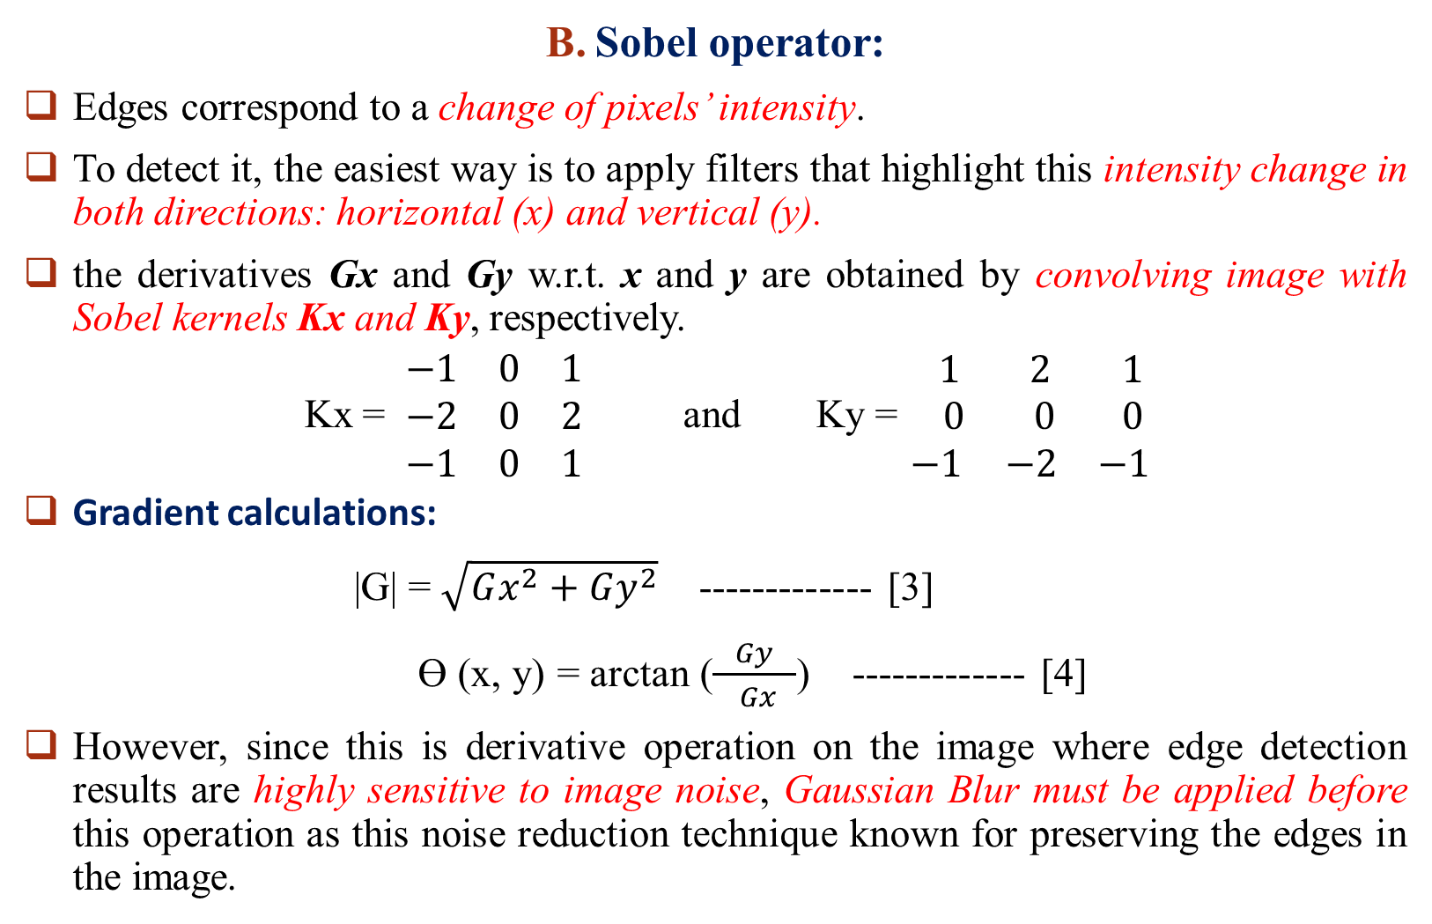
Sobel operator:
Edges correspond to a change of pixels’ intensity.
To detect it, the easiest way is to apply filters that highlight this intensity change in both directions: horizontal (x) and vertical (y).
the derivatives Gx and Gy w.r.t. x and y are obtained by convolving image with Sobel kernels Kx and Ky, respectively.
Kx = $\begin{matrix}−1 & 0 & 1 \\ −2 & 0 & 2 \\ −1 & 0 & 1\end{matrix}$ and Ky = $\begin{matrix} 1 & 2 & 1 \\ 0 & 0 & 0 \\ −1 & −2 & −1\end{matrix}$
Gradient calculations:
|G| = $\sqrt{Gx^{2}+Gy^{2}}$ ------------- [3]
ϴ (x, y) = arctan ($\frac{Gy}{ Gx }$) ------------- [4]
However, since this is derivative operation on the image where edge detection results are highly sensitive to image noise, Gaussian Blur must be applied before this operation as this noise reduction technique known for preserving the edges in the image.

Slide 8
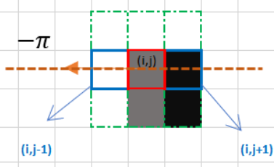
Non-maximum Suppression:
Thinning out the thicker edges.
Angle information calculated by the sobel operator is used.
Here we check basically if the pixels on the same edge direction are more or less intense than the ones being processed.
Double thresholding:
(Analysis by Trial and error)
The double threshold step aims at identifying 3 kinds of pixels: strong, weak, and non-relevant.
The result of this step is an image with only 2-pixel intensity values (strong and weak).

Slide 9
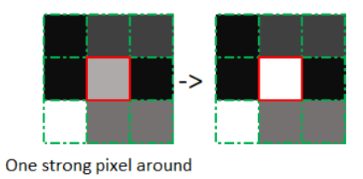
Edge Tracking by hysteresis
Based on the double thresholding results, the hysteresis consists of transforming weak pixels into strong ones, if and only if at least one of the pixels around the one being processed is a strong one.
Image Dilation:
Adds pixels at boundaries.
Increases the object area.
Used to accentuate features.
Working:
A kernel (a matrix of odd size (5,5) is convolved with the image
A pixel element in the original image is ‘1’ if at least one pixel under the kernel is ‘1’.
It increases the white region in the image or size of foreground object increases.

Slide 10
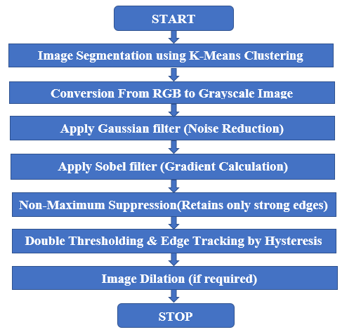
Implementation details:

Slide 11
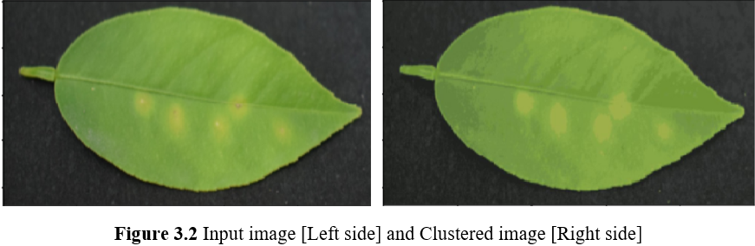
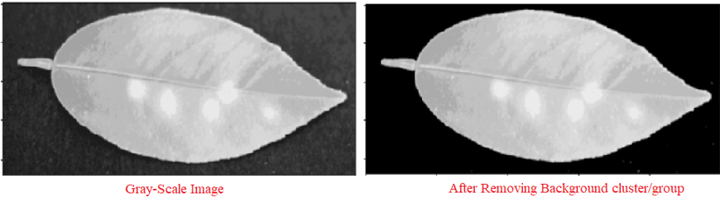
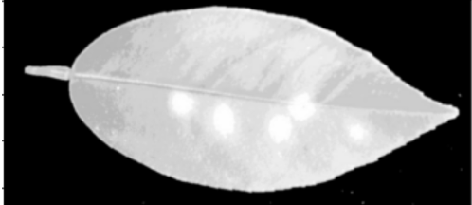
Image Segmentation using K-Means clustering:
Classified the image pixels into different no. of
Important groups so that all possibilities will be
considered and preserved by strong artificial edges.
Conversion from RGB to Grayscale Image:
Three channel RGB image is then converted to 1
channel Gray Scale image. Also, the background
noise (or cluster defining the background image)
is removed by Histogram analysis of clustered
image.
Noise reduction by applying Gaussian Blur
Mathematics involved in this edge detection method involves
the calculation of derivatives, it is highly sensitive to image noise.
Gaussian is known for preserving the edges in the image.

Slide 12
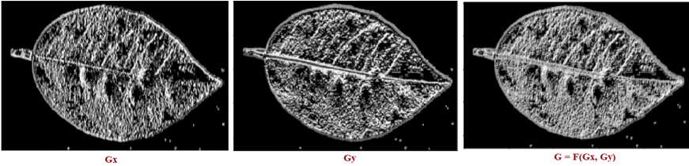
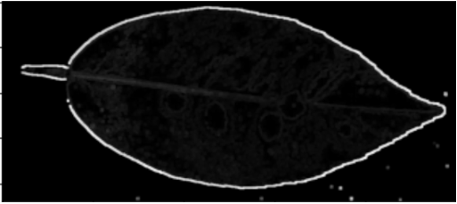
Gradient Calculation using Sobel Filter:
Gradient calculation is basically calculating the derivative of image which also means that detecting the high intensity value changes in the image. First gradient in x and y direction is calculated then merged together to form a magnitude image which contains every possible edge in the image.
Non-Maximum Suppression:
Edges are thinned out.

Slide 13
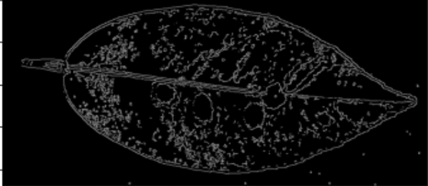
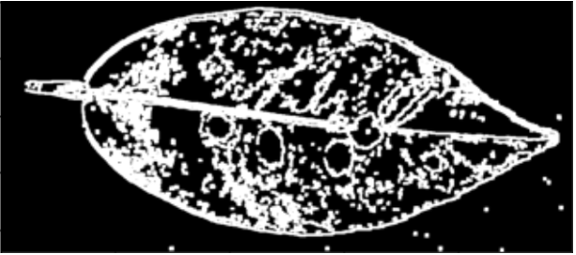
Double Thresholding and edge tracking by Hysteresis:
After non-maximum suppression we notice that still some pixels are brighter than others. The result of double thresholding is an image with only two-pixel values (strong and weak).
Using edge tracking by hysteresis, weak pixels are transformed into strong pixels if and only if it is surrounded by at least one strong pixel.
Image Dilation:
some deep learning methods may require thicker strong
edges which are thinned out at non-maximum separation stage.
Image dilation basically adds pixels at the boundaries/edges.

Slide 14
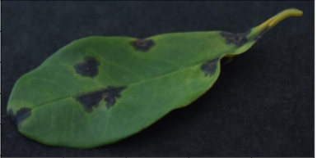
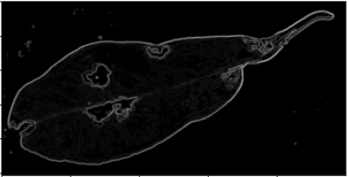
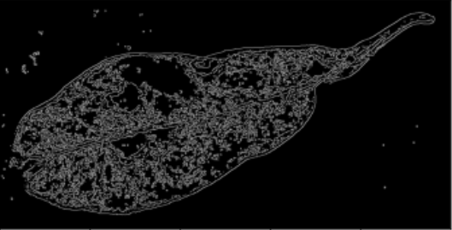
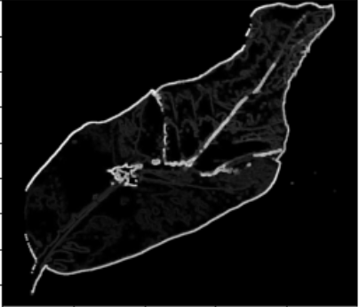
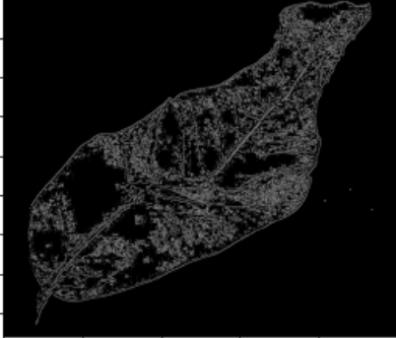
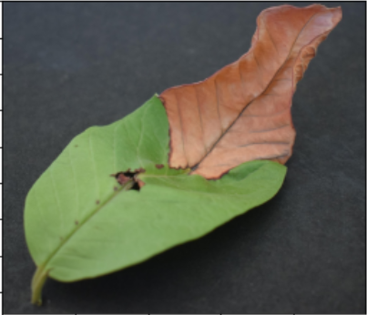
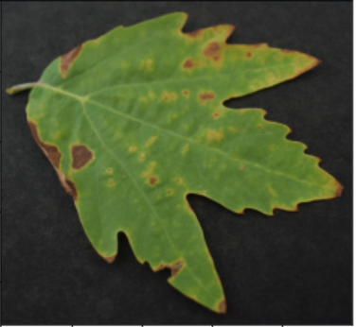
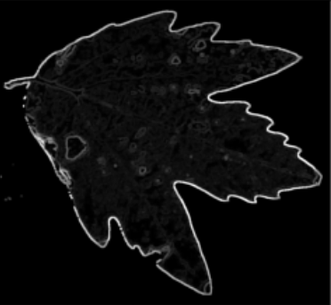
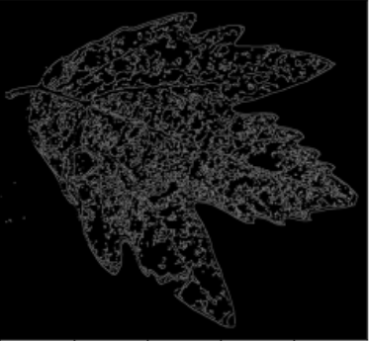
Results:
Better for Disease Better for Plant
detection task Classification task
(Just after non-max (After last step)
suppression)
Pomegranate Leaf
Guava Leaf
Chinar Leaf

Slide 15
Conclusion:
Experiments with different leaf images have shown that:
If image dilation is performed right after Non-Maximum Suppression without performing double thresholding & edge tracking by hysteresis then resultant output image is better suited for disease detection while other edge information (Leaf veins) for plant classification is lost.
On the other hand, if all the steps in algorithm are followed in order then resultant output image is better suited for plant classification as veins details are retained while disease information is lost.
This algorithm is better suited for image pre-processing of plant leaf images. The processed images can be used further by modern deep learning methods for better Plant classification as well as plant disease detection.

Slide 16
References
Plant Leaf Disease Detection using Mean Value of Pixels and Canny Edge Detector, Dr. S.M. Taohidul Islam, Md. Abdul Masud±, Md. Arif Ur Rahaman, Md. Mehedi Hasan Rabbi, 2019 International Conference on Sustainable Technologies for Industry 4.0 (STI), 24-25 December, Dhaka.
An Effective Algorithm for Edges and Veins Detection in Leaf Images, R. Radha, S. Jayalakshmi, 2014 World Congress on Computing and Communication Technologies.
Advanced Plant Leaf Classification Through Image Enhancement and Canny Edge Detection, Jibi G. Thanikkal1, Ashwani Kumar Dubey2, Thomas M.T.3, 2018 7th International Conference on Reliability, Infocom Technologies and Optimization (ICRITO) (Trends and Future Directions).
Data Set:
(https://data.mendeley.com/datasets/hb74ynkjcn/1).

Slide 17
Thank you!

