Slide 1
Fast and improved image compression technique using Huffman coding
By
Shrikant M. Patil
Under the guidance of
Prof. Aparna P.

Slide 2
Content
Huffman coding
Proposed Method
Implementation
Results and Conclusion
References

Slide 3
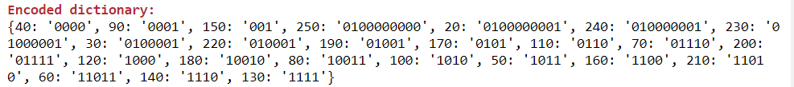
Huffman coding
Steps:
Build Frequency Dictionary:
Build Huffman Tree and assign codes to characters by traversing the tree from root :

Slide 4
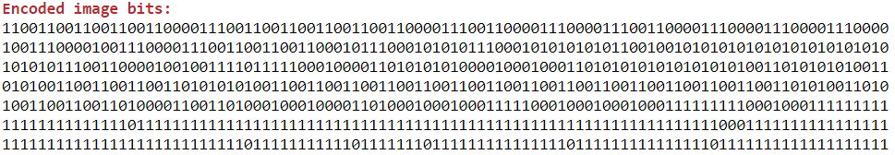
Encode the input file by replacing characters with its code and save it as binary (.bin) file :
For reconstruction:
Read the binary file and replace the valid Huffman codes with character values.

Slide 5
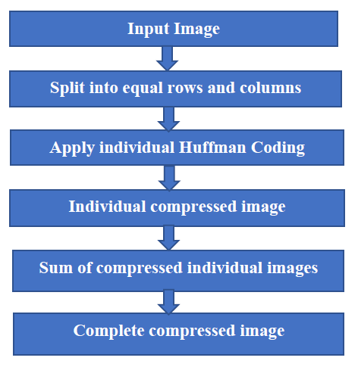
Proposed Method

Slide 6
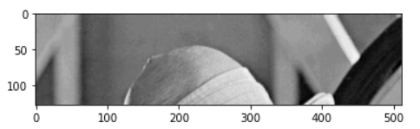
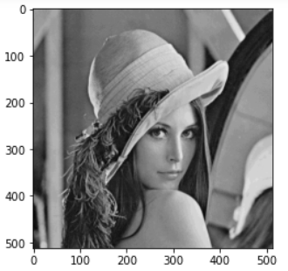
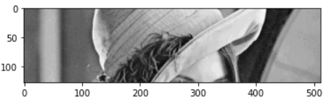
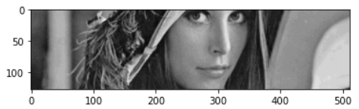
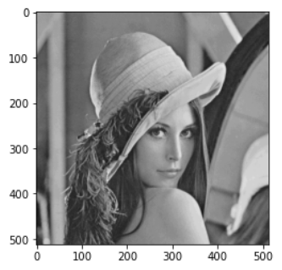
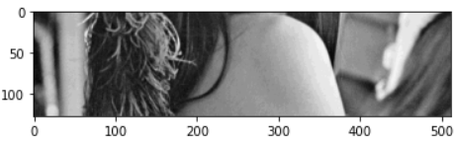
Implementation :
Input original image
Reconstructed image

Slide 7
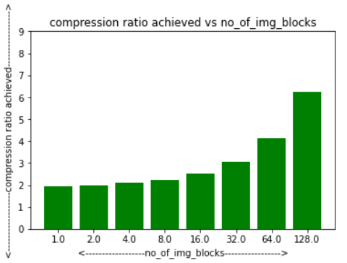
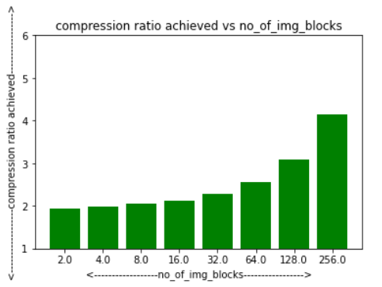
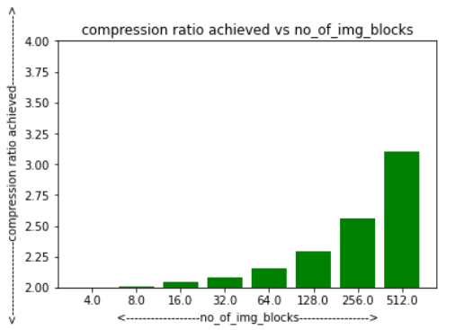
Results and conclusion
Effect of no. of blocks of
image on compression ratio
for images with different resolution:
256x256
512x512
1024x1024

Slide 8
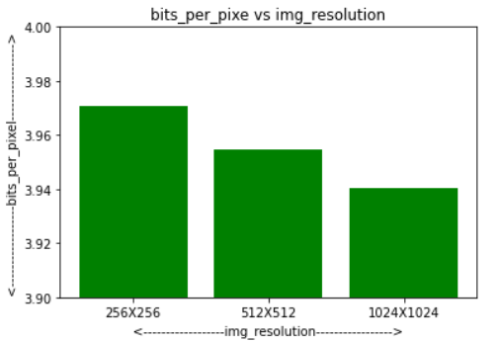
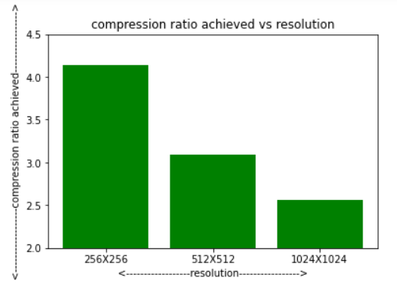
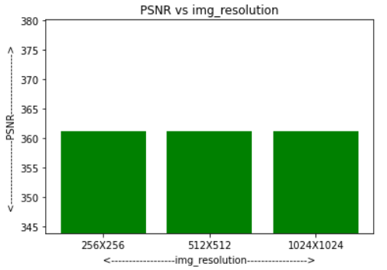
For Window size = 4

Slide 9
References
[1] A Fast and Improved Image Compression Technique Using Huffman Coding Rachit Patel, Virendra Kumar, Vaibhav Tyagi, Vishal Asthana, Department of ECE ABES-IT, Ghaziabad, India. presented at the IEEE Wisp NET 2016 conference.

Slide 10
Thank You!

