Slide 1
ARC MICROGRANT SUBMISSION
THELEMA
Trade the impact. Not just the odds.
Conditional synthetic prediction markets deployed on Arc Testnet, powered by The Graph decentralized gateway consensus and Chainlink CRE confidential workflows.
Arc Testnet (Chain ID 5042002) | The Graph (Messari Schema) | Chainlink CRE (WASM) | 100% Solvency Vaults

Slide 2
THE PROBLEM
Prediction Markets Predict Odds, Not Consequences
Binary Markets Today (e.g. Polymarket)
• Binary $1 / $0 Payout:
Tells you if policy passes, but zero information on economic impact.
• No Asset Pricing:
Cannot price how Nvidia, semiconductor equities, or commodities react to the decision.
• Speculative Only:
Investors cannot use binary outcome tokens to hedge physical portfolio exposure.
What Capital Actually Needs (THELEMA)
• Conditional Synthetic Assets:
Trade outcome-contingent shares: sNVDA if policy passes vs sNVDA if policy fails.
• Quantified Price Impact:
Derives Δ Impact = E[S | YES] − E[S | NO] directly from continuous AMM pool reserves.
• True Portfolio Hedging:
Holders of physical stocks or treasuries can hedge regulatory risk with mathematical certainty.

Slide 3
THE PRICING MECHANISM
Same Asset. Different Futures. Four Verified Numbers.
EVENT PROBABILITY
54.7%
P(event)
Binary YES pool midprice
ASSET IF YES
$212.92
E[S | YES]
Conditional price if allowed
ASSET IF NO
$96.46
E[S | NO]
Conditional price if restricted
CONDITIONAL IMPACT
+$116.47
Δ Impact
YES world minus NO world
The Pricing Identity & Solvency Guarantee:
P × E[S | YES] + (1 − P) × E[S | NO] = Implied Spot Index ($160.21)
Mathematical Vault Solvency: Depositing collateral mints complete sets: Y + N + R capped at $500. Winning asset shares pay min(index, cap); losing pays 0; residual R pays max(0, cap − min(index, cap)). Collateral is 100% conserved.

Slide 4
INFRASTRUCTURE & SPONSOR TRACKS
Three Rigorous Integrations Built from Scratch
Arc Testnet
Best Stablecoin-Native DeFi Pool
• 6 Smart Contracts Active: BinaryAMM, ShareAMM, Vaults, and DemoOracle.
• Native USDC Precompile (0x3600...): Direct 6-decimal collateral and native gas.
• Live On-Chain Trade: 1.00 USDC demo trade executed & confirmed on Arcscan in block 61728406.
• Zero Mocked State: Verified bytecode, balances, and nonces on Chain ID 5042002.
The Graph
Messari Standardized Schema
• Cross-Protocol Engine: Queries Uniswap V3 and SushiSwap pools on Arbitrum One.
• Standardized Messari DEX Schema: Normalized fields across different DEX protocols.
• Real-Time Spread Consensus: Verifies pools agree within 0.25% spread (threshold 1.5%).
• Decentralized Gateway: Server-side queries keep production keys out of client bundle.
Chainlink CRE
Confidential Workflows
• Confidential Size Clipping: Hides order notional inside TEE to prevent front-running.
• WASM Policy Compilation: Pure TypeScript policy compiled to standalone WebAssembly.
• Official CLI Simulation: Tested via Chainlink CRE CLI simulator (halted at network boundary).
• Honest Grant Reporting: Production contract standby pending organization deploy access.

Slide 5
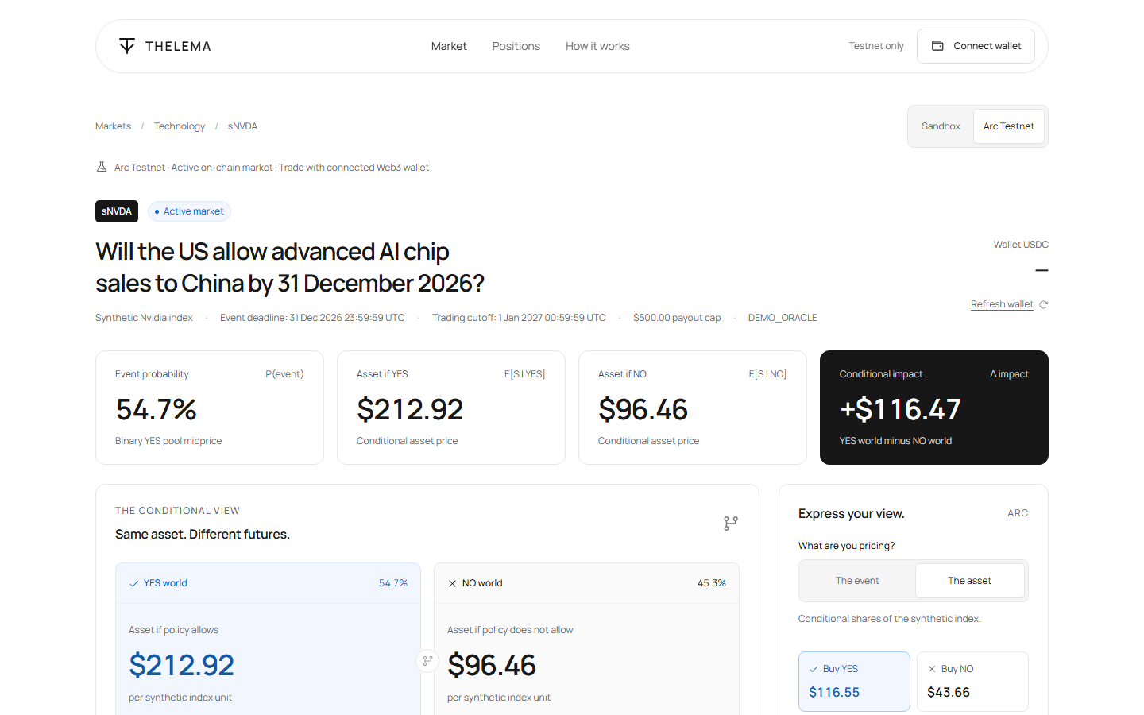
LIVE PRODUCT DEMONSTRATION
Active On-Chain Prediction Market on Arc Testnet
Market Parameters & Features
Target Market:
Will the US allow advanced AI chip sales to China by 31 Dec 2026?
Active Trading Window:
Event deadline: 31 Dec 2026 | Trading cutoff: 1 Jan 2027.
Real Web3 Wallet Integration:
Connects MetaMask on Chain ID 5042002. Displays live on-chain token balances.
Automated Quotation:
Calculates precise 30 bps LP fee, price impact, and minimum shares received.
One-Click Execution:
Direct smart contract interactions without custodial intermediaries.

Slide 6
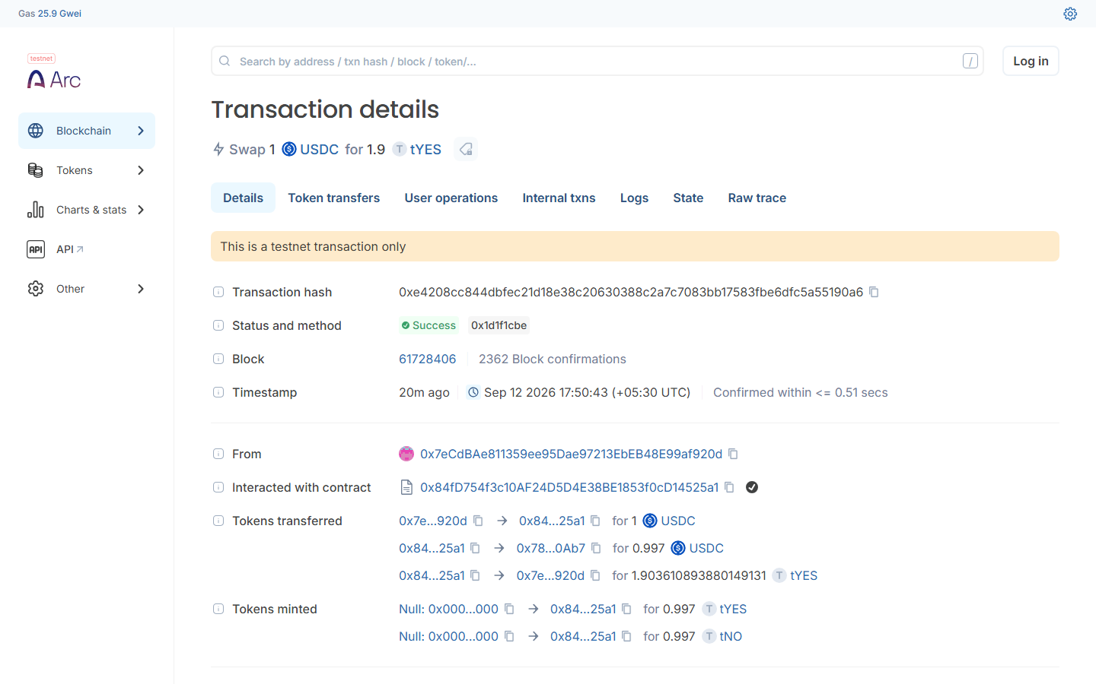
ON-CHAIN PROOF & AUDIT
Verified Demonstration Trade & Spending Reconciliation
Trade Proof & Holdings
Trade Hash:
0xe4208cc844dbfec21d18e38c20630388c2a7c7083bb17583fbe6dfc5a55190a6
Mined Block:
Block 61728406 on Arc Testnet (Success).
Swap Execution:
Deposited 1.000000 USDC -> Received 1.903611 tYES tokens.
Verified On-Chain Holdings:
11.9036 tYES, 10.0000 tNO, 0.1000 R.
Audited Spending Ceiling:
Total spent: 173.707142 USDC <= 180.000000 USDC ceiling. Balance: 22.292857 USDC.

Slide 7
CONCLUSION
The Next Generation of Prediction Markets
100% Verified Quality
• 238 core unit & integration tests passing.
• 24 Foundry Solidity invariant tests passing.
• 18 Playwright end-to-end browser tests passing.
• Green GitHub Actions CI on every commit.
Live & Deployed
• Active on-chain contracts on Arc Testnet.
• Native 6-decimal USDC collateral & gas precompile.
• Live hosted application on Render.
• Real-time The Graph decentralized reference feeds.
Future Roadmap
• Deploy live CRE TEE workflows once org access opens.
• Expand to macro tariffs, interest rates & chip governance.
• Permissionless creation of custom impact pairs.
• Institutional hedging integrations.
Live Hosted Application: thelema.onrender.com | GitHub Repository: github.com/ShrikarT/thelema

