Slide 1


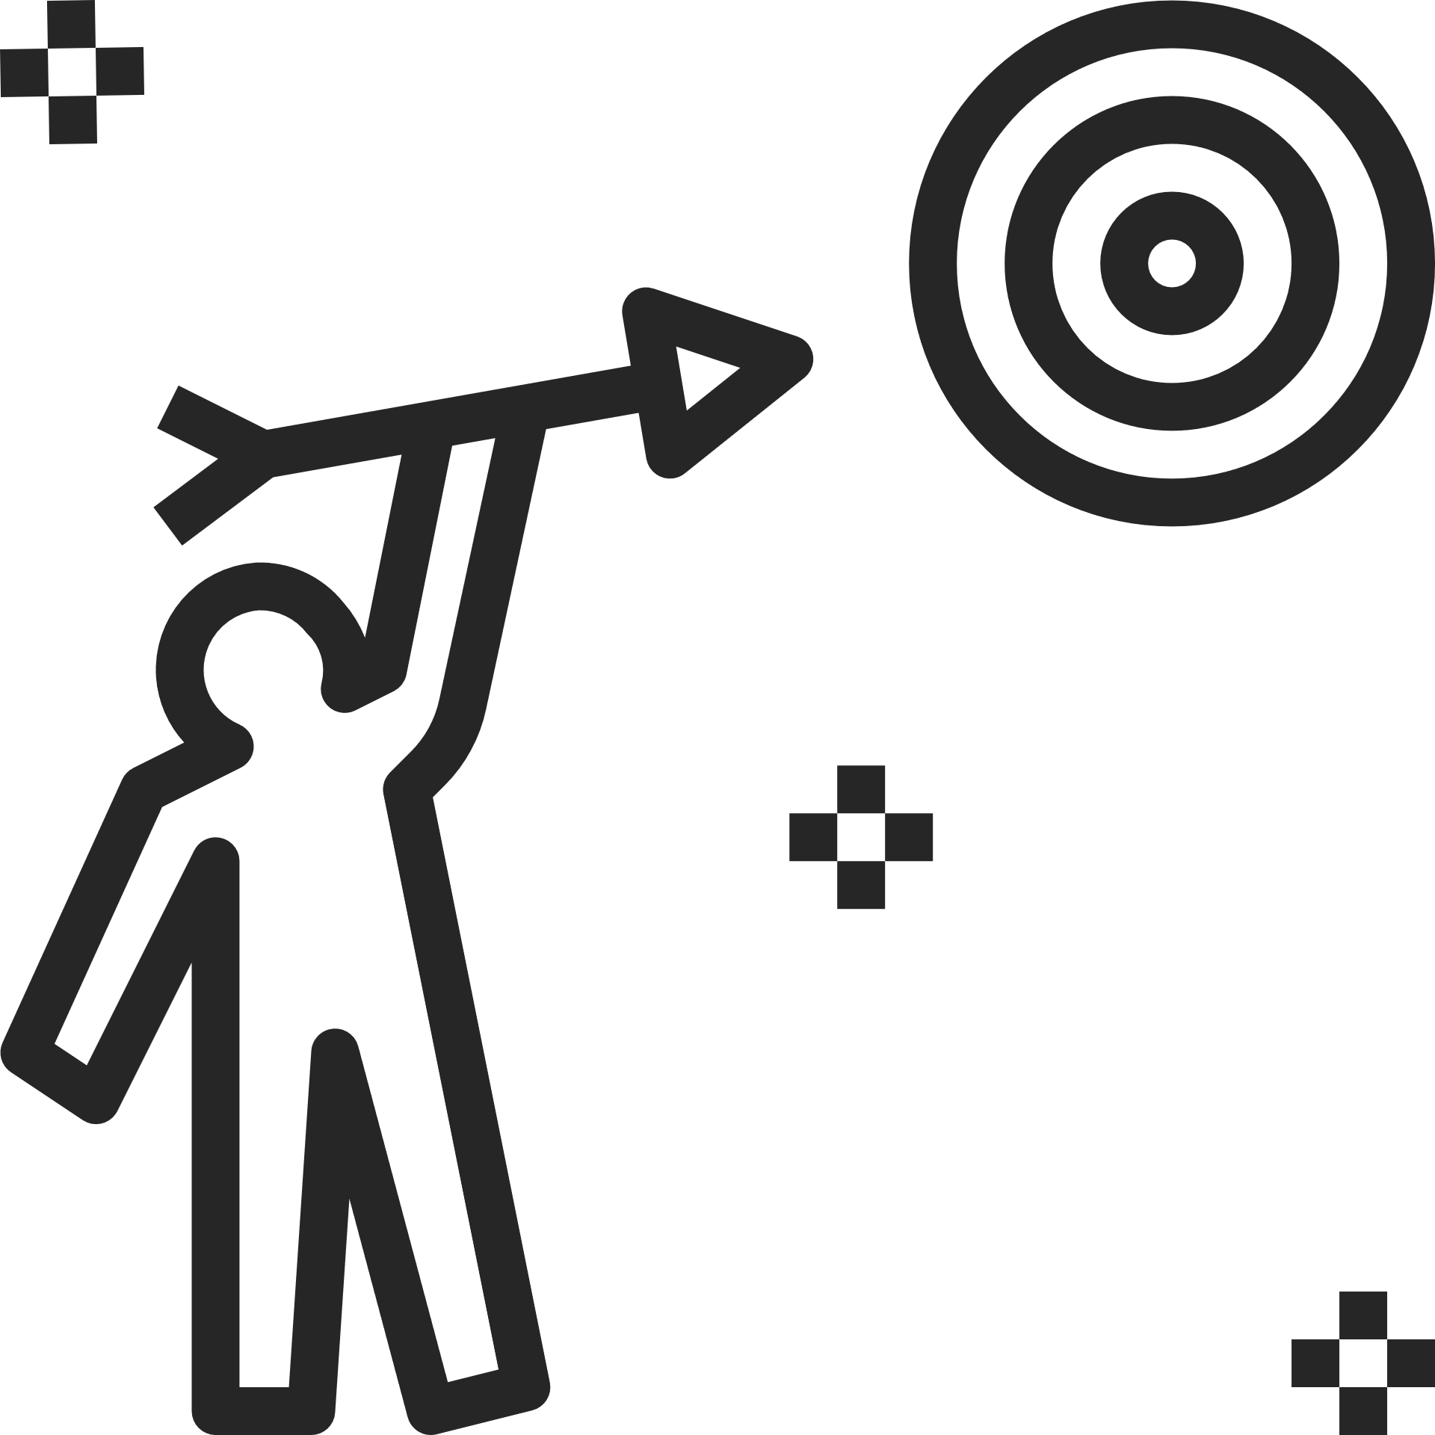



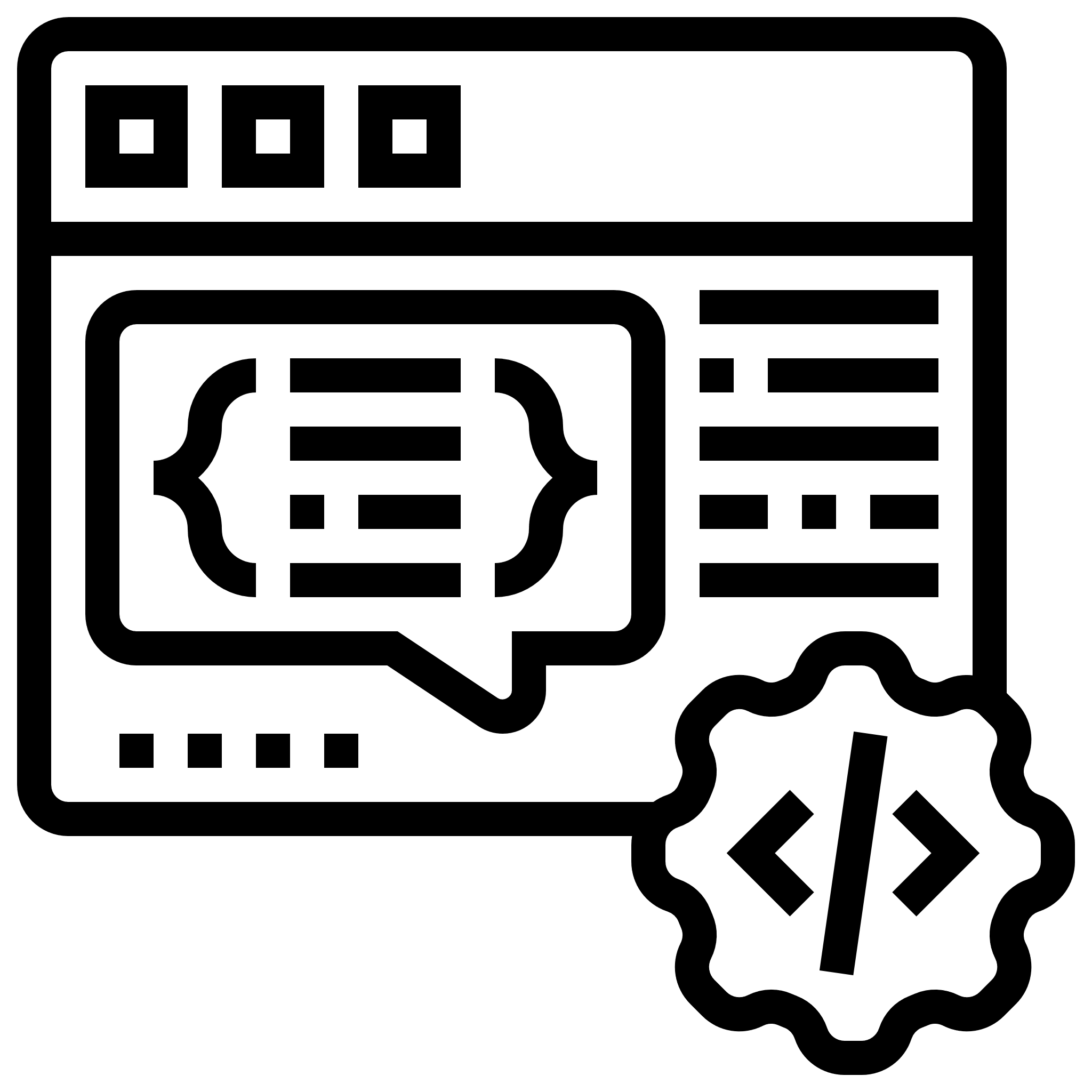
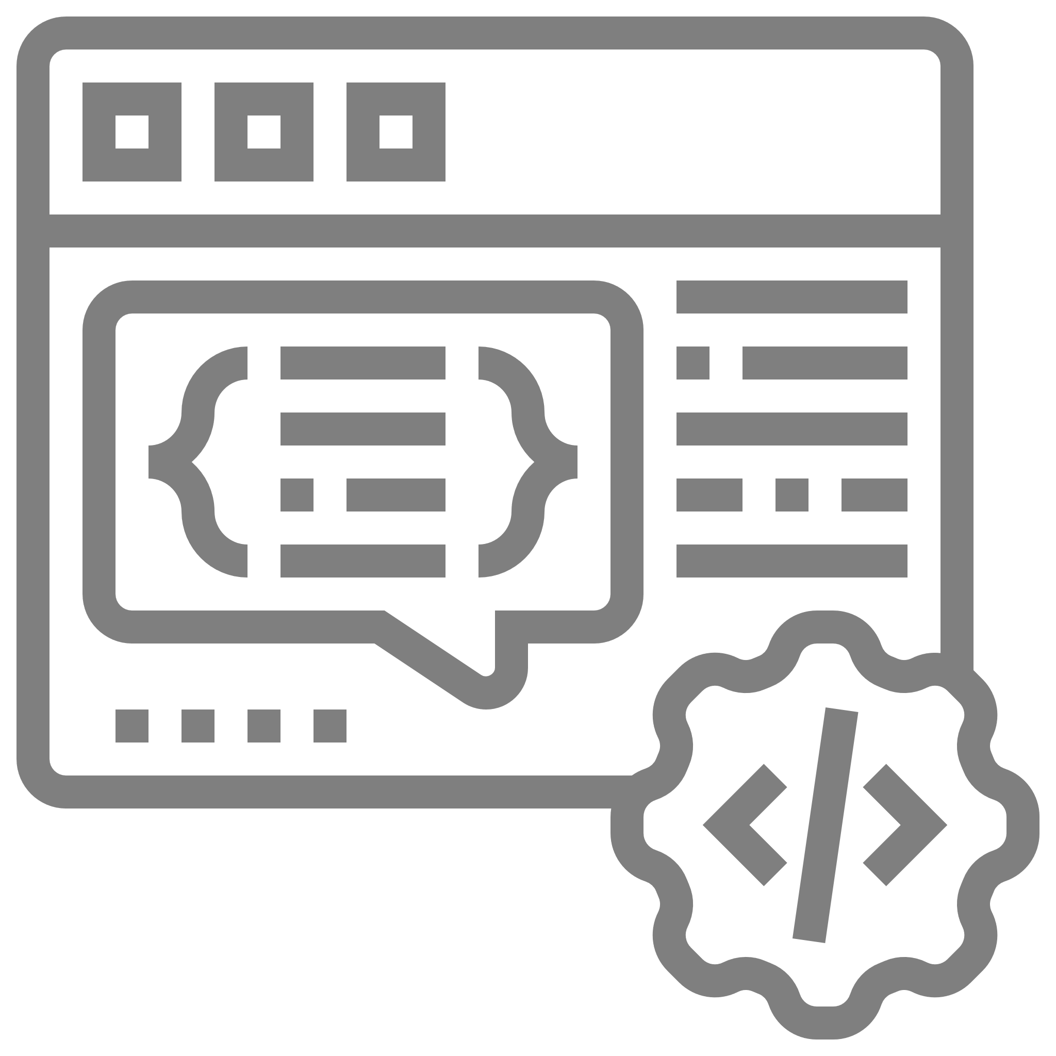


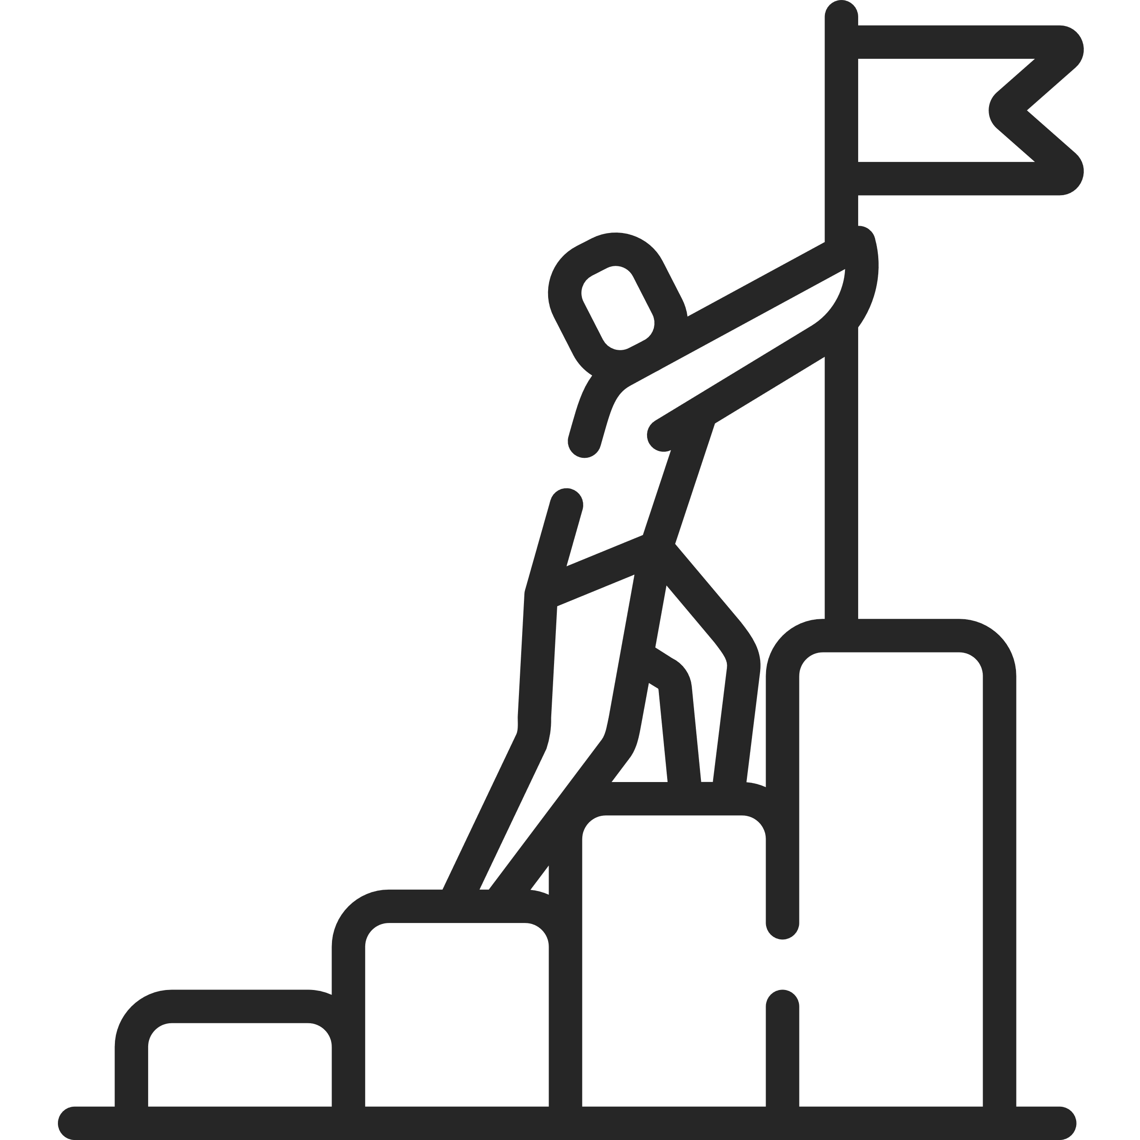



HAND GESTURE RECOGNITION USING ARTIFICIAL INTELLIGENCE
K.L.N. College Of Information Technology
TEAM MEMBERS :
SHRIKARAN K - 910717104049
SRINIDHI S - 910717104053
THIRUMALINI H – 910717104062
INTERNAL GUIDE :
T.T. MATHANGI, AP/CSE.

Slide 2


PROJECT OBEJECTIVE
To Train a Dataset.
By Trained Dataset, to sense gesture of hand.
Manipulate the sensing gesture of hand.
Provide appropriate control for gesture.
By the gesture to control Media player.

Slide 3
Introduction
The Artificial Intelligence project in which user will be able to control computer using hand gestures with computer vision techniques.
In this project, the python programming is done with Jupyter Notebook.
The package used to manipulate various functions are Keras, Pandas, NumPy, Matplotlib.
The concepts referred - Data Augmentation, CNN, Resnet and stochastic gradient descent with momentum.

Slide 4
Project Overview
Existing System :
The Existing System possess gesture of four using GNU Octave and Gradient Descent. The Gradient Descent is the most common optimization algorithm and the foundation of how we train an machine learning model. but it can be really slow for larger dataset.
Proposed System :
To make the algorithm much more faster, the Stochastic Gradient Descent with momentum is introduce to work on larger dataset.
Problem Definition :
To Train twenty-seven gesture using Stochastic Gradient Descent Algorithm.

Slide 5
Software and Hardware Requirements
Software Requirements :
Python 3.8.4
Jupyter Notebook from Anaconda Distribution
Visual Studio Code - version : 1.52.0 (system setup)
Hardware Requirement :
Processor – AMD Ryzen 5 (4000 series)
Graphic Memory – NVIDIA GeForce GTX 1650 Ti
RAM – 8 GB (3200 MHz)
Web Camera

Slide 6

Goals for Next Review
To Manipulate the data provide on dataloader.py
To Resolve bug on ImageDataGenerator() class on Train.py to refine data frames.
To Complete Classification.py in order to categorize the gesture of hand from dataset to get desired output.

Slide 7

Reference
Gavril Ognjanovski- Build Hand Gesture Recognition from Scratch using Neural Network — Machine Learning Easy and Fun | by Gavril Ognjanovski | Towards Data Science
Raghavendra Kotikalapudi -
GitHub - raghakot/keras-resnet: Residual networks implementation using Keras-1.0 functional API
Towards Differentiable Neural Architecture (raghakot.github.io)

