Slide 1

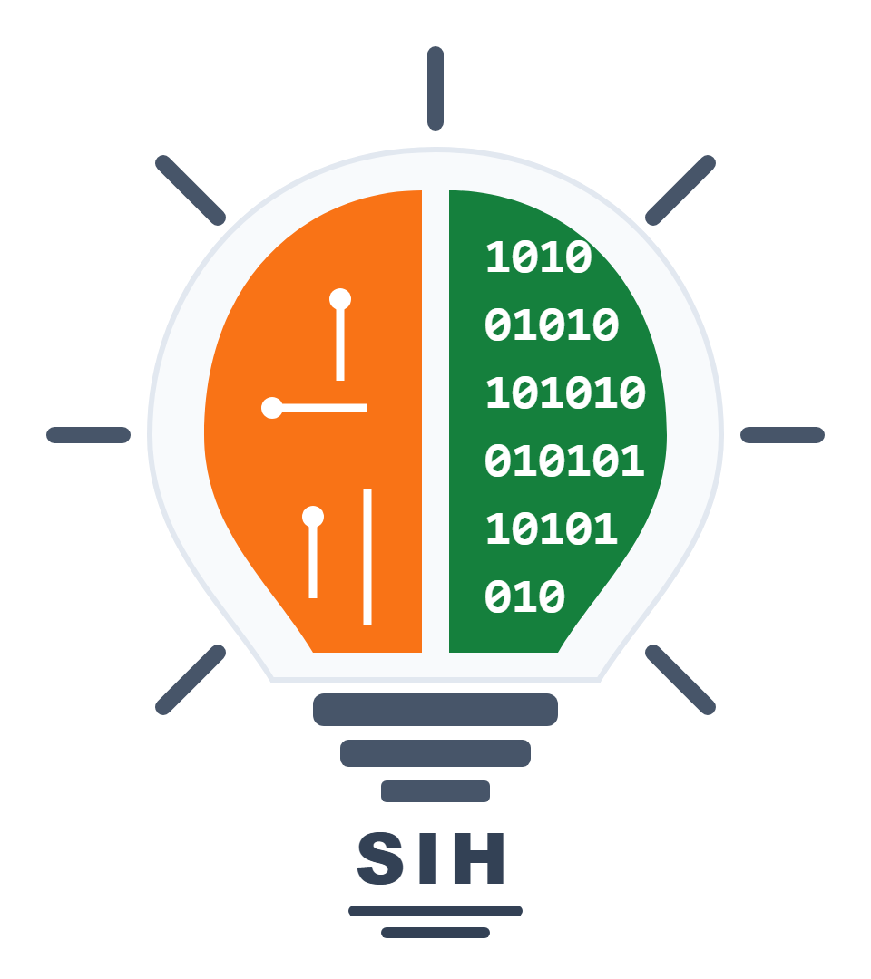
SMART INDIA HACKATHON 2025
TITLE PAGE
• Problem Statement ID – SIH26195
• Problem Statement Title- Digital Preservation, AI-Powered Paleography and Interactive 3D WebGIS Atlas for Indian Cultural Heritage, Monuments & Ancient Manuscripts. (Centres to be concentrated: National Archives, ASI Sites, Craft Clusters)
• Theme- Heritage & Culture
• PS Category- Software
• Team ID- 57385
• Team Name- Sanskriti RakshaX
1

Slide 2
Team
Sanskriti RakshaX
IDEA TITLE
❖ Proposed Solution:
• 3D Archival & Artifact Studio : 360° interactive rotation, dynamic lighting & sub-millimeter zoom inspection for sculptures.
• Ancient Manuscript Paleography : AI decipherment of fragile palm-leaf (Talapatra) & birch-bark scripts with Sanskrit audio.
• Multimodal AI Heritage Guide : Voice, vision, and multilingual conversational assistance grounded in verified archives.
• Computer Vision Iconography Scanner : Identifies dynastic art styles, postures (asanas), mudras, and motifs from photos.
• Chronological Epoch Explorer : Interactive 11-epoch historical timeline spanning 5,000+ years of civilizational heritage.
• Interactive Heritage Web-GIS Atlas : Dynamic platform for exploring monuments, excavations, and conservation zones.
• GI Artisan Marketplace & Livelihood : Direct fair-trade connect supporting GI-certified traditional master artisan cooperatives.
• Sustainable Tourism & Itinerary AI : Eco-friendly tour planner dispersing crowds away from overtouristed monuments.
• GI Tagging and E-Signature : To preserve cultural heritage, safeguard traditional products and paperless approval.
Login
▼
User Login
Govt Login
▼
▼
User Dashboard
Ministry Of Culture
ASI Depts.
NMM & Archives
▼
▼
Artifact Search
Government Dashboard
▼
▼
3D Studio & OCR
Document Verification
▼
▼
AI Guide & Voice
Spatial & Epigraphic Verification
▼
▼
Artisan Connect
Approve/Publish Exhibit
▼
▼
Feedback & Support
Update Heritage Atlas
▼
Generate Reports
▼
VirasatX Central Heritage Atlas + DSS
2

Slide 3
Team
Sanskriti RakshaX
TECHNICAL APPROACH
• Data Extraction: Optical Character Recognition (OCR), NLP, Vision Transformers.
• WebGIS platform: Leaflet.js & OpenLayers (for interactive maps).
• Asset Mapping: Random Forest & CNN (for motif & iconography classification).
• Data Storage: PostgreSQL & PostGIS (for geospatial data).
• Data Management: Cloud Object Storage & MySQL (Structured metadata).
• GeoServer: Use standard protocols WMS and WFS to serve maps.
• Decision Support System: For tourist dispersal & scheme recommendations.
• Blockchain based Security: Hyperledger Fabric (for digital provenance & GI).
• Key Lock Framework: Open-source Identity & Access Management.
• Rasa / RAG AI: Preferred for its offline, multilingual, and secure chatbot.
🌐 Web / Mobile Browser
▼
Frontend Layer (HTML5, CSS, JS, Leaflet.js, Three.js, React 19)
▲ Request ▼ Response
Backend (API Gateway / Node.js)
▼
GIS Module (GeoServer/Leaflet)
AI/ML Core (CNN & Paleography)
Blockchain (Hyperledger Fabric)
▼
Data Storage: PostgreSQL + PostGIS | Cloud Object Storage | MySQL
🏛️ VirasatX Digital Heritage Portal (Draft Live Prototype)
[ Navigation: 3D Studio | Manuscripts | Heritage Map | AI Curatorial Guide ] • 3D Canvas: 360° rotation, real-time lighting simulation, sub-mm loupe. • AI Sidecar: Grounded RAG citations with ancient script transcription.
User Interface: It is a draft version, subject to future updates.
Integration: Satellite APIs | Government APIs | Decision Support System
Security: Blockchain, JSON Web Tokens, AES-256 & RSA Encryption
3

Slide 4
Team
Sanskriti RakshaX
FEASIBILITY AND VIABILITY
❖ Feasibility:
1. Technical Feasibility:
1. Digitization, AI Mapping and Web-GIS Dashboards:
• OCR and AI extract data from fragile ancient manuscripts.
• Web-GIS dashboards show real-time interactive heritage maps.
2. DSS Integration with Blockchain Security:
• AI engines match cultural schemes to community needs.
• Blockchain ensures secure, tamper-proof digital records.
2. Operational Feasibility:
1. Existing Setup and Simple Staff Training:
• Museum and archival data exists, needs unified connection.
• Staff need basic training through short workshops.
2. Stakeholder Support and Effective Implementation:
• Ministries and cultural NGOs already support heritage preservation.
• System strengthens efforts, not replacing existing work.
3. Legal & Ethical Feasibility:
1. Data Privacy:
• Must follow India’s DPDP Act, ensuring legal compliance.
• Blockchain and encryption safeguard sensitive user data.
2. Consent Mechanism:
• Holders' informed consent required in all processes.
• Real-time feedback enables secure two-way communication.
❖ Viability:
1. Economic Viability:
1. Cost-Effective & Efficient:
• Saves paperwork, effort, duplication, and reduces physical wear.
• Cuts processing delays, expenses, and operational overhead.
2. Supported & Scalable Technology:
• Backed by government programs and cultural inclusion schemes.
• Open-source tech ensures flexible, low-cost, future-ready deployment.
2. Social Viability:
1. Empowers Communities & Improves Scheme Access:
• Provides transparency, secure records, and better documentation.
• Directly benefits artisan cooperatives through market access.
2. Reduces Conflict & Promotes Stronger Inclusion:
• Verified records, citations reduce frequent historical disputes.
• Mobile updates, two-way communication improve engagement.
3. Scalability:
1. Pan-India Expansion for Wider Community Benefits:
• Pilot in districts & ASI circles, then scale across India.
• Adjust platform easily for local data and regional dialects.
2. Cross-Sector Use of WebGIS + DSS:
• Adaptable for archaeology, urban heritage planning needs.
• Useful in disaster management and post-crisis restoration.
4

Slide 5
Team
Sanskriti RakshaX
IMPACT AND BENEFITS
❖ Benefits:
1. Social Benefits:
• Digital platform enables communities with interactive heritage learning.
• IVR helpline, e-learning ensure inclusive literacy access.
• Transparent records, video testimonies reduce conflict, build trust.
2. Environmental Benefits:
• Sustainable tourism through AI crowd dispersal around monuments.
• Conservation through community stewardship and digital archiving.
• GI Tagging preserves cultural heritage & traditional handicraft products.
3. Economic Benefits:
• Access to schemes (Heritage City Development, PRASHAD, Swadesh Darshan).
• GI Tagging boosts local artisanal products & tribal livelihoods.
• Direct artisan connection ensures secure economic stability -> fair wages.
4. Governance Benefits:
• Audit trails ensure curatorial accountability, prevent misuse.
• Whistleblowing/review portal boosts transparency, fights illicit trade.
• Cross-validation stops duplication and fraudulent claims.
5. Legal & Security Benefits:
• E-Signature & Digital Records provide legally valid provenance records.
• Protection against unauthorized duplication (Illegal Practice Alert).
• Digital witness/testimony ensures fair dispute settlement.
❖ Impacts:
1. Secure Cultural Rights & Transparency:
• Communities track claims and archival data, reducing neglect.
• Digital records ensure authenticity in museum cataloging.
• Builds trust between citizens, scholars, and government authorities.
2. Heritage Protection & Conservation with AI:
• AI monitors physical & digital assets to prevent loss and decay.
• Conserves ancient knowledge and safeguards rare manuscripts.
• Promotes sustainable, community-driven cultural resource management.
3. Boost Livelihoods & Local Development:
• Resource planning improves incomes and rural handicraft economy.
• GI tagging protects heritage, boosts local products internationally.
• VirasatX enables fair access to national cultural welfare schemes.
4. Digital, Eco-Friendly & Cost Effective:
• Reduces paperwork, ensuring greener, eco-friendly e-governance.
• Preserves tribal & traditional knowledge through digital archiving tools.
• Lowers administrative costs and increases curatorial efficiency.
5. Smart, Transparent & Scalable Governance:
• Transparent dashboards track digitization performance and visitor engagement.
• AI dispute mediation ensures fairness, reduces subjective human bias.
• Unified digital platform enables future-ready, pan-India expansion.
5

Slide 6
Team
Sanskriti RakshaX
RESEARCH AND REFERENCES
1. Archaeological Survey of India (ASI) & National Heritage Portals:
The Archaeological Survey of India (ASI) and Ministry of Culture govern the protection and documentation of cultural heritage monuments, ancient inscriptions, and archaeological excavations.
https://asi.nic.in/ | https://asi.nic.in/epigraphy/
2. National Mission for Manuscripts (NMM) & Paleography Standards:
Established by Ministry of Culture to unearth, preserve, and digitally catalog India’s vast manuscript heritage (Talapatra, Bhojpatra) and ancient epigraphy.
https://www.namami.gov.in/ | https://ignca.gov.in/
3. Best Practices for Web Security & Cryptographic Integrity:
This framework outlines key web security measures, DPDP Act 2023 compliance, and verifiable tamper-proof records using Blockchain & Encryption Standards.
https://owasp.org/www-project-top-ten/ | https://www.meity.gov.in/data-protection-framework
4. The AMASR Act 1958 & GI Registry:
The Ancient Monuments and Archaeological Sites and Remains Act (1958 & 2010) and Geographical Indications of Goods Act (1999) safeguarding cultural heritage & traditional artisan products.
https://indiacode.nic.in/handle/123456789/1631 | https://ipindia.gov.in/geographical-indications.htm
To enable smooth implementation and integration of the VirasatX System, the following contacts serve as official national-level resources for communication, data coordination, and support:
5. Ministry of Culture: https://indiaculture.gov.in/ | secy-culture@nic.in
6. National Museum, New Delhi: https://nationalmuseumindia.gov.in/
7. National Archives of India: https://www.abhilekh-patal.in/
8. UNESCO World Heritage Centre: https://whc.unesco.org/en/statesparties/in
6

