Slide 1

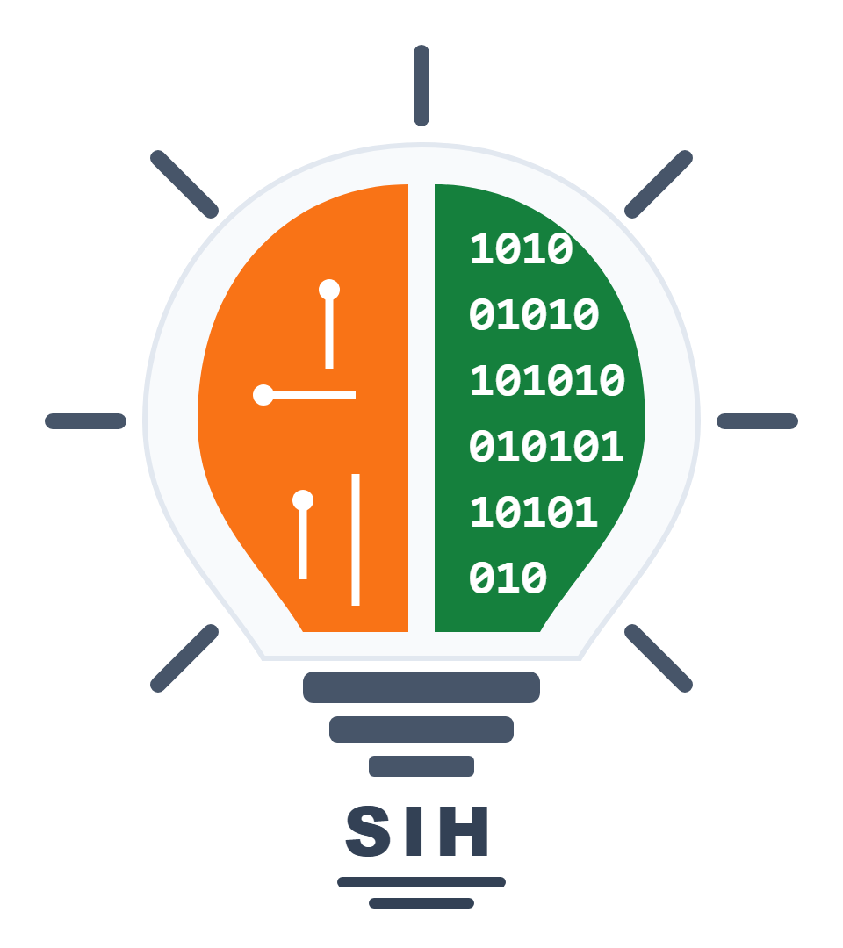
SMART INDIA HACKATHON 2026
TITLE PAGE
• Problem Statement ID – SIH26197
• Problem Statement Title- Student Innovation—Ideas that showcase the rich cultural heritage and traditions of India
• Theme- Heritage & Culture
• PS Category- Software
• Team ID- 57385
• Team Name (Registered on portal) Team VirasatX

Slide 2
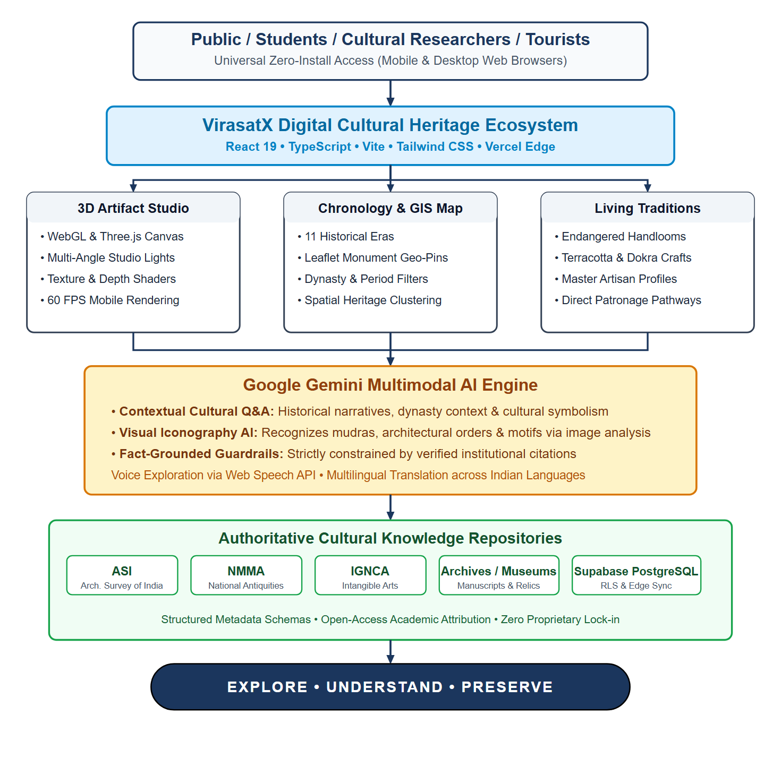
Team
VirasatX
IDEA TITLE: VIRASATX
❖ Proposed Solution (Describe your Idea/Solution/Prototype):
• Detailed explanation of the proposed solution
• Unified Cultural Ecosystem: VirasatX connects monuments, 3D artifacts, living traditions, timelines, and regional geography into one cohesive, discoverable experience.
• Multi-Modal Exploration: Interactive Three.js WebGL 3D artifact studio, 11-period chronological timeline, Leaflet GIS heritage mapping, and living artisan craft profiles.
• Google Gemini Multimodal AI: Contextual conversational cultural Q&A and visual iconography AI analyzing motifs, mudras, and architectural orders with fact-grounded guardrails.
• How it addresses the problem
• Synthesizes Fragmented Archives: Overcomes isolated, disconnected heritage archives by linking assets across historical epochs and geographic regions into an intuitive discovery graph.
• Bridges Cultural Context Gap: Transitions users from passive browsing to deep civilizational context (Dynasty → Period → Artisan Technique → Architectural Symbolism).
• Elevates Endangered Traditions: Provides dedicated digital visibility and direct patronage pathways for endangered craft forms, folklore, and master artisans.
• Innovation and uniqueness of the solution
• Context-First Philosophy: “VirasatX connects the cultural context around heritage — not just isolated artifacts or 3D models.”
• Interconnected Discovery Chain: Artifact → Story → Period → Place → Tradition → Community → Active Learning & Patronage.
@SIH Idea submission- Template
2

Slide 3
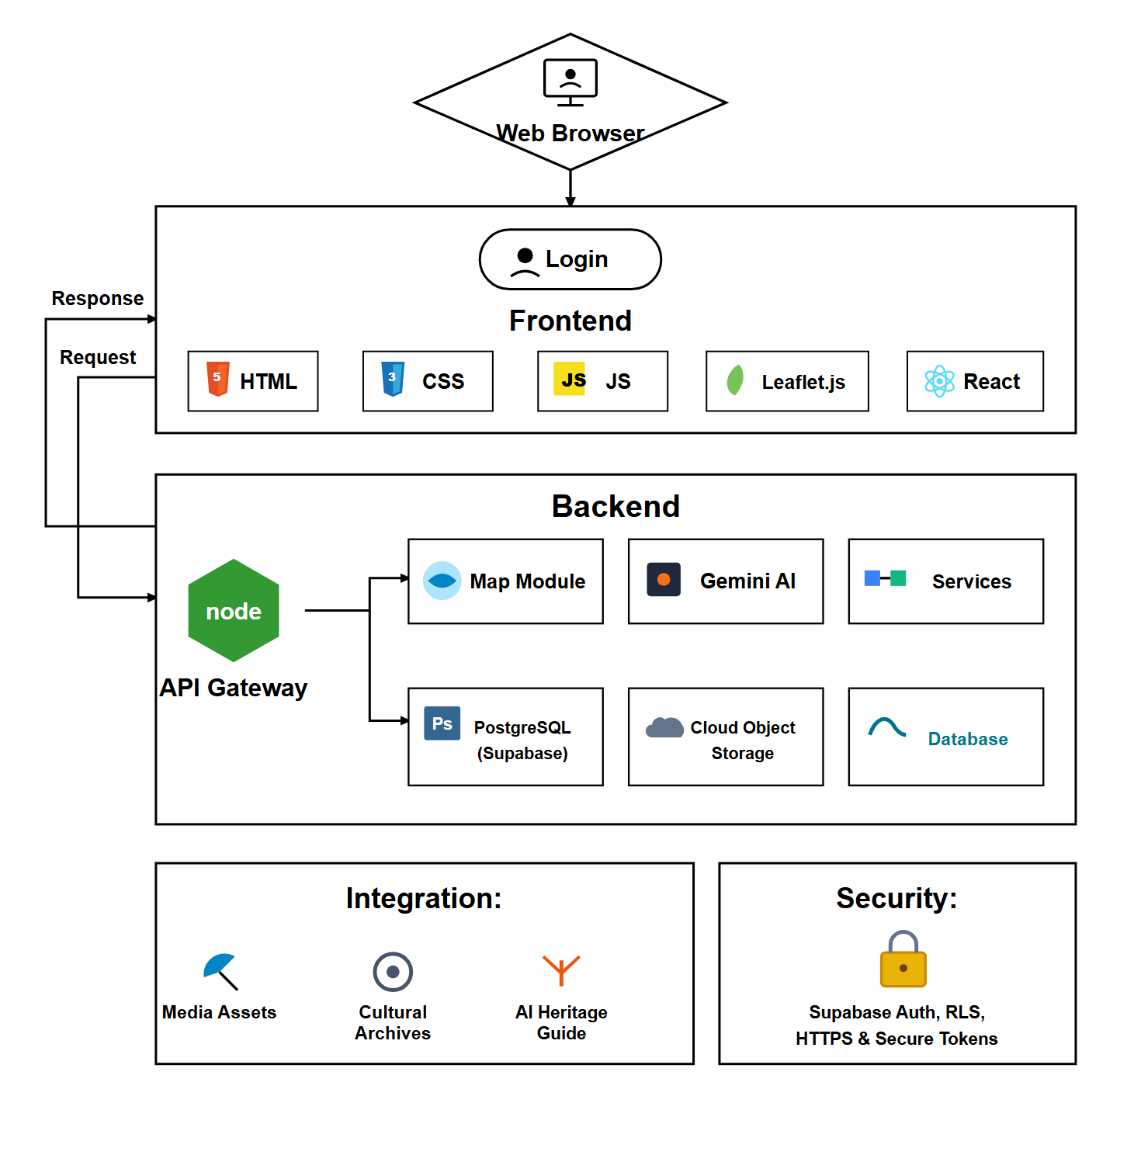
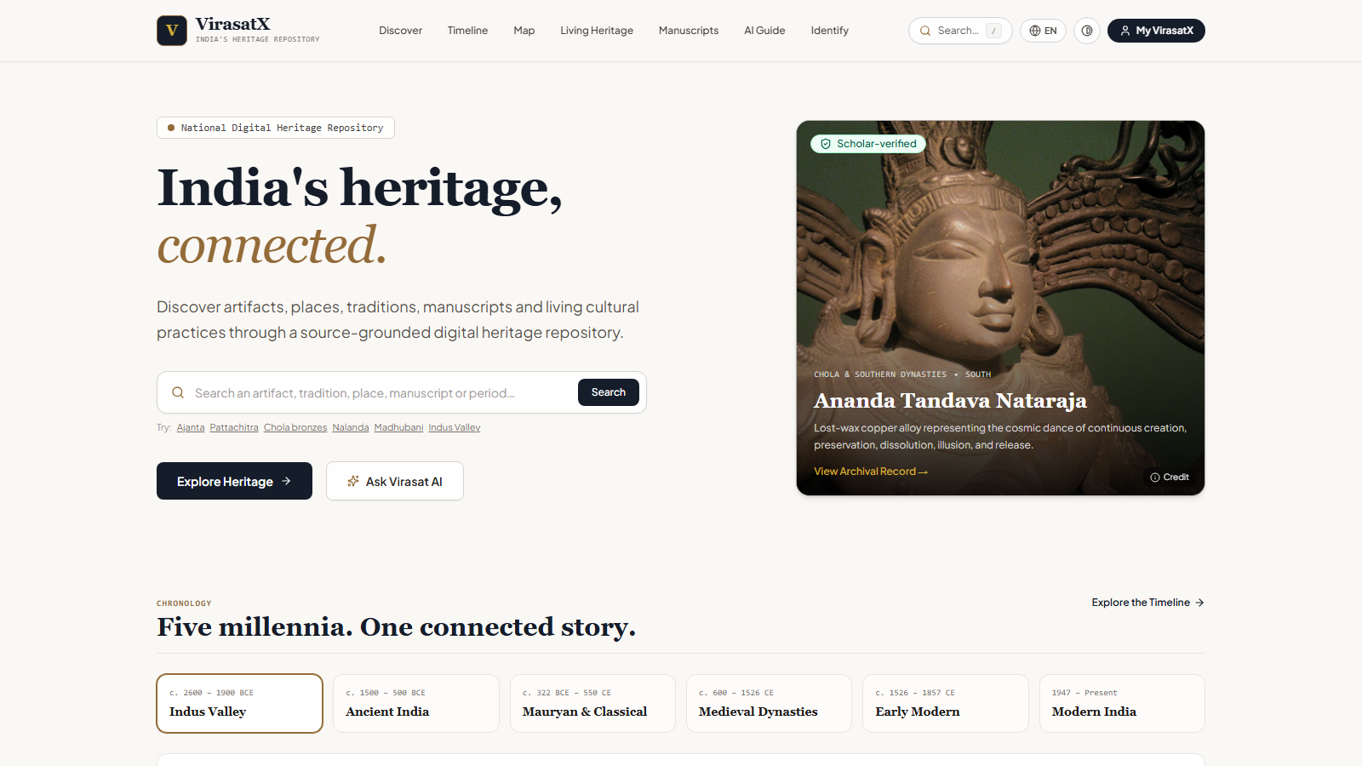
Team
VirasatX
TECHNICAL APPROACH
• Technologies to be used (e.g. programming languages, frameworks, hardware)
• Frontend Framework: React 19, TypeScript, Vite & Tailwind CSS with Motion.
• Multimodal AI Engine: Google Gemini AI for contextual cultural exploration and visual iconography analysis.
• 3D Artifact Studio: Three.js & WebGL for real-time interactive 3D model rendering directly in mobile browsers.
• GIS Spatial Mapping: Leaflet & OpenStreetMap for geographic heritage discovery and cluster exploration.
• Voice Interaction: Web Speech API for voice-assisted queries and audio guidance.
• Backend & Database: Supabase with PostgreSQL relational database and Row Level Security (RLS).
• Cloud & Edge: Vercel serverless edge deployment ensuring sub-second global response times.
• Methodology and process for implementation (Flow Charts/Images/ working prototype)
Live Working Prototype: React 19 • Three.js WebGL • Gemini AI (https://virasatxai.vercel.app/)
@SIH Idea submission- Template
3

Slide 4
Team
VirasatX
FEASIBILITY AND VIABILITY
• Analysis of the feasibility of the idea
1. Technical Feasibility:
• Lightweight Web Architecture: React 19, TypeScript, and WebGL deliver responsive 3D artifact rendering in mobile browsers without demanding app downloads.
• Modular Multimodal AI: Google Gemini multimodal AI orchestrated through serverless edge functions for rapid, low-latency contextual guidance.
• Standardized Cultural Data Schemas: Structured PostgreSQL & JSON schemas compatible with national heritage classification standards.
2. Operational Feasibility:
• Public Open Datasets: Built upon documented public domain archives, monument registries, and academic resources without proprietary data locks.
• Zero Infrastructure Overhead: Serverless deployment on Vercel and Supabase eliminates physical server upkeep and high operational costs.
• Modular Content Extensibility: Structured content taxonomy allows adding new regional monuments, epochs, and craft traditions effortlessly.
3. Legal & Ethical Feasibility:
• Privacy & Data Governance: Strictly compliant with India’s Digital Personal Data Protection (DPDP) Act with zero unauthorized user tracking.
• Cultural Sensitivity & Attribution: Strict prompt guardrails enforce respectful, non-distorted historical interpretation with explicit source citations.
• Potential challenges and risks
• Data Fragmentation: Heritage information scattered across divergent regional archives with inconsistent naming conventions.
• AI Hallucination Risk: Risk of large language models generating inaccurate historical dates, dynasties, or architectural styles.
• Connectivity Variations: Rich 3D models and high-resolution cultural imagery may face latency on 3G/4G rural mobile connections.
• Strategies for overcoming these challenges
• Unified Taxonomy Schemas: Standardized normalizers reconcile regional spelling variants, dynasties, and historical eras into a single linked graph.
• Source-Grounded Prompting: AI Guide strictly constrained to verified facts with explicit archival citations and uncertainty disclaimers.
• Progressive Web Optimization: WebP compression, low-polygon 3D meshes, and browser caching ensure sub-second page loads.
❖ Economic Viability & Scalability
• Cost-Effective Foundation: Built on modern open-source web technologies with near-zero baseline hosting expenses.
• Elastic Cloud Scaling: Serverless edge hosting through Vercel and Supabase scales dynamically on demand from pilot to national scale.
@SIH Idea submission- Template
4

Slide 5
Team
VirasatX
IMPACT AND BENEFITS
• Potential impact on the target audience
1. Students & Youth:
• Interactive Learning: Replaces dry textbook memorization with interactive 3D artifact exploration, timeline navigation, and conversational AI guidance.
• Civilizational Pride: Fosters civilizational pride and active engagement among younger generations through visual and interactive pathways.
2. Cultural Researchers & Educators:
• Centralized Reference: Provides a centralized digital platform linking monuments, artifacts, regional periods, and living traditions with institutional citations.
• Accelerated Research: Accelerates cultural studies with structured epoch relationships, iconography references, and comparative timelines.
3. Traditional Artisans & Craft Communities:
• Digital Visibility: Creates direct digital visibility for indigenous handlooms, terracotta, metalcasting, and regional craftsmanship.
• Artisan Discovery: Connects traditional craftspeople to cultural discovery pathways, fostering greater public awareness and patronage.
4. Cultural Tourists & Heritage Travelers:
• Context-First Travel: Promotes responsible travel, encouraging deeper respect and cultural literacy before visiting physical heritage sites.
• Hidden Heritage: Uncovers hidden, lesser-known regional heritage treasures beyond mainstream crowded tourist landmarks.
• Benefits of the solution (social, economic, environmental, etc.)
1. Social & Cultural Benefits:
• Heritage Preservation: Digitally preserves India’s tangible and intangible heritage for future generations.
• National Unity: Fosters intercultural dialogue and civilizational awareness across diverse Indian regions and languages.
2. Educational & Research Benefits:
• Open-Access Knowledge: Delivers an open-access cultural learning repository for schools, universities, and self-directed learners nationwide.
• Interdisciplinary Exploration: Encourages exploration connecting architecture, epigraphy, mythology, and craft sciences.
3. Economic & Community Benefits:
• Tourism Dispersal: Stimulates regional cultural tourism, dispersing economic benefits to rural communities and artisan clusters.
• Demand for Crafts: Increases awareness and demand for authentic traditional craftsmanship and community-made goods.
4. Digital Preservation & Scalability:
• Pan-India Scalability: Creates a future-ready, resilient digital architecture that scales seamlessly across hundreds of regional sites.
• Knowledge Safeguarding: Safeguards vulnerable cultural knowledge against permanent loss through structured digital documentation.
@SIH Idea submission- Template
5

Slide 6
Team
VirasatX
RESEARCH AND REFERENCES
• Details / Links of the reference and research work
1. Project & Prototype:
• Live Working Prototype: https://virasatxai.vercel.app/
• GitHub Source Repository: https://github.com/ShrilCarpenter/VirasatX
• Core Production Modules: React 19 • Three.js WebGL • Gemini AI • Supabase
2. Institutional Reference Sources:
• Archaeological Survey of India (ASI) (asi.nic.in)
• Ministry of Culture, Govt. of India (indiaculture.gov.in)
• National Archives of India (nationalarchives.nic.in)
• National Mission on Monuments & Antiquities (nmma.nic.in)
• Museums of India Portal (museumsofindia.gov.in)
• Indira Gandhi National Centre for Arts (IGNCA) (ignca.gov.in)
• Vedic Heritage Portal (vedicheritage.gov.in)
• UNESCO World Heritage Centre (whc.unesco.org)
3. Technical Standards & Frameworks:
• W3C WebGL & WebXR Guidelines: Mobile-optimized interactive 3D rendering standards.
• CIDOC-CRM & Dublin Core: Global cultural heritage cataloging & semantic metadata models.
• DPDP Act 2023 Compliance: Complete regulatory compliance for citizen data privacy.
• NEP 2020 Guidelines: Pedagogical alignment with Indian Knowledge Systems (IKS).
VIRASATX
“From scattered heritage knowledge to one connected cultural experience.”
EXPLORE • UNDERSTAND • PRESERVE
Smart India Hackathon 2026 — Problem Statement ID: SIH26197 Theme: Heritage & Culture • PS Category: Software • Team: Team VirasatX (ID: 57385)
@SIH Idea submission- Template
6

