Slide 1


SMART INDIA HACKATHON 2025
TITLE PAGE
• Problem Statement ID –SIH25108
• Problem Statement Title-Development of AI-powered FRA Atlas and WebGIS-based Decision Support System (DSS) for Integrated Monitoring of Forest Rights Act (FRA) Implementation. (States to be concentrated: Madhya Pradesh, Tripura , Odisha, Telangana)
• Theme-Miscellaneous
• PS Category- Software
• Team ID- 57385
• Team Name- Team Hackastra
1

Slide 2
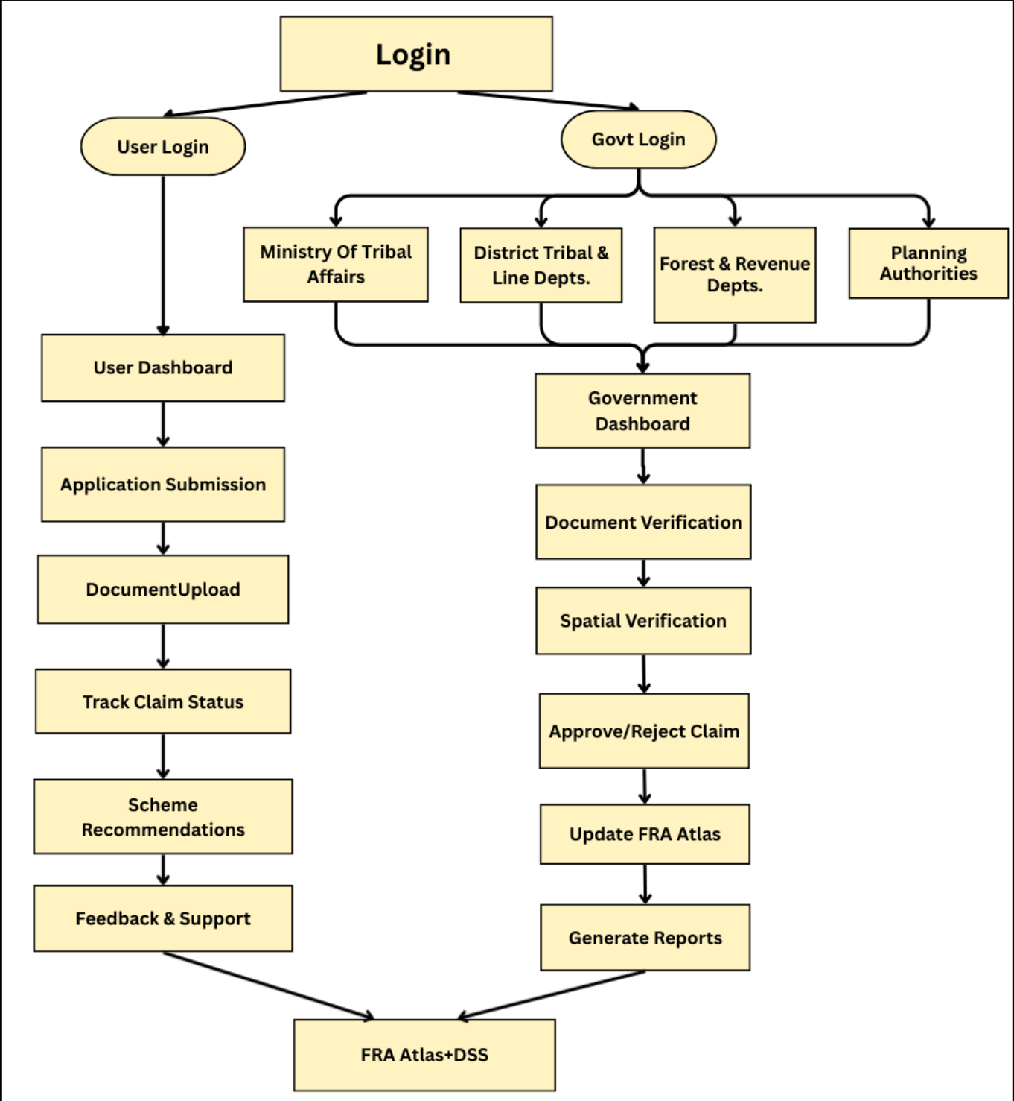
Team
Hackastra
IDEA TITLE
❖ Proposed Solution:
• NGO Digital Aid : Teach Gram Sabhas and communities apps, IVR, and GIS tools.
• Digital Witness & Testimony: Voice and video records stored securely as valid proof.
• Title Insurance / Digital Patta : Ensures authenticity with secure 7/12 land record entry.
• Grievance Resolution & Illegal Alerts: Efficient FRA grievance handling and unauthorized land encroachment warnings.
• AI Disciplinary Dashboard : Suggests actions and tracks officer accountability.
• Analytics-Driven Officer Monitoring: Tracks verification time, claim outcomes, and grievances reported.
• Interactive FRA Web-GIS Atlas: Dynamic platform for exploring forest rights and assets.
• AI Disputes Mediator: Resolving conflicts within existing legal frameworks.
• GI Tagging and E-Signature : To preserve cultural heritage safeguard traditional products and paperless approval .
@SIH Idea submission- Template
2

Slide 3
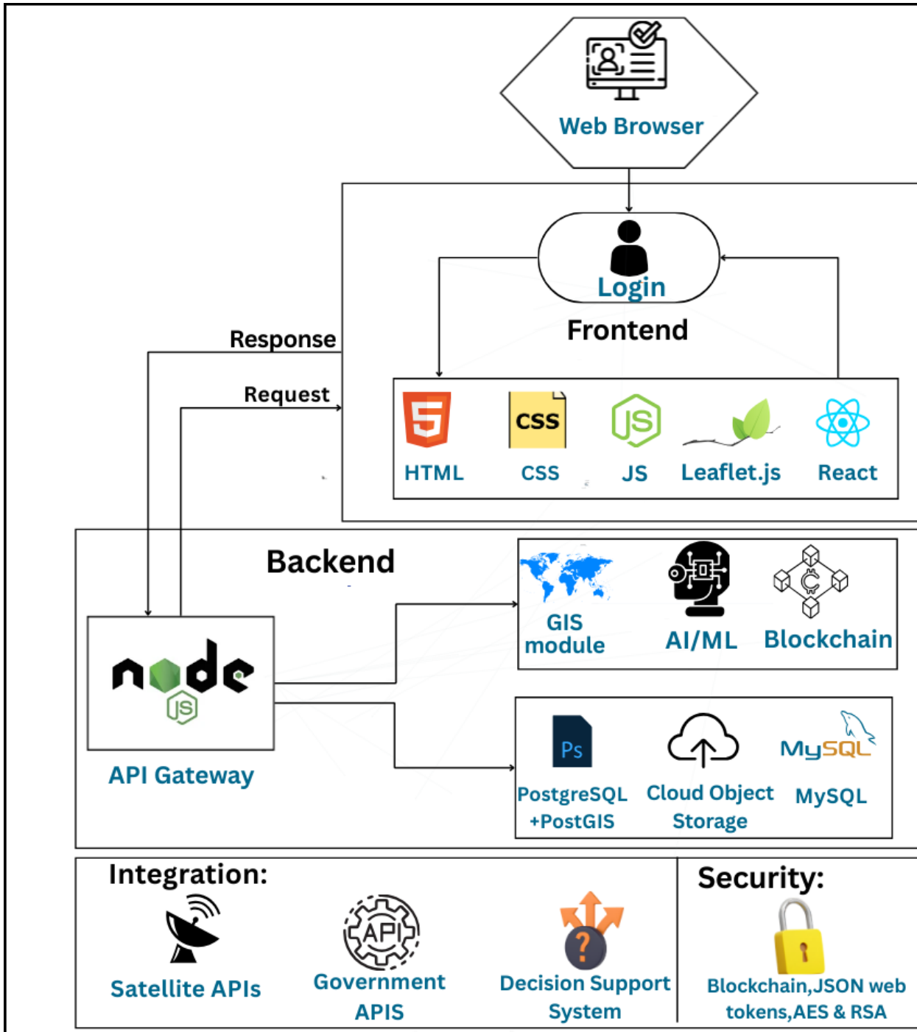
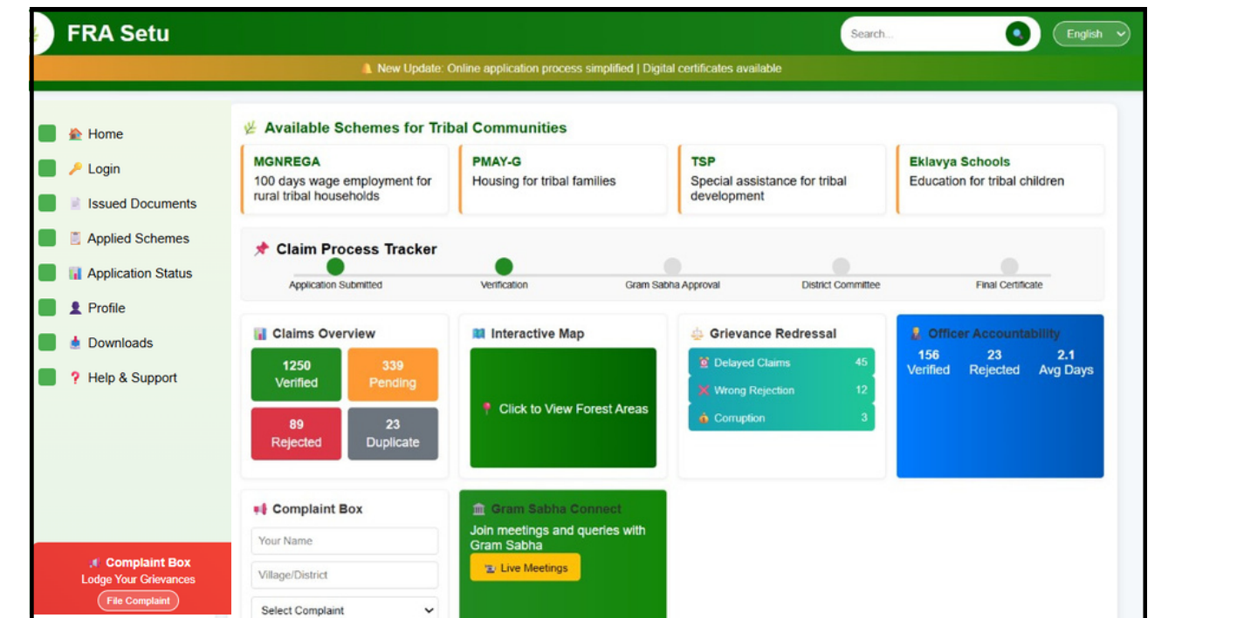
Team
Hackastra
TECHNICAL APPROACH
• Data Extraction: Optical Character Recogntion(OCR), NLP.
• WebGIS platform: Leaflet.js(for interactive maps).
• Asset Mapping: Random Forest & CNN.
• Data Storage: PostgreSQl & PostGIS(for geospatial data).
• Data Management: Cloud Object Storage & MySQL(Structured).
• GeoServer: Use standard protocols WMS and WFS to serve maps.
• Decision Support System: for scheme recommendations.
• Blockchain based Security: Hyperledger Fabric.
• Key Lock Framework: Open-source Identity & Access Management
• Rasa: Preferred for its offline, multilingual, and secure chatbot.
User Interface: It is a draft version, subject to future updates.
@SIH Idea submission- Template
3

Slide 4
Team
Hackastra
FEASIBILITY AND VIABILITY
❖ Feasibility:
1. Technical Feasibility:
1.Digitization, AI Mapping and Web-GIS Dashboards:
• OCR and AI extract data from documents.
• Web-GIS dashboards show real-time interactive maps.
2. DSS Integration with Blockchain Security:
• AI engines match schemes to community needs.
• Blockchain ensures secure, tamper-proof digital records.
2. Operational Feasibility:
1.Existing Setup and Simple Staff Training:
• Government data exists, needs proper connection.
• Staff need basic training through short workshops.
2. Stakeholder Support and Effective FRA Implementation:
• Ministries and NGOs already support FRA schemes.
• System strengthens efforts, not replacing existing work.
3. Legal & Ethical Feasibility:
1.Data Privacy:
• Must follow India’s DPDP Act, ensuring legal compliance.
• Blockchain and encryption safeguard sensitive user data.
2. Consent Mechanism:
• FRA holders’ informed consent required in all processes.
• Real-time feedback enables secure two-way communication.
❖ Viability:
1. Economic Viability:
1.Cost-Effective & Efficient:
• Saves paperwork, effort, duplication, and reduces fraud.
• Cuts processing delays, expenses, and operational overhead.
2. Supported & Scalable Technology:
• Backed by government programs and tribal inclusion schemes.
• Open-source tech ensures flexible, low-cost,future-ready deployment.
2. Social Viability:
1. Empowers Communities & Improves Scheme Access:
• Provides transparency, secure records, better documentation.
• Directly benefits FRA holders through scheme access.
2. Reduces Conflict & Promotes Stronger Inclusion:
• Verified records, alerts reduce frequent land disputes.
• Mobile updates, two-way communication improve engagement.
3. Scalability:
1. Pan-India Expansion for Wider Community Benefits:
• Pilot in districts, then scale across India.
• Adjust platform easily for local data.
2. Cross-Sector Use of WebGIS + DSS:
• Adaptable for agriculture, urban development needs.
• Useful in disaster management and planning.
@SIH Idea submission- Template
4

Slide 5
Team
Hackastra
IMPACT AND BENEFITS
❖ Benefits:
1.Social Benefits:
• Digital platform enables communities with land rights tracking.
• IVR helpline, e-learning ensure inclusive literacy access.
• Transparent records, video testimonies reduce conflict, build trust.
2. Environmental Benefits:
• Sustainable forest use by recognized communities.
• Conservation through community stewardship.
• GI Tagging preserves cultural heritage & traditional products.
3. Economic Benefits:
• Access to schemes (MGNREGA, PM-KISAN, DAGAJU, Jal Jeevan Mission)
• GI Tagging boosts local products & tribal livelihoods
• Title insurance & digital patta ensure secure land ownership → easier loans & income stability
4. Governance Benefits:
• Audit trails ensure accountability, prevent misuse.
• Whistleblowing portal boosts transparency, fights corruption.
• Cross-validation stops duplication and fraudulent claims.
5.Legal & Security Benefits:
• E-Signature & Digital Patta provide legally valid ownership records.
• Protection against land encroachment (Illegal Practice Alert).
• Digital witness/testimony ensures fair dispute settlement.
❖ Impacts:
1.Secure Land Rights & Transparency:
• Communities track claims, reducing corruption and fraud.
• Digital patta ensures authenticity in land ownership records.
• Builds trust between citizens and government authorities.
2. Forest Protection & Conservation with AI:
• AI monitors land to prevent illegal encroachment.
• Conserves biodiversity and safeguards natural resources.
• Promotes sustainable, community-driven forest management.
3. Boost Livelihoods & Local Development:
• Resource planning improves incomes and rural economy.
• GI tagging protects heritage, boosts local products.
• FRA enables fair access to welfare schemes.
4. Digital, Eco-Friendly & Cost Effective:
• Reduces paperwork,ensuring greener, eco-friendly governance.
• Preserves tribal knowledge through digital archiving tools.
• Lowers administrative costs and increases efficiency.
5. Smart, Transparent & Scalable Governance:
• Transparent dashboards track officer performance and claims.
• AI dispute mediation ensures fairness, reduces human bias.
• Unified digital platform enables future-ready expansion.
@SIH Idea submission- Template
5

Slide 6
Team
Hackastra
RESEARCH AND REFERENCES
1. FRA: The Forest Rights Act (FRA), 2006 gives rights to forest-dwelling and tribal people, but challenges in implementation remain. https://tribal.nic.in/FRA.aspx https://mpvanmitra.mkcl.org/hi
2. Best Practices for Web Security: This guide outlines key web security measures to safeguard user information using Blockchain Technology. https://owasp.org/www-project-blockchain-appsec-standard/
3. The Wildlife Protection Act: 1972 aims to protect wild animals, birds, plants, and their habitats. https://share.google/F3sPygTbDmIslAmAd
To enable smooth implementation and integration of the FRA Atlas System, the following contacts serve as official state-level resources for communication, data coordination, and support:
4. Madhya Pradesh: dirtadp@mp.gov.in
5. Odisha: https://stsc.odisha.gov.in/acts-policies-guidelines/scheduled-tribes-and-other-traditional-forest-dwellers
6. Tripura: https://forest.tripura.gov.in/
7. Telangana: https://forestrights.telangana.gov.in/
@SIH Idea submission- Template
6

