Slide 1




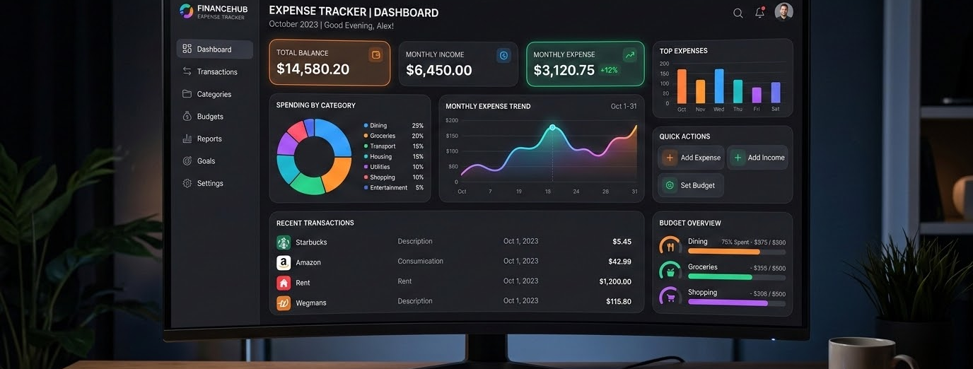
Budget Wise
Personal Expense Tracker — CRUD Application Internship Project
Developed By
Frontend
Bhavesh Prajapati & Neel Vaghela
HTML 5, CSS 3, Bootstrap, Chart.js
Backend
Node.js, Express.js, EJS, Nodemon
Database
MongoDB, Mongoose
Other Tools
POSTMAN, VS Code, .env

Slide 2




Budget Wise
Simplifying Personal Expense Lists & Financial Tracking
Introduction to BudgetWise
BudgetWise is a user-friendly web application designed to help individuals efficiently manage their daily expenses. It focuses on providing an accessible platform to track personal spending without hassle.
95%
Accuracy
Expense Lists Effectiveness
95% of users report improved tracking accuracy due to search and filter functions.
89%
Adoption
Convenience & Offline Analysis
About 89% of users frequently use export options to analyze their expenses offline.
Key Features & Purpose
Users can add, view, edit, and delete entries with advanced search, filter, and export options.
The main goal is to simplify financial management and help users keep control of spending habits.
75%
Control
Habit Transformation
75% of users indicate BudgetWise helps them better understand and control daily expenses.

Slide 3
Simplifying Expense Tracking with Digital Solutions
Many Challenges
Overcome Challenges
Overcome traditional expense tracking issues with robust digital alternatives.
Traditional Methods
Manual and paper-based processes bring numerous organizational challenges.
New Solutions
Old Methods
Digital Solutions
Modern cloud tools offer automated features and highly effective management.
Old Methods
Legacy systems typically lack streamlined data analytics and easy accessibility.
Easy Management

Slide 4

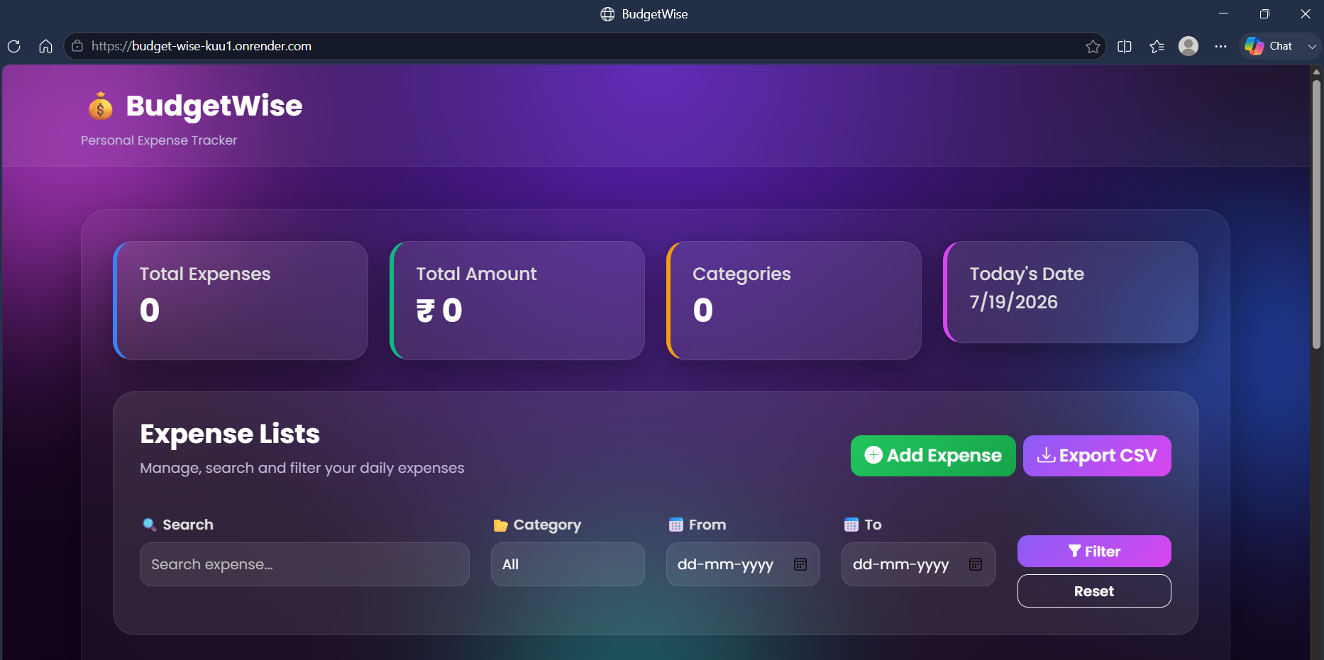


Overview of Project
[ Placeholder for Project Screenshot ]
Insert your system dashboard screenshot here
Backend Architecture
Powered by Node.js runtime environment with Express.js framework, providing a robust and scalable server-side solution.
Database & Modeling
MongoDB serves as the database, managed through Mongoose for smooth interaction and efficient data management.
Frontend & UI Design
Uses EJS templating, Bootstrap and CSS for visual styling, plus client-side JavaScript and Chart.js for data visualization.

Slide 5
System Architecture & Workflow
End-to-End Request Lifecycle & Data Persistence Pipeline
Frontend Interface
Built with EJS templates, Bootstrap, and dynamic CSS to enable clean user interactions.
Captures daily expense inputs and renders real-time budget views.
Express.js Router & Controllers
Handles incoming HTTP requests, orchestrating security and data extraction.
Controller logic maps user inputs into strictly validated data transfer payloads.
MongoDB & Mongoose
NoSQL database storing reliable expense schema documents.
Mongoose ensures precise structural enforcement and query execution.
1
STEP 01
User Submission
User records expense details on the EJS client view interface.
2
STEP 02
Route Processing
Express server catches the routing path and runs controllers.
3
STEP 03
Data Storage & Sync
Mongoose schema writes entry to MongoDB, resolving UI visual states.

Slide 6
Database Design for Expense Collection
Overview of Expense Collection Database & Schema Architecture
Key Fields Explained
Each expense entry contains essential fields designed to capture comprehensive expense details for organized storage and easy retrieval:
Title & Category: String types for classification
Amount & Date: Numeric and Date types
Description: Optional string for context
40%
WEIGHT
Classification Focus
Title and Category fields cater directly to classification needs, representing 40% of the core meta attributes.
30%
WEIGHT
Financial Tracking
The Amount field is strictly numeric, serving as the foundation for budgeting metrics and statistical calculations.
Practical Example Schema
A standard JSON representation highlights how real expense data fits into our structured MongoDB schema:
{
"title": "Pizza", "amount": 450,
"category": "Food", "date": "2026-07-15",
"description": "Dinner team gathering"
}
30%
WEIGHT
Temporal Context
Date and Description keys complete the document pattern, allowing timeline query sorting and user notes.

Slide 7
Expense Tracking System: CRUD & Features
Core Operations, Enhanced Functionalities & Educational Insights
Core CRUD Operations Overview
The system supports fundamental CRUD operations essential for managing expenses: creating new entries, viewing the expense list, updating existing records, and deleting unwanted items.
These basics ensure smooth, real-time handling of user financial data stored in the underlying database.
85%
DAILY CRUD
User Interaction with CRUD Features
Studies show over 85% of users actively perform Create, Read, Update, and Delete actions daily within modern expense management tools.
70%
ENHANCED
Usage of Additional Features
Around 70% of users regularly utilize enhanced features such as search, filters, and export options, indicating high value in advanced tools.
Enhanced Functionalities for Better Control
Apart from core operations, the system includes advanced features such as searching expenses, filtering by category or date, and exporting data to CSV files.
Visual analysis tools like dashboard cards and dynamic charts provide a comprehensive look into spend habits.
60%
EDUCATIONAL
Teaching Application Insights
More than 60% of educators emphasize dashboards and charts for teaching, citing improved comprehension of complex database workflows.

Slide 8


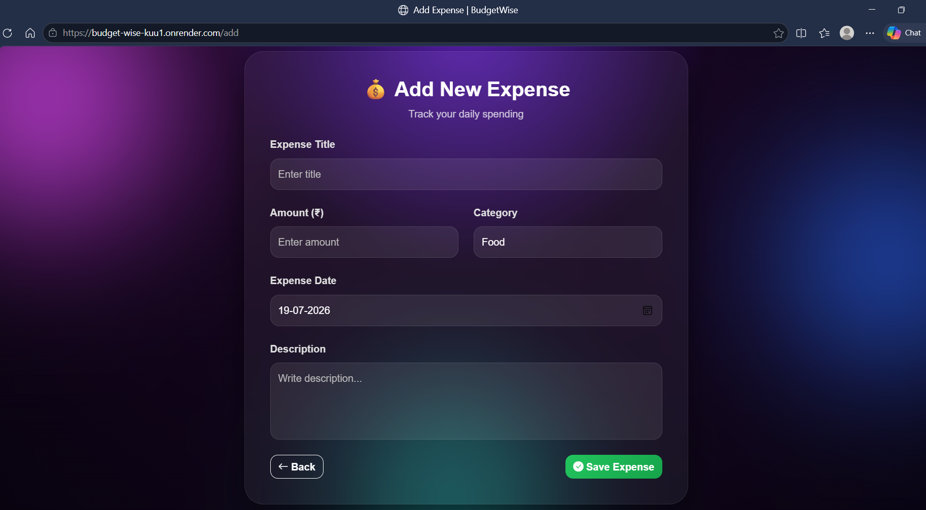
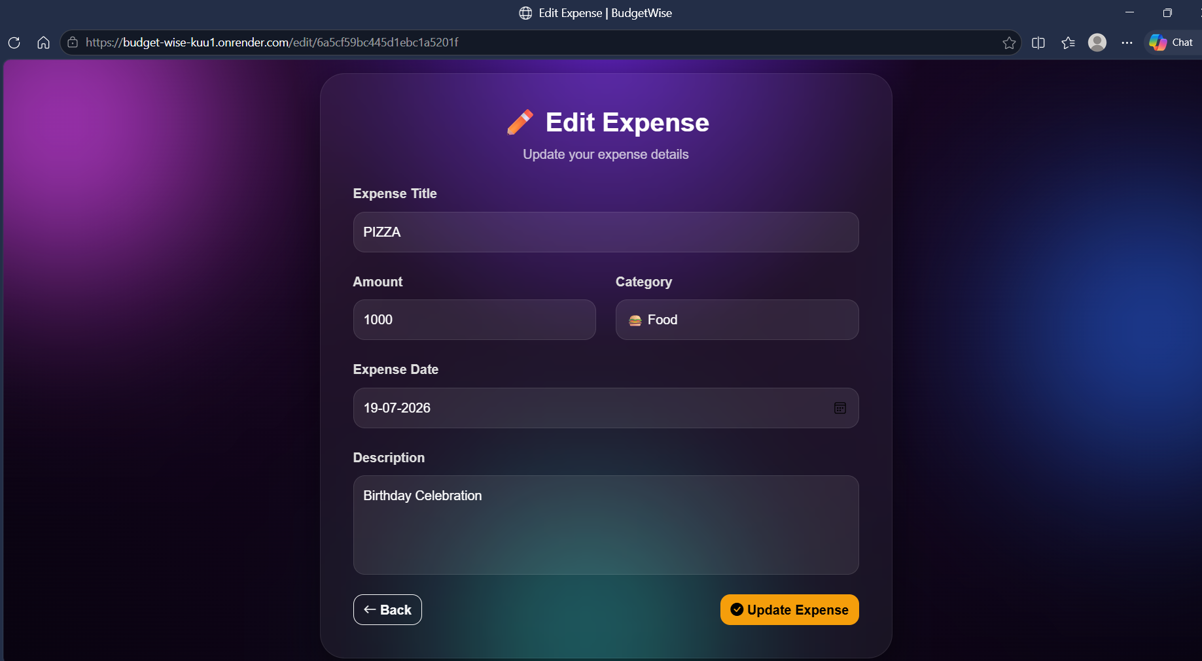
Key Features of the Expense Tracking Project
Intuitive & Modern Design
The project boasts a user-friendly dashboard combined with a sleek, modern user interface, ensuring ease of navigation and a pleasant user experience for all users.
Comprehensive Tracking
It offers robust expense management tools, including the ability to view expenses categorized by type, track monthly expenditures through charts, and apply custom filters.
Enhanced Functionality
Additional features such as search functionality, export options to CSV format, and a responsive design make the project flexible and accessible across a range of devices.
Placeholder for Screenshot 1
[ Insert Add Expense Screen Here ]
Placeholder for Screenshot 2
[ Insert Edit Expense Screen Here ]

Slide 9

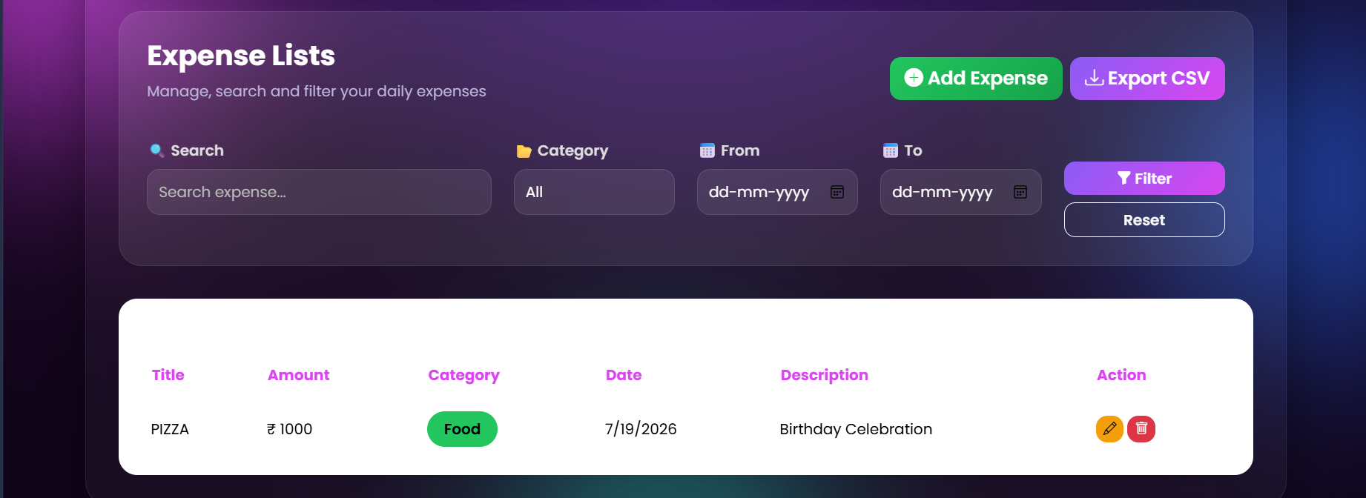
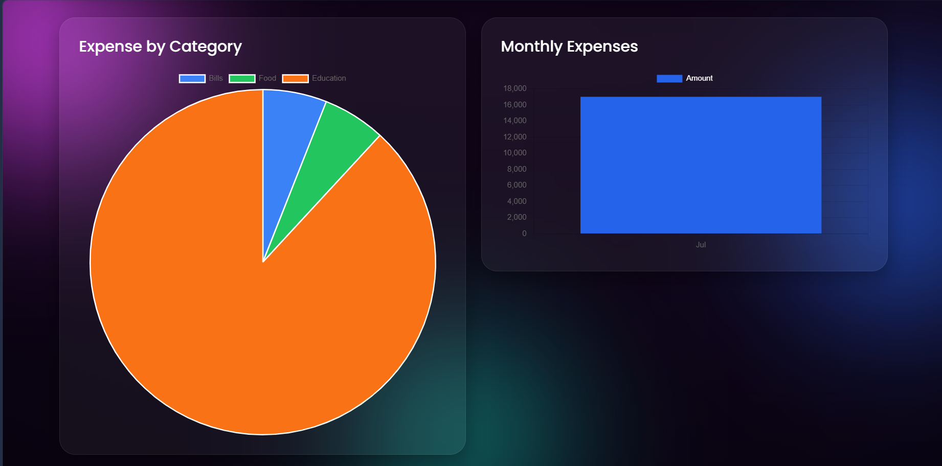
Future Enhancements Planned
Roadmap for Scalability, Advanced Analytics & Global Access
User Access & Interface
Planned upgrades include user login and registration systems, along with dark and light theme options to enhance user experience and personalization.
Financial Management
New capabilities such as setting monthly budget limits, AI-driven expense prediction, and email reports aim to help users better manage and anticipate finances.
Expansion & Accessibility
Future development will focus on launching a mobile application and cloud deployment, ensuring greater accessibility and seamless data sync.
[ User Image Space 1 ]
Click to insert custom screenshot
[ User Image Space 2 ]
Click to insert custom screenshot

Slide 10

BudgetWise: Expense Tracking & Learning
Efficient Personal Expense Tracking and Development Learning Outcomes
1
2
3
Successful CRUD Operations
BudgetWise effectively supports all Create, Read, Update, and Delete operations, ensuring seamless management of personal expense records in real-time.
User-Friendly Features
The application offers graphical reports, comprehensive filtering options, and a highly responsive interface to enhance user experience and provide clear financial insights.
Educational Impact
Developing BudgetWise deepened full-stack understanding: Front/Backend, Database integration, API Communication, MVC Architecture, and complex CRUD workflows.

Slide 11
Comprehensive Personal Expense Tracking
BudgetWise Internship Project: Core Focus Areas & Architectural Strengths
1
2
3
Advanced Tech Integration
BudgetWise combines a variety of cutting-edge technologies and features to deliver an all-inclusive solution for personal expense tracking. This integration enhances the tool’s ability to provide users with a seamless financial management experience.
Practical Application Focus
The internship project emphasizes hands-on development, ensuring that the application is not only functional but also user-friendly. This practical approach highlights the importance of usability in software design.
Scalability & Future Growth
In addition to usability, the project places significant emphasis on scalability. This ensures that the application can grow and adapt to increasing user needs and data volumes over time, demonstrating foresight in development.

Slide 12
THANK YOU
BudgetWise Internship Project

