Slide 1
INTERNSHIP PROJECT
Job Application Tracker
A Full-Stack Web Application to Track and Manage Job Applications
Developed By : Darpan Patel
Keval Prajapati
Job Application Tracker
1

Slide 2


THE CHALLENGE
Problem Statement & Objective
The Problem
The Objective
Managing applications across different companies can become confusing and difficult to track.
Important information such as status, deadlines, locations and notes may be scattered.
Provide one simple dashboard where users can add, view, update, search and manage all job applications — end to end, in a single place.
Job Application Tracker
2

Slide 3


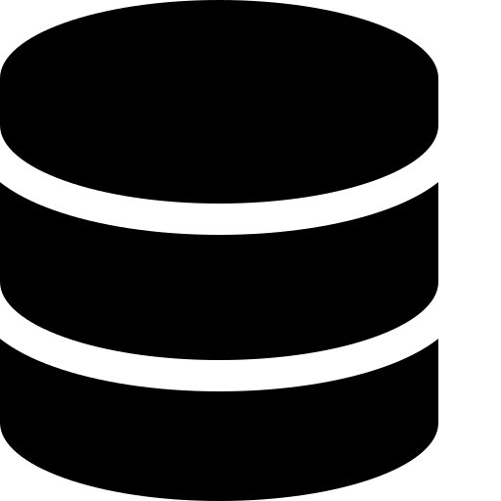

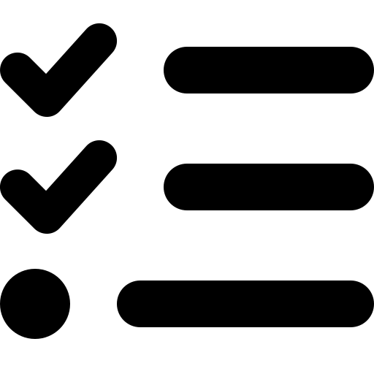




CAPABILITIES
Key Features
Main functionality available in the application
Add new job applications
Search by company, role or location
Dashboard statistics
View all applications in one place
Filter applications by status
Application deadline tracking
Edit and delete records
Sort applications by date
Light and dark mode
Job Application Tracker
3

Slide 4

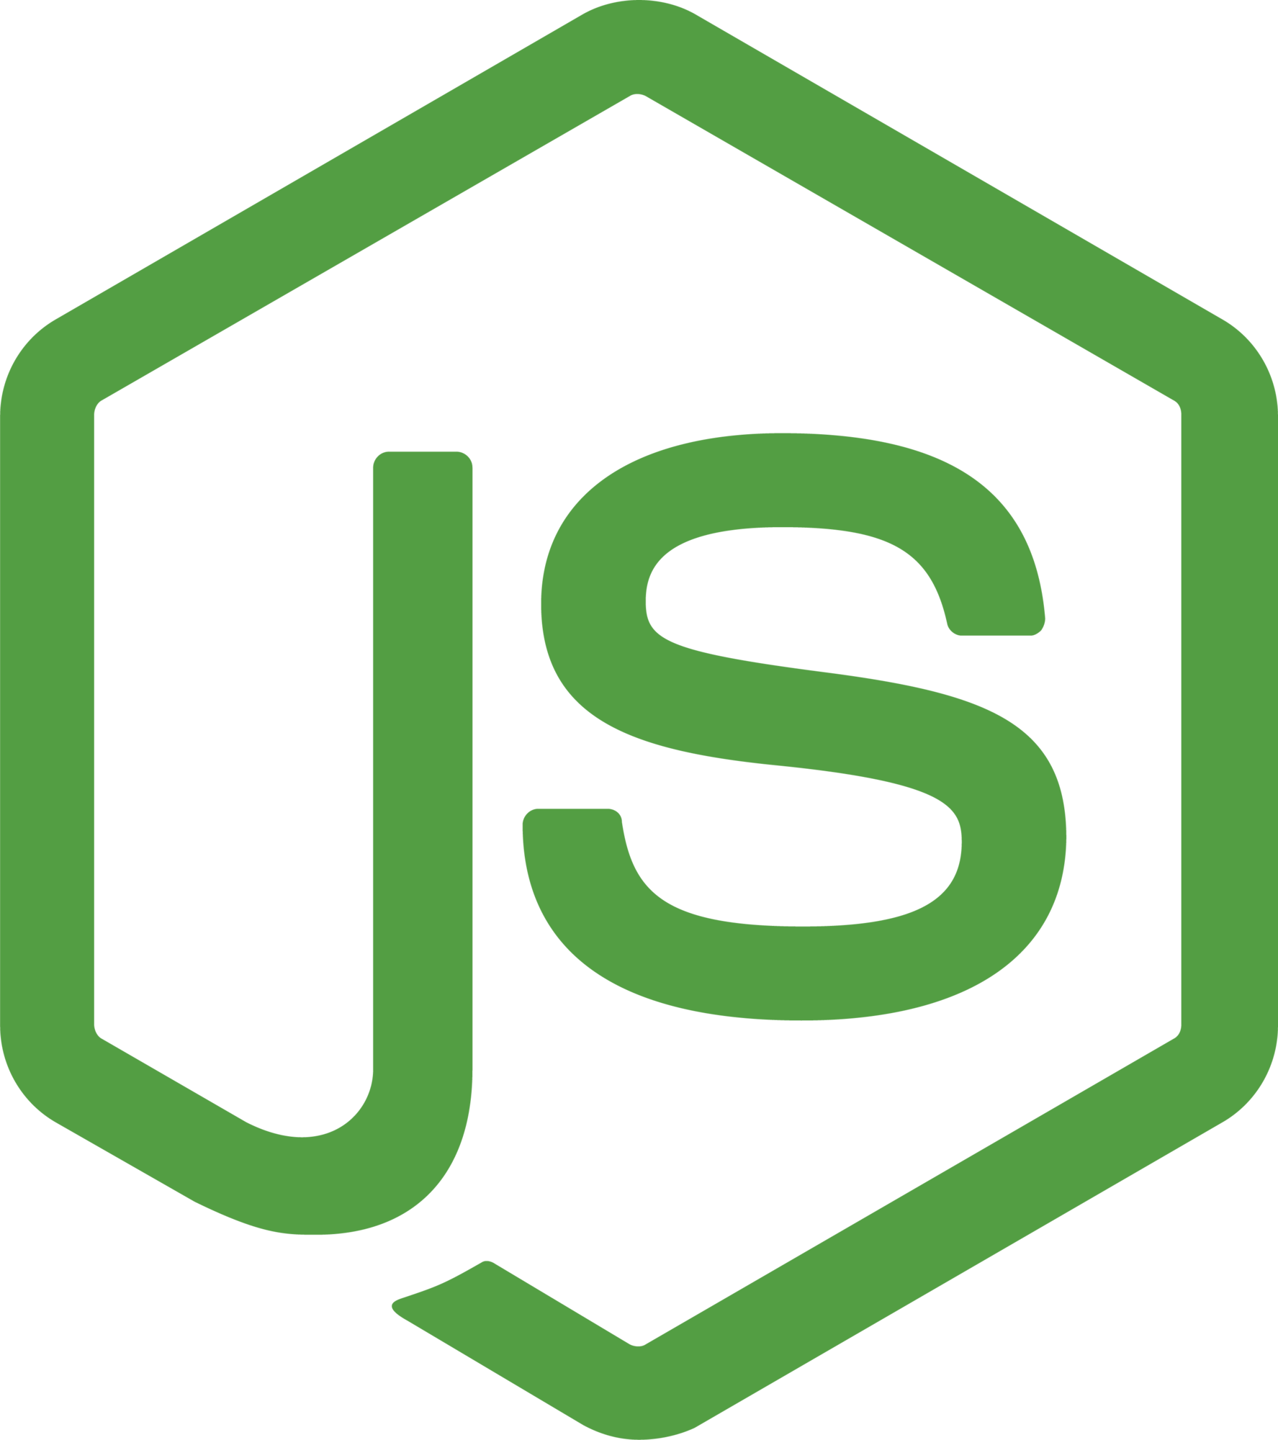
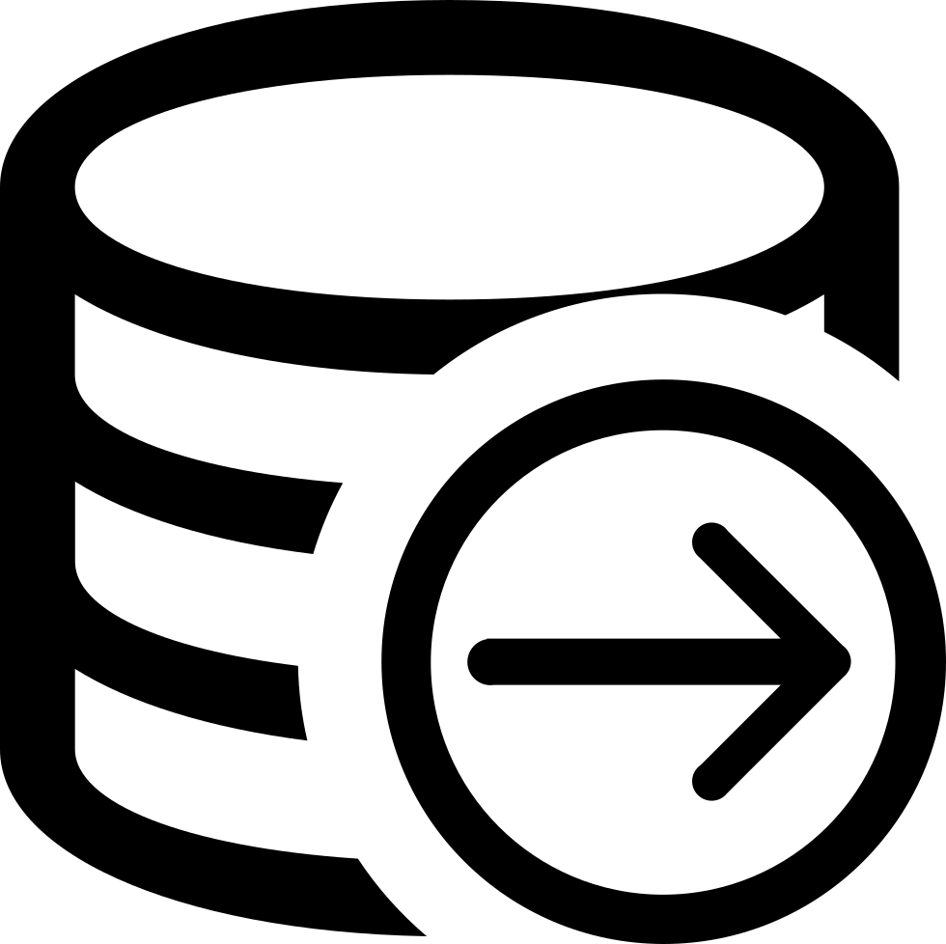



UNDER THE HOOD
Technology Stack
FRONTEND
BACKEND
DATABASE
React + Vite
Node.js + Express.js
PostgreSQL
VERSION CONTROL
BACKEND DEPLOYMENT
FRONTEND DEPLOYMENT
Git & GitHub
Render
Vercel
Job Application Tracker
4

Slide 5

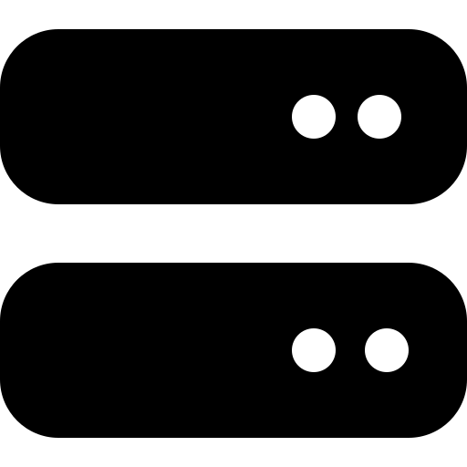

ARCHITECTURE
System Architecture & Workflow
User / Browser
React Frontend
Express API
PostgreSQL
Vercel
Render
Database
The frontend sends HTTP requests to the deployed REST API.
The backend processes requests and reads/writes application data in PostgreSQL.
Job Application Tracker
5

Slide 6

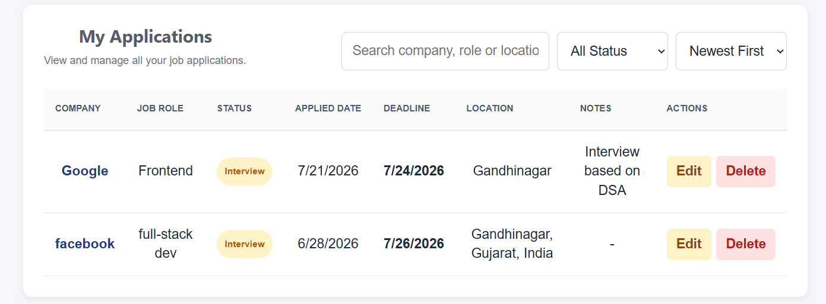
DATA LAYER
CRUD Operations
Core data-management functionality
CREATE
READ
UPDATE
DELETE
Add a new job application.
Fetch and display saved applications.
Edit existing application details and status.
Remove an application when it is no longer needed.
Application form
Job Application Tracker
6

Slide 7
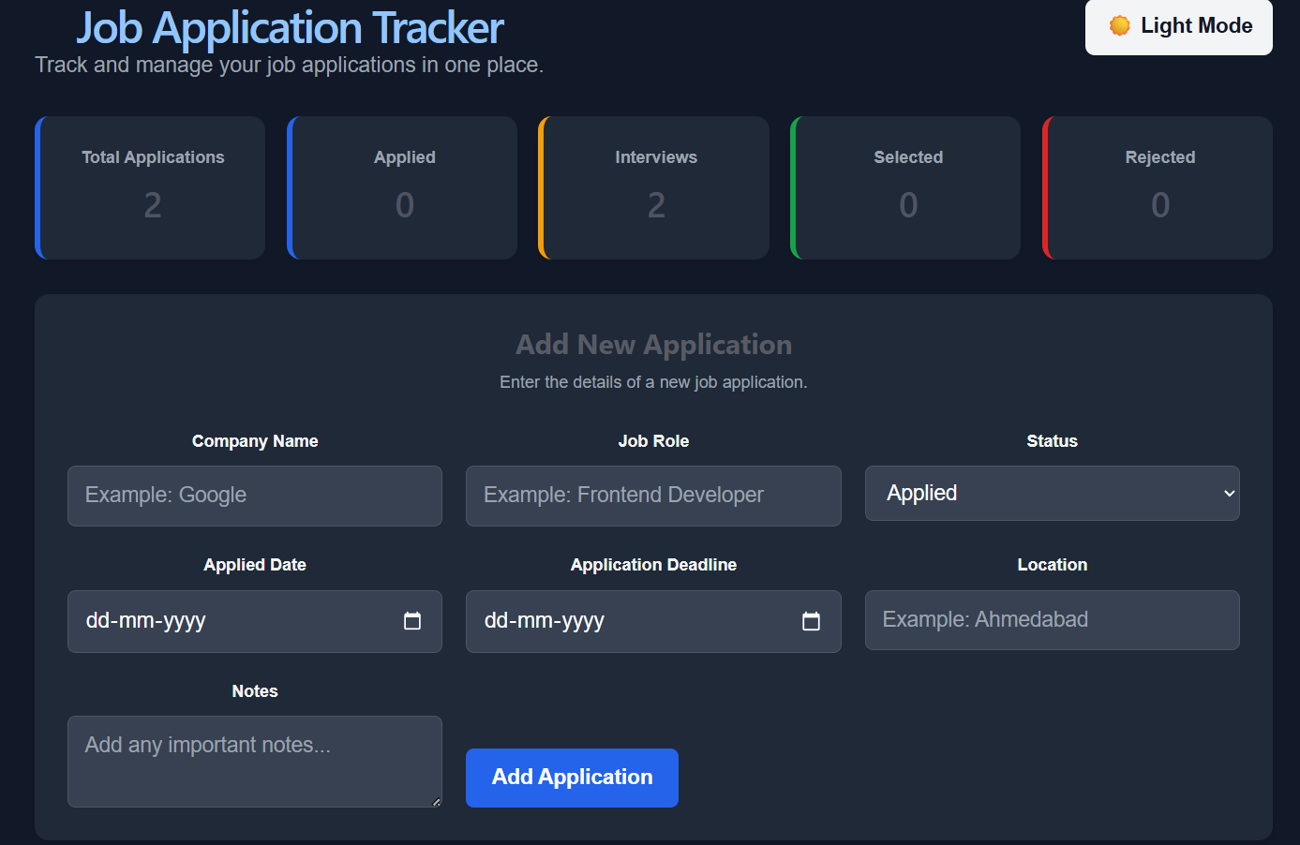
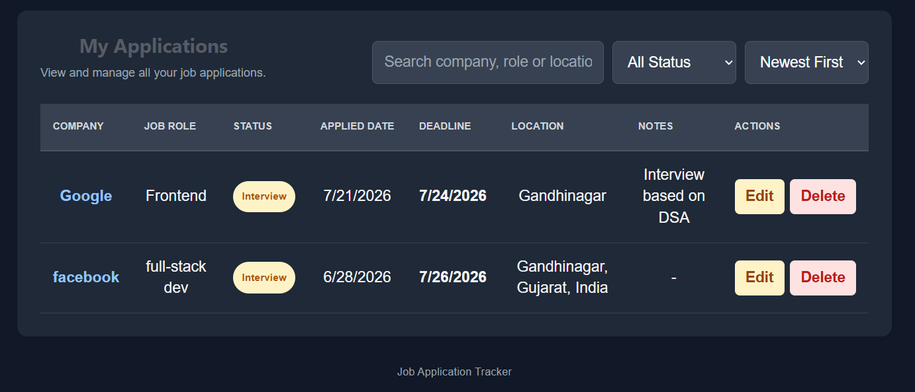
DESIGN
User Interface
Responsive interface with light and dark themes
Applications table
Dashboard — dark mode
Job Application Tracker
7

Slide 8
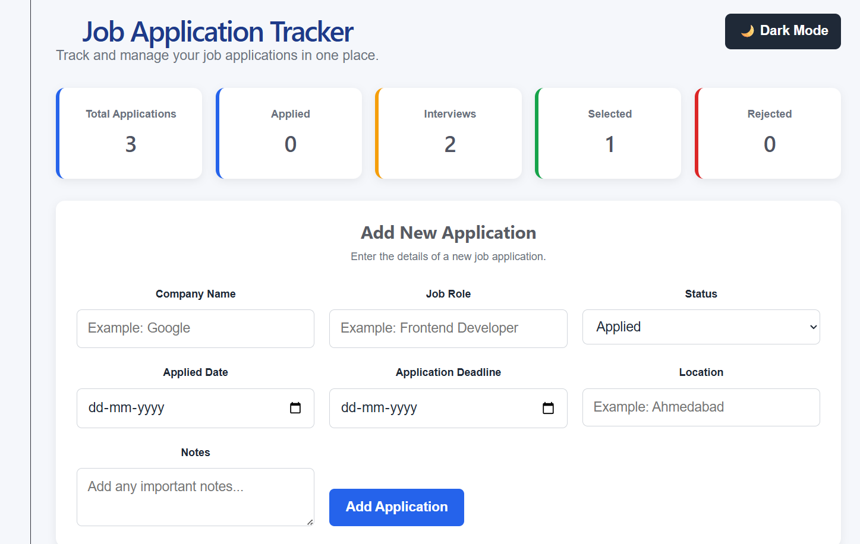
DESIGN
User Interface
Responsive interface with light and dark themes
Applications table
Dashboard — light mode
Job Application Tracker
7

Slide 9



BACKEND
Database & REST API
PostgreSQL stores application records permanently.
Key fields: company name, job role, status, applied date, deadline, location and notes.
REST endpoints connect the React frontend with the backend.
Typical operations use GET, POST, PUT and DELETE requests.
Deployment uses environment variables to keep database credentials outside the source code.
Job Application Tracker
8

Slide 10






DELIVERY
Deployment & Team Collaboration
1
2
3
Local Development
GitHub Collaboration
Team Sync
Development and testing were first performed locally.
GitHub was used as the shared repository for version control and collaboration.
Changes were committed and pushed so both team members could work with the latest version.
4
5
6
Backend Deployment
Frontend Deployment
Live Testing
The backend API was deployed on Render and connected to the hosted PostgreSQL database.
The React frontend was deployed on Vercel and configured to call the deployed backend API.
After deployment, the complete application was tested through the public website.
Job Application Tracker
9

Slide 11


WRAP UP
Conclusion & Future Scope
The project successfully provides a centralized system for managing job applications.
It demonstrates full-stack development, REST API integration, database connectivity, GitHub collaboration and cloud deployment.
Future Improvements
User authentication • Email deadline reminders • Analytics charts • Resume tracking • Company-specific interview notes
Thank You
Job Application Tracker
10

