Slide 1
INTERNSHIP PROJECT
Contact Book
A Full-Stack CRUD Web Application
React (Vite) • Spring Boot • MySQL
Presented by Siddhant Trivedi
Sunday, 19 July 2026

Slide 2
Project Introduction
What is it?
Objective
Contact Book is a real-life application that lets a user store, search, and manage personal contacts — name, phone, email, and address — entirely through the web.
1
Build a working full-stack CRUD application
2
Separate, connected frontend and backend layers
Why this project?
3
Persist data reliably in a relational database
It was assigned to demonstrate a complete CRUD workflow — Create, Read, Update, Delete — built with a separate frontend and backend, as required for the internship task.
4
Apply concepts taught in internship lectures
5
Deliver a real-life, non-generic use case
2

Slide 3
Key Features
Everything a working contact manager needs, wrapped in a clean interface.
C
Create
R
Read
S
Search
Add a new contact with name, phone, email, and address via a simple form.
View every saved contact instantly in a clean, organized table.
Filter the contact list live by typing a name.
U
Update
D
Delete
V
Validation
Edit any existing contact's details in place.
Remove a contact permanently with a single click.
Form fields guide correct entry for phone, email, and address.
4

Slide 4
Technology Stack
A classic three-tier architecture: React talks to Spring Boot, which talks to MySQL.
F
B
D
Frontend
Backend
Database
React + Vite
Spring Boot
MySQL
Component-based UI, fast dev server, calls REST endpoints for every CRUD action.
Exposes REST APIs, handles business logic, and connects to the database via JPA/Hibernate.
Relational database that persistently stores every contact record.
5

Slide 5
System Architecture & Workflow
How a request flows from the browser to the database and back.
React UI
HTTP request (JSON)
Spring Boot API
SQL query
MySQL
Browser (localhost:5173)
GET / POST / PUT / DELETE
REST Controller + Service
via JPA / Hibernate
contacts table
1
2
3
4
User fills the form or clicks Edit/Delete in the browser
React sends an HTTP request to the Spring Boot REST API
Spring Boot processes it and reads/writes to MySQL
Response flows back and the UI table updates instantly
6

Slide 6
Database Design
Two related MySQL tables: contacts and the new accounts table used for login.
contacts
users
id
BIGINT (PK, auto-increment)
id
BIGINT (PK, auto-increment)
full_name
VARCHAR(100), not null
username
VARCHAR(50), unique, not null
phone_number
VARCHAR(15)
password_hash
VARCHAR(255), not null
email
VARCHAR(100)
email
VARCHAR(100), unique
address
VARCHAR(255)
created_at
DATETIME
user_id
BIGINT (FK -> accounts.id)
role
VARCHAR(20), default 'USER'
Each contact belongs to one account, so users only see and manage their own contacts.
7

Slide 7
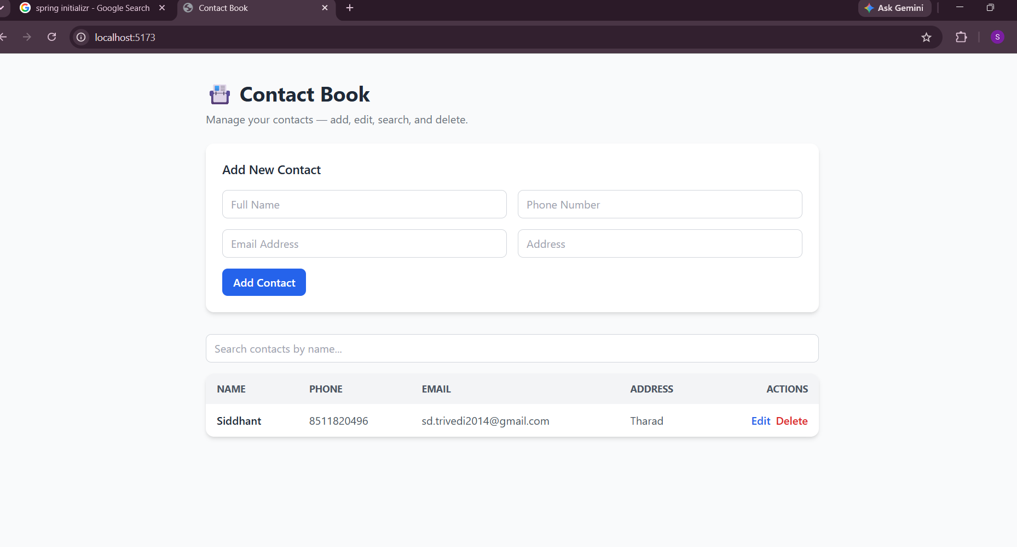
Application in Action
The Contact Book UI — add, search, edit, and delete, all in one screen.
8

Slide 8
Conclusion & Future Scope
What was achieved
Future enhancements
✓
Full CRUD app with separate frontend and backend
→
User authentication and per-user contact lists
React (Vite) UI connected to a Spring Boot REST API
Pagination for large contact lists
✓
→
✓
Data persisted reliably in MySQL
→
Import / export contacts as CSV or vCard
✓
Live search and clean, usable interface
→
Deploy frontend and backend to the cloud
Thank You
9

