Slide 1
Deep Learning in Object Detection
Presented By-
Shringa Bais
Prasanna Shanmuganathan
11/29/2017

Slide 2
Outline
Goal
Dataset
Architecture Of the Network
Evaluation
Learning
Results
Discussion

Slide 3
Goal
Explore techniques to analyse and compute efficiency and performance of Deep Convolutional Neural Networks with limited precision data representation on Object Detection on Image.
Run the model on GPU which has high computing power and support mixed precision
Evaluate the functional quality and performance of the model on varying precision on both the training and testing phase.
Test the model on different datasets to check the consistency of accuracy across varying data.

Slide 4
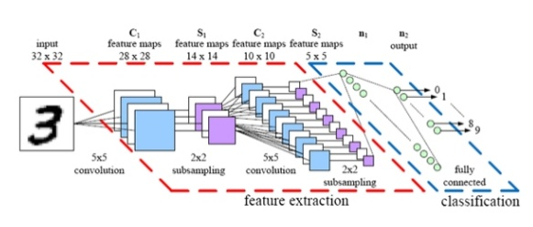
Convolutional Neural Networks
Model with large learning capacity
Prior knowledge to compensate all data we do not have.
Convolutional Neural Networks(or convnets) are based on the following principle:
Local receptive fields
Shared Weights
Pooling (or down sampling)
This special neural network architecture takes special advantage of the spatial data structure.
Notes:
Using floating point arithmetic was the easiest way to preserve accuracy.

Slide 5
Model Components
Hidden Layer : 1
Hidden Units : 128
Activation Function: ‘Relu’
Output Layer: 1
Function: ‘sigmoid’
Notes:
1 object is passing to the model that’s why 1 hidden layer.
We have taken only 2 classes of images cats or dogs to build a model.

Slide 6
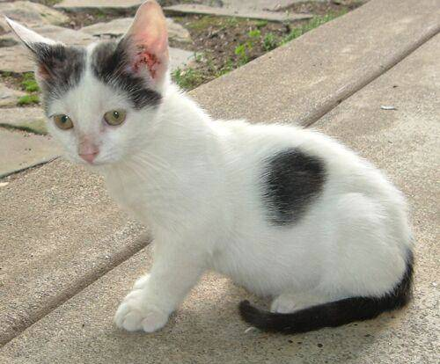
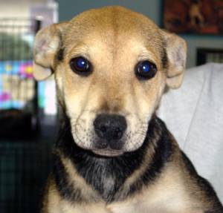
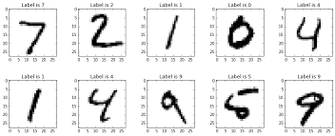
Dataset
Cifar-10 :
Training Images : 8000
Test Images : 1000
MNIST

Slide 7
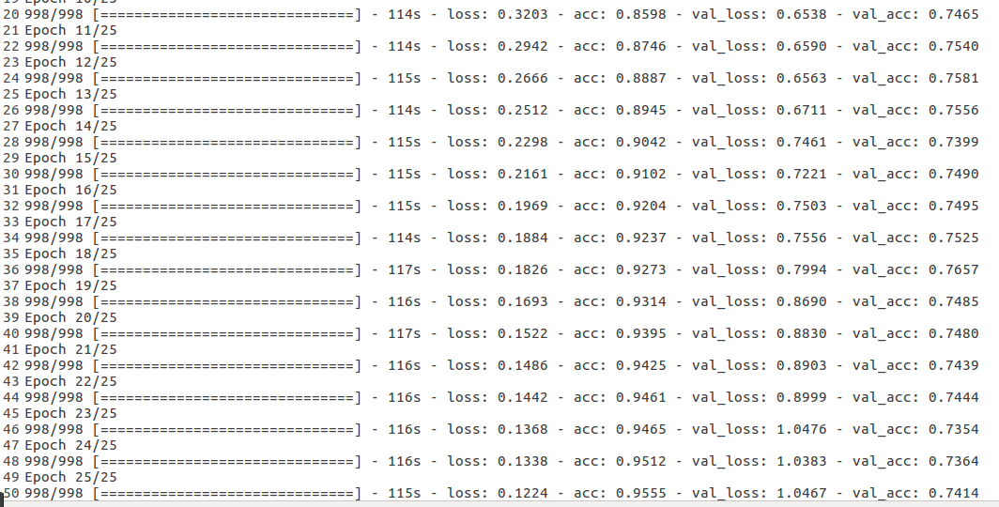
Conv model output

Slide 8
Quantization
The simplest motivation for quantization is to shrink file sizes by storing the min and max for each layer, and then compressing each float value to an eight-bit integer representing the closest real number in a linear set of 256 within the range.
Another reason to quantize is to reduce the computational resources you need to do the inference calculations, by running them entirely with eight-bit inputs and outputs
Notes:
We cannot directly build model by using lower precision data

Slide 9
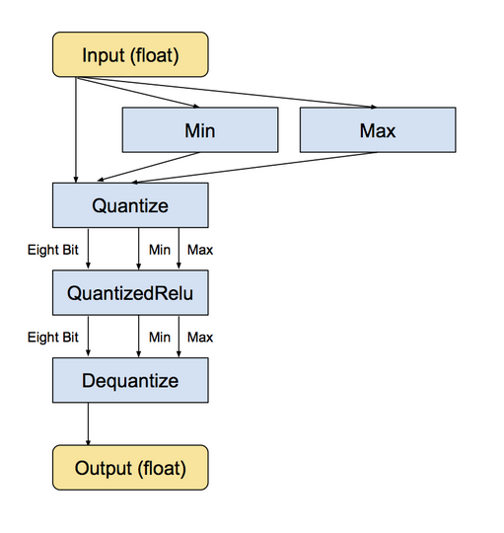
Notes:
The min and max operations actually look at the values in the input float tensor, and then feeds them into the Dequantize operation that converts the tensor into eight-bits. There are more details on how the quantized representation works later on.
These include convolution, matrix multiplication, activation functions, pooling operations and concatenation
For the sizes, I have commented what's happening. We're taking 5x5 convolutions on the initial image, and producing 32 outputs. Next, we take 5x5 convolutions of the 32 inputs and make 64 outputs. From here, we're left with 7x7 sized images, and 64 of them, and then we're outputting to 1024 nodes in the fully connected layer. Then, the output layer is 1024 layers, to 10, which are the final 10 possible outputs for the actual label itself (0-
https://petewarden.com/2017/06/22/what-ive-learned-about-neural-network-quantization/
then in the forward pass the float values will be rounded to the specified number of levels (typically 256) to simulate the effects of quantization. In the backward pass, this rounding won’t be performed, so gradients will be calculated using full float values. This has the effect of forcing the graph to adapt to the lower precision it will encounter during inference, and in practice we’ve seen this improve the accuracy of the quantized graph dramatically, sometimes to a level indistinguishable from float.

Slide 10
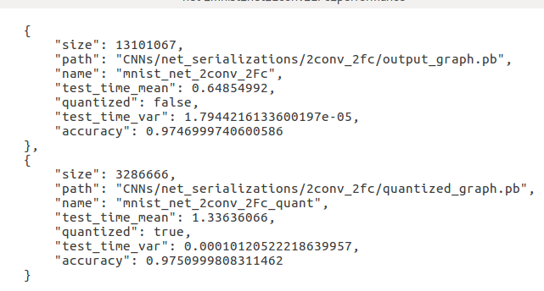
Quantization Results
Notes:
We cannot directly build model by using lower precision data

