Slide 1
Framework

Slide 2
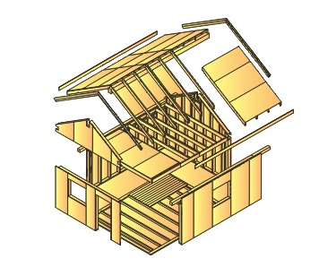
Framework
In computer systems, a framework is often a layered structure indicating what kind of programs can or should be built and how they would interrelate.

Slide 3
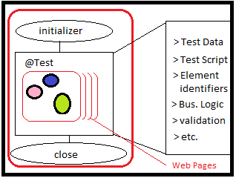
Existing test:

Slide 4
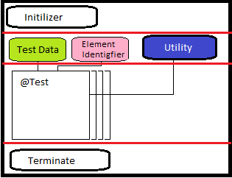
Framework

Slide 5
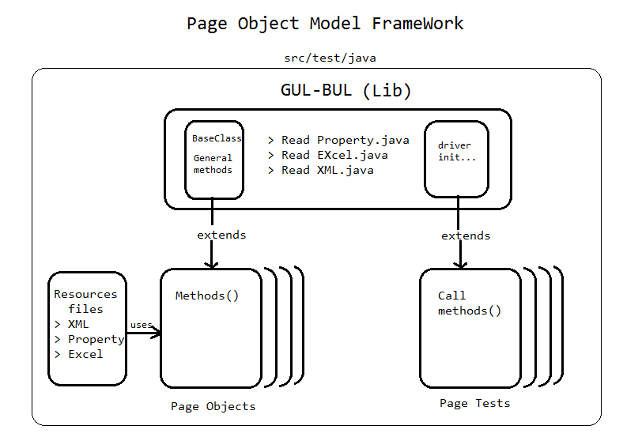

Slide 6
Thank You

