Slide 1
Web Service automation using SoapUI By Deepak

Slide 2
Agenda
Web Service
What is SoapUI?
Why SoapUI Automation?
Components of Web Services
SoapUI Architecture
Approach
SoapUI framework
Creating SOAP project
Data Source and Data Sink
Groovy Script
Sample Data source and Data sink file

Slide 3
Web Service
A web service is any piece of software that makes itself available over the internet and uses a standardized XML messaging system. XML is used to encode all communications to a web service
It makes application platform and technology independent
Communication
SOAP over HTTP protocol

Slide 4
Web Services
Services Oriented Architecture
Web Service
Service
Provider
Request
Service
Consumer
Implementation
Response
Web service is an implementation of SOA

Slide 5
What is SoapUI?
SoapUI is a complete testing tool!
Functional testing
Load testing
Security testing
Open Source
SoapUI Pro is the commercial enterprise version
V5.1.2 is last version of Pro & latest version available is SoapUI NG Pro 1.3.1

Slide 6
Why SoapUI Automation?
Reduce rework
Increase the effectiveness, efficiency and coverage
Reduce the time to run regression tests

Slide 7
Components of Web Services
The basic Web services platform is XML + HTTP.
SOAP (Simple Object Access Protocol)
SOAP is an XML-based protocol for exchanging information between computers
WSDL (Web Services Description Language)
WSDL is an XML-based language for describing web services and how to access them
UDDI (Universal Description, Discovery and Integration)
UDDI is an XML-based standard for describing, publishing, and finding web services

Slide 8
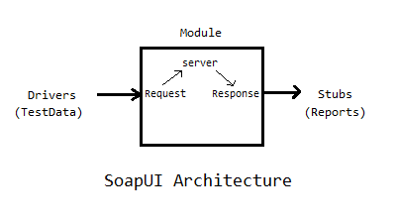
SoapUI Architecture

Slide 9
Approach
Requirement Gathering
Requirement analysis and Planning
Test case identification
Test Data Preparation
Test script design/Develop (Soap UI)
Unit Testing of Soap UI Script
Execution
Test result Analysis and validation

Slide 10
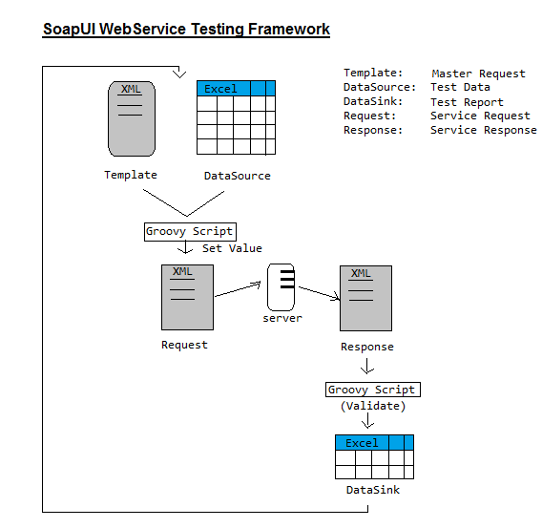

Slide 11
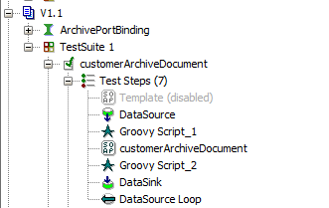
Creating SoapUI project

Slide 12
Data Source and Data Sink
Data Source holds the test data for SOAP request message
Excel, JDBC, XML, Groovy etc.
Data Sink contain test result and SOAP response data.
Excel, JDBC, XML, Groovy etc.

Slide 13
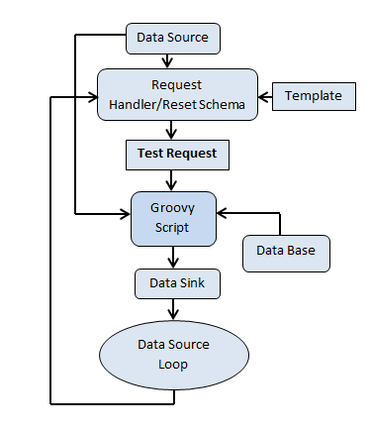
SoapUI Architecture

Slide 14
Groovy Script
To set input data in SOAP request message
To customize SOAP request according to input data
Validate SOAP response with the expected values
Set value to report
References:
http://www.soapui.org/
http://www.tutorialspoint.com/webservices/what_are_web_services.htm
Notes:
A proximity sensor is a sensor able to detect the presence of nearby objects without any physical contact.
An accelerometer is a device that measures acceleration.
A gyroscope is a device for measuring orientation in 3D.
Ambient sensors are sensors capable of jointly sensing multiple physical phenomena in various surroundings – temperature, light.

Slide 15
Sample Input data file

Slide 16
Sample Test report

Slide 17
Thank You

