Slide 1
Software Testing

Slide 2
Agenda
History
Statistics
Importance of testing

Slide 3
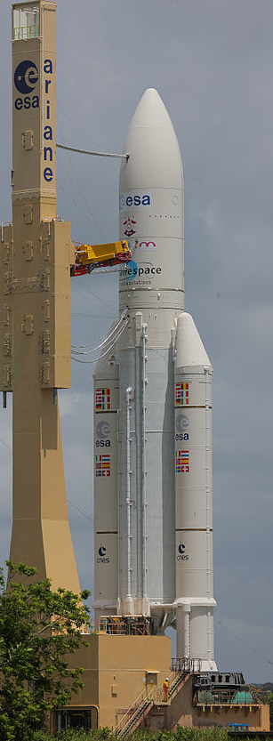
History
Ariane 5’s first test flight on 4 June 1996
An Expendable launch vehicle (ELV)
Function: Heavy launch vehicle
Height: 46–52 metres
Mass: 1,713,000 lb
Stages: 2

Slide 4
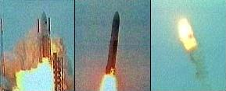
History cont.
Self-destructed 37 seconds after launch
Cause:
A data conversion from 64-bit floating point value to 16-bit signed integer value.
Cost: approx. $500 million

Slide 5
Statistic
40 percent of the IT budget is allocated towards quality assurance and software testing
More Info: www.gartner.com

Slide 6
Why Testing?
Humans make mistakes all the time.
Point out the defects and errors
Ensure the Quality
Delivery of high quality product or software application

Slide 7
Questions

Slide 8
Thank You

