Slide 1
Web Service Automation

Slide 2
Agenda
Web Services
Web service protocols
Web service automation using soapui
SoapUI automation framework
Automator
Test Automator Features

Slide 3
Web services
A Web service is a method of communication between two electronic devices over a network.
Features:
Interoperability: for interactions between different platforms
communicate using open protocols
Loosely coupled
Supports Remote Procedure Calls (RPCs)

Slide 4
Web service protocols
SOAP - Simple Object Access Protocol
REST - Representational State Transfer
UDDI - Universal Description, Discovery, and Integration etc.

Slide 5
Web service automation using soapui
A full-fledged automation implemented and optimized since 2012 in SPAN
Data driven test automation
Includes standard groovy library
Reduces complex logic/scripts in to reusable components

Slide 6
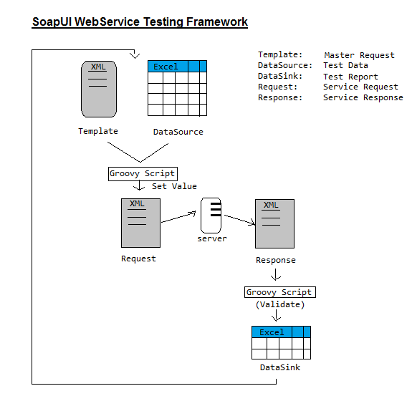
SoapUI automation framework

Slide 7
Automators
Software developed to automate repetitive tasks
Perform different actions automatically
Use batch files
Use code (Programing language)
Use automation scripts
Develop well designed and fully tested applications.

Slide 8
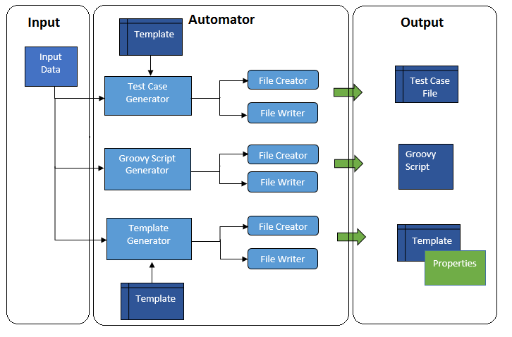
Test Automator design

Slide 9
Test Automator Features
Identify different test scenario w.r.t input data
write test cases
Generate sample data for validation
optimize test cases
Generate scripts, templates and other artifacts

Slide 10

Questions

Slide 11
Thank You

