Slide 1

The Voice of the Developer (AI IN FOCUS):
Insights from the 2023 Developer Survey
DATA230 : VISUALIZATION PROJECT
NAME: SHRINIVAS A BHUSANNAVAR
SJSU ID: 016990545

Slide 2
INTRODUCTION:
For more than ten years, Stack Overflow has been like the hub spot for developers. where they explore, share what they know, and help each other out with problems. So, every year, they do this big survey to figure out what's going on in the world of programming. This time, almost 90,000 developers took part, and it's kind of like getting insights into the stuff in AI.

Slide 3
DATA COLLECTION:
In this project, we gathered our data from two distinct sources:
1.Stack Overflow Survey dataset : https://www.kaggle.com/datasets/stackoverflow/stack-overflow-2023-developers-survey
2.Global AI Index : https://www.kaggle.com/datasets/katerynameleshenko/ai-index
The Stack Overflow Survey dataset provides a rich source of information directly from developers worldwide. By tapping into this dataset, we aim to understand developers' perspectives on various aspects, including their use of AI, the tools they employ, and their sentiments towards AI accuracy. This dataset acts as a valuable window into the real-world experiences and opinions of developers across different regions and industries.
Complementing this, I incorporated data from the Kaggle Global AI Index dataset. IT encompasses key information about 62 countries, including the Global AI Index and seven indicators influencing it. These indicators cover Talent, Infrastructure, Operating Environment, Research, Development, Government Strategy, and Commercial aspects, offering insights into AI implementation, innovation, and investment globally A

Slide 4
DATA CLEANING:
To clean up the data for visualization, I used Python and some features within Tableau. For a clear view, I utilized Python's Pandas library to clean the data and generate total counts for each related column. Chord diagrams were crafted using pivot tables, explode, and group-by functions. Similarly, for other charts like Sankey,
I employed filtering null values and created JSON files for certain D3 plots. The main visualization was done using Tableau supporting the overall presentation.

Slide 5
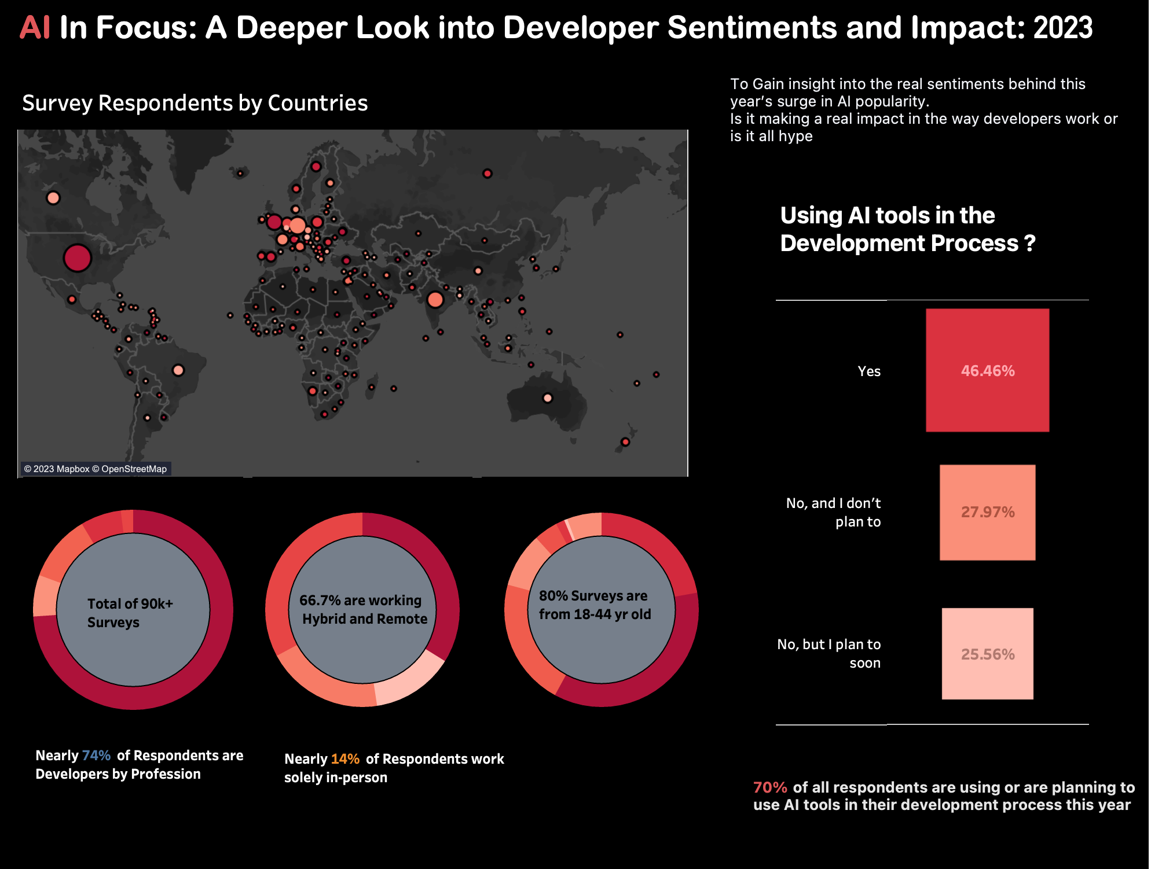
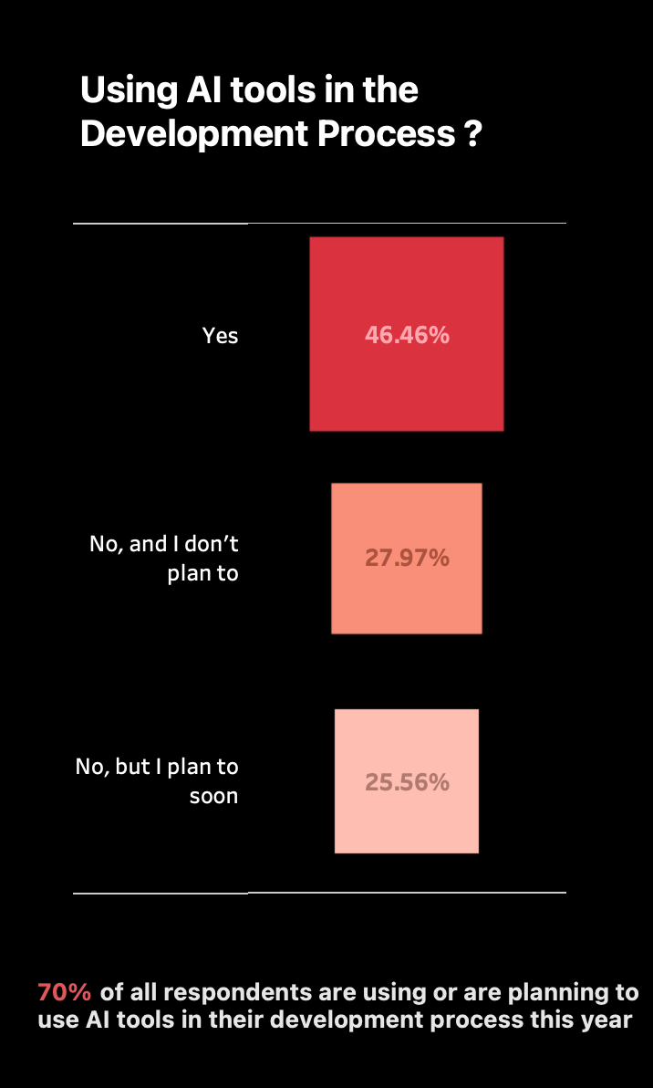
AI In Focus 2023 Survey Insights: Developer Sentiments and Impact
Gain insights into the genuine sentiments driving the surge in AI popularity this year. Evaluate whether it's genuinely impacting developers' work or if it's more of a hype.

Slide 6
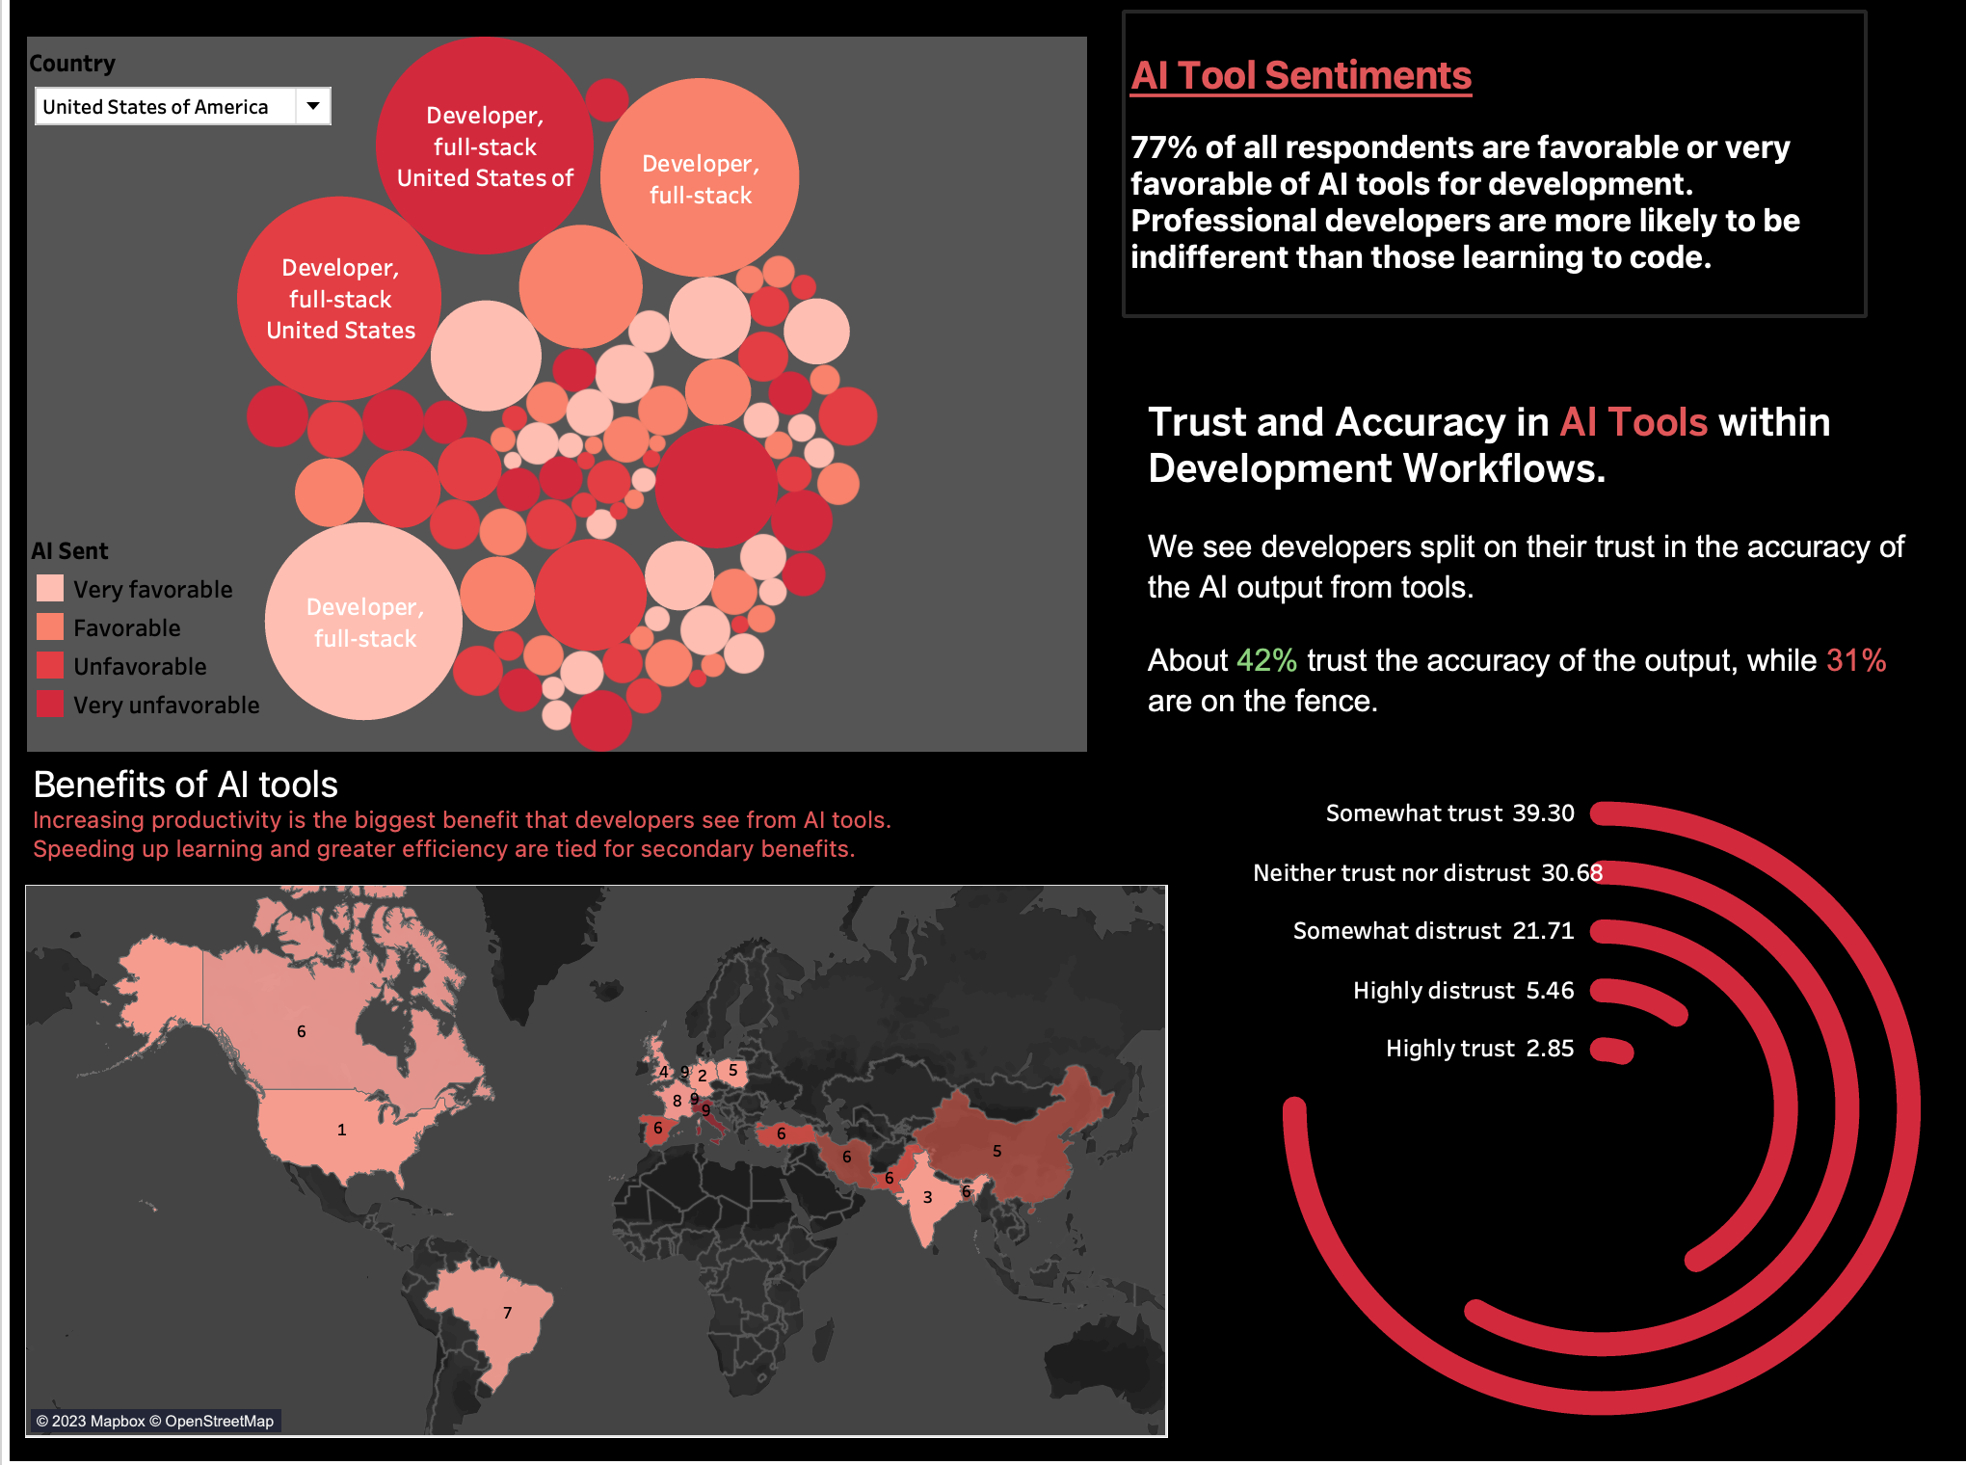
Dashboard 2: AI TOOLS SENITMENTS
It provides an overview of the AI In Focus 2023 survey results on developer sentiments and impact.
The dashboard includes several different visualizations, such as maps, charts, and graphs. These visualizations provide insights into how developers.
are using AI tools, their trust in the accuracy of AI output, and the benefits they are seeing from using AI tools

Slide 7
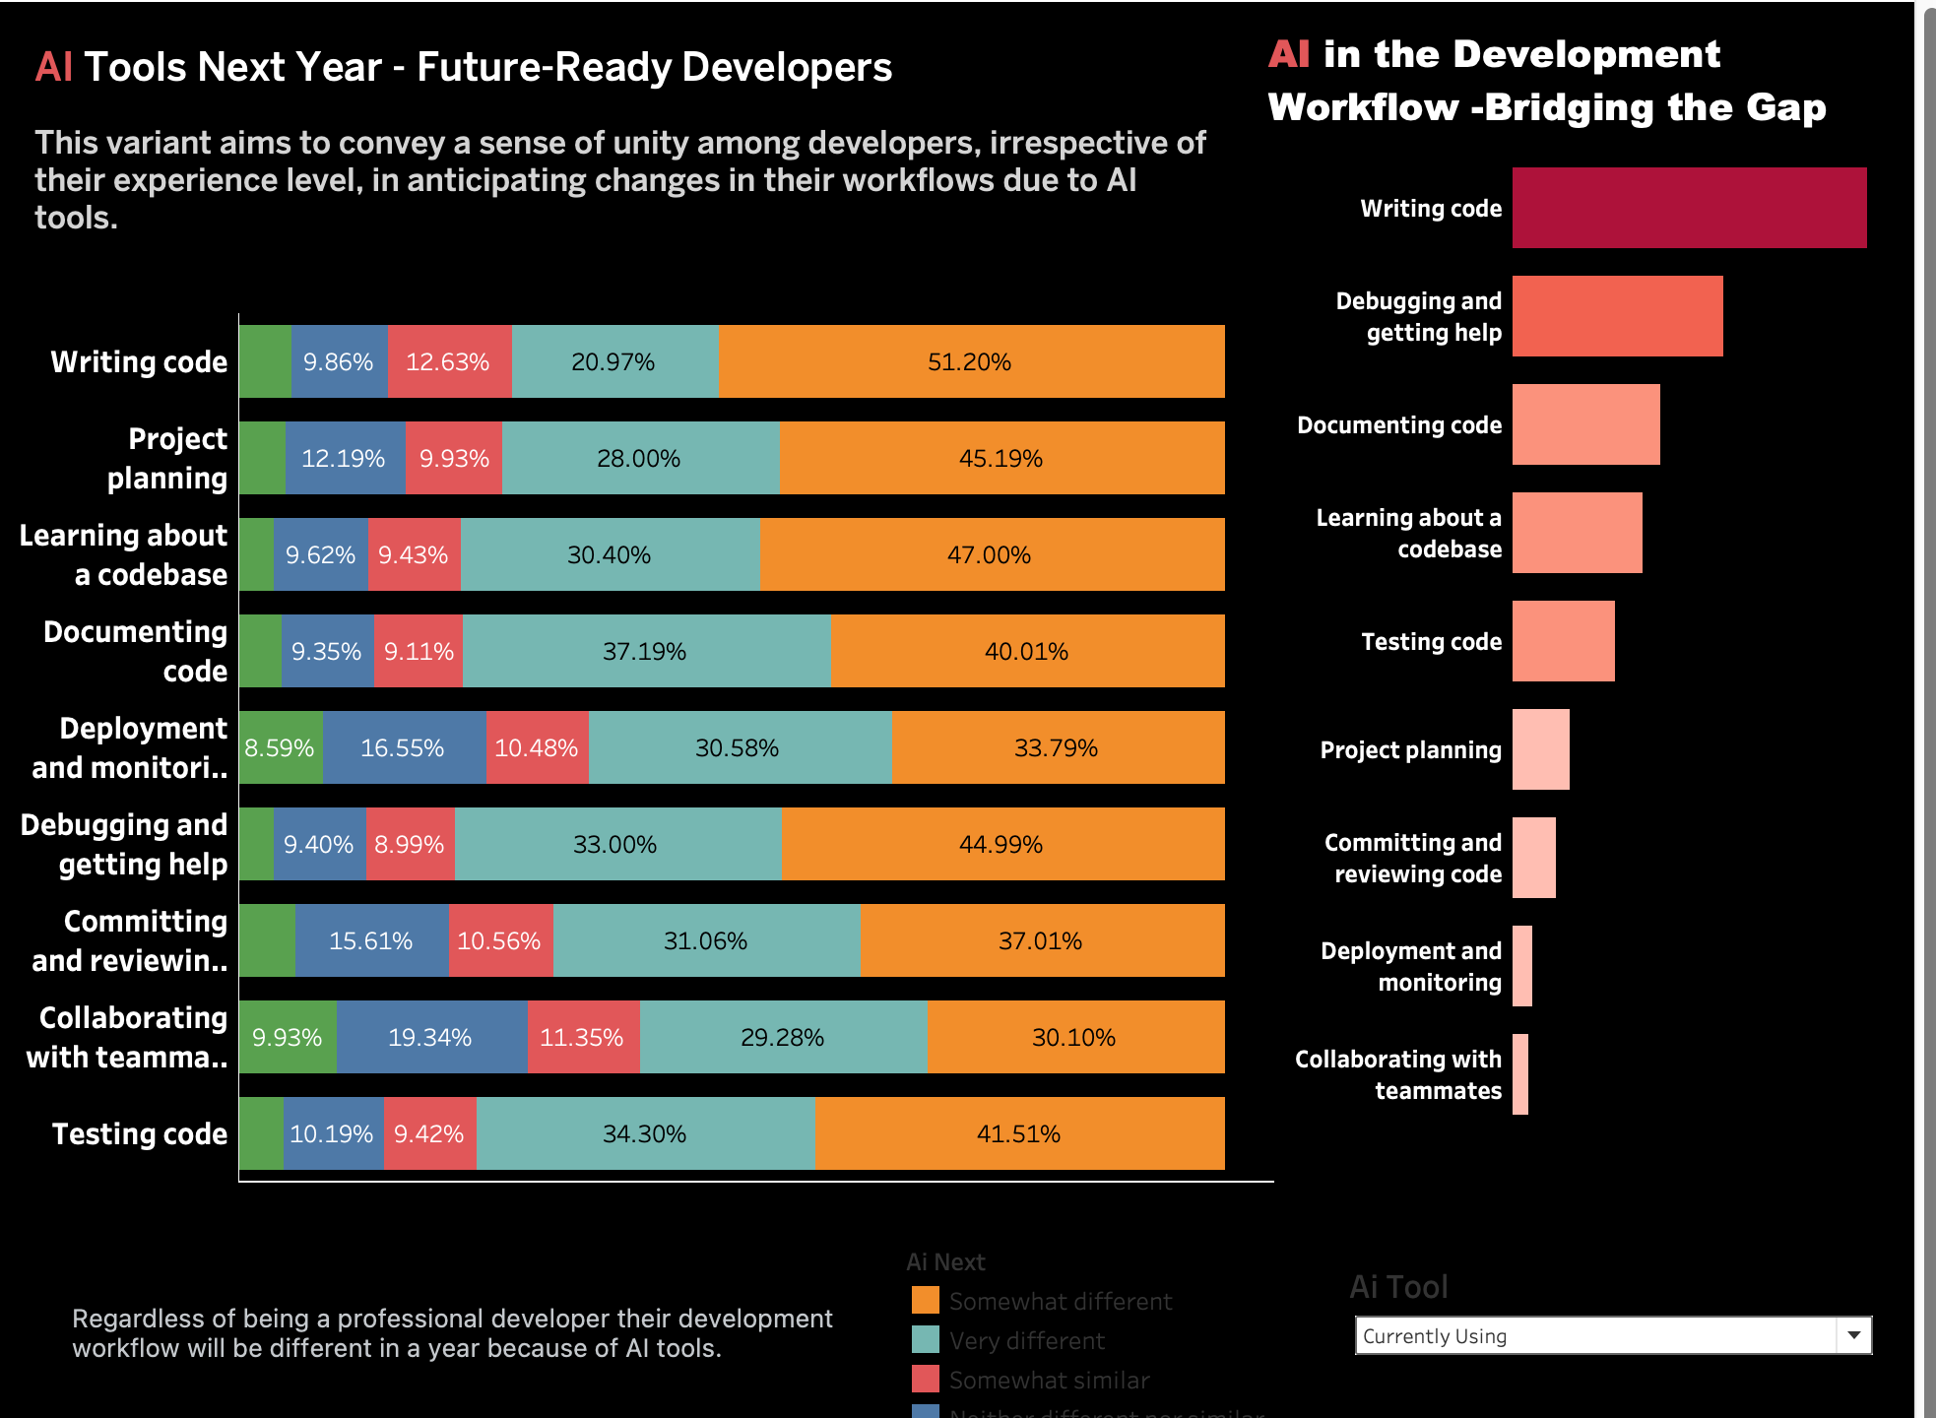
Dashboard 3: AI TOOLS NEXT YEAR
The dashboard is designed to show how developers of all experience levels are anticipating changes to their workflows due to AI tools. The graph shows that the four most important tasks for developers are writing code, debugging, and getting help, project planning, and documenting code

Slide 8
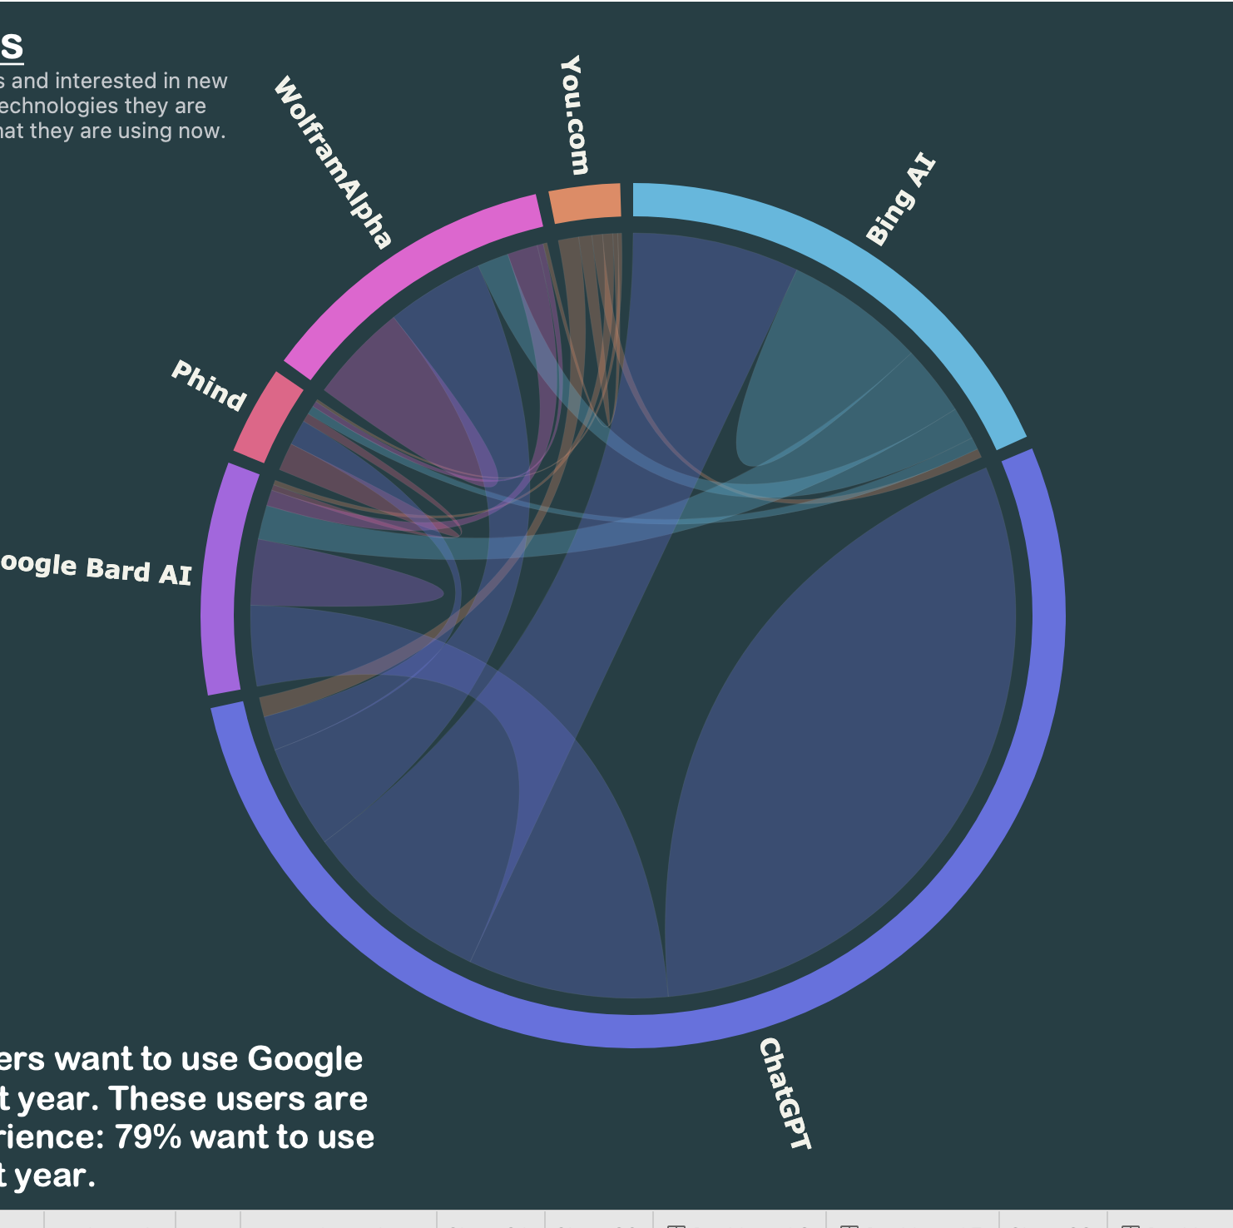
Chord diagram: AI Search Tools
Developers like trying out new technologies. We're checking which ones they're interested in based on what they use now. I created a chord diagram using D3, allowing data filtering, and performed pivot calculations in Python to analyze the AI search tools preferred by developers.

Slide 9
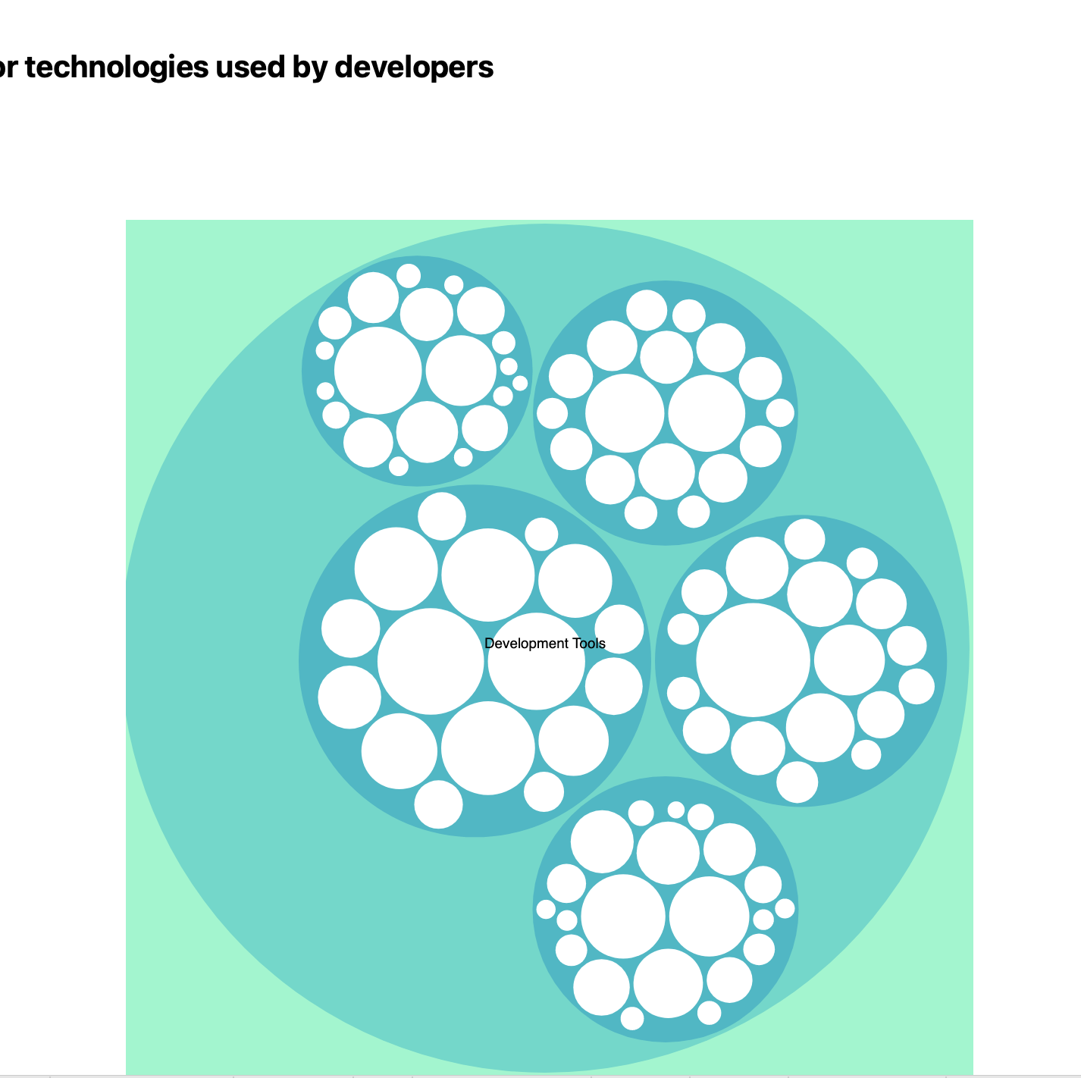
Zoomable Bubble Chart: Developer Tools Overview
Five main categories:
1.LANGUAGES
2.WEBFRAMEWORKS
3.NEWCOLLAB TOOLS
4.DATABASES
5.OFFICE TOOLS
This interactive chart allows users to zoom in and explore details within each category, providing a visual and user-friendly representation of various developer tools across these five significant domains.

Slide 10
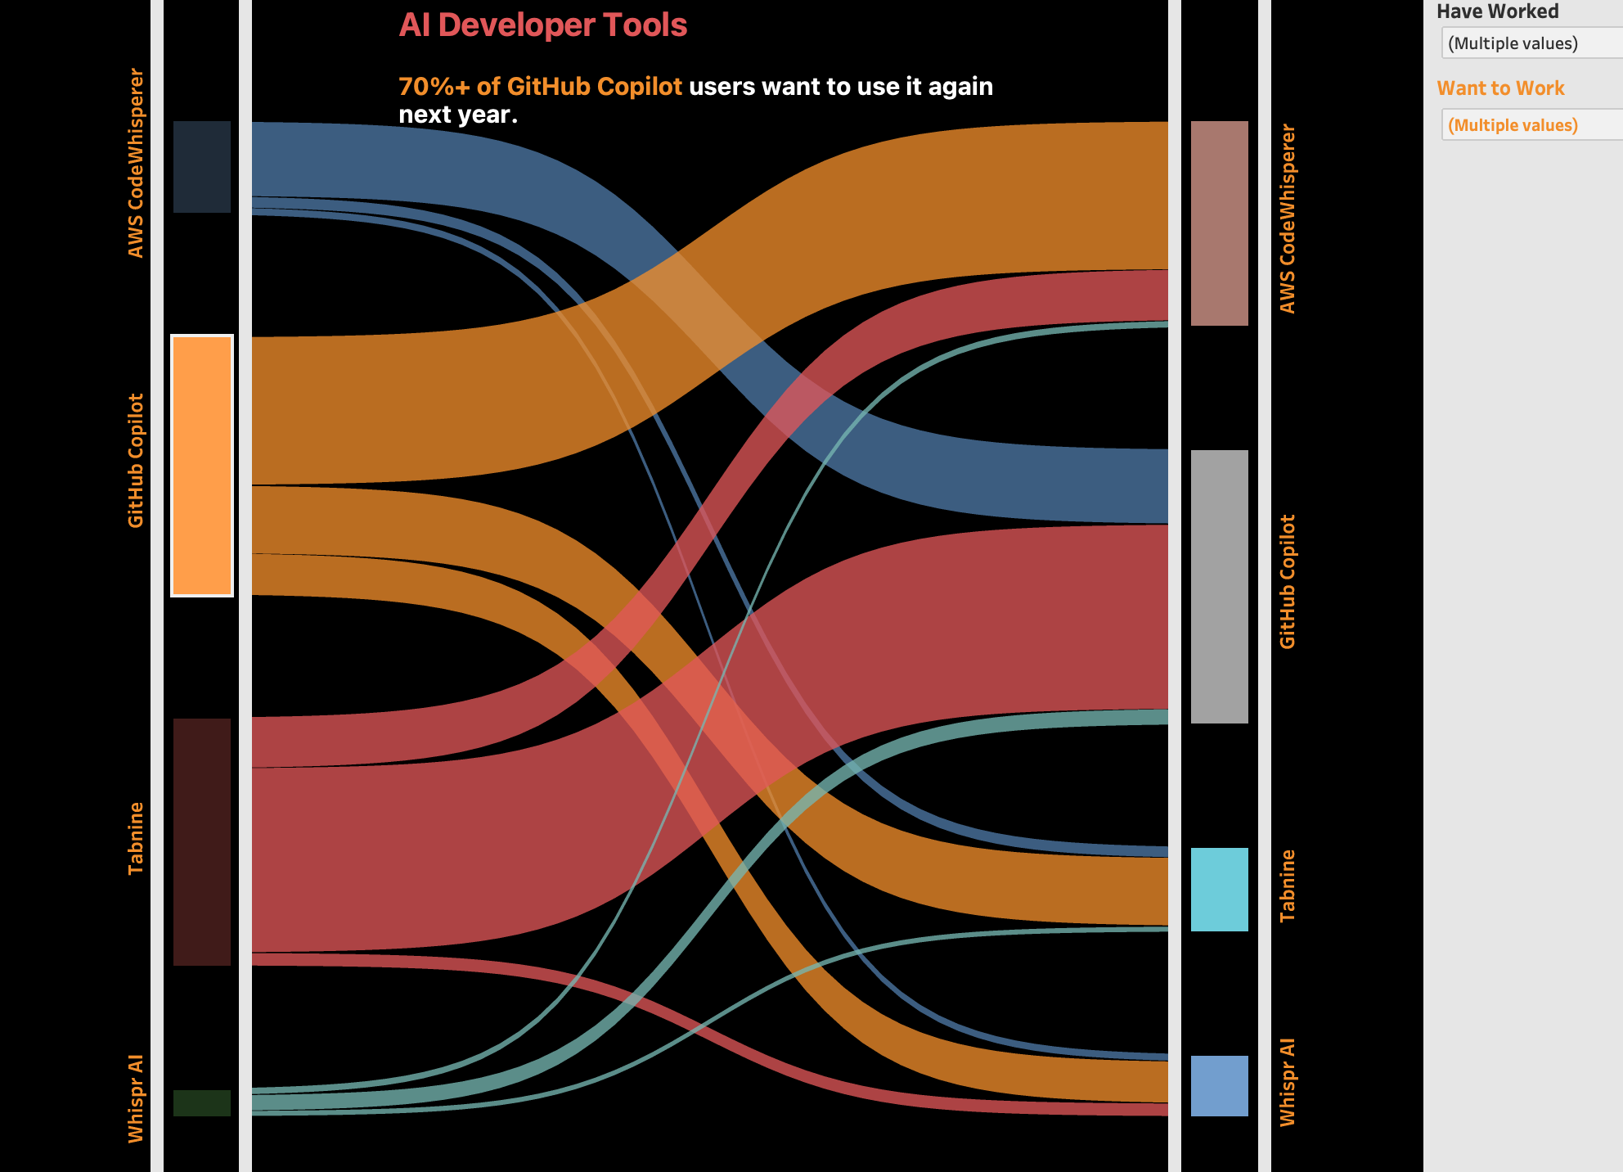
Sankey chart: with filter on (AI DEV Tool)
The Sankey chart illustrates how users transition between different AI developer tools. GitHub Copilot leads as the most favored tool, with 50.2% of users, followed by Tabnine (25.1%) and Whispr AI (12.4%). AWS CodeWhisperer (12.3%).

Slide 11
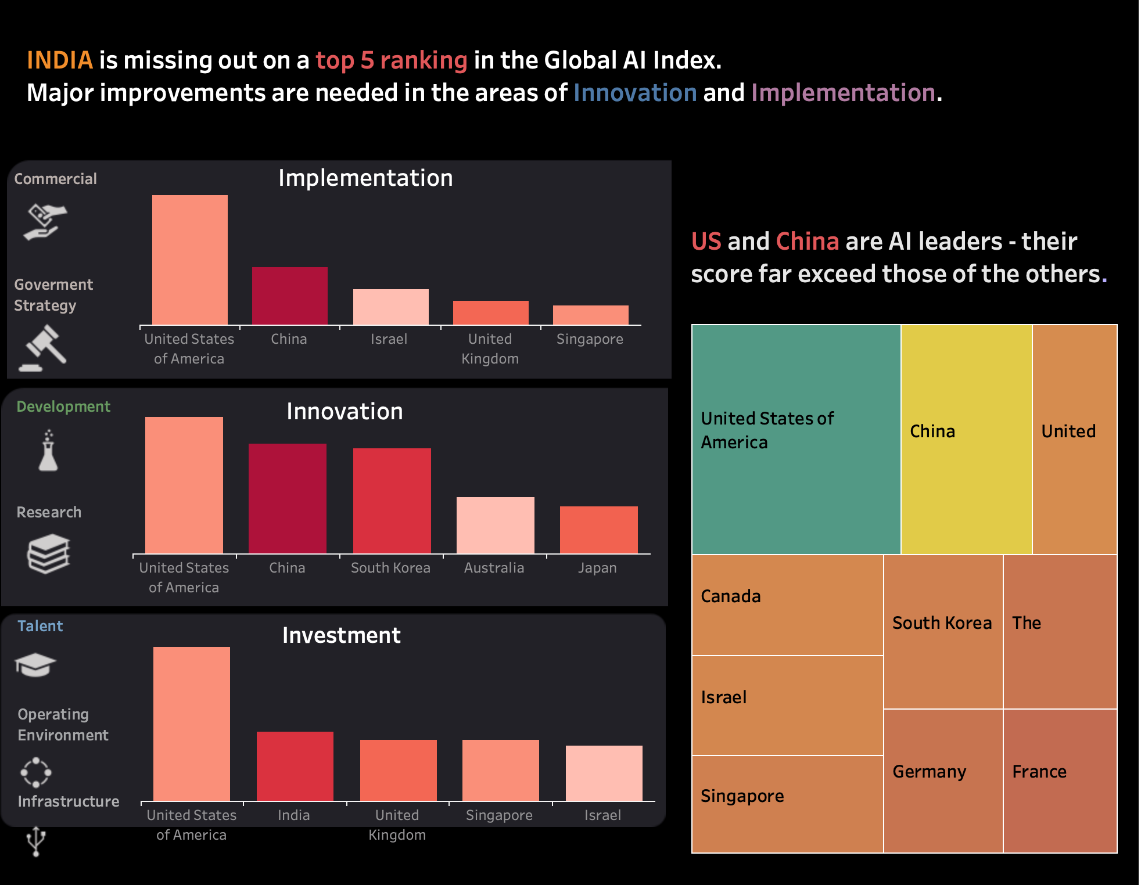
GLOBAL AI INDEX DASHBOARD:
The dashboard you sent shows India's performance on the Global AI Index 2023.
The index measures the performance of countries in terms of their AI innovation, investment, and implementation.
Insights from dashboard:
Global AI Leadership:
The United States maintains its position as the world leader in AI.
China is swiftly advancing and narrowing the gap in AI capabilities.
Leading AI Hubs:
Beyond the U.S. and China, other prominent AI hubs include Israel, Singapore, and the United Kingdom

Slide 12
Summary:
In summary, our exploration into the worldZ of AI covered a wide range of areas, from how developers feel about it to its global reach and the tools they use. Here's what we learned:
Conclusion:
In conclusion, our findings reveal a dynamic AI landscape. While the United States stays on top, other countries like China and India are catching up. Developers are actively embracing AI tools, indicating a significant shift in how technology is used. Looking ahead, innovation, investments, and skill development will continue to shape the future of AI, influencing technology landscapes across the globe.

