Slide 1
Customer Shopping Trends
DATA-225 Sec 21 - Db Systems for Analytics

Slide 2
TEAM DATA DYNAMOS
Shrinivas Bhusannavar – 016990545
Harivardhana Naga Naidu Polireddi – 017437238 Yashasvi Kotra - 017466436 Karthik Nimmagadda - 016996148

Slide 3
Agenda
Introduction
OLTP Database: Customer Shopping Bill
Analytics Database: Sales Data
Customer Data Integration
Sales Analytics
Conclusion

Slide 4
ABOUT PROJECT
Customer shopping trends refer to the patterns, behaviors, and preferences that customers exhibit when making purchasing decisions. Understanding these trends is crucial for businesses as it allows them to adapt their strategies to meet consumer expectations, enhance the shopping experience, and ultimately drive sales.

Slide 5
DATA SOURCE
DATASET USED:
https://www.kaggle.com/datasets/iamsouravbanerjee/customer-shopping-trends-dataset

Slide 6
Application Design​
Developing tools include :
ETL : Python,
Database : MySQL Workbench,
GUI : Tkinter Designer.​​
It requires additional packages to install:-​
Pandas​
Numpy
Matplotlib​
Tkinter​

Slide 7
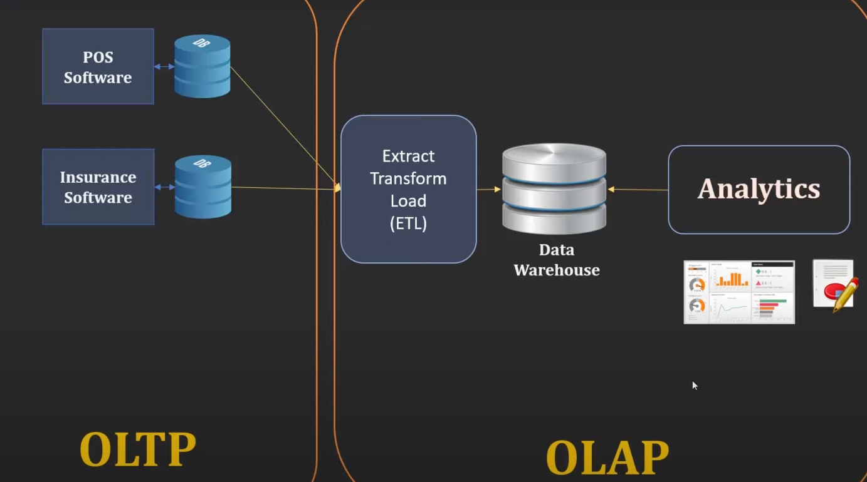

Bill Generation
DATA WORK FLOW
Extract Transform Load
(ETL)
Inventory Update
Analytics
Data Dynamos DB
Data Dynamos WH

Slide 8
Operational Module​
Store Employee Functions:
Registration and Login:
Store employees can register and log in to the system.
Billing:
Prepare bills for customer shopping transactions.
Bill Generation:
Generate bills using the system for completed transactions.
Admin/Store Manager Functions:
Inventory Management:
Update, add, and delete items from the warehouse.
Employee Management:
Register new employees and manage their details.

Slide 9
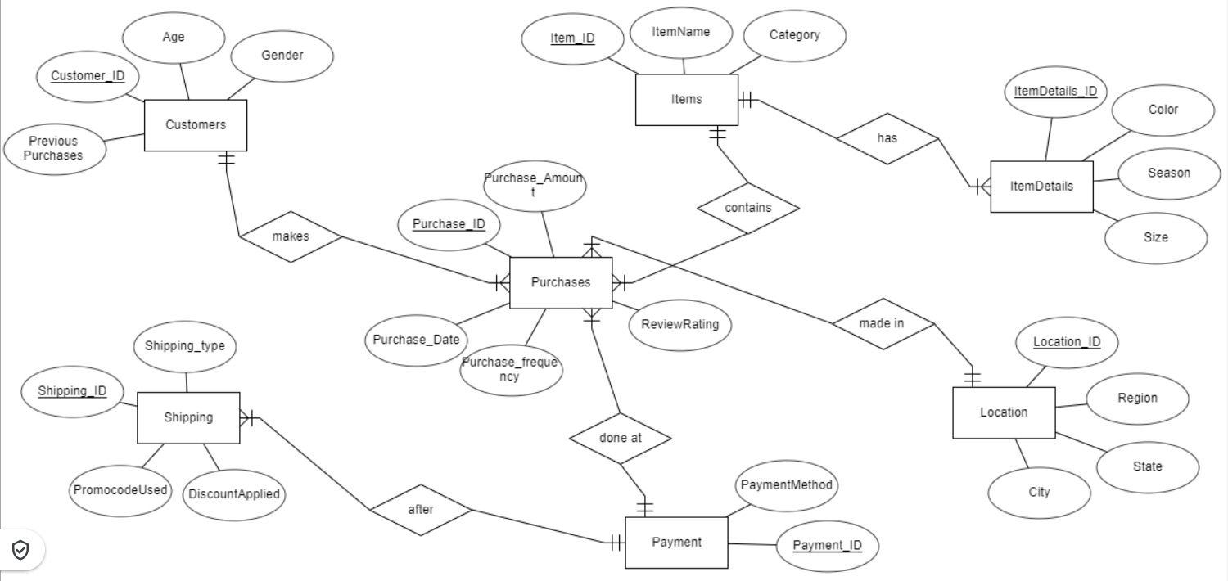
OLTP ER- DIAGRAM

Slide 10
ETL Process
ETL Execution in Python:
Python is the primary language for our ETL process.
ETL execution occurs from the server side in SQL.
SQL Integration :
Seamless execution of SQL queries from Python.
User Interaction:
Dynamic queries triggered from a user-friendly GUI.
Process Flow:
Python initiates the ETL workflow.SQL queries, including view creation and stored procedures, are executed.
User input via GUI drives dynamic queries.

Slide 11
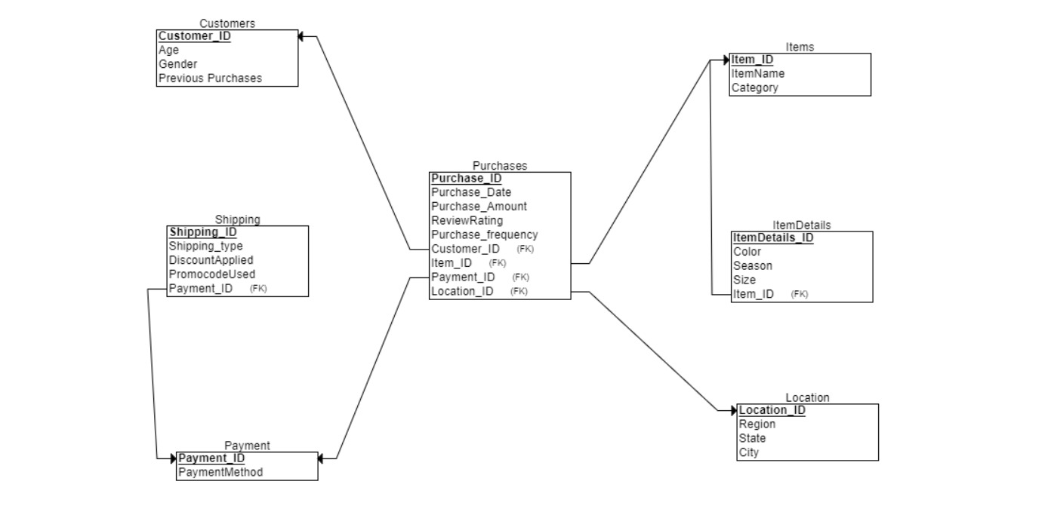
OLTP Relational Schema

Slide 12
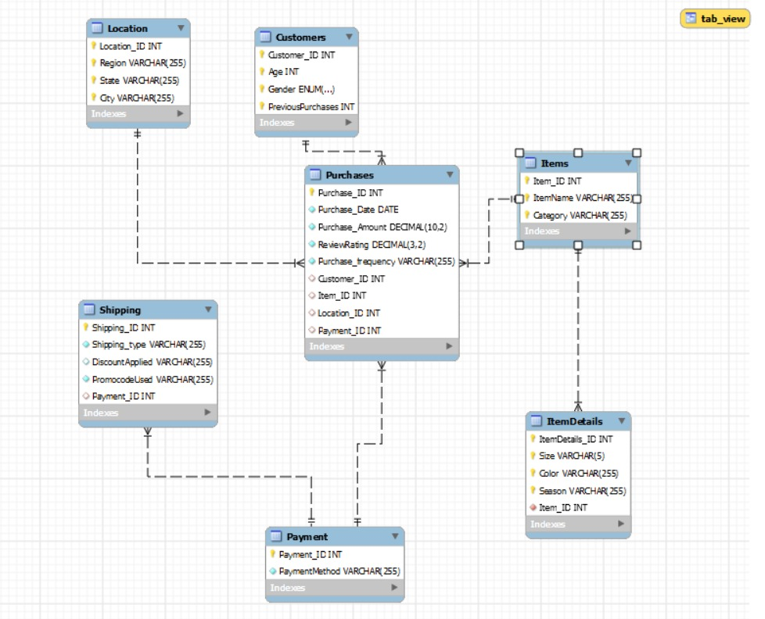
OPERATIONAL DB STRUCTURE
Normalized Tables
Maintained All the Integrity Constraints
Views
Nested Queries
Stored Procedure
ETL :- Using CSV file we have done Inserting and Cleaning and preprocessing by using SQL and Python

Slide 13
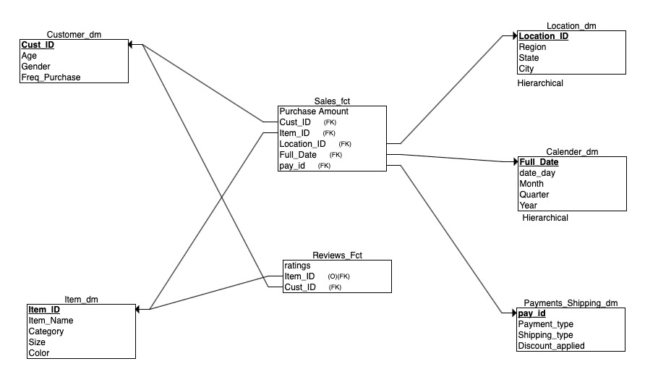
OLAP – STAR SCHEMA

Slide 14
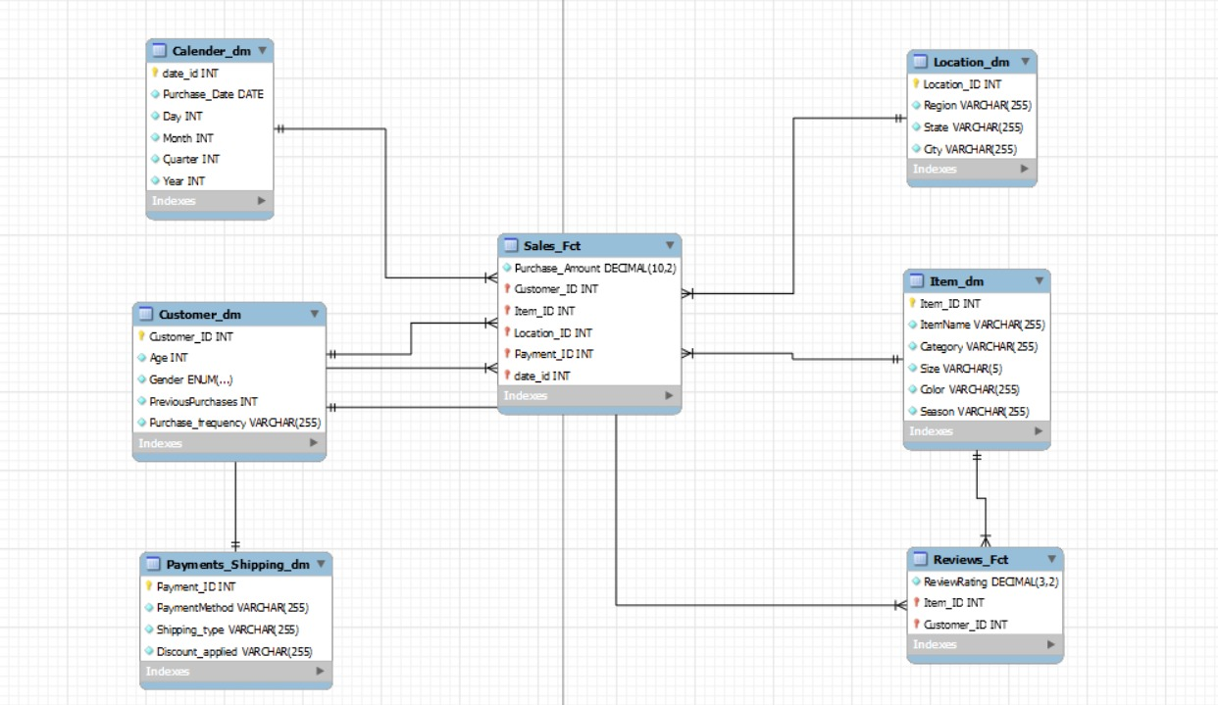
ANALYTICAL DB STRUCTURE
Normalized Tables
Maintained All the Integrity Constraints
Views
Nested Queries
Slicing Operations
Dicing Operations
Rollup Operations
Drill Down Operations
Granularity Maintained
ETL :- Done from operational tables using sql(server side executing from python scripts including graphs)

Slide 15
Analytical Module
Data Collection: Analyzing data collected from the operational database module billing systems.
Revenue Analytics Dashboard:
Total Revenue: Display the total revenue up to date.
Total Customers: Showcase the total number of customers up to date.
Monthly Revenue by Category: Breakdown of revenue for each category on a monthly basis.
Revenue Breakdown: Analyse total revenue by category, season, and region.

Slide 16
Customer Demographics:
Average Age: Explore the average age of customers.
Average Reviews: Analyze the average reviews provided by customers.
Gender Distribution: Showcase the distribution of sales by gender.
Age Groups Distribution: Display the distribution of sales across different age groups.
Gender Distribution by Category: Breakdown of gender distribution for each product category.

Slide 17
Product Analytics:
Roll-Up and Drill-Down: Implement roll-up and drill-down features for sales analysis at the month, quarter, and year levels.
Product Performance: Evaluate the performance of each product based on sales data.

Slide 18
THANK YOU

