Slide 1
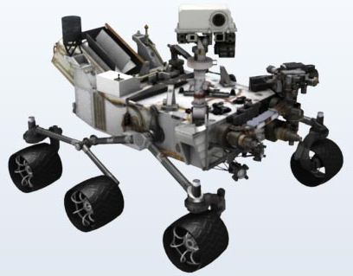
Robotics: Manipulation, Decision Making and Learning Project Work
Implementation of Reinforcement Learning (Q-learning) based robotic navigation system to help a robot to move out of an unknown maze autonomously
Laura Garcia
604697
Shikha Sharma
605159

Slide 2
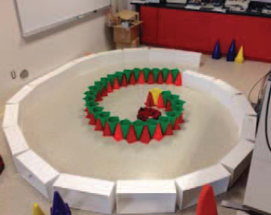
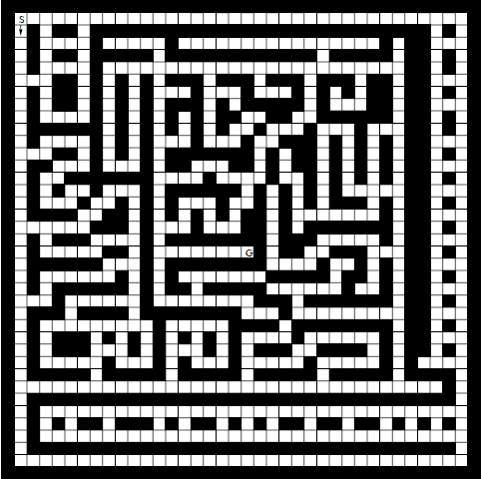
The problem
To navigate the autonomous mobile robot out of the maze.
Two optimal policies are required:
Policy I: Teaching obstacles avoidance
Policy II: Teaching navigation through the maze

Slide 3
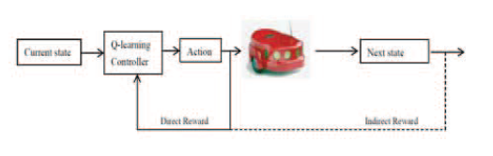
Q-learning
Advantages:
Low requirements of computational resources
Good real-time performance
It does not need training samples

Slide 4
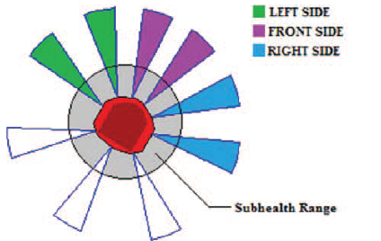
Policy I: Obstacle Avoidance
In order to determine the world states in the Q-learning algorithm, IR/sonar sensors are used to detect the distances between the robot and the closest obstacles in three specific directions.
State is a vector with relative amplitude of the distance from obstacle, s = [Left Right Front]
Action can be one of the four, a= [F L R]
Action F: Move forward for specified distance e.g. 100mm
Action L: Turn left for 15 deg
Action R: Turn right for 15 deg
*Emergency action: Protection to prevent the robot three distances is smaller than 170mm, the robot will move backward for 100mm.

Slide 5
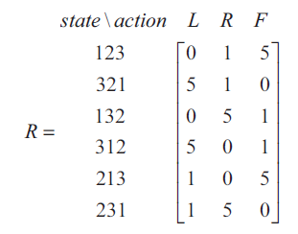
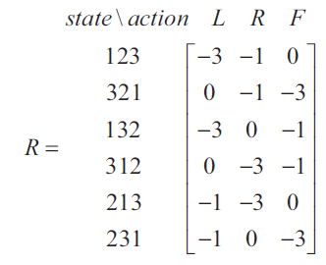
Policy I: Obstacle Avoidance
The Rewards earned are according to if robot ends in health state or sub-health state.
If a health state is observed by the robot, a positive reward will be received.
On the other hand, a sub-health state indicates that at least one of obstacles is very close to the robot and the robot needs to move away from it immediately. Thus, a robot in a sub-health state will always receive a negative reward
Reward table, Health State
Reward table, Sub-Health State

Slide 6
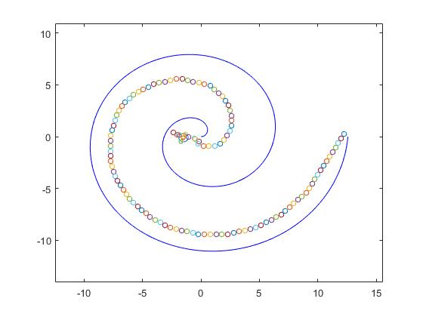
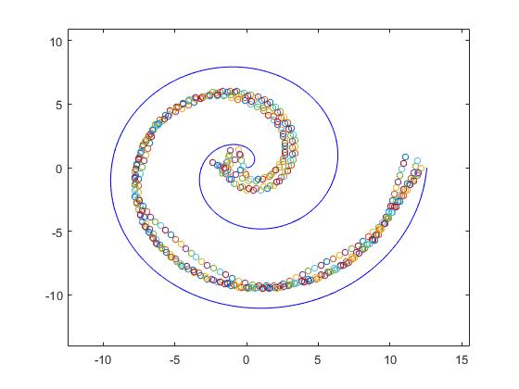
Policy I: Obstacle Avoidance
Simulation results
One Episode
Five Episodes

Slide 7
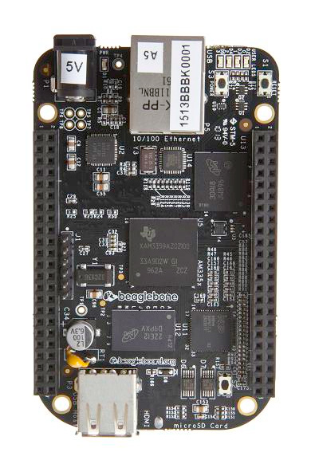
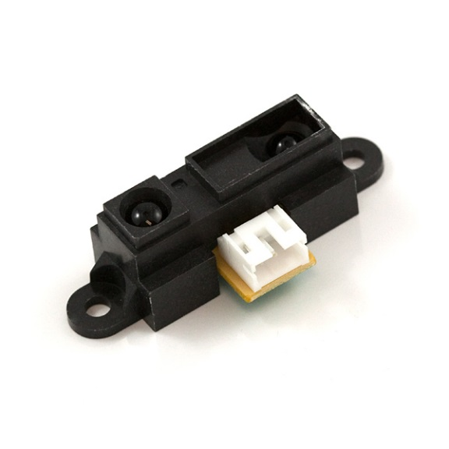

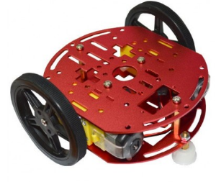
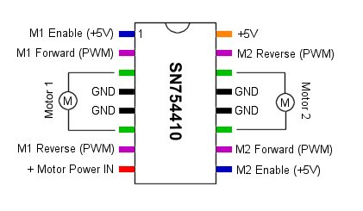
Policy I: Obstacle Avoidance
Hardware Implementation

Slide 8

Policy I: Obstacle Avoidance
Hardware Implementation

Slide 9
Policy II: Navigation through maze
Options Considered
Value Iteration (The way we used for assignments)
Episodic Q-learning (Position in maze as state)
Non-episodic Q-learning (Obstacle position as state)
Traversing maze from start state to end state
Decision nodes as state

Slide 10
Policy II: Navigation through maze
Episodic Q-learning (Position in maze as state)
Position in grid as state.
Actions : [N, S, E,W]
Rewards are given for terminal state.
Parameters used for Q-learning: epsilon=0.1(e-greedy, probability of choosing action randomly); gamma=0.9 (discount factor); alpha=0.1 (step size constant)

Slide 11
Policy II: Navigation through maze
Non-episodic Q-learning (Obstacle position as state)
Position of obstacles in NSEW direction as state, total 16 states.
[0 0 0 0 ] – no obstacles, free to move in all directions
[1 0 0 0 ] – obstacle in east
Actions : [N, S, E,W]
Trying to find the best action in each state with Q-learning.
Results are random i.e. number of iteration vary.

Slide 12
Policy II: Navigation through maze
Traversing maze from start state to end.
Decision nodes as states.
Actions : [N, S, E,W]
Local position of the robot is assumed to be known (with the help of some localization sensors)
Rewards
If loop or dead end then -100 as reward.
If Next meaningful state then +10 a reward.

Slide 13
Limitations and Future Direction
Limitation
Inaccuracy estimating states (sensors output being noisy).
Policy for navigation is not optimal in case of non episodic traversal of the maze
Future
Using POMDP framework to solve the problem.

Slide 14
References
Bashan Zuo1 Jiaxin Chen1, Larry Wang2 and Ying Wang1,” A Reinforcement Learning Based Robotic Navigation System”, 2014 IEEE International Conference on Systems, Man, and Cybernetics,October 5-8, 2014.
Richard S. Sutton and Andrew G. Barto,” Reinforcement Learning: An Introduction”

