Slide 1
FPGA-ENHANCED FAST AND SECURE BIOMETRIC RECOGNITION

Slide 2
CONTENTS
Introduction
Objective
Literature survey
Hardware and software used
Block diagram
Methodology
Results
Conclusion
References

Slide 3
INTRODUCTION
One of the crucial biometrics used for identification of a person is the iris recognition since the patterns in iris remain unaltered for the whole lifetime of an individual and it cannot be replicated.
This project focuses on optimizing iris recognition by enhancing the speed, accuracy of iris feature extraction and matching using FPGA which also ensures data security.
The parallel processing through pipelining in Field Programmable Gate Array (FPGA) can be used for achieving real-time authentication while implementing robust security measures to protect sensitive biometric data.
The goal is to overcome the limitations of existing CPU and GPU-based systems by providing a high-performance, resource-efficient solution suitable for a wide range of applications.

Slide 4
OBJECTIVES
To develop a robust iris recognition system using a custom Convolutional Neural Network (CNN) model, achieving high classification accuracy.
To overcome the limitations of existing methods by direct implementation of deep learning system on FPGA.
To realize real time model for iris recognition with FPGA Zynq board to attain high accuracy, efficient real-time processing, and secure execution of the CNN model.

Slide 5
LITERATURE SURVEY
AUTHORS | TITLE | JOURNAL / CONFERENCE / PUBLISHER / YEAR | SIGNIFICANT CONTRIBUTION
Huda Moyasar Therar, Ahmed Emad, Ahmed.J.Ali, Jadaan Ahmed. | Multibiometric system for iris recognition based on CNN and transfer learning. | Journal of Biometric Systems, 12(2), 105-118. | The paper proposes multimodal biometric system combining convolutional neural networks (CNN) and transfer learning for iris recognition
N.Almolhis. | A biometric model for iris images segmentation and deep learning classification. | International Journal of Biometrics and Security, 9(1),45-59. | This paper addressed the challenges in iris recognition, like noise and reflections using AlexNet for classification
Pasha, Syed , D, Anitha, Anbunathan.R , C.Gobinath, K.Madhura. | An efficient novel approach for iris recognition and segmentation based on the utilization of deep learning. | Journal of Pattern Recognition and Image Analysis, 32(4), 256-268. | This paper presented a deep learning framework based on a residual CNN for iris recognition.
Vineet Kumar, Abhijit Asati, Anu Gupta | Dedicated hardware architecture for localizing iris in VW images | Journal of King Saud University - Computer and Information Sciences. Volume 34, Issue 7, Pages 4568-4578, July 2022. | The paper proposes a specialized hardware architecture for iris localization in visible wavelength (VW) images.
Vineet Kumar, Abhijit Asati, Anu Gupta | Hardware Accelerators for Iris Localization. | Journal of Signal Processing Systems, Volume 90, issue 4, pages-655-671,2017. | This paper discusses the development of hardware accelerators specifically designed for iris localization.

Slide 6
HARDWARE AND SOFTWARE USED
HARDWARE:
FPGA board - Zynq UltraScale+ MPSoC ZCU104
SOFTWARE:
Kaggle
TeraTerm5 (FPGA interfacing)

Slide 7
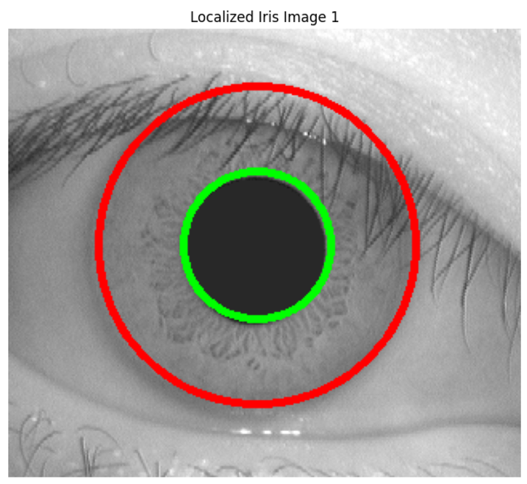
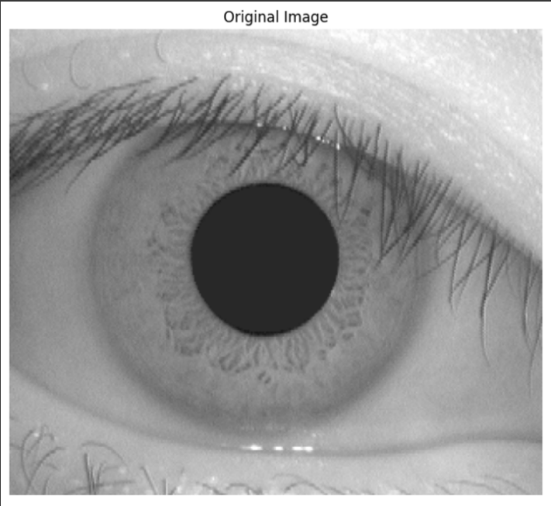
BLOCK DIAGRAM
Iris boundary
Pupil boundary
Eyelid detection and iris normalization
Feature extraction
Template matching
(1:N or 1:1)
Design implementation
Iris Localization
Iris Localized image
Eye image

Slide 8
METHODOLOGY
The FPGA-enhanced biometric authentication system is developed by designing and optimizing FPGA hardware using Python to accelerate biometric processing.
Images undergo pre-processing, iris localization, normalization, and enhancement before training.
The CASIA V1 dataset with 108 classes (individuals) and 320x280 images is used, with each class having 10 images augmented to 36 using various techniques.
Deep learning is employed for feature extraction and mapping, followed by identification or verification.
In identification, the image is classified, and authentication is denied if it doesn't match any class based on a confidence threshold.
In verification, a passcode (class number) is input along with the image verification succeeds only if they match.
The real-time system is deployed on FPGA using PYNQ and the ARM MALI GPU, interfaced via TeraTerm5 for Jupyter Notebook execution, with results displayed on a monitor.

Slide 9
RESULTS
The Custom CNN model architecture is designed to take the enhanced images as input and predict the class of given image where each class represents a person.
The test images are eye images which represent the practical scenario which will go through the processing till enhancement before being fed as input to the model.
This testing is being implemented on FPGA for real-time application via the Jupyter notebook hosted by the board and corresponding output images of identification and verification are displayed on monitor.
The process of localization is separately run on FPGA to display the localized image in monitor

Slide 10
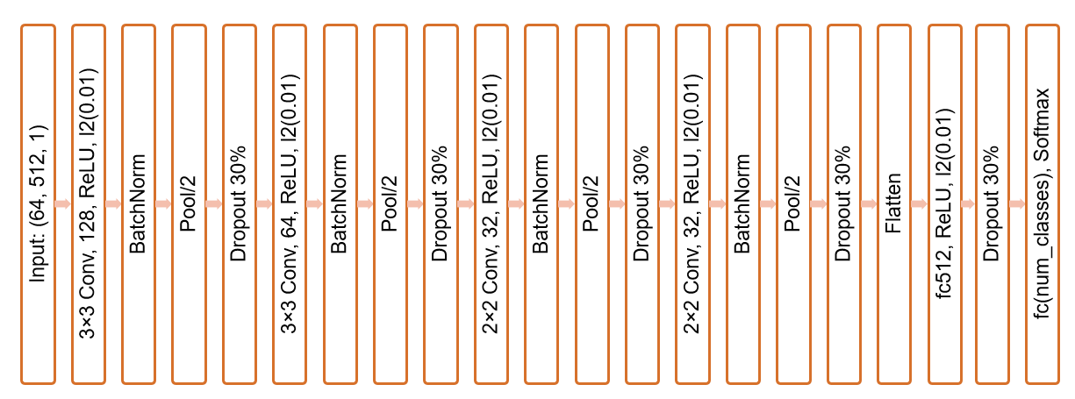
MODEL ARCHITECTURE
5x5

Slide 11
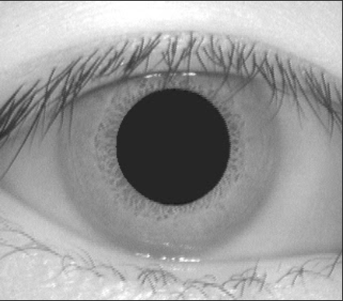
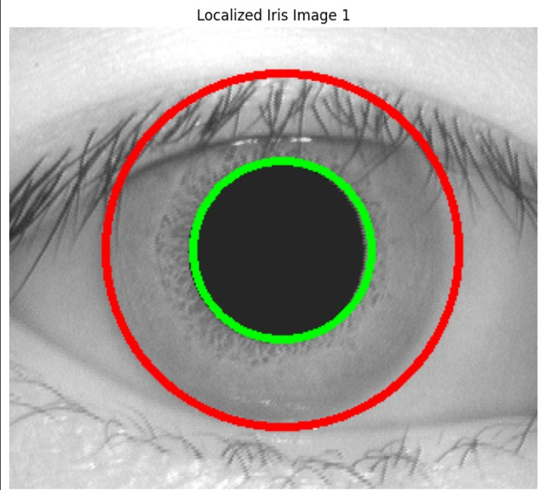
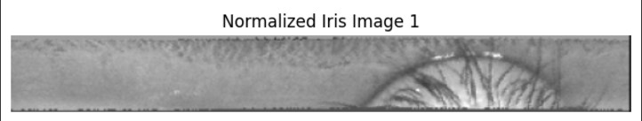
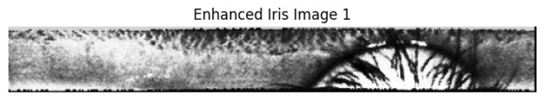
IMAGE PROCESSING BEFORE TRAINING

Slide 12
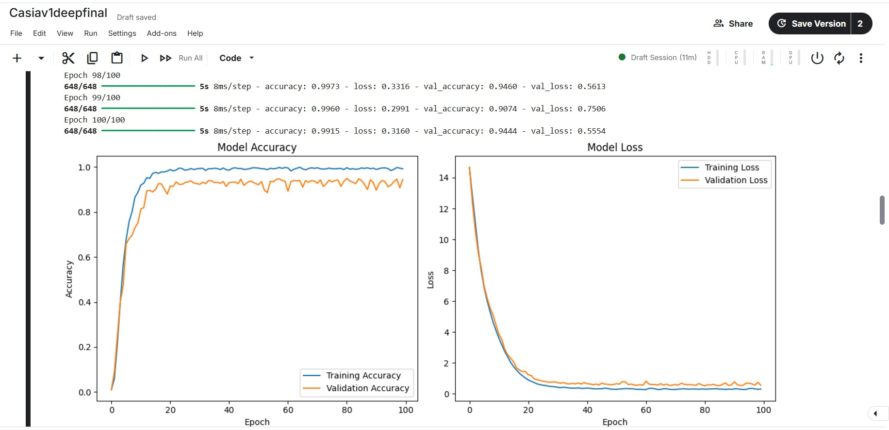
ACCURACY AND LOSS PLOT MODEL DURING TRAINING AND VALIDATION

Slide 13
OBTAINED ACCURACIES OF CNN MODEL
Training accuracy | 99.15%
Validation accuracy | 94.6%
Testing accuracy | 95.52%

Slide 14
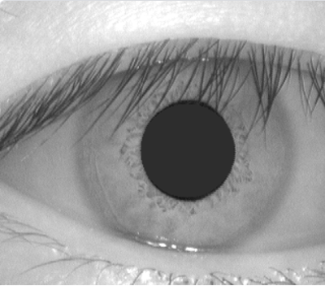
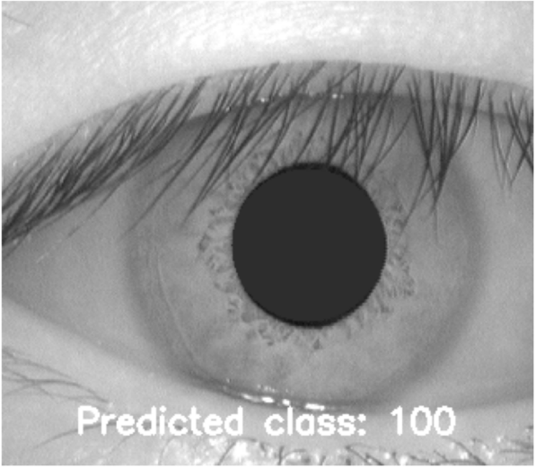
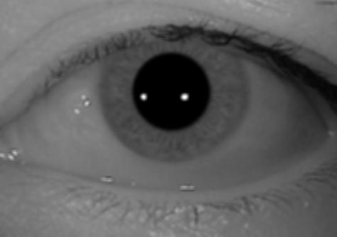
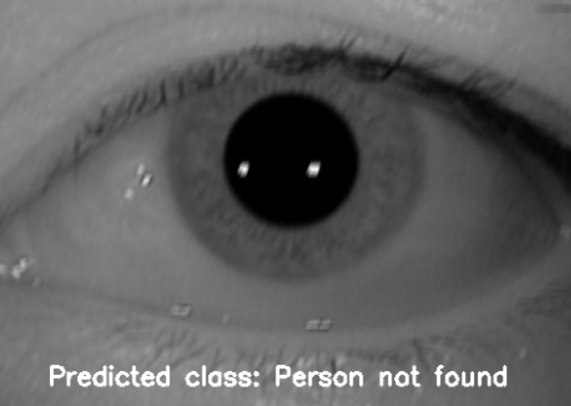
PERSON IDENTIFICATION USING TRAINED MODEL

Slide 15
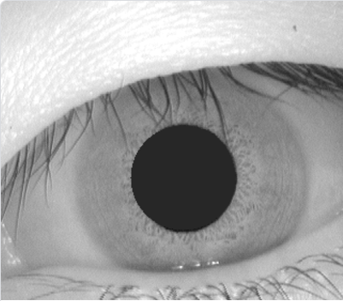
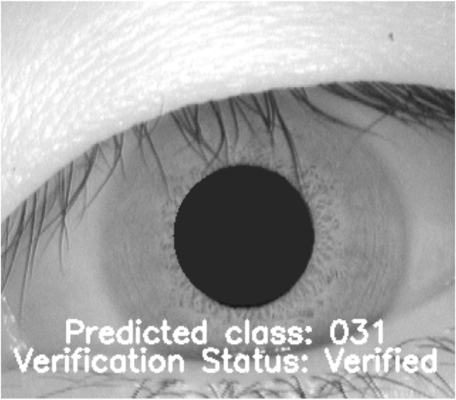
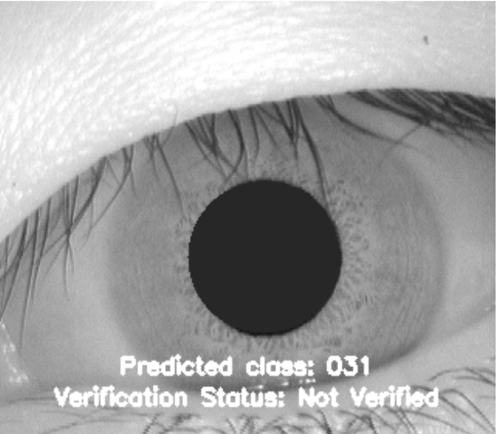
PERSON VERIFICATION USING TRAINED MODEL

Slide 16


TERATERM INTERFACING FOR PYNQ

Slide 17
DEEP LEARNING IN CPU VS FPGA
Processor | Latency | Memory utilisation
CPU | 0.97 seconds | 12.3 MB
FPGA Mali processor | 0.71 seconds | 7.89 MB

Slide 18
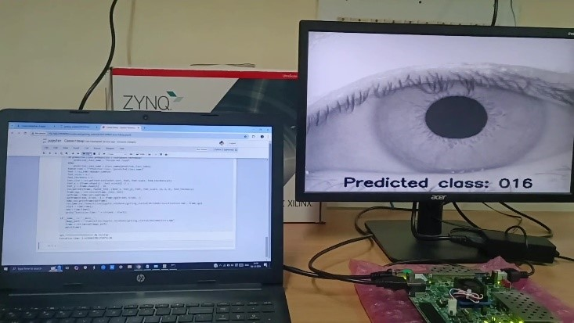
HARDWARE IMPLEMENTATION

Slide 19
CONCLUSION
This project proposed an efficient Custom CNN architecture for a model that performs identification and verification with high accuracies.
Iris recognition has been implemented on FPGA and the output images with predicted class names and verification status are displayed in monitor.
Iris localization is performed separately through FPGA and the localized image is also displayed in monitor.
It can be used in applications like authorization in defense, surveillance of restricted regions, and day-to-day security.

Slide 20
REFERENCES
[1] Almolhis, M., et al. (2024). A biometric model for iris images segmentation and deep learning classification. International Journal of Biometrics and Security, 9(1), 45-59.
[2] Boutros, F., Damer, N., Raja, K., Ramachandra, R., Kirchbuchner, F., & Kuijper, A. (2020). Iris and periocular biometrics for head mounted displays: Segmentation, recognition, and synthetic data generation. Image and Vision Computing, 104, 104007.
[3] Harikrishnan, D., Sunil Kumar, N., Shelbi Joseph, R., Nair, K., Nishanth, R., & Joseph, A. J. (2021). FPGA implementation of fast & secure fingerprint authentication using TRSG Microprocessors and Microsystems, 82, 103858.
[4] Huda Moyasar Therar, M., et al. (2023). Multibiometric system for iris recognition based on CNN and transfer learning. Journal of Biometric Systems, 12(2), 105-118.

Slide 21
REFERENCES
[5] Kumar, V., Asati, A. & Gupta, A. Hardware Accelerators for Iris Localization. J Sign Process Syst 90, 655–671 (2018).
[6] Kumar, V., Asati, A., & Gupta, A. (2022). Dedicated hardware architecture for localizing iris in VW images. Journal of King Saud University - Computer and Information Sciences, 34(7), pp 4568-4578.
[7] Minaee, S., Abdolrashidi, H., et al. (2019). DeepIris: Iris recognition using a deep learning approach. Iris and Biometric Recognition Journal, 15(2), 97-108.
[8] Pasha.S.N, et al. (2023). An efficient novel approach for iris recognition and segmentation based on the utilization of deep learning. Journal of Pattern Recognition and Image Analysis, 32(4), 256-268.

Slide 22
THANK YOU

