Slide 1
FastAPI CRUD Operations
Presented by:
SHRINIDHI BAPURI

Slide 2
Overview & Objective
Objective: Develop an API to manage users with CRUD operations
User Data Fields:
id (int): Unique identifier for each user.
name (str): Name of the user.
phone_no (str): Phone number of the user.
address (str): Address of the user.
Technology Used: FastAPI framework, Pydantic for validation

Slide 3
CRUD Operations
Create: POST /users/ (Add a new user)
Read: GET /users/{id} (Retrieve user by ID)
Update: PUT /users/{id} (Modify user details)
Delete: DELETE /users/{id} (Remove a user)
Testing: Swagger UI (/docs), Postman

Slide 4
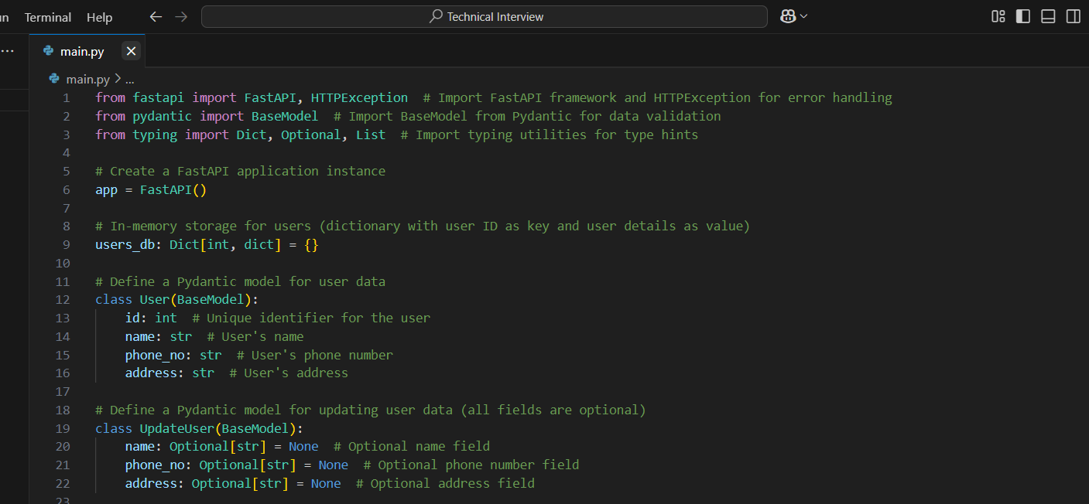
Code

Slide 5
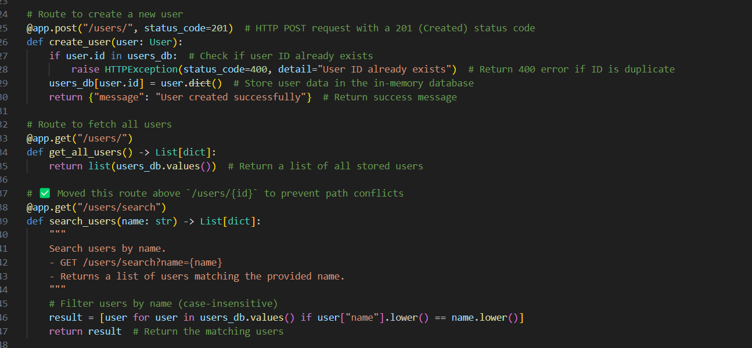

Slide 6
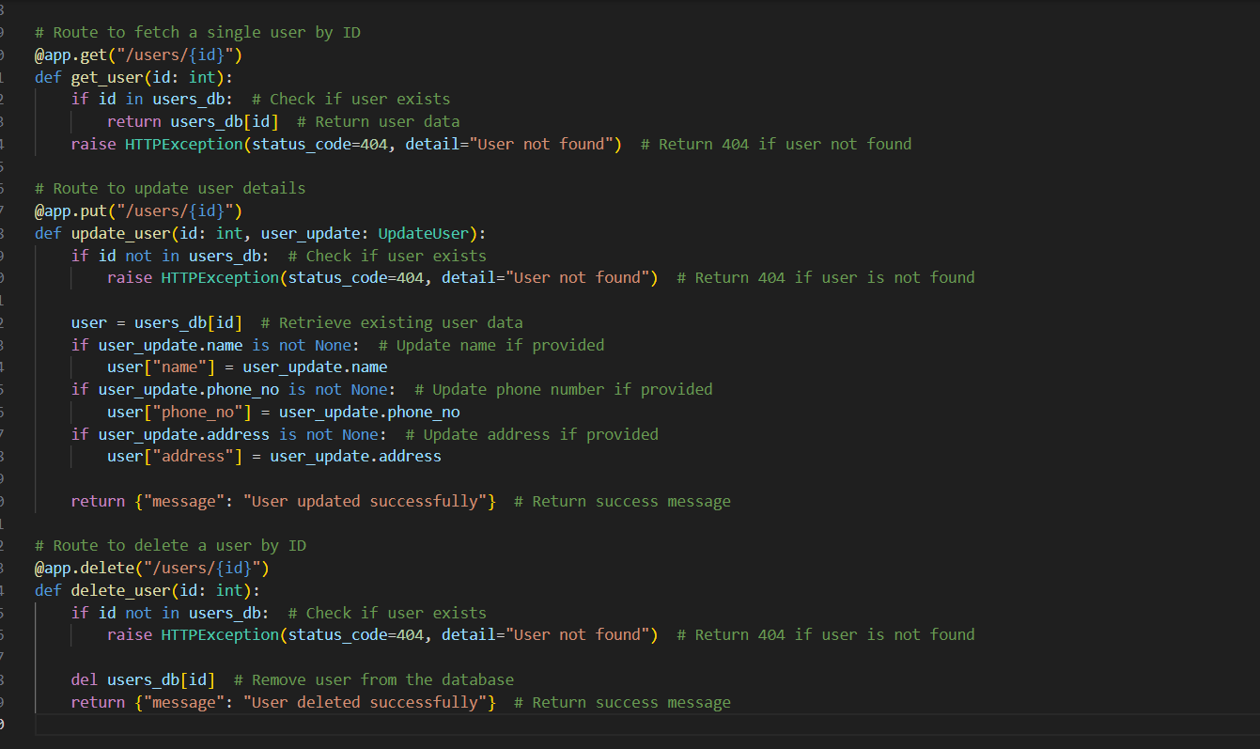

Slide 7
This FastAPI application provides a simple user management system using an in-memory database (a Python dictionary). It defines endpoints for creating, retrieving, updating, and deleting users, ensuring data validation with Pydantic models. The User model enforces required fields, while UpdateUser allows optional updates. The application also includes a search feature to filter users by name. Error handling is implemented using HTTPException to manage cases like duplicate user IDs or missing users. By structuring routes logically, it ensures efficient request handling and prevents conflicts in endpoint resolution.
The importance of this code lies in its ability to quickly set up a RESTful API for user management with minimal effort, thanks to FastAPI’s built-in validation and asynchronous capabilities. It follows best practices by maintaining clear separation between data models and route logic, ensuring scalability and maintainability. This structure can be easily extended to use a database instead of an in-memory dictionary, making it a great starting point for more advanced applications. Moreover, FastAPI’s speed and automatic documentation features make this implementation both efficient and developer-friendly.
Additionally, this implementation highlights the power of FastAPI in building high-performance APIs with minimal boilerplate code. The framework's automatic data validation using Pydantic ensures data integrity, reducing the chances of incorrect or incomplete data being stored. The inclusion of structured error handling enhances user experience by providing clear error messages when issues arise, such as duplicate IDs or missing users. By leveraging type hints, the code improves readability and maintainability, making it easier for developers to extend functionality or integrate with external databases and authentication systems in the future.

Slide 8
Conclusion
FastAPI simplifies API development with automatic validation and documentation.
CRUD operations ensure efficient user data management.
Can be extended with database integration and security enhancements.

Slide 9


