Slide 1


project-4 ATM USING PYTHON LANGUAGE
Under the Guidance of:
Prof. Manjula Biradar
Submitted by:
SHRIHARI-SG21CSE137
SHUBHAM-SG21CSE141
SHRINIDHI-SG21CSE138
VIJAY-SG21CSE170

Slide 2
contents:
ABSTRACT
INTRODUCTION
WORKING OF ATM
FLOWCHART
ADVANTAGES
DISADVANTAGES
CONCLUSION
REFERENCES

Slide 3
Abstract:
This application allows the customers to collect cash ,know the balance, account status, credited and debited status. It allows authorized users to access the system by entering a valid pin number. This ensures security and prevents unauthorized access. It also enables to make transaction from the account at any time of the day. ATM programs connects to banking networks to process transactions and update account balances.

Slide 4
INTRODUCTION:
An Automated Teller Machine is an electronic telecommunications device that enables customers to perform financial transactions, such as cash withdrawals, deposits, balance inquiries at any time and without the need for direct interaction with bank staff . Using an ATM customers can access their bank account in order to make a variety of most notably cash withdrawals and balance checking. Customers are typically identified by inserting a plastic ATM card (or some other acceptable payment card) into the ATM, with authentication being by the customer entering a personal identification.

Slide 5
Working OF Atm:
The project is based upon using python language. In this application an programmer uses python language to identify the code used in ATM machine, the project shows the following details when the user accesses his/her account by applying the PIN which he or she has and the code which will be confidential to only user. After updating the PIN the user can credit/debit the money, know the accounts.

Slide 6
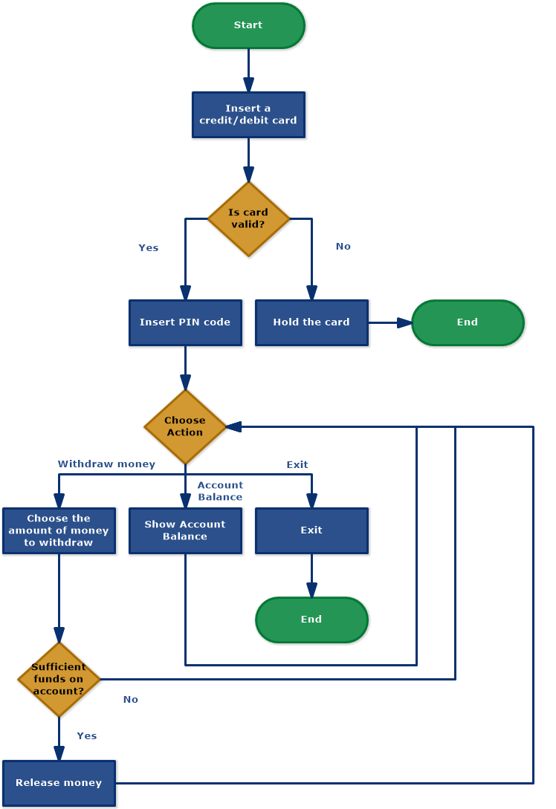
Flow Chart:

Slide 7
ADVANTAGES:
Users can perform transactions without the need to visit bank physically
Users can conduct transactions in private without need for direct interaction with bank staff.
Automated transactions reduce operational cost for both user and bank compared to manual processes.
The ATM system allows users to access and performs transactions on their accounts at any time.
Users can create new accounts with unique user name and pin.

Slide 8
DISADVANTAGES:
Technical issues can occur preventing transactions or causing error that may temporarily
We might face currency conversion fees or additional fees with international transaction
If not properly secured ,the system can be vulnerable to data breaches and cyberattack leading to financial loss
Poor data management might expose simulated user data, raising privacy issues.
if system is not mentioned properly,there is a risk of data loss due to hardware or software failure

Slide 9
CONCLUSION and future work:
In conclusion, the ATM project successfully demonstrates the design and implementation of a functional Automated Teller Machine system. Through this project, important concepts of software development and security measures were explored.
User Authentication Enhancement: We can provide two factor aunthentication for accounts.
GUI Implementation: Create a graphical user interface (GUI) for the bank account management system using libraries like Tkinter or PyQt

Slide 10
-:Thank:- -:YOU:-

