Slide 1
INFINITY MODEL
By Shrinidhi

Slide 2
Content:
HTML
CSS
From 10/11/2025 to 22/11

Slide 3
Introduction
What is HTML?h
is
HTML ie. Hyper text markup language is used to structure content on a web page.
It consists of Elements and Tags.
Browser reads HTML to display web page

Slide 4
What is CSS?
CSS = Cascading Style Sheets
Used to style and format HTML content
Separates content (HTML) from presentation (CSS)
Controls colors, fonts, layout, spacing
Makes web pages attractive and responsive
Reusable styles across multiple pages
Works with HTML and JavaScript

Slide 5
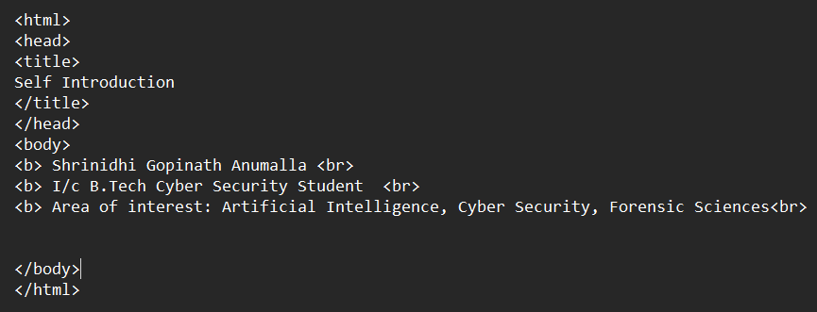
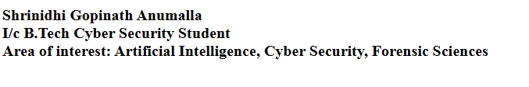
Day 1
On day 1, Programme 1 was completed which helped us understand how to write a basic self-introduction page using HTML.

Slide 6
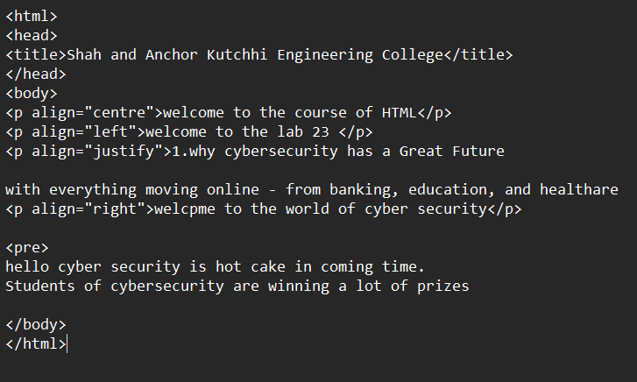
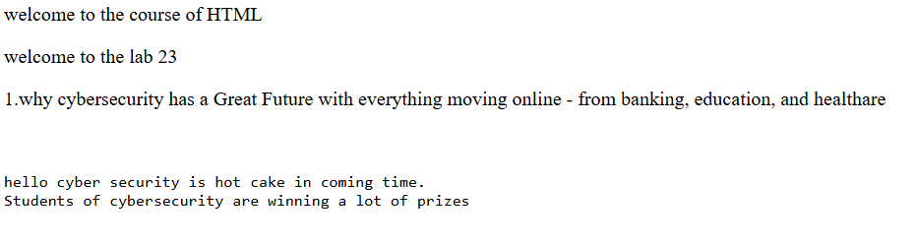
Day 1
Here, we understood how to align texts in center, right or left as perr our wish.

Slide 7
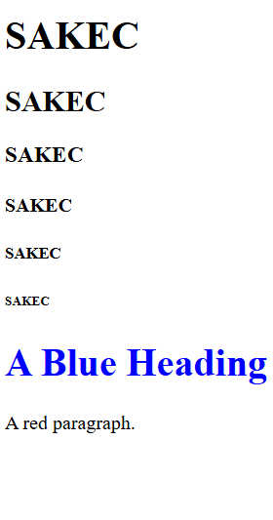
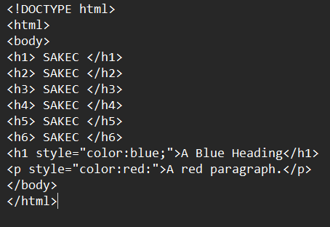
Day 1
Here we learnt how to add colored headings.

Slide 8
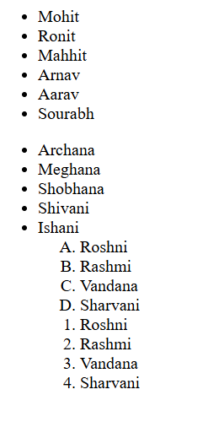
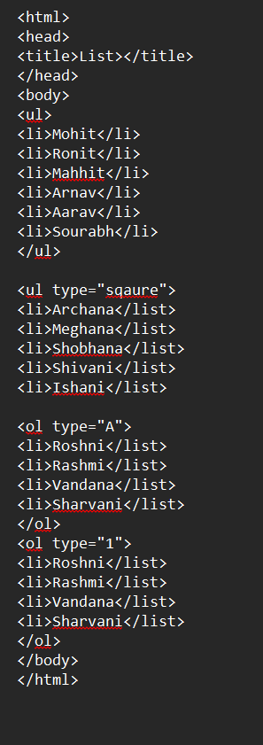
Day 1
How to add ordered and unordered lists.

Slide 9
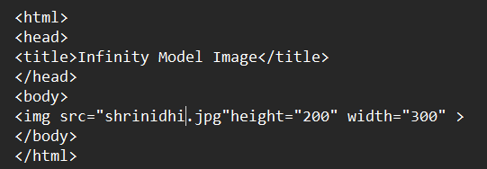
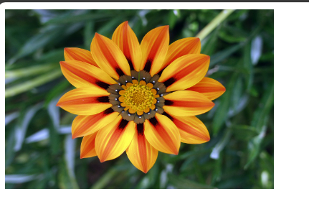
We can add images using the img src tag.

Slide 10
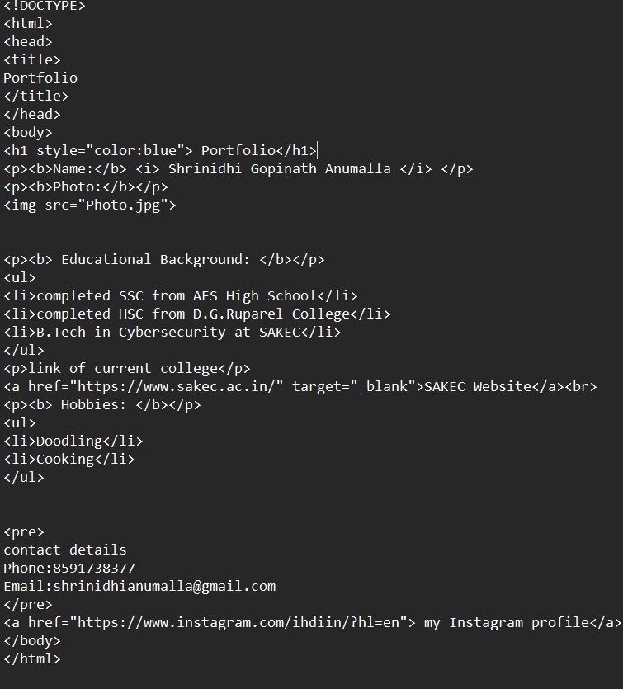
Experiment 1
In experiment, we created a Personal Profile using hyperlink reference.
We used href tag to open an external website

Slide 11
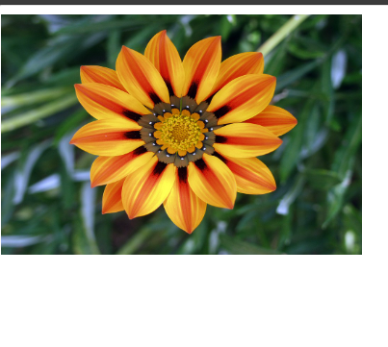
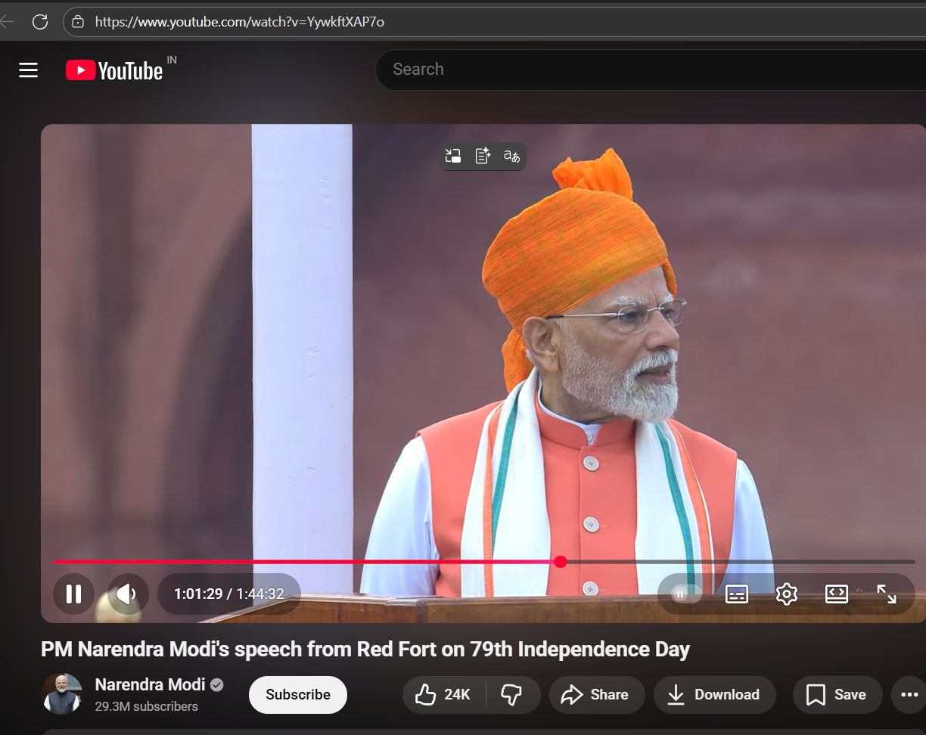
Day 2
Experiment 2
The experiment

Slide 12
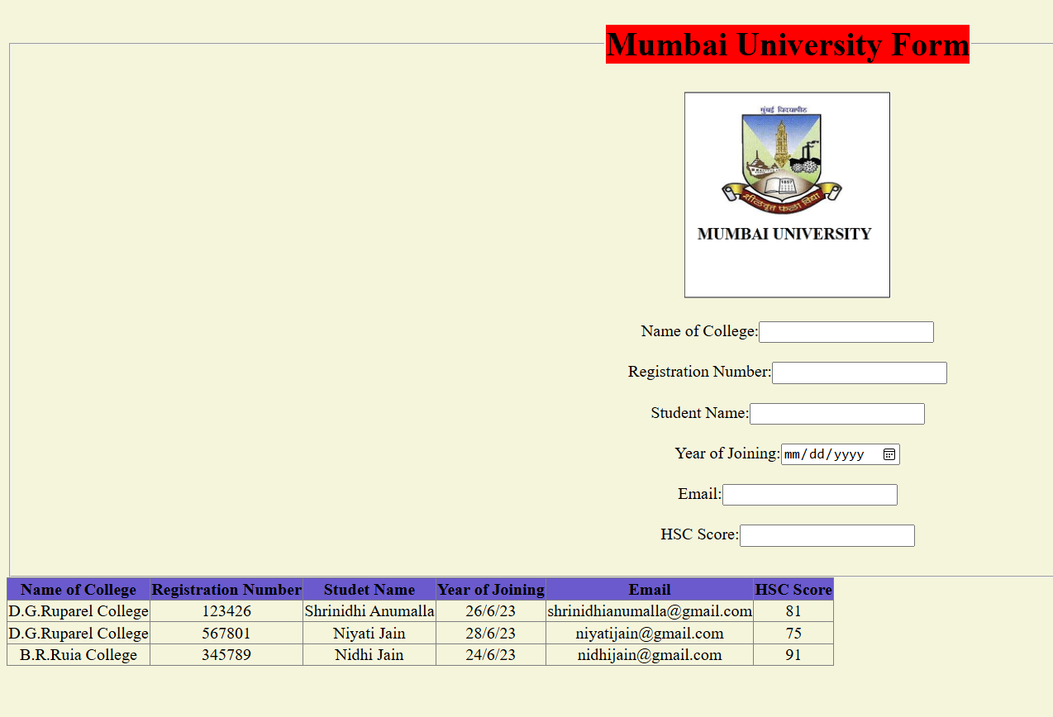
Day 2 Experiment 3
Created Mumbai University Form to store the information about the students with tables using html.

Slide 13
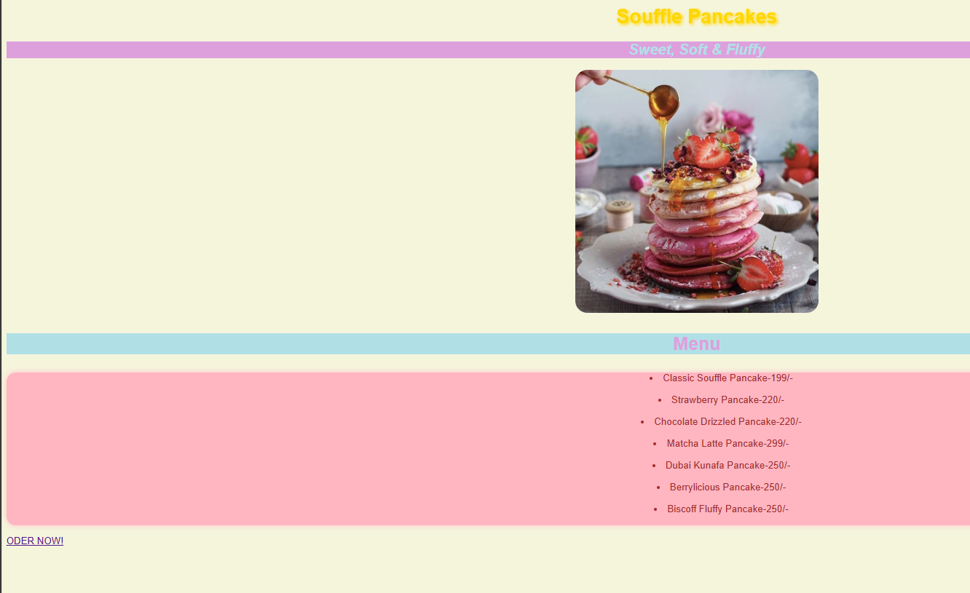
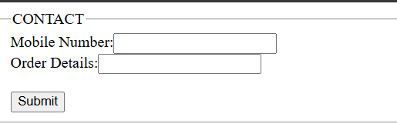
Day 3 Experiment 4
Created a Menu using html and css. We used three methods ie. Inline CSS, Internal CSS and External CSS.

Slide 14
Conclusion
We learnt the basics of HTML and CSS through all these experiments. We became familiar with all the elements, tags used in HTML, structural tags such as <!DOCTYPE html>, <title>, <body> and content tags such as <h1>, <p>,<img>, <ul>,etc.

