Slide 1
HYBRID SEMANTIC AWARE IMAGE STEGANOGRAPHY USING U-NET ARCHITECTURE
REVIEW 1
GUIDE: DR. SUBHASHINI N
TEAM:
SHRINIVASAN M (21BLC1047)
ATHIBHAN P (21BLC1088)
HARISUDHAN P (21BLC1103)

Slide 2
INTRODUCTION
Background:
Image steganography is a technique for embedding information in images while preserving visual fidelity.
With the increasing need for secure communication, the challenge is to achieve high quality embedding with minimal detectability.
Context:
U-Net, known for segmentation, is adapted to efficiently encode and retrieve secret data.
This project uses U-Net to embed and extract data.
Significance:
The significance of this approach lies in its ability to enhance data security and retrieval accuracy.
Addresses limitations in existing GAN-based approaches, such as instability and high resource usage.

Slide 3
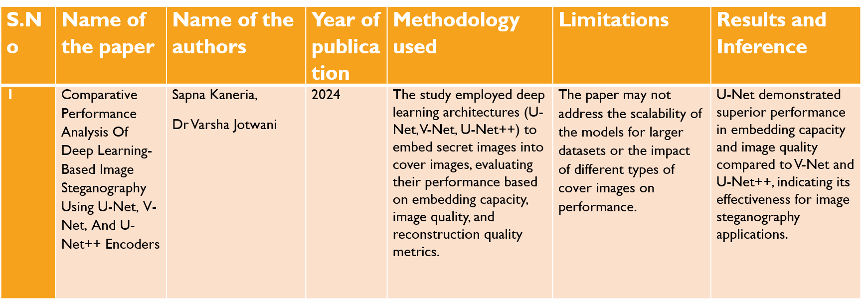
LITERATURE REVIEW

Slide 4
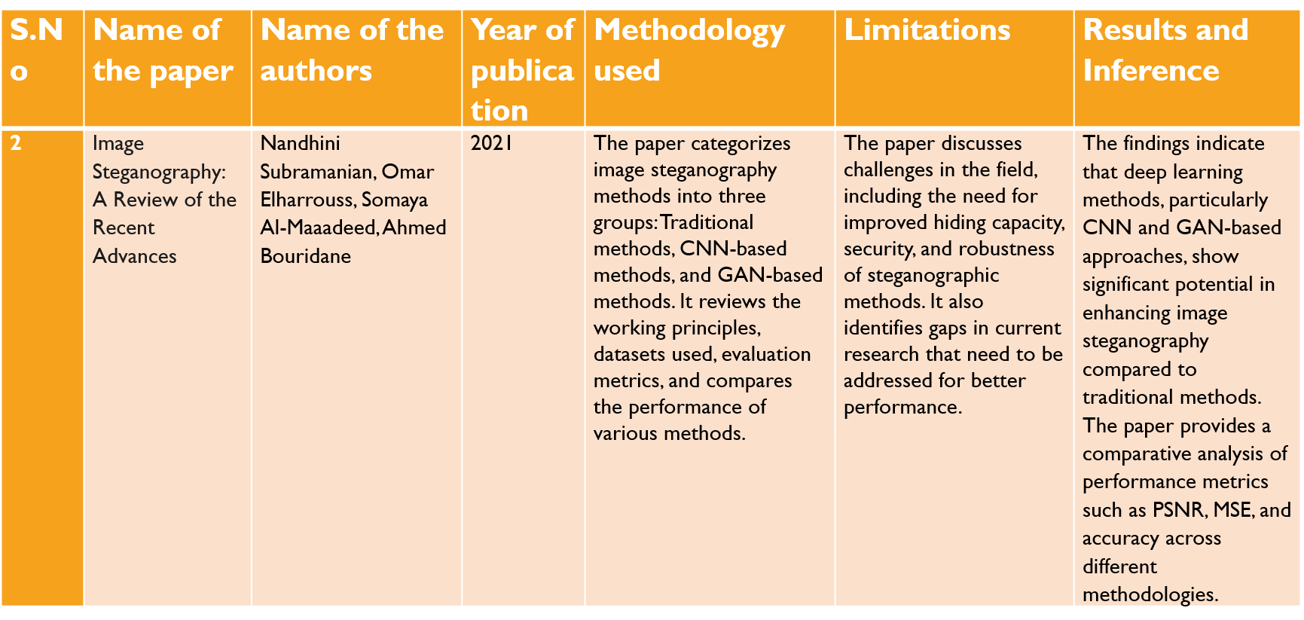
LITERATURE REVIEW

Slide 5
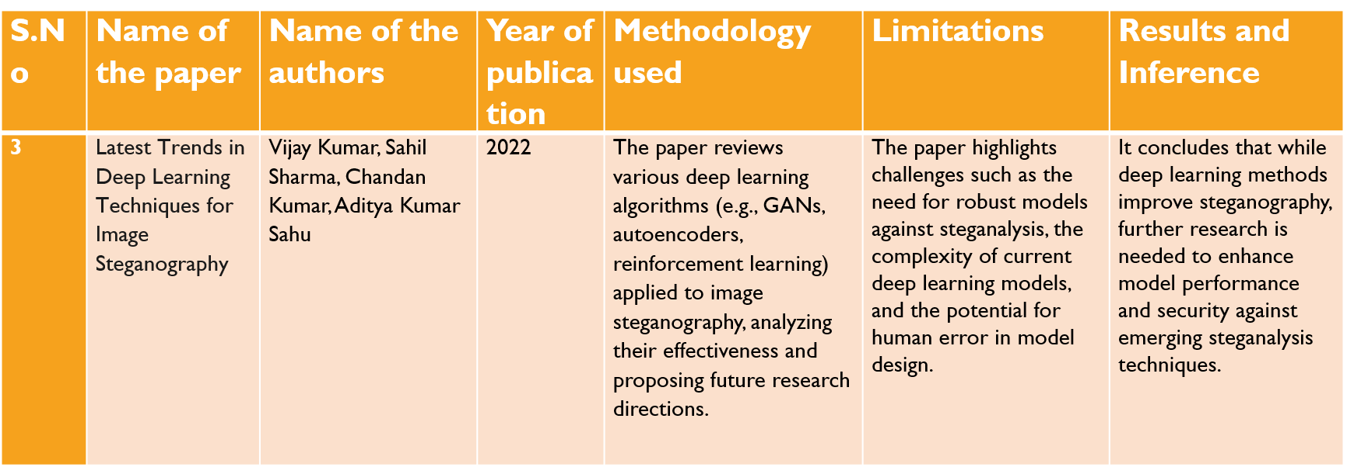
LITERATURE REVIEW

Slide 6
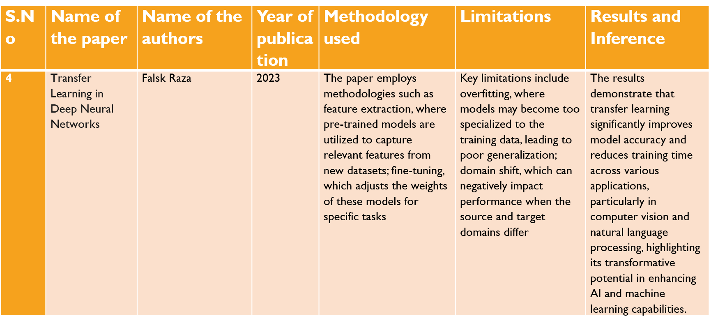
LITERATURE REVIEW

Slide 7
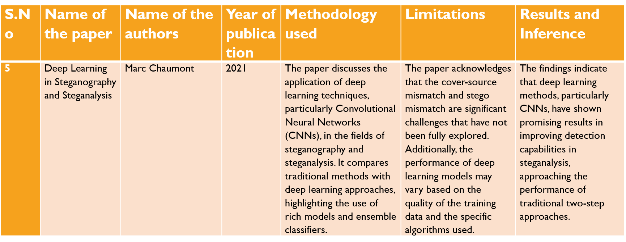
LITERATURE REVIEW

Slide 8
LITERATURE REVIEW
Title of Paper | Authors | Year of Publication | Methodology | Results | Limitations | Inference
Encoder-Decoder Architecture for Image Steganography Using Skip Connections | Akshay Kumar, Rajneesh Rani, Samayveer Singh | 2023 | - Encoder-decoder model with skip connections and dilated inception modules. - Encoder: Utilizes dilated convolutions for feature extraction. - Decoder: Classical CNN with ReLU activation. - End-to-end training for simultaneous hiding and revealing. | PSNR: 37.55 dB, SSIM: 0.98554 for 128×128128 \times 128128×128 images. Outperformed existing methods in PSNR and SSIM for both stego and extracted images. | - Reduced performance for smaller images (64×6464 \times 6464×64). - Computational overhead due to complex modules limits scalability to larger datasets. | - Balances imperceptibility, capacity, and security effectively. - Achieves higher payload capacity (24 bpp). - End-to-end architecture improves efficiency for training hiding and revealing processes.

Slide 9
LITERATURE REVIEW
Themes Discovered
GAN-based steganography dominates but faces challenges in consistency.
U-Net's skip connections improve spatial localization, making it suitable for data embedding and retrieval.
Gaps Identified
Limited studies combining U-Net with steganographic metrics like PSNR and BPP.
Encoder-decoder models are designed to optimise specific quantitative metrics, such as peak signal-to-noise ratio (PSNR) and mean square error (MSE), directly, thereby ensuring high reconstruction fidelity.
Generative adversarial networks (GANs) focus more on perceptual quality. While they can produce visually satisfactory results, their quantitative performance (e.g. PSNR, MSE) may be suboptimal.

Slide 10
PROBLEM STATEMENT
The objective of this project is to design and implement a deep learning-based image steganography framework that leverages an encoder-decoder architecture, specifically a U-Net model, to embed secret images into cover images and retrieve them with minimal distortion. The primary objective is to attain high embedding efficiency, as measured by metrics such as Peak Signal-to-Noise Ratio (PSNR), Mean Squared Error (MSE), and Bits Per Pixel (BPP).
Also, it is essential to ensure that the stego images remain visually indistinguishable from the original cover images.This project seeks to explore enhancements such as attention mechanisms, advanced decoder designs.. These enhancements are designed to enhance embedding capacity, reconstruction accuracy, and model performance in practical applications.

Slide 11
RESEARCH OBJECTIVES
To develop a U-Net-Based Steganography Model
To evaluate Steganographic Performance
To explore Novel Enhancements( such as attention mechanisms, advanced encoding techniques)
Compare with GAN-Based Methods
Achieve Real-World Applicability( by training the model with diverse datasets)

Slide 12
METHODOLOGY
Modules/ Algorithm:
Encoder:
Combines multi-scale features of cover and secret images using convolutional layers and skip connections.
Incorporates batch normalization for stabilized training and improved feature learning.
Utilizes skip connections to preserve spatial details, ensuring better visual quality in the stego image.
Decoder:
Recovers secret data with minimal error using upsampling layers combined with convolutional layers
Includes residual connections for refined reconstruction and improved gradient flow

Slide 13
METHODOLOGY
Data Collection:
MNIST dataset of handwritten digits.(Standardized, lightweight)
CIFAR-10 Dataset.
Data Analysis:
Loss vs Epochs: Measures training convergence.
PSNR vs Epochs: Evaluates visual quality.
MSE vs Epochs: Measures the total error.

Slide 14
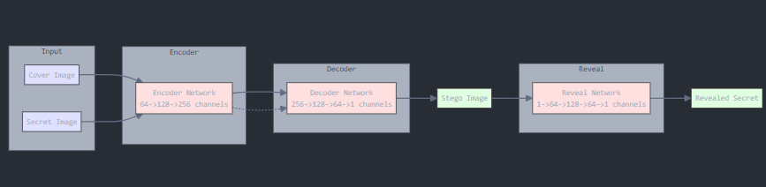
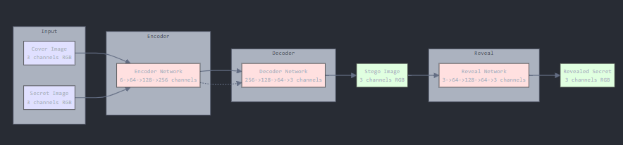
METHODOLOGY
System diagram:
MNIST:
2) CIFAR10:

Slide 15
30% IMPLEMENTATION AND RESULTS OBTAIBED SO FAR
Completed Work:
Implemented U-Net model for embedding and retrieval.
Trained on MNIST, CIFAR-10 with training loss, PSNR, and MSE as metrics.
Results Obtained:
Plots of combined training loss of MNIST and cifar10 vs epochs
Plots of combined MSE of MNIST and cifar10 vs epochs
Plots of PSNR of MNIST and cifar10 vs epochs
Original, Secret, Stego and revealed images comparison for MNIST
Original, Secret, Stego and revealed images comparison for CIFAR

Slide 16
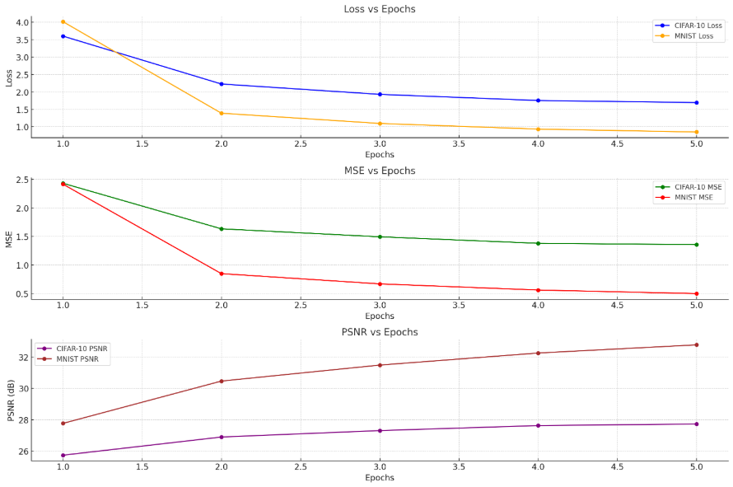
RESULTS OBTAINED
1) Epochs = 5

Slide 17
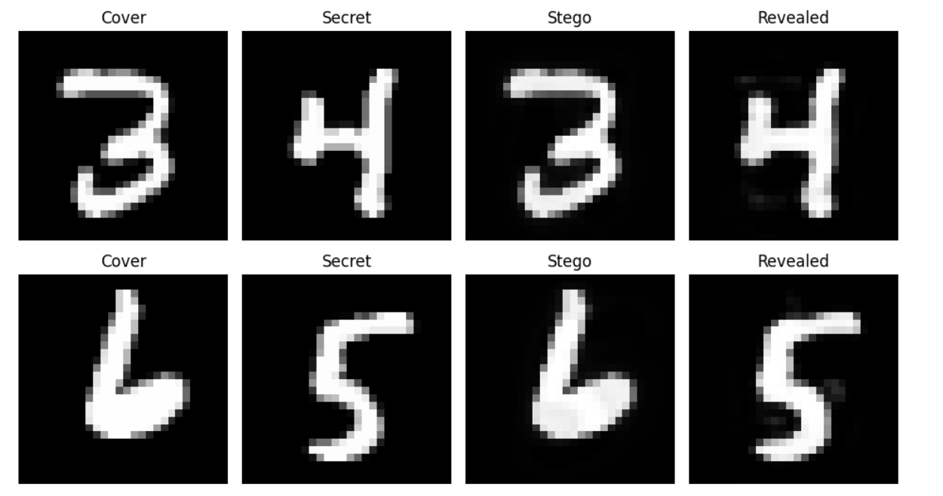
RESULTS OBTAINED
Original, Secret, Stego and revealed images comparison for MNIST

Slide 18
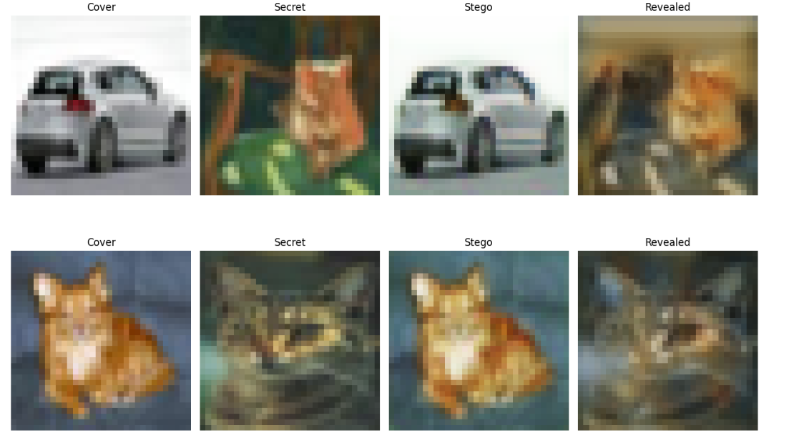
RESULTS OBTAINED
Original, Secret, Stego and revealed images comparison for CIFAR

Slide 19
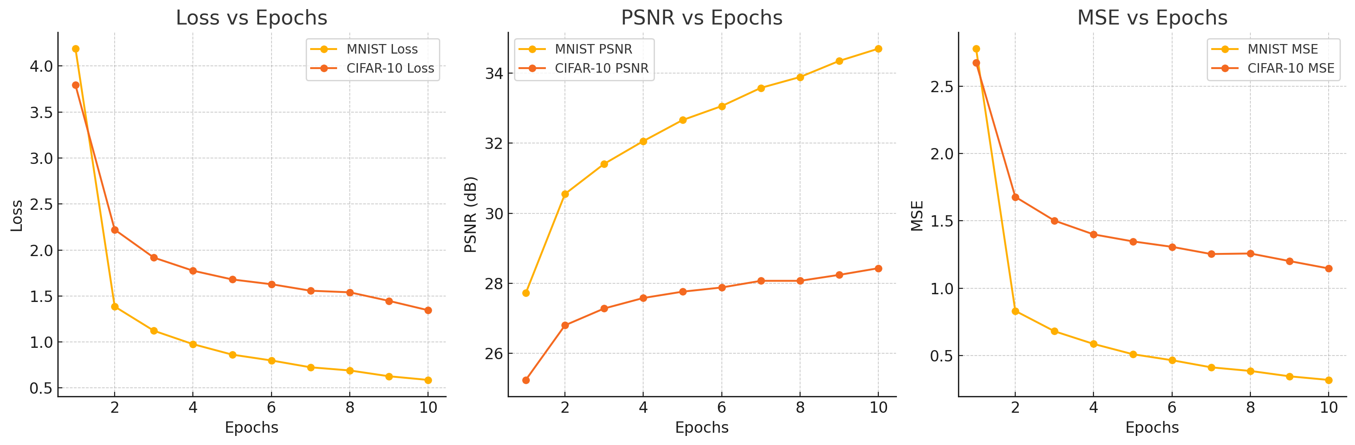
RESULTS OBTAINED
2) Epochs = 10

Slide 20
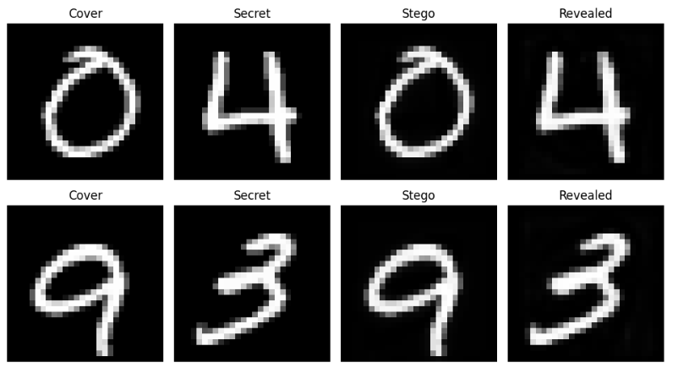
RESULTS OBTAINED
Original, Secret, Stego and revealed images comparison for MNIST

Slide 21
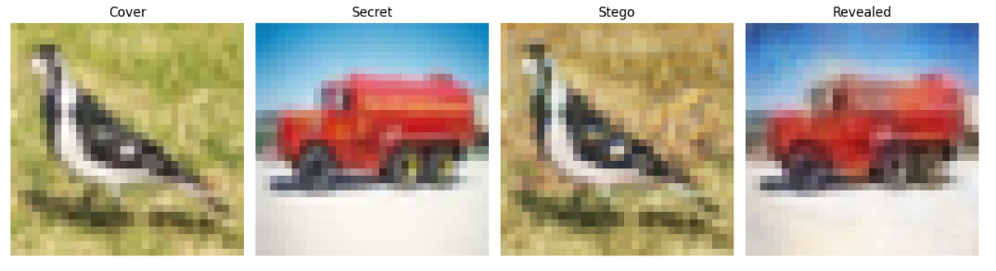
RESULTS OBTAINED
Original, Secret, Stego and revealed images comparison for CIFAR

Slide 22
WORK TO BE DONE
Fine tune the existing U Net model.
Explore the use of attention based mechanisms and residual blocks for encoding and decoding.
Extend experiments to natural image datasets like ImageNet, Pascal VOC.
Comparison with GANs
Including additional metrics like SSIM and embedding rate.

