Slide 1


Case Study:
Cancer Risk Detection
Student names:
Shrinivasan Thevar
Tanisha Teli
Sanveda Yadav
Sanika Konde
Sushma Gore

Slide 2
Problem Statement
Brief Overview:
Cancer is one of the leading causes of mortality worldwide, and early detection significantly improves treatment outcomes and survival rates. The Cancer Risk Detection aims to develop a predictive system that assesses an individual’s risk of developing cancer based on various factors such as genetic predisposition, lifestyle choices, environmental exposure, and medical history.
Real-Life Example : A real-world example of cancer risk detection using AI is IBM Watson for Oncology. IBM Watson, an AI-powered cognitive computing system, has been used in collaboration with leading healthcare institutions to analyze vast amounts of medical data and assist doctors in cancer diagnosis and treatment recommendations.
Source :
www.freepik.com/

Slide 3
Key Objectives:
Early Risk Prediction – Develop a system that identifies individuals at high risk of developing cancer based on genetic, lifestyle, and environmental factors.
Machine Learning-Based Analysis – Utilize AI and statistical models to analyze patient data and detect patterns associated with cancer risk.
Personalized Risk Assessment – Provide tailored risk scores and recommendations for preventive measures, lifestyle changes, and medical checkups.
User-Friendly Accessibility – Design a web-based or mobile platform to make risk detection easily accessible for individuals and healthcare professionals.
Enhance Preventive Healthcare – Support early diagnosis and proactive health management, reducing cancer-related mortality through timely interventions.
Source :
www.freepik.com/

Slide 4
Dataset Overview :
1. Patient Demographics
Age: Range from 15 to 89 years.
Gender: Male and Female distribution.
Ethnicity: Includes categories like Caucasian, Hispanic, African, and Asian.
2. Environmental & Lifestyle Factors
Radiation Exposure: Whether the patient has been exposed to radiation (Yes/No).
Iodine Deficiency: Presence of iodine deficiency, which is linked to thyroid health issues (Yes/No).
Smoking: Smoking status of the patient (Yes/No).
3. Thyroid Function Test Results
TSH Level: Thyroid-Stimulating Hormone levels (Range: 0.1 - 10.0).
T3 Level: Triiodothyronine levels (Range: 0.5 - 3.5).
T4 Level: Thyroxine levels (Range: 4.5 - 12.0).
4.
Nodule Characteristics & Cancer Risk
Nodule Size: Size of detected thyroid nodules (Range: 0 - 5.0 cm).
Thyroid Cancer Risk: Categorized into Low, Medium, and High risk.
Diagnosis: Final classification as Benign or Malignant.
Source :
www.freepik.com/

Slide 5
Methodology
1.*Data Collection* - Gather data from hospitals, medical research institutions, government health agencies (e.g., CDC, WHO), and public datasets (e.g., Kaggle, SEER Cancer Statistics). Collect patient medical history, genetic data, lifestyle factors (e.g., smoking, diet, exercise), environmental exposures, and demographic information.
2. *Data Preprocessing* - Remove duplicate records, handle missing or inconsistent values, and filter out erroneous data points. Standardize data across different units (e.g., BMI, blood test results, exposure levels).
3. *Exploratory Data Analysis (EDA)* - Examine the distributions of cancer risk factors and prevalence across different demographics. Use graphs, heatmaps, and histograms to visualize patterns, trends, and anomalies in cancer-related data.
4. *Model Development* - Select appropriate machine learning models such as logistic regression, decision trees, random forests, support vector machines, and deep learning models. Split the dataset into training and testing sets, training the model to predict cancer risk based on given features.
5. *Model Evaluation* - Performance Metrics: Assess model performance using evaluation metrics such as accuracy, precision, recall, F1-score, and AUC-ROC. Test the model with unseen data to ensure it generalizes well to real-world applications.
Source :
www.freepik.com/

Slide 6
Algorithms Used:
1. *Linear Regression* : - A statistical model that estimates the probability of a binary outcome (e.g., cancer risk: high or low) based on input features. Use case: Suitable for cancer risk prediction, as it helps determine the impact of risk factors such as smoking, age, and genetic history on cancer probability.
2. *Decision Trees* : -A tree-based model that makes decisions based on feature splits. Use case: Provides interpretability in understanding how individual risk factors contribute to cancer prediction.
3. *Random Forest* : - An ensemble learning method that builds multiple decision trees and combines their outputs to improve accuracy and reduce overfitting. Used for robust and accurate cancer risk prediction, particularly in cases where multiple factors contribute to risk assessment. Also useful for determining feature importance.
4. *Support Vector Machines (SVM)* : - A model that finds the optimal hyperplane for classifying data points. Can be effective in classifying cancer risk levels when dealing with high-dimensional datasets.
5. *Artificial Neural Networks (ANN)*: - A deep learning model with multiple layers of interconnected neurons. Effective for complex cancer risk prediction tasks, capturing non-linear relationships between genetic and lifestyle factors.
Source :
www.freepik.com/

Slide 7
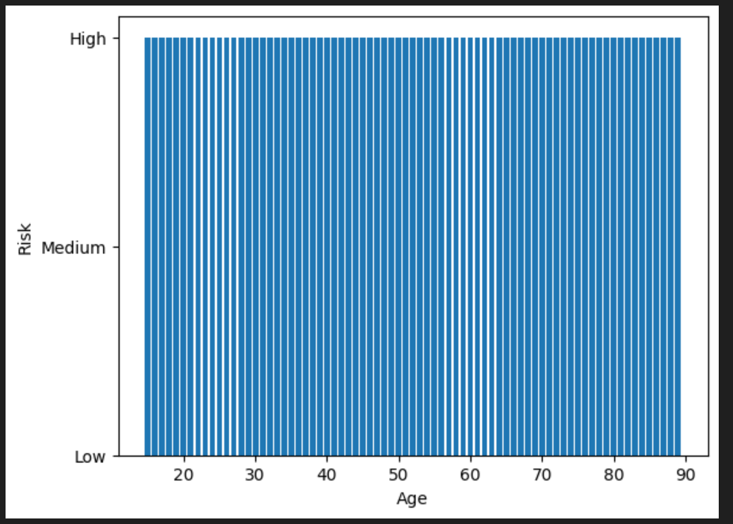
Bar Chart:
Fig : Cancer Risk Prediction
Source :
www.freepik.com/

Slide 8

Conclusion
The Cancer Risk Detection plays a crucial role in enhancing early diagnosis and preventive healthcare by leveraging AI and data analytics. By identifying individuals at high risk based on genetic, lifestyle, and environmental factors, this system empowers both individuals and healthcare professionals to take proactive measures before cancer develops. With the integration of machine learning models and a user-friendly platform, the project enables accurate risk assessments, personalized recommendations, and timely medical interventions.
Future Work: Integration of Advanced AI Models, Expansion to Multiple Cancer model types, Genomic and Biomarker Analysis
Source :
www.freepik.com/

Slide 9
References
Books:
"Machine Learning Techniques for Biomedical and Health Informatics" – Shuiwang Ji, et al.
“Biomedical Informatics: Computer Applications in Health Care and Biomedicine" – Edward H. Shortliffe, et al.
Online Resources
1.*Coursera, edX (topics: "machine learning in healthcare," "bioinformatics")

Slide 10
Thank You
Notes:
Thank You !!

