Slide 1

7th Semester Major Project Work (21MP67)
SEE Presentation
December 2024
Dayananda Sagar College of Engineering, Bengaluru, Karnataka
Department of Electronics & Communication Engineering
Section : D
Brain Tumor Segmentation and Classification
Major Project Batch No : IP7
USN : 1DS21EC208 Name : Sudeer Reddy
USN : 1DS21EC224 Name : Vaibhav
USN : 1DS21EC196 Name : Shrinivas
USN : 1DS21EC226 Name : Vashnavi
Section Coordinator
Prof. Bindu H M
Assistant Professor, Dept. of ECE, DSCE
Mini Project Guide
Dr. Yashaswini Gowda N
Assistant Professor, Dept. of ECE, DSCE

Slide 2
Overview
Introduction
Problem Statement
Objectives
Literature Review
Clarifications to the comments given during phase-1
Methodology adopted with Block-Diagrams
Tools used
Results
Timeline
References

Slide 3
Introduction
Brain tumors represent one of the most critical health challenges faced by individuals worldwide, requiring timely and accurate diagnosis for effective treatment.
Brain tumors are abnormal growths of cells within the brain or surrounding tissues.
Brain tumors are categorized further based on their histological features, location, and growth patterns
As brain tumors can significantly affect an individual's quality of life and prognosis, early detection and accurate characterization are essential.
Advancements in imaging technologies and processing techniques continue to improve our ability to identify and treat brain tumors effectively.

Slide 4
Problem Statement
Accurate segmentation of brain tumors is crucial for effective diagnosis, treatment planning, and monitoring of tumor progression . Many algorithms struggle to enhance MRI images without losing critical information, and tumor classification models may exhibit poor generalization when dealing with diverse patient data. This leads to incorrect or delayed diagnoses, directly impacting patient outcomes.

Slide 5
Objectives
Tumor Segmentation:
To effectively segment tumor regions from the pre-processed image using OTSU algorithm, to facilitate effective extraction followed by classification of the tumor.
Feature extraction
To extract features such as mean ,SD ,variance ,correlation, energy, contrast etc, using GLCM technique from the segmented image
Classification of tumor
Classification of tumor into benign and malignant tumor using Multi SVM and CNN techniques based on the feature extracted

Slide 6
Literature Review
Reference paper | Methods used in the paper | Ideas implemented from the paper
Enhancing Brain Tumour Classification through Hybrid Machine Learning Approaches-2022-Journal of electrical systems | Developed an algorithm on the classification of brain tumors into 2 different classes by extracting 4 GLCM features using Gray-Level Co-occurrence Matrix (GLCM) textural features extracted from Magnetic Resonance Imaging (MRI) scans | We have implemented GLCM technique for extracting 13 features which facilitates classification of tumors into 2 classes: Benign and Malignant
Optimized Brain Tumor Detection: A Dual-Module Approach for MRI Image Enhancement and Tumor Classification-2024- (IEEE Access). | Adaptive Wiener filtering for pre-processing RBF neural network for training of the dataset, Support vector model (SVM) classifier to classify 3 classes of brain tumors. | We have used SVM classifier algorithm which uses the trained CNN model to classify the tumor into benign and malignant tumors
"Classification of Brain Tumor MRI Images Using GLCM Texture Features,cnn and svm,"-2023-(IEEE Access) | The Proposed methodology extracts essential features to classify three types of brain tumors and healthy brains (no tumor) by 2D CNN, auto-encoder network, and common machine learning techniques. | We have used CNN algorithm to develop a model which is trained using raw image data. This CNN model is used by the Multi SVM Classifier to classify the two types of tumors

Slide 7
Data set collection
The data set was fetched by a publicly accessible ‘Abdallah Wagih Ibrahim’ collection
The Data set was collected from Kaggle website
The Data Set consists of different MRI scanned images of varying pixel sizes, which was resized to 255 x 255 pixels size.
There are total 170 MRI images in dataset

Slide 8
Flow Diagram
Flow Diagram
8
8

Slide 9
Methodology
Pre processing
Adaptive Histogram Equalization (AHE)
To improve the visibility of key features for better segmentation, we applied Adaptive histogram equalization, which enhances the contrast of the input MRI images.
Conversion of the equalized MRI image to grayscale
Median Filtering
It reduce salt and pepper noise while preserving edges in the enhanced image. This step helps in smoothening the image and removing small noise artifacts without blurring important details
The pre –processing steps helps to improve the quality of the data, reduce noise, and ensure effective segmentation and classification.

Slide 10
OTSU segmentation
Otsu's method is a popular image segmentation technique used to automatically perform clustering-based thresholding.
The Otsu's method separates the pixels of an image into two classes: the foreground and the background. It chooses an optimal threshold that minimizes the intra-class variance (the variance within each class) or equivalently maximizes the inter-class variance (the variance between the classes)..
Compute the histogram : The algorithm calculates the histogram of the pixel intensities, showing how many pixels have each intensity value.
Calculate probabilities: For each possible threshold, calculate the probability of each pixel belonging to either the foreground or background.
Maximize inter-class variance: Compute the inter-class variance for all possible thresholds and choose the one that maximizes this variance.
Segment the image: Using the optimal threshold, segment the image into two parts — the foreground and background.
The region of interest (ROI) is separated from the rest of the image using a bounding box.

Slide 11
Feature Extraction
Gray-Level Co-occurrence Matrix (GLCM) is used for extracting texture features from the segmented image.
It captures the spatial relationship between pixel pairs in an image, representing the texture of the image. It calculates the frequency of pixel pairs with specific values occurring in a specific spatial relationship (i.e., distance and orientation).
The features extracted in our work are:
Mean
Standard deviation
Variance
Correlation
Energy
Contrast
Skewness
Homogenity

Slide 12
Training of CNN
Convolutional neural networks are composed of multiple layers, including convolutional layers, pooling layers, and fully connected layers, which work together to automatically learn features from input data, primarily images.
The features extracted by GLCM is passed through the layers of the CNN. Each layer processes the input and extracts relevant features, with the final layer producing a prediction of the class label.
After training, this CNN model is used by the classifier to classify the tumors into benign and malignant
Validation performance of the model is evaluated, which refers to how well a trained model generalizes to unseen data, specifically the data that is not used during training

Slide 13
Classification
Multi SVM technique is used to classify the tumor after training
The trained CNN model is used by the SVM classifier which accurately classifies the tumor into Benign or Malignant type.
A confusion matrix is obtained which consists of four elements: TN, FP, TP, and FN. Accuracy is calculated as the ratio of correctly segmented samples to the total number of samples, serving as an indicator of segmentation performance. A value of one generally signifies an almost perfect segmentation result.

Slide 14
Tools used
Matlab 2023A- image processing

Slide 15
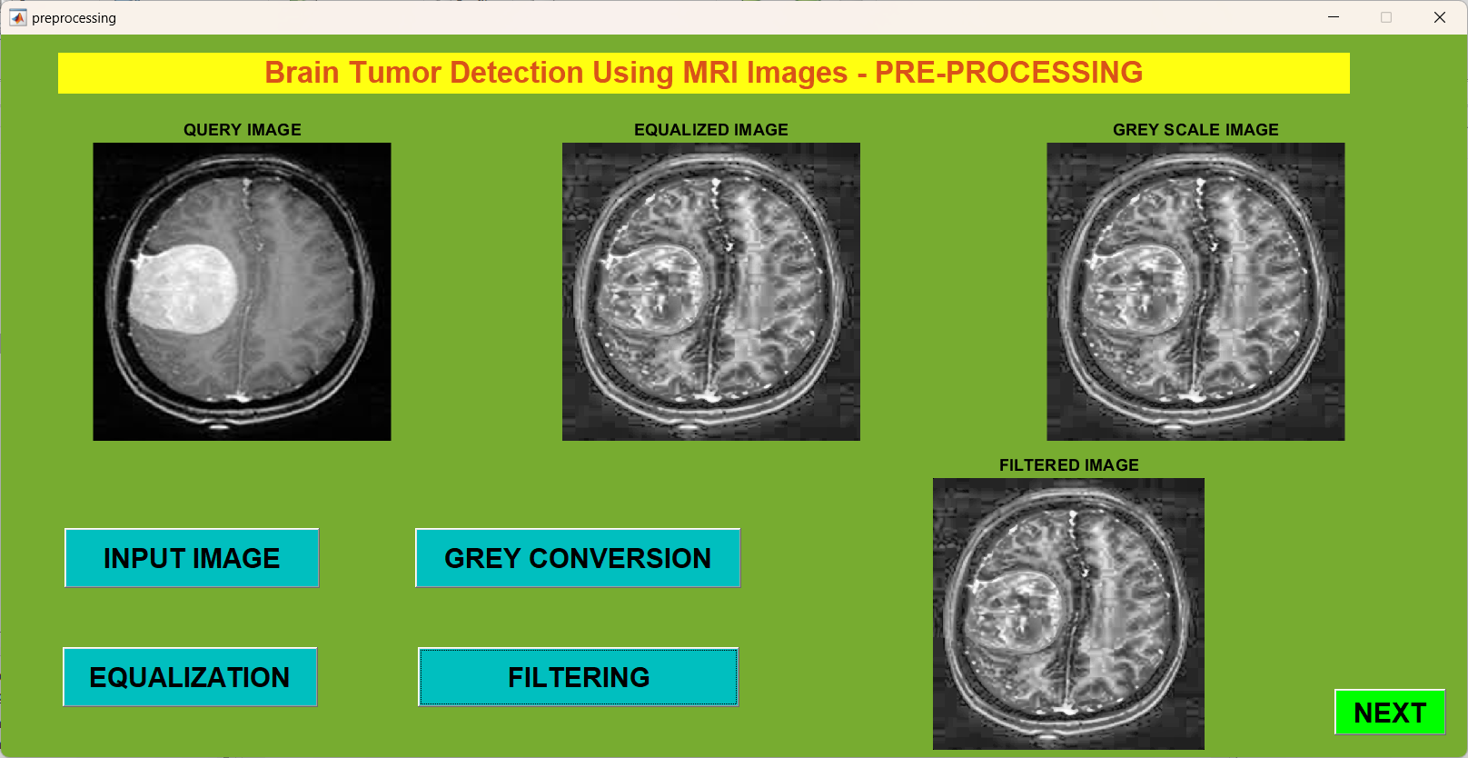
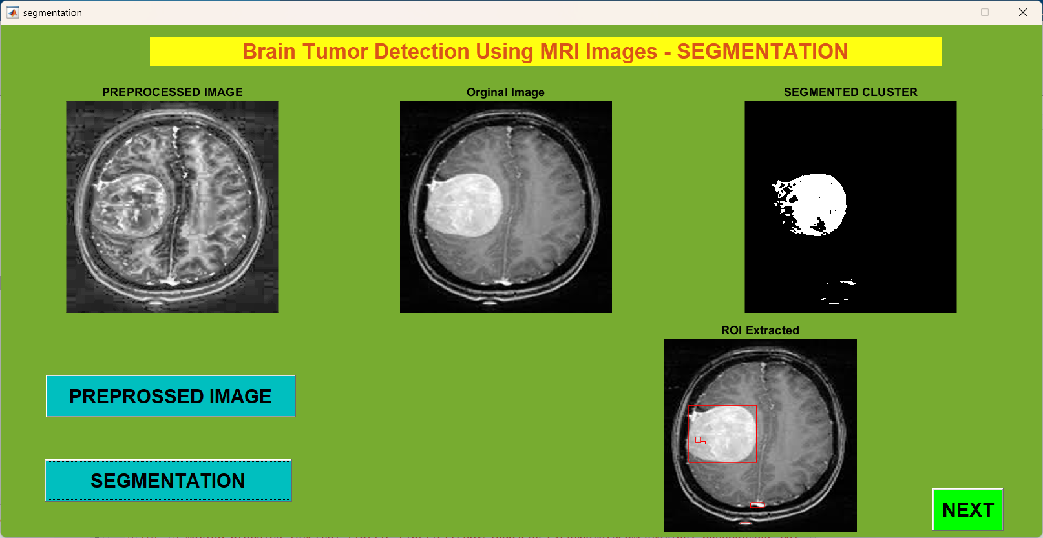
Results

Slide 16
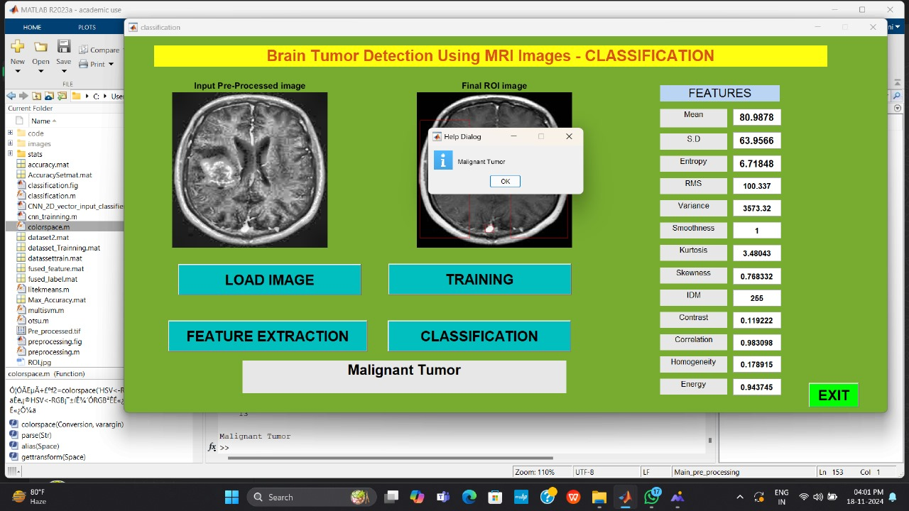
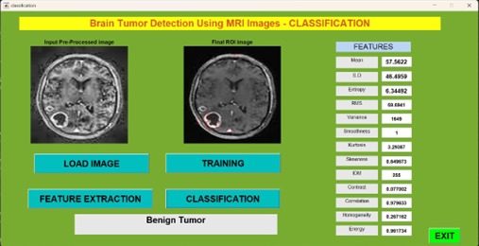

Slide 17
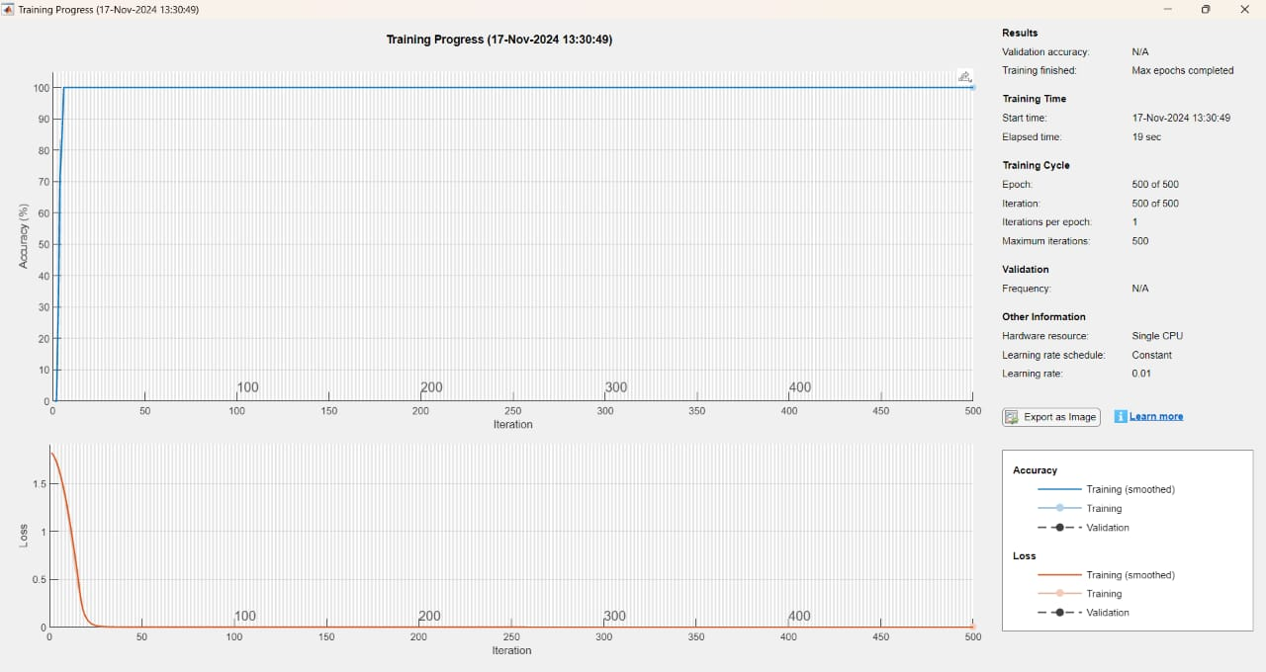
The graph depicts accuracy versus iterations for the training data shows that the accuracy starts low at the beginning of the training process. As the training continues, the accuracy gradually improves
The graph also shows that the loss is initially very high at the start of training but gradually decreases as the number of iterations increases

Slide 18
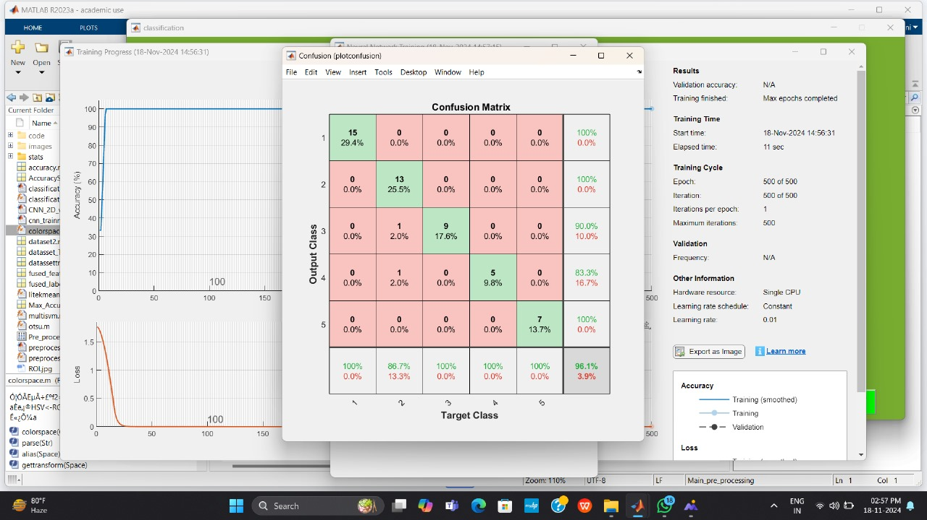

The confusion matrix consists of four elements: TN, FP, TP, and FN. Accuracy is calculated as the ratio of correctly segmented samples to the total number of samples, serving as an indicator of segmentation performance
Accuracy(%) =

Slide 19
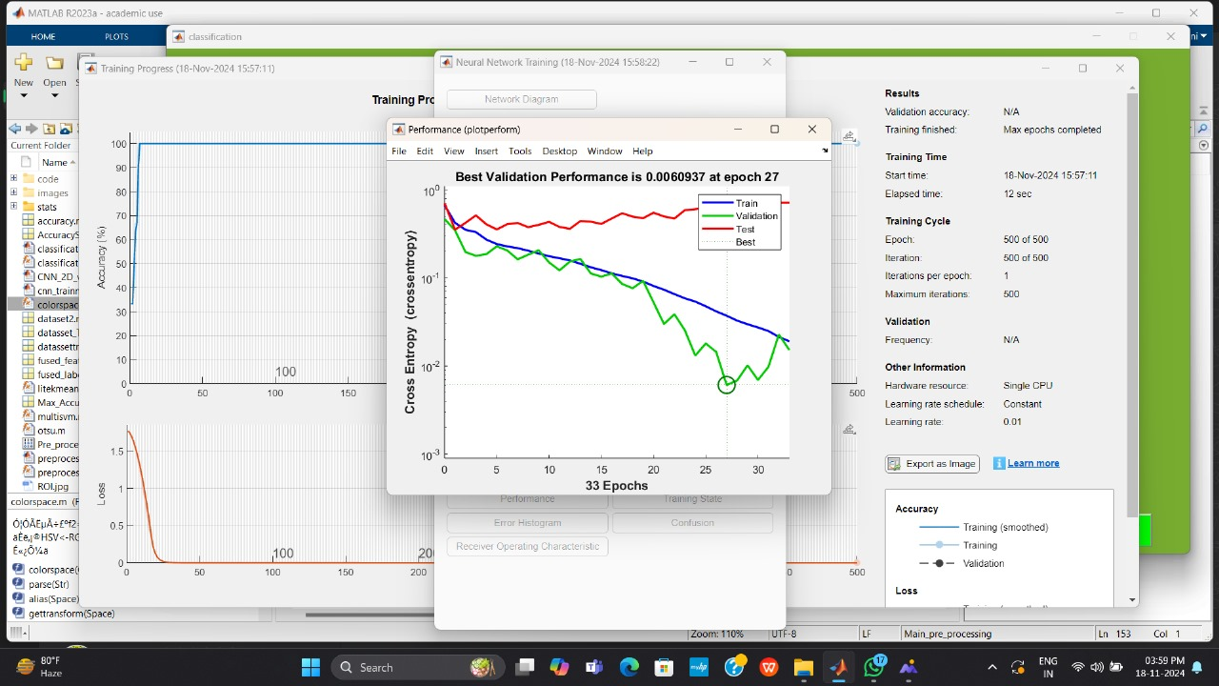
The model's performance assessed using cross-entropy loss on the training, validation, and test datasets. The best validation performance occurred at epoch 27, with a minimum cross-entropy loss of 0.06084. The validation loss decreased steadily initially and reached its lowest point at this epoch

Slide 20
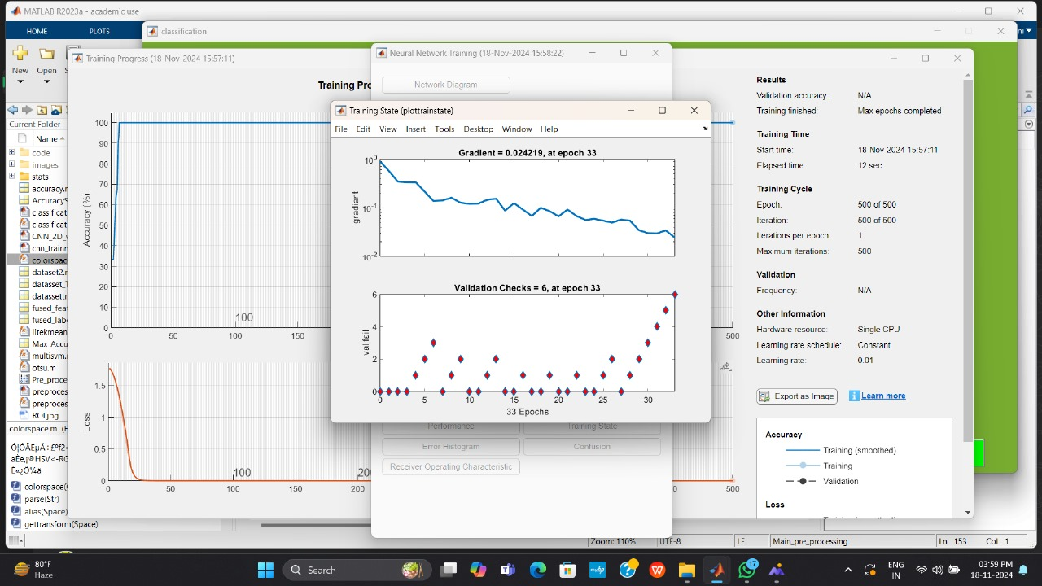
Gradients are derivatives of the loss function with respect to the model's parameters (weights and biases).
Large gradients cause significant updates, while small gradients result in minimal updates.
It monitors stability

Slide 21
This proposed model achieved:
Accuracy value of 96.1 %,
Best Validation Performance of 0.0060937,
Gradient of 0.024219 for an MRI image which indicates that the model’s predictions are close to the true values with low errors

Slide 22
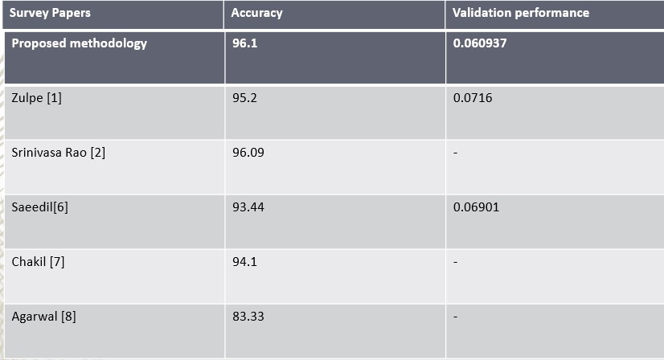
Comparison of Result with other Papers

Slide 23
References
[1] V. Pawar, "Enhancing Brain Tumour Classification through Hybrid Machine Learning Approaches," Research Publication, pp. 21-30,2022
[2] N. Zulpe, "Classification of Brain Tumors Using GLCM Textural Features Extracted from MRI Scans," Research Paper, pp. 1-10,may 2023
[3] A. K. Aggarwal, "Classification of Brain Tumor MRI Images Using GLCM Texture Features and svm," Research Paper, pp. 71-80,2023
[4] S. Jain, "Brain cancer Classification for Early Detection and Improved Survival Rates," Research Study, pp. 11-20,2024.
[5] K. S. Prasad, "Optimized Brain Tumor Detection: A Dual-Module Approach for MRI Image Enhancement and Tumor Classification, pp. 31-40,2024.
[6] H. P. Hadi, "Brain Tumor Segmentation Using Multimodal Benchmark Data and Active Contour Model," Research Results, pp. 41-50,2020
[7] S. Saeedi, "Advancements in Brain Tumor Detection via Machine Learning and Deep Learning Techniques," Literature Review, pp. 51-60,2019
[8] J. Chaki, "Brain Tumor Categorization with Deep and Reinforcement Learning Techniques," Research Advances, pp. 61-70,2019

Slide 24

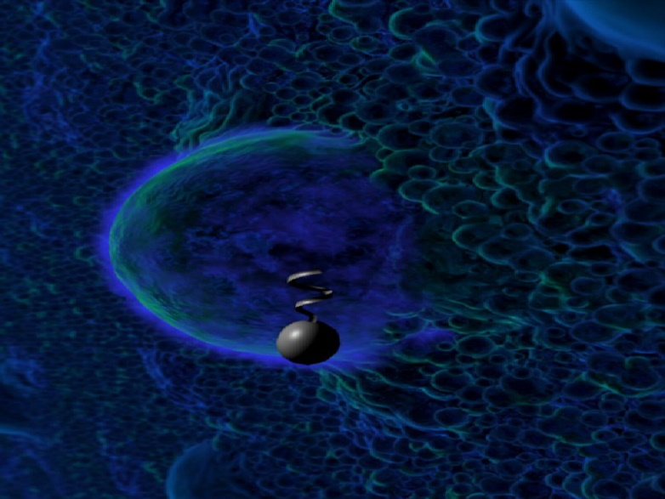
?
?
Questions

