Slide 1



Mental
Health
Prediction Application
Introduction and Working

Slide 2

PLEDGE TO PROGRESS
Sustainability Hackathon
Your Team Name:-
Team Shripad
Team Members:- Prof. S. T. Pirjade Assistant Professor-Guide
1)Shripad Vichare
2)Samiksha Jaunjale
3)Samrudhi Parte
4)Diya Salunkhe

Slide 3


Problem Statement
Mental health plays a crucial role in our daily life as it affects our thoughts, emotions, and behavior, which ultimately shape our overall well-being and quality of life. Detection of the state of ones mind using the modern technologies using the mobile application that the one will be able to handle and is easy to use.

Slide 4
User Segment And Pain Points
Now a days every person is suffering from various problems some of them might be related as physical and some may be psychological. Physical problems have a lot of solutions as compared to psychological.
Many a time a person having psychological problem doesn't know what is his state of mind and may not get aware about the upcoming problems. So detection of psychological problems in early stage is most important.
A person who is mentally unstable, depressed, tensed or stressed will be able to easily discuss their problems and work on them according to the report generated.

Slide 5

Pre-Requisite
Application will consist of an annonymous chatbot with all privacy methods.So that one can easily express about his feelings and discuss about them without hesitation.
By having the access to camera's the emotion of one person can be detected using the facial emotions, the expressions express a lot about persons particular state of mind.
The facial recognition and the emotion detection can be done by using the various machine learning algorithms and the artificial intelligence technology.
Using voice analyzer by detecting the pitch of the voice and tone of the talking we can categorize the mindset of person.
The person using the application will be asked to read the text provided and depending on the vocal notes the record can be maintained and determine the health of person.
By using eye sensor while talking ,eye contact frequency tells a lot about the mind set of the person.

Slide 6
Solution and methodology
Mental health plays a very important role in a person's everyday work and routine.
All along with the development in various aspects of electronic and digital devices has gained much more importance, smart technologies are used to tackle various problems.
Facial recognition is being used to detect the emotion of the person using the cameras of the devices.
One more technique that the psychologists use is the Eye contact frequency of the person.
Using the device camera the app is going to count the eye contact frequency and the time period of the eye contact of the person and through the data obtained we are going to define the mental stability of the person.

Slide 7

When a person is in an unstable condition like anxiety,depression,stress,pressure his/her voice note changes drastically and that can be observed and noted.
This app is going to have some text or paragraphs that the user should read and the voice is stored and processed to obtain the result.
Chatbots are being used for a friendly and unrecognized, private conversation that a person doesn't want to express with someone else for an easier and better way to deal with the condition because most of the problems are solved through conversation.
Natural Language processing is used to study for the texts that a user may have posted on social media or has been asked to type there and through the text obtained we are going to process it through various methods and try to determine the mental state of the person and also for voice recognition in case of people speaking in different languages.

Slide 8
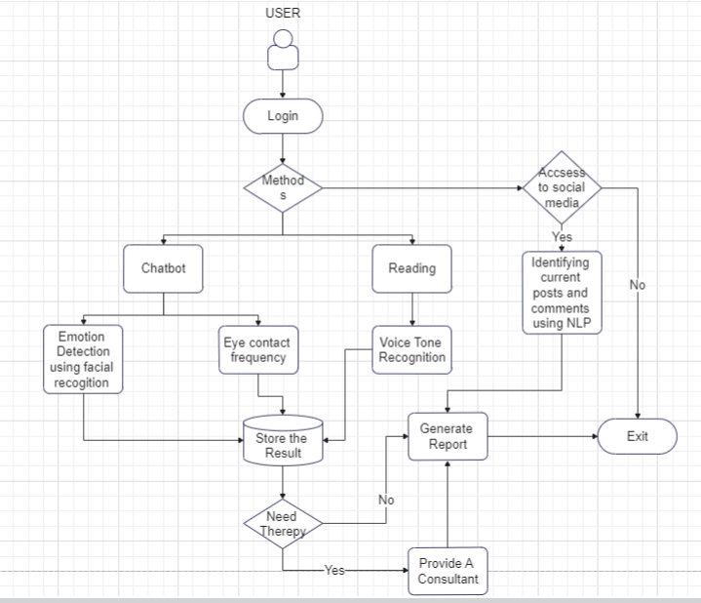
System
Design:-

Slide 9
Why our application will be better?
There are various applications in market, we tried some of them personally. Following is the is list of things we noticed that were not up to the mark as compared to our application and some more extra features that our application will include that these do not: -
1.) Chat functionality not good.
2.) Severely lacking AI and ML technology in their chat bots.
3.) No interest/engagement built up for user to connect with the application.
4.) No enough activities to help the user.
5.) No Voice tone recognition/Emotion detection using facial recognition/Eye contact frequency technology used in the application.

Slide 10

How far it can go
Application will take approximately 1.5-2 years to be completed.
We have decided to help the people who are suffering from mental issues and give them correct and healthy solution.We are making our application user friendly so that one can easily use our application.Also we are providing lots of practices to our users.Also after this we will take suggetions from psychologists.So this will take one to two years to develop the best mental health application.

Slide 11
Thank You
Team Members:- Prof. S. T. Pirjade Assistant Professor-Guide
1)Shripad Vichare
2)Samiksha Jaunjale
3)Samrudhi Parte
4)Diya Salunkhe
Notes:
Functional

