Slide 1
Battle of Neighborhood -
New Delhi
Shripad D. Mhetre

Slide 2
Introduction:
New Delhi is the capital city of India. It is a part of the city of Delhi’s 11 districts. The city itself has a large population. However, the much larger metro area has a population that exceeds 30 million.
With Delhi's diverse culture , comes diverse food items. There are many restaurants in New Delhi City, each belonging to different categories like Chinese , Italian , French etc. So as part of this project , we will list and visualise all major parts of New Delhi City.

Slide 3
Data
New Delhi Restaurants data that contains list Locality, Restaurant name,Rating along with their latitude and longitude
○ Data Source​ : ​ Zomato kaggle dataset
○ Description of Data​ : This dataset contains the locality of different restaurants, along with their ratings given by customers. The Latitude and Longitude are also provided.
○ Example​ : if i want to know best locality of chinese restaurant in New Delhi city then from dataset, we will group the restaurants in the same locality
Nearby places in each locality of new delhi city
○ Data source​ : ​ Foursquare API
○ Description​ : The foursquare api will be used to get all the nearby venues in each neighborhood.
○ Example​ : Using this we will find the venues in all or selected neighborhoods. And then by filtering out nearby locality and then aggregating the rating of each restaurant, we get the best places.

Slide 4
Methodology

Slide 5
Approach
Collect the New delhi city data from Zomato kaggle dataset.
Using FourSquare API we will find all venues for each neighborhood.
Filter out all venues that are nearby by locality.
Using aggregate rating for each resturant to find the best places.
Visualize the Ranking of neighborhoods using folium library(python).

Slide 6
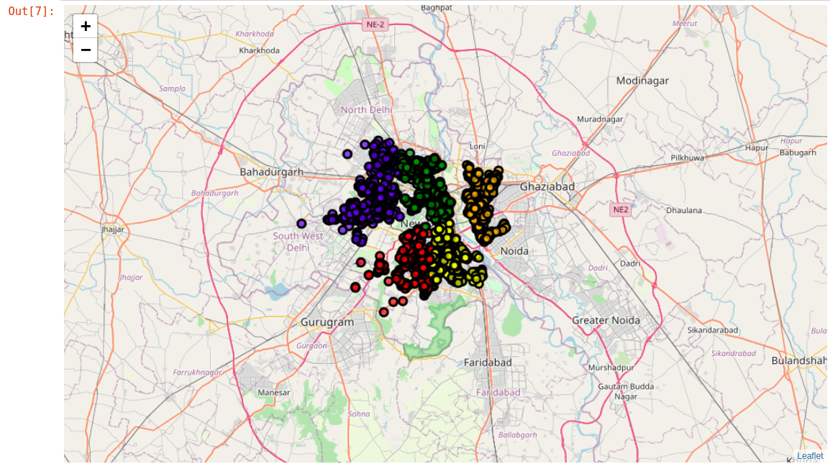
Folium Map before cluster analysis:

Slide 7
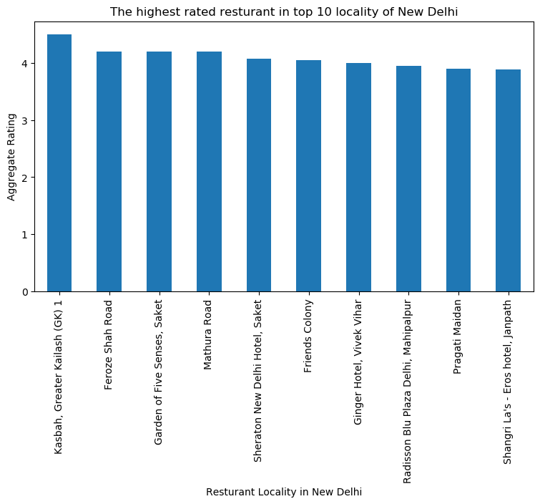

Slide 8
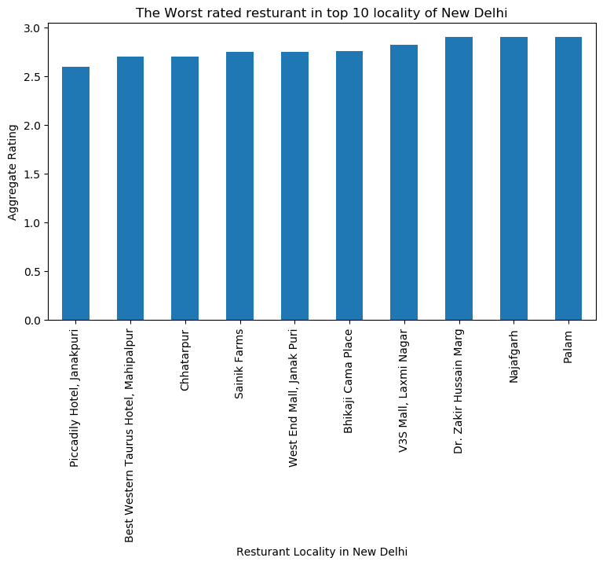

Slide 9
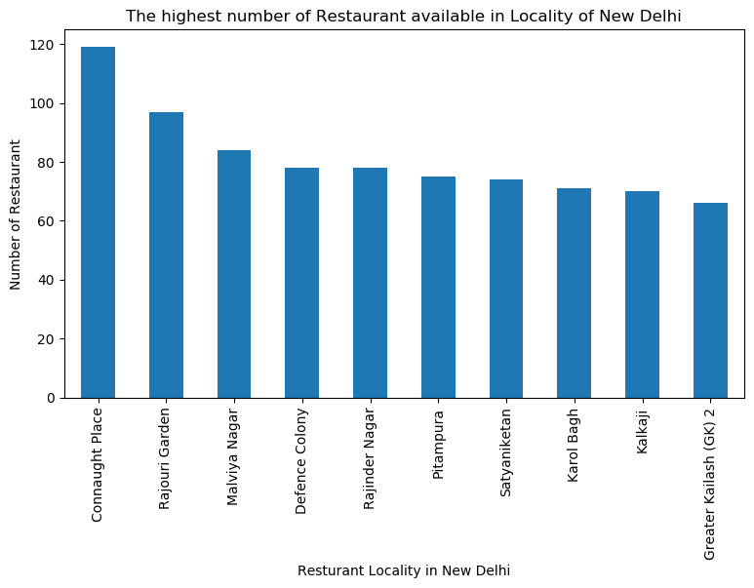

Slide 10
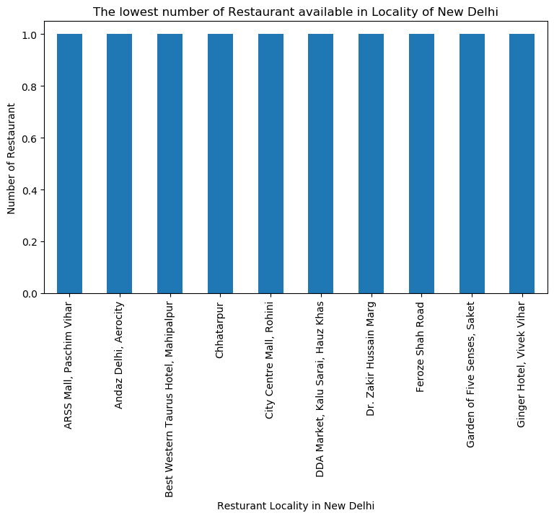

Slide 11
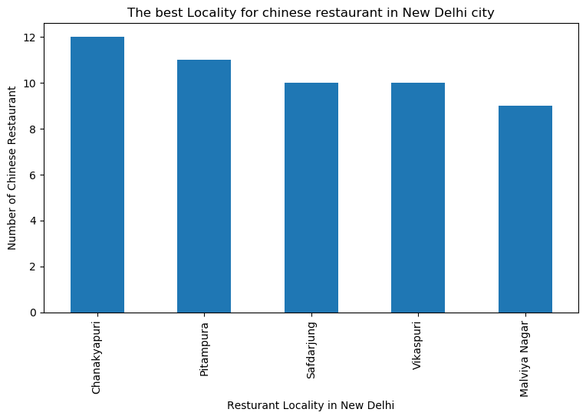

Slide 12
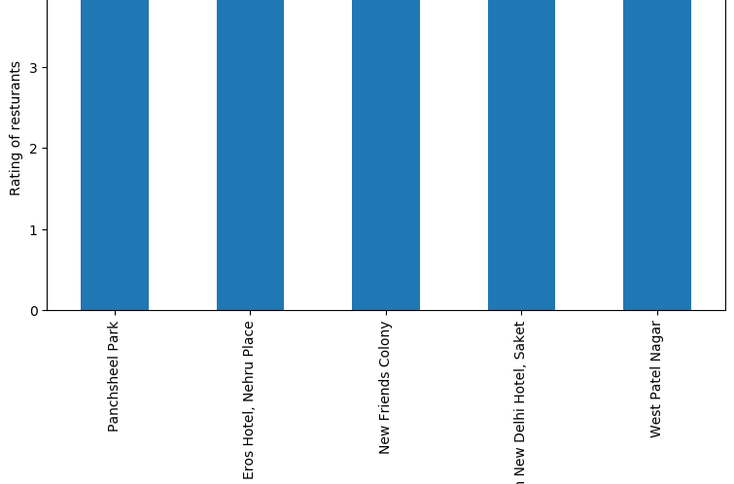

Slide 13
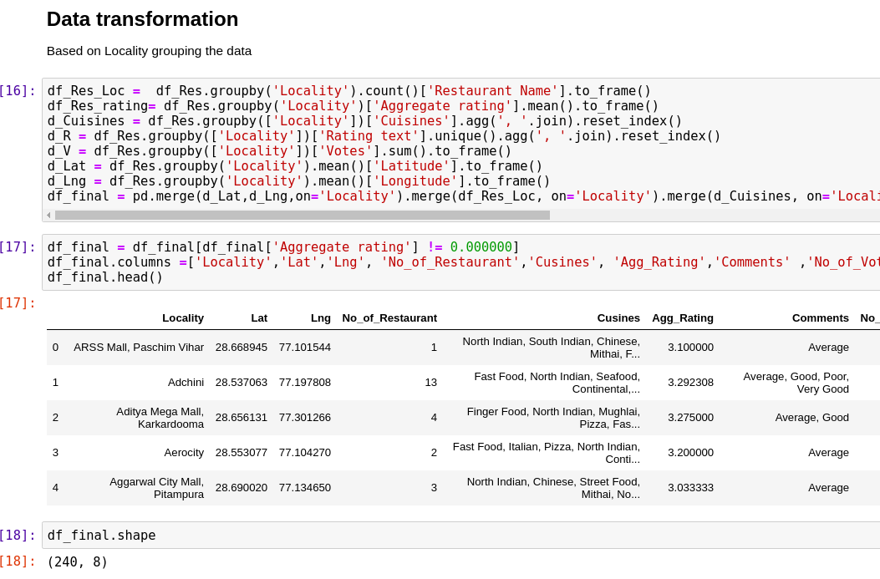

Slide 14
K Means Cluster analysis on transformed data
After cluster analysis, It is found that -
Cluster 1: It is most recommended for Indian Restaurants.
Cluster 2: It is most recommended for Hotels and night clubs.
Cluster 3 and Cluster 4: It is most recommended for Fast food.
Cluster 5: It is most recommended for the cafe and pizza.

Slide 15
Conclusion
● Chanakyapuri, Pitampura, Safdarjung are some of the best neighborhoods for Chinese cuisine.
● Panchsheel park, Nehru place have the best Chinese Restaurant.
● Connaught place, Rajouri garden, Malviya nagar are the best places for edible food.
● Greater kailash, Feroze shah road, Saket have the best restaurants in New Delhi.

