Slide 1

G H Raisoni College of Engineering & Management, Pune (An Empowered Autonomous Institute Affiliated to Savitribai Phule Pune University)
Department of Information Technology

Slide 2

The Impact of Digital Channels on Integrated Marketing Communications (IMC)
Unifying brand messages in the digital age for stronger customer connections and business growth.

Slide 3
What Is Integrated Marketing Communications (IMC)?
Strategic Unification
Breaking Down Silos
Core Principles
IMC is a strategic approach that unifies all marketing channels to deliver a consistent, compelling brand message across diverse platforms.
It breaks down traditional barriers between advertising, public relations, sales promotion, and digital marketing to create one cohesive customer experience.
The foundation of IMC rests on customer-centricity, message consistency, channel synergy, two-way communication, and strategic alignment of all efforts.

Slide 4
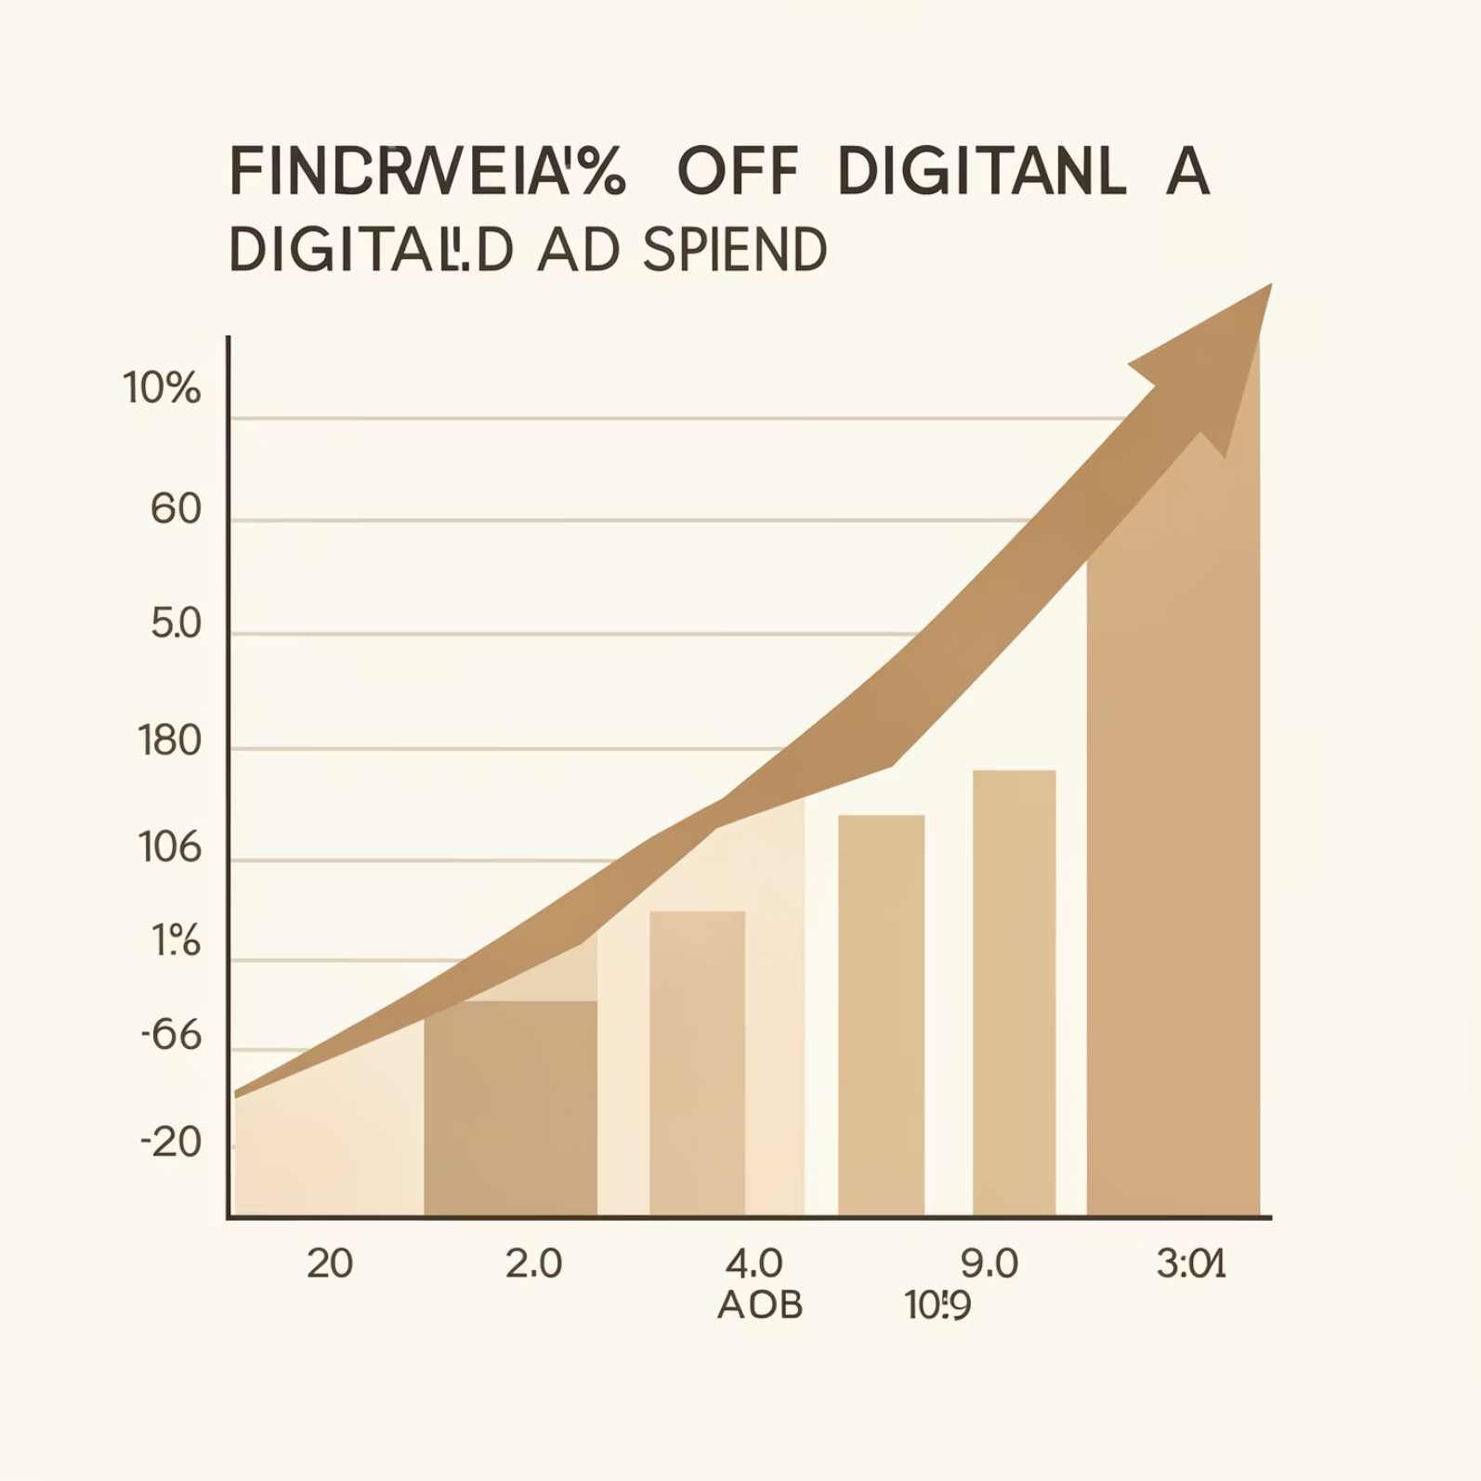
Digital Channels: The Game Changer for IMC
Digital Channels: SEO, social media, email campaigns, PPC advertising, content marketing, and mobile apps.
Ad Spend Shift: Projected 70% digital by 2026, escalating to 75% by 2027.
Key Advantages: Precise audience targeting, real-time engagement, and measurable Return on Investment (ROI).

Slide 5
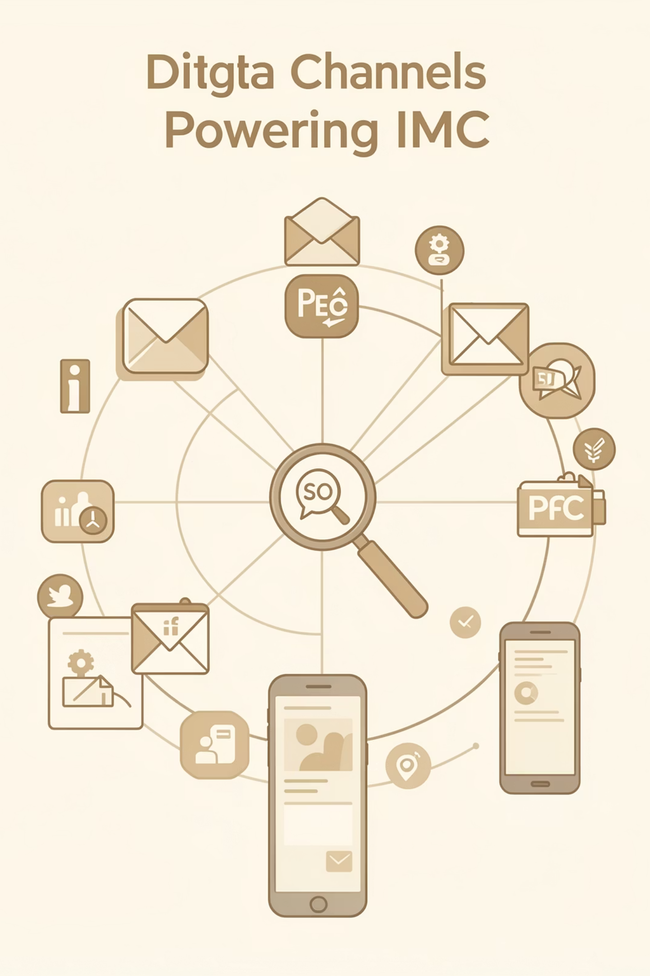
Digital: The Engine of Modern IMC
Offers unparalleled precision in audience targeting.
Enables real-time connection and engagement with customers.
Delivers measurable impact and quantifiable results.
Transforms brand engagement and fosters significant growth.

Slide 6




How Digital Channels Enhance IMC Effectiveness
Unwavering Consistency
Dynamic Interaction
Digital platforms ensure uniform messaging across all touchpoints, from your website to social media profiles and email newsletters.
Consumers actively engage with brands through likes, shares, comments, and personalized content, fostering a two-way dialogue.
Powerful Synergy
Actionable Analytics
Digital content amplifies traditional campaigns, extending their reach (e.g., TV ads on YouTube, shared on social media).
Tools like Google Analytics provide deep, real-time insights to continuously optimize campaigns and improve performance.

Slide 7
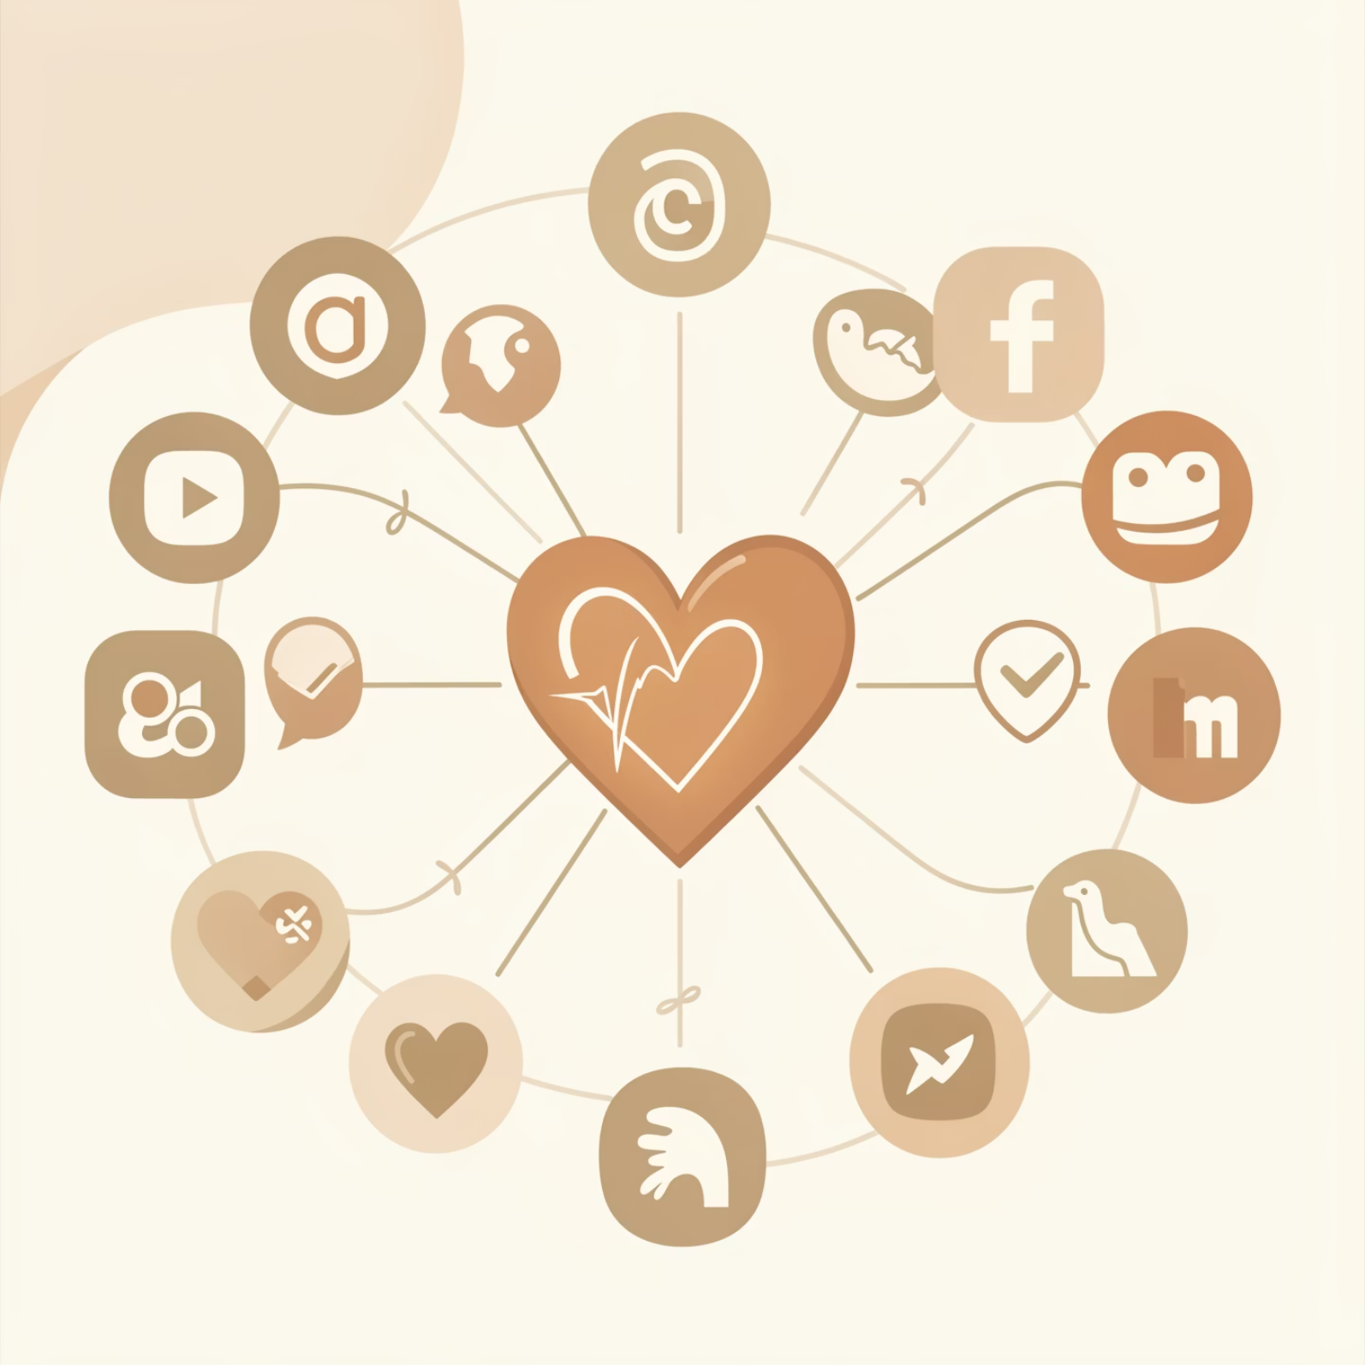
Social Media: The Heartbeat of Digital IMC
Platforms like Facebook, Instagram, and LinkedIn are central to digital IMC, enabling targeted advertisements and organic community engagement.
Social media supports various marketing functions, including:
Public relations
Direct marketing initiatives
Sales promotions
Compelling brand storytelling
Brands leverage these platforms for:
Running integrated contests
Collaborating with influencers
Distributing viral content

Slide 8
Challenges & Solutions in Integrating Digital Channels with IMC
Challenge: Fragmentation
Solution: Unified Strategy
Balancing diverse traditional and digital messaging without fragmenting the brand identity.
Develop a cohesive content strategy and maintain a consistent brand voice across all marketing channels.
Challenge: Rapid Changes
Solution: Agile Adaptation
Keeping pace with the fast-evolving digital landscape and emerging trends.
Employ agile marketing tactics and leverage continuous, data-driven optimization to stay relevant.

Slide 9

Conclusion: Digital Channels Are Essential to Modern IMC Success
Digital marketing has revolutionized IMC into an integrated, interactive, and highly measurable strategy.
Mastering the integration of digital channels builds stronger customer trust, fosters lasting loyalty, and achieves significant business growth.
Embracing evolving digital tools is crucial to ensure your IMC strategy remains relevant, impactful, and ahead of the curve.

Slide 10
G H Raisoni College of Engineering & Management, Pune (An Empowered Autonomous Institute Affiliated to Savitribai Phule Pune University)
Department of Information Technology

Slide 11
The Impact of Digital Channels on Integrated Marketing Communications (IMC)
Unifying brand messages in the digital age for stronger customer connections and business growth.

Slide 12
What Is Integrated Marketing Communications (IMC)?
Strategic Unification
Breaking Down Silos
Core Principles
IMC is a strategic approach that unifies all marketing channels to deliver a consistent, compelling brand message across diverse platforms.
It breaks down traditional barriers between advertising, public relations, sales promotion, and digital marketing to create one cohesive customer experience.
The foundation of IMC rests on customer-centricity, message consistency, channel synergy, two-way communication, and strategic alignment of all efforts.

Slide 13
Digital Channels: The Game Changer for IMC
Digital Channels: SEO, social media, email campaigns, PPC advertising, content marketing, and mobile apps.
Ad Spend Shift: Projected 70% digital by 2026, escalating to 75% by 2027.
Key Advantages: Precise audience targeting, real-time engagement, and measurable Return on Investment (ROI).

Slide 14
Digital: The Engine of Modern IMC
Offers unparalleled precision in audience targeting.
Enables real-time connection and engagement with customers.
Delivers measurable impact and quantifiable results.
Transforms brand engagement and fosters significant growth.

Slide 15
How Digital Channels Enhance IMC Effectiveness
Unwavering Consistency
Dynamic Interaction
Digital platforms ensure uniform messaging across all touchpoints, from your website to social media profiles and email newsletters.
Consumers actively engage with brands through likes, shares, comments, and personalized content, fostering a two-way dialogue.
Powerful Synergy
Actionable Analytics
Digital content amplifies traditional campaigns, extending their reach (e.g., TV ads on YouTube, shared on social media).
Tools like Google Analytics provide deep, real-time insights to continuously optimize campaigns and improve performance.

Slide 16
Social Media: The Heartbeat of Digital IMC
Platforms like Facebook, Instagram, and LinkedIn are central to digital IMC, enabling targeted advertisements and organic community engagement.
Social media supports various marketing functions, including:
Public relations
Direct marketing initiatives
Sales promotions
Compelling brand storytelling
Brands leverage these platforms for:
Running integrated contests
Collaborating with influencers
Distributing viral content

Slide 17
Challenges & Solutions in Integrating Digital Channels with IMC
Challenge: Fragmentation
Solution: Unified Strategy
Balancing diverse traditional and digital messaging without fragmenting the brand identity.
Develop a cohesive content strategy and maintain a consistent brand voice across all marketing channels.
Challenge: Rapid Changes
Solution: Agile Adaptation
Keeping pace with the fast-evolving digital landscape and emerging trends.
Employ agile marketing tactics and leverage continuous, data-driven optimization to stay relevant.

Slide 18
Conclusion: Digital Channels Are Essential to Modern IMC Success
Digital marketing has revolutionized IMC into an integrated, interactive, and highly measurable strategy.
Mastering the integration of digital channels builds stronger customer trust, fosters lasting loyalty, and achieves significant business growth.
Embracing evolving digital tools is crucial to ensure your IMC strategy remains relevant, impactful, and ahead of the curve.

