Slide 1
Traffic Signal Violation Detection System
Presented By-
Shripoorna Praveen Katageri
1

Slide 2
Objectives
Automate traffic signal violation detection
Make it easy for the traffic police department to monitor the traffic
Detecting and tracking the vehicle and their activities accurately
2

Slide 3
OVERVIEW
The System contains two main components –
Vehicle Detection Model (Raspberry Pi)
Graphical User Interface (Matplotlib and Pandas Dataframe)
3

Slide 4
Methodology
Vehicle Classification:
An object detection model (Raspberry Pi)is used to detect vehicles that violates the rules.
Features of the model:
time prediction at which violation happens.
Data extractor
graph for the data collected
5

Slide 5
Methodology (Cont.)
Violation Detection:
The vehicles are detected using raspberrypi model. After detecting the vehicles through IR Sensors, violation cases are checked.
If any vehicle passes the traffic light in red state, violation happens. After detecting violation, the time is recorded at which the violation has occurred.
10

Slide 6
Implementation (Cont.)
Graphical User Interface:
1)pandas library to make use of DataFrame function to display a table of the collected data.
2) matplotlib.pyplot library to plot a graph of time of violations happened.
13

Slide 7
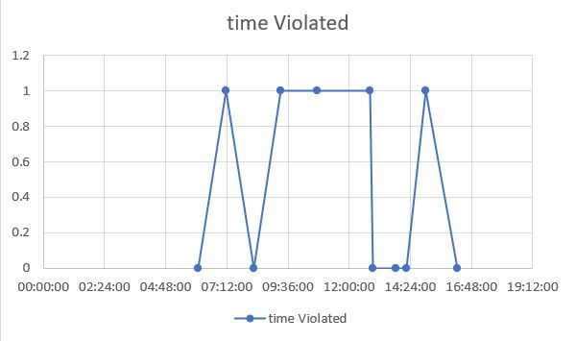
Graph Overview
Therefore we can observe most violations happened between 9:30 to 12:00
11

Slide 8
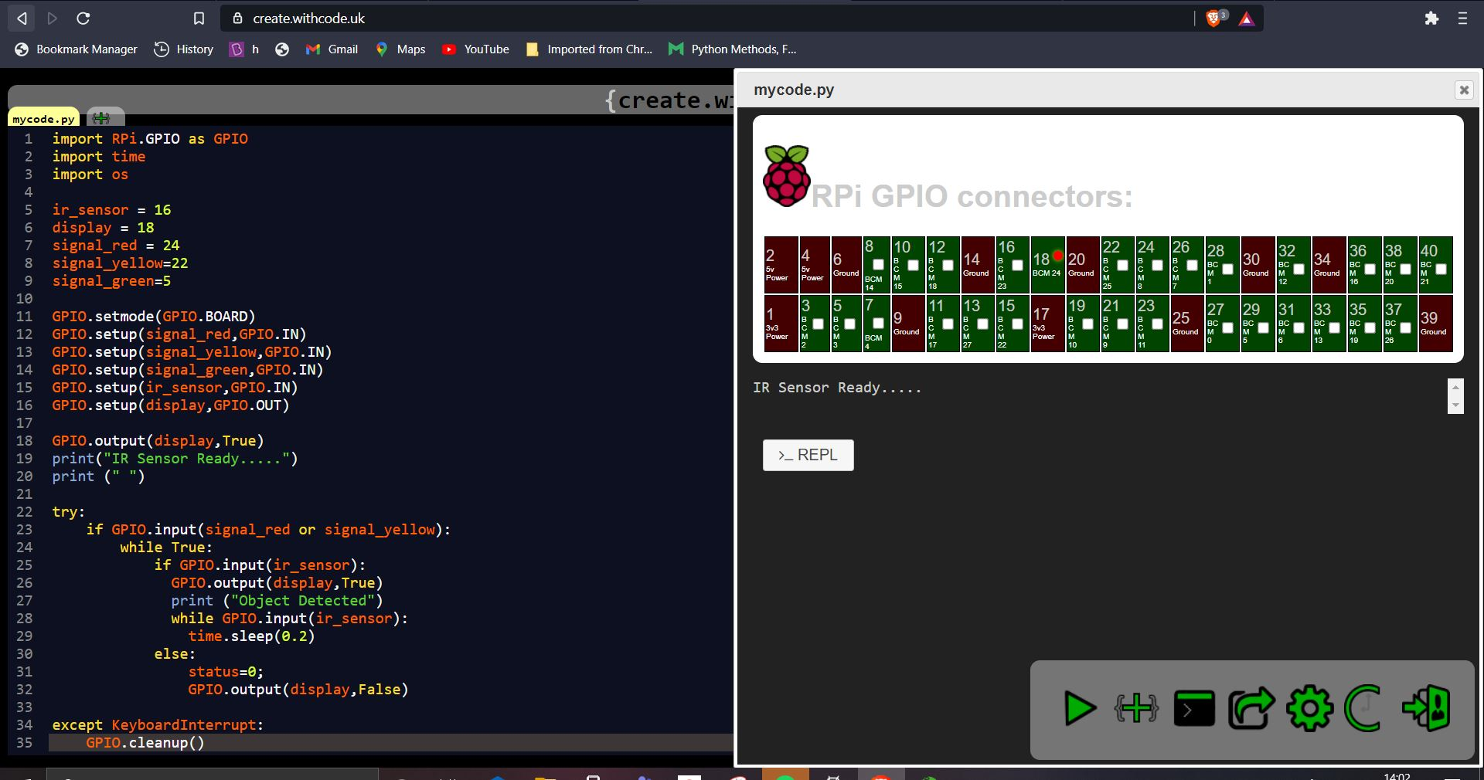
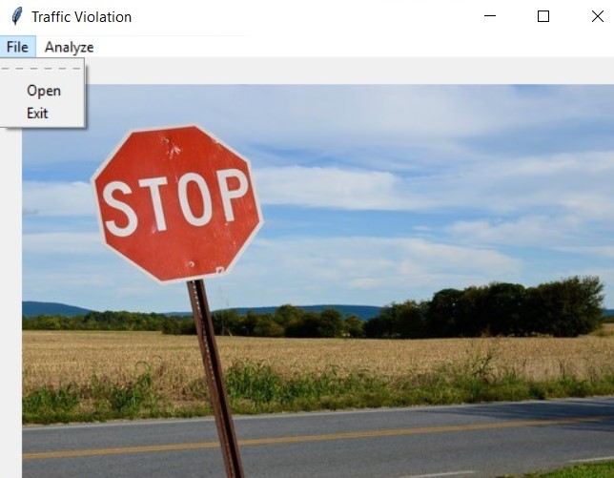
Implementation (Cont.)
Home Page

Slide 9
Future Plan
Adding more sensors to predict more data such as speed, type of the vehicle.
Making this system more robust.
Adding Number Plate Detection.
Adding more traffic violation conditions.
19

Slide 10
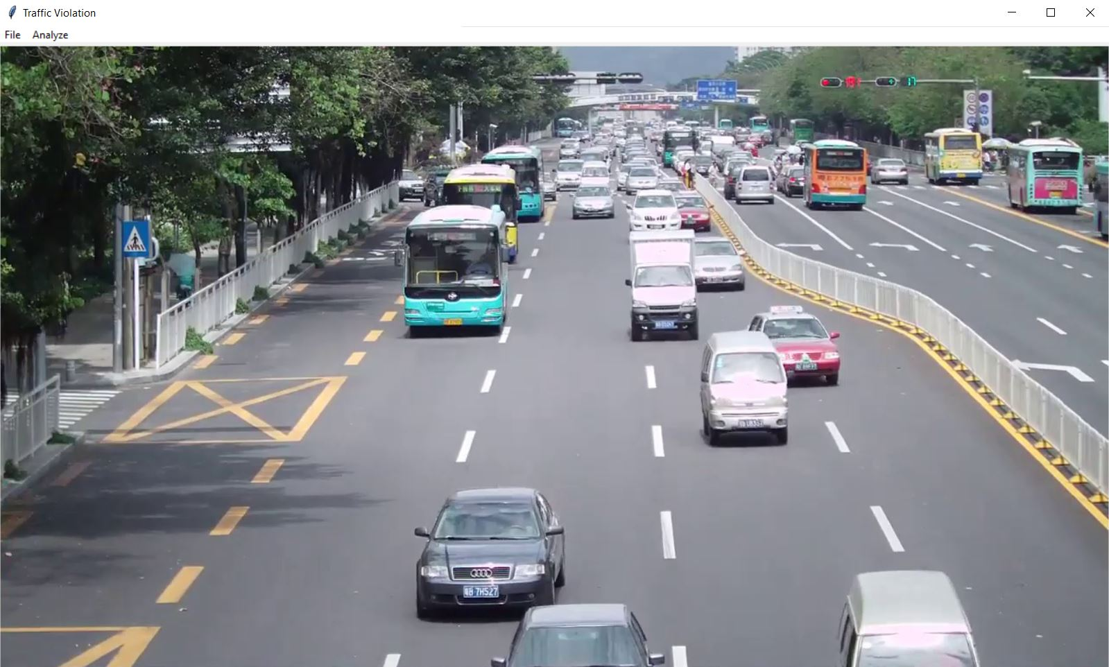
Implementation (Cont.)
Preview Loaded for specific video footage
16

Slide 11
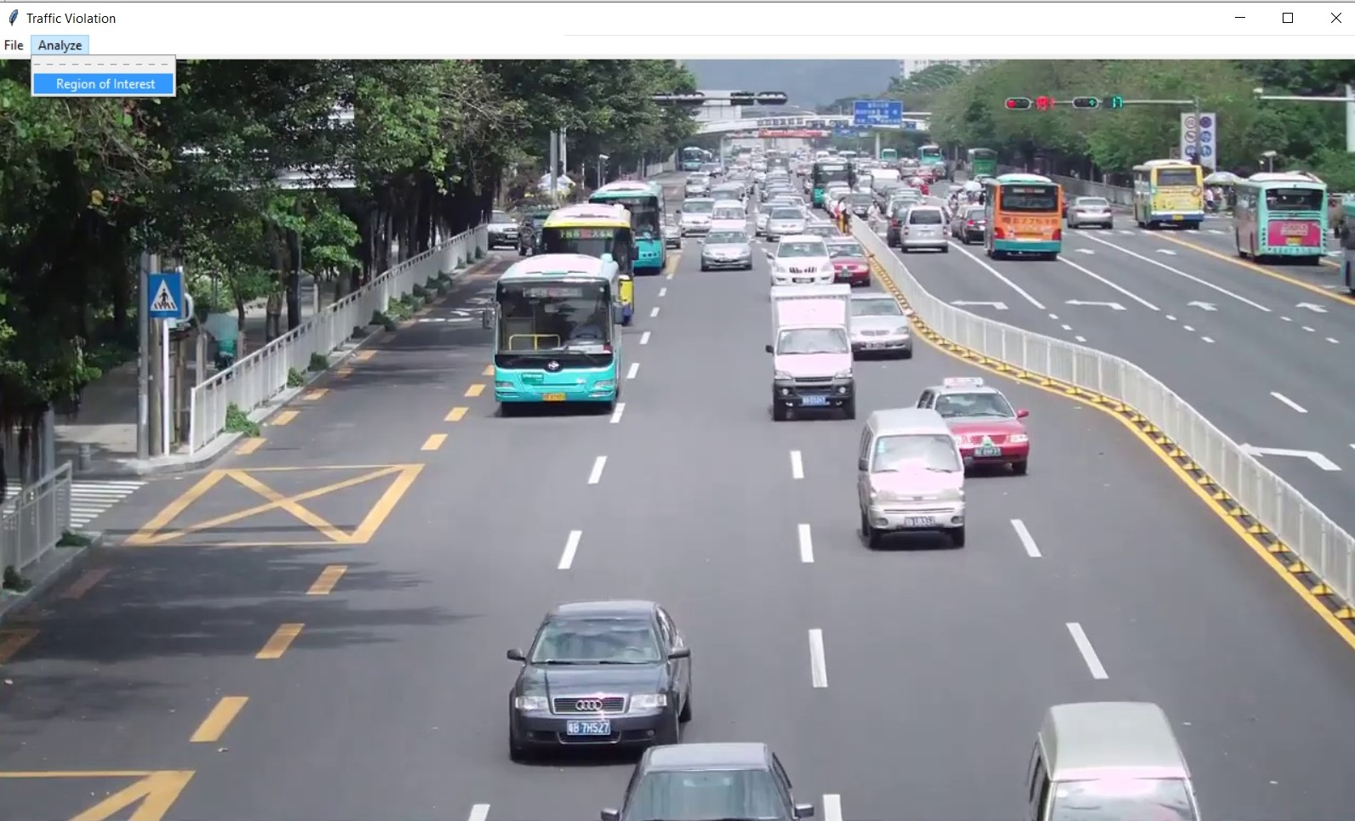
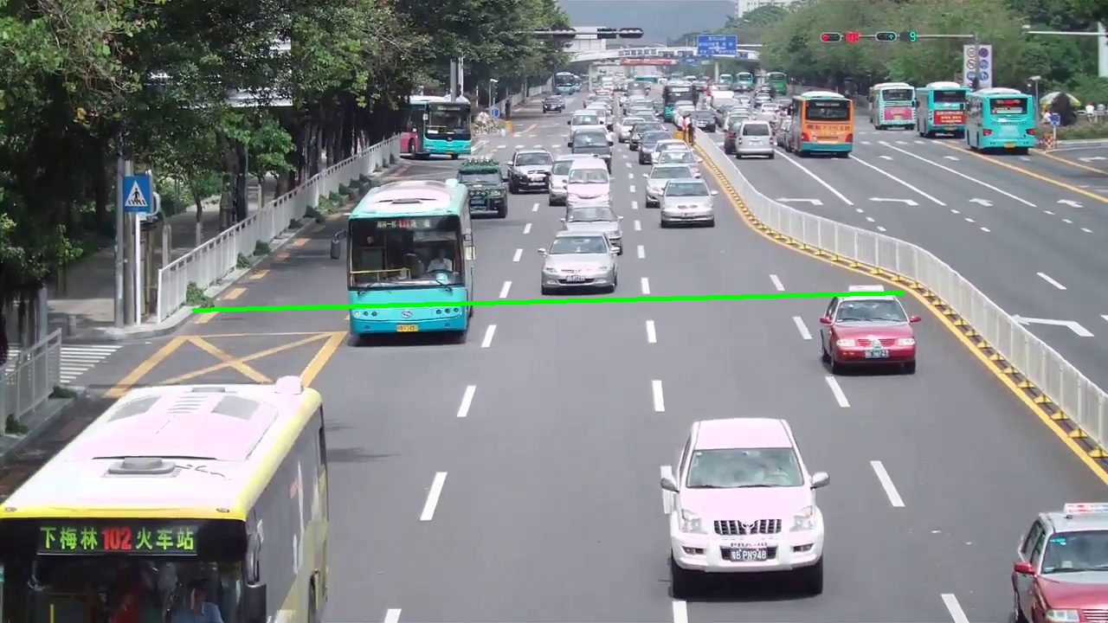
Implementation (Cont.)
Region of Interest
(Drawing Signal Line)
17

Slide 12
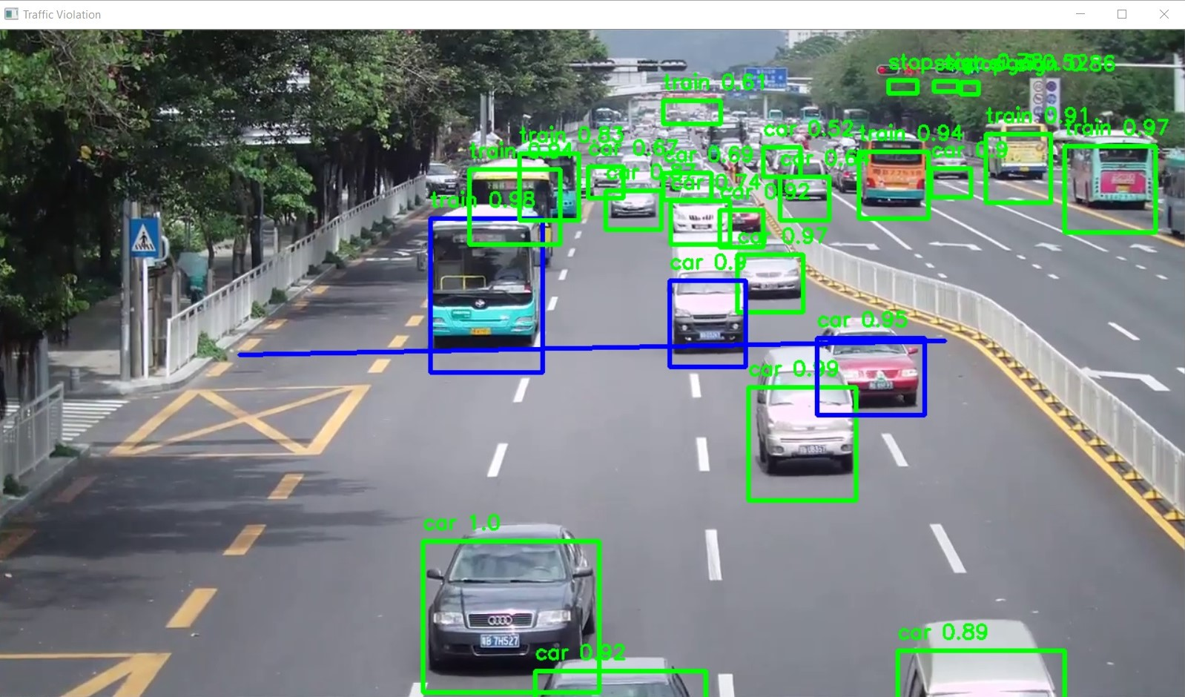
Future Implementation (Cont.)
Final Output
(on each frame)
18

Slide 13
THANK YOU
20

