Slide 1
CAPSTONE PROJECT
movie rental analytics

Slide 2
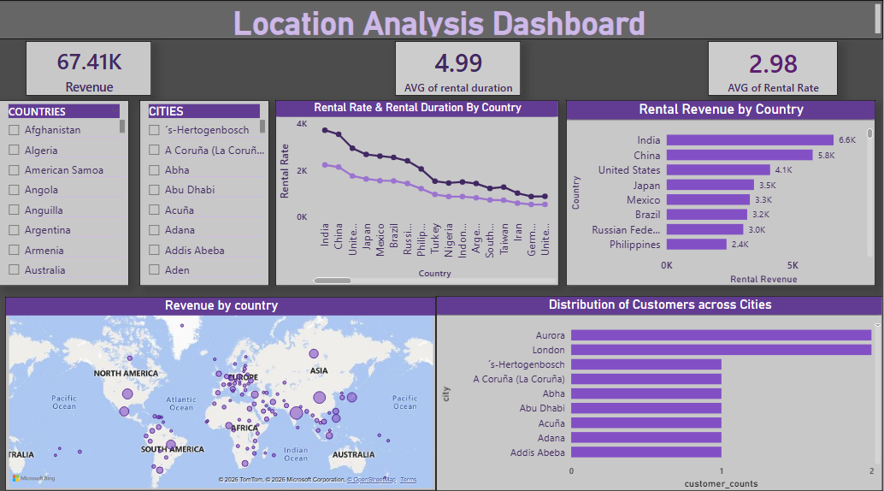
LOCATION ANALYSIS
Key Findings-
India, China, and the United States contribute the highest rental revenue.
Average rental duration is approximately 4.7 days, with an average rental rate of 2.99.
Customer distribution is spread across multiple cities, indicating geographically diversified demand.
Insight: Revenue is concentrated in key countries, but customer presence is globally distributed.

Slide 3
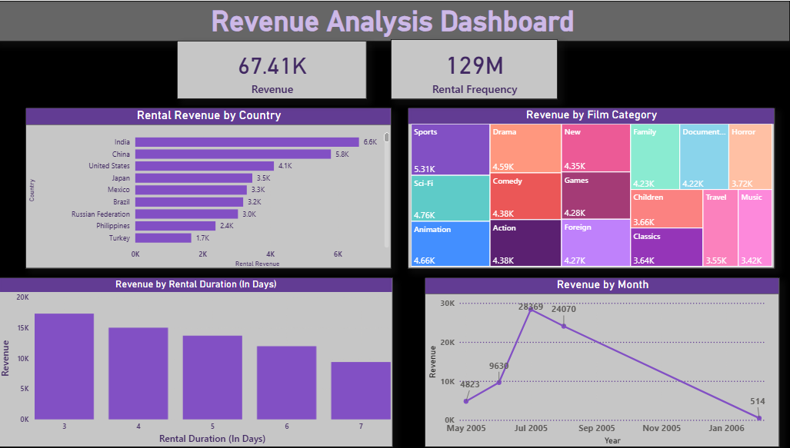
REVENUE ANALYSIS
Key Findings -
Total revenue generated is 67.41K with total rental frequency of 129M.
Monthly revenue trends show peak performance mid-year, followed by a gradual decline.
Top revenue-generating categories include Sports, Sci-Fi, Animation, and Action.
Rental duration between 4–6 days contributes the highest revenue.

Slide 4
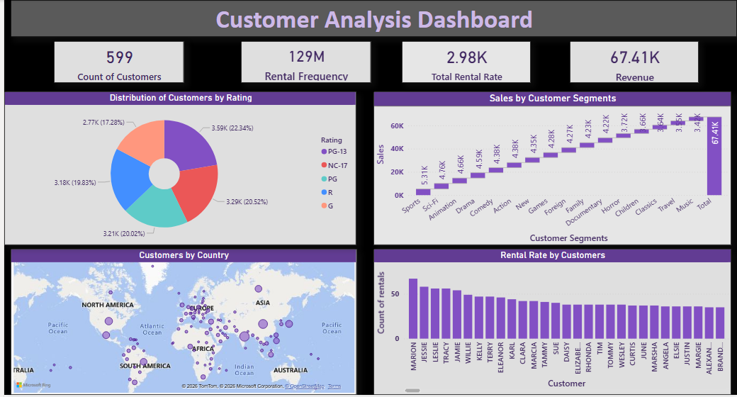
CUSTOMER ANALYSIS
Key Findings –
Total customers: 599
Total revenue: 67.41K
Customer revenue contribution is relatively evenly distributed, with top customers contributing moderately higher revenue.
Customer ratings distribution shows balanced engagement across categories.
Insight: No heavy revenue dependency on a small customer group — revenue base is diversified.

Slide 5
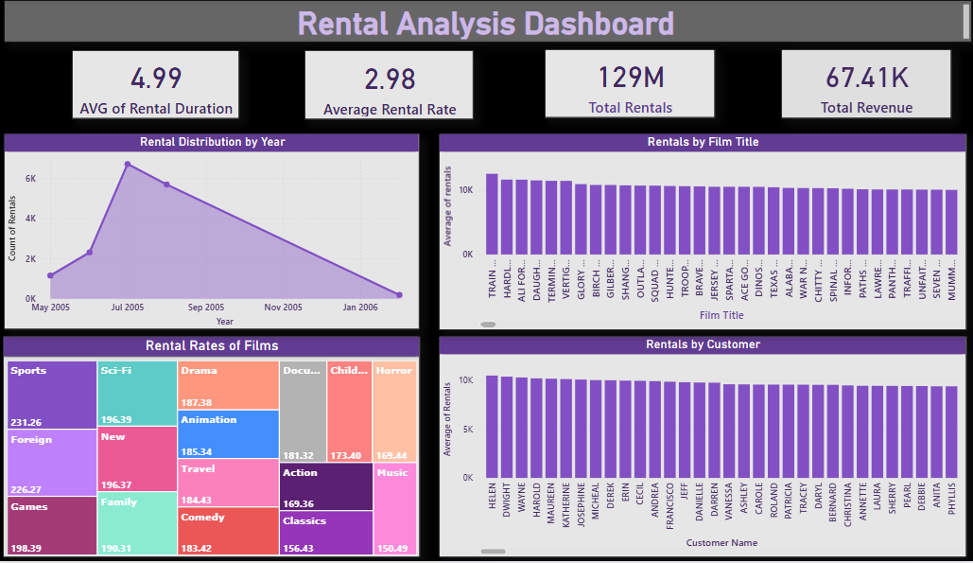
RENTAL ANALYSIS
Key Findings -
Total rentals: 129M
Average rental duration: 4.99 days
Average rental rate: 2.98
Rental volume peaked around mid-2005 and declined afterward.
Insight: Rental demand is time-sensitive with clear seasonal trends.

Slide 6
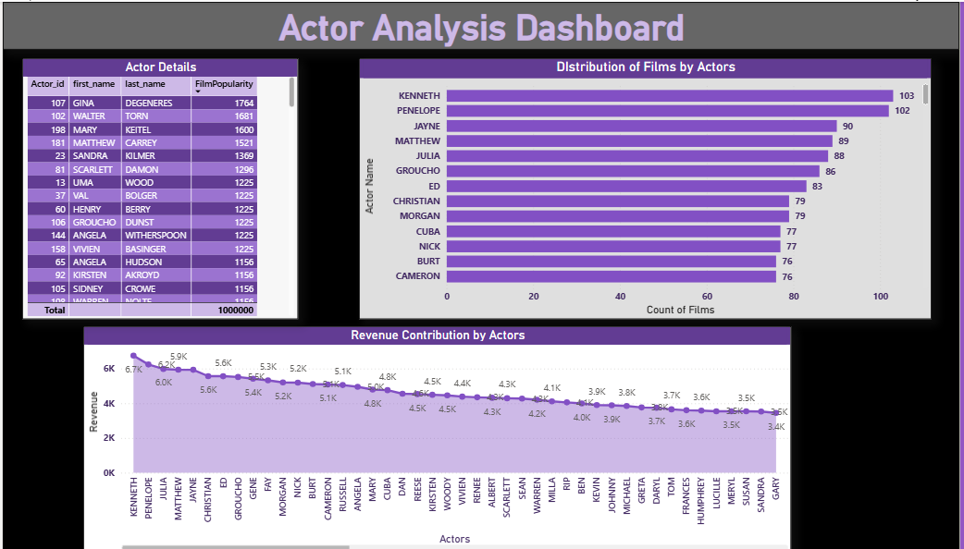
ACTOR ANALYSIS
Top actors such as Kenneth and Penelope contribute the highest revenue (~6K+).
Actors with higher film participation tend to generate more revenue.
Film count per actor ranges between 75–103 films.
Insight: Revenue strongly correlates with actor participation and popularity.

Slide 7
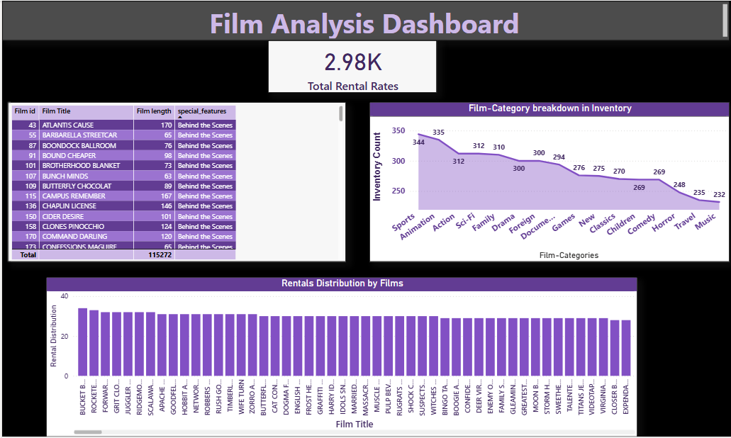
FILM ANALYSIS
Total rental rate: 2.98K
Top inventory categories: Sports (344) and Animation (335).
Rental demand is evenly distributed across multiple films.
Lower inventory categories include Music and Travel.
Insight: Inventory allocation aligns with high-demand genres, ensuring balanced revenue generation.

Slide 8
Overall Business Insight Summary
Revenue is Diversified and Stable
Revenue is not dependent on a single country, customer, or film — demand is well distributed across locations and segments.
High-Performing Genres Drive Profitability
Sports, Animation, Sci-Fi, and Action categories generate the strongest revenue and justify higher inventory allocation.
Actor Popularity Impacts Revenue
Actors with higher film participation significantly contribute to rental revenue, showing a clear popularity–performance relationship.
Seasonal Rental Trends Exist
Rental demand peaks during specific months, indicating seasonal behavior that can guide promotional and inventory strategies.

Slide 9
!
THANK YOU !

