Slide 1

Project Title – Seasonal Agriculture Performance Analysis
Student Name: SHRIRAKSHA
College Name: AMC Engineering College
AICTE STU ID : STU6a6b62e4de2d51785422564

Slide 2

PROBLEM STATEMENT
Agricultural activities are influenced by seasonal variations in environmental conditions,
farming practices, resource availability and market conditions. As a result, agricultural
performance may differ from one season to another.
However, raw agricultural data does not clearly explain how agricultural performance changes
across seasons or what patterns can be observed in different seasonal conditions.
The problem is to analyze the given agricultural dataset and investigate seasonal differences
in agricultural performance by identifying meaningful patterns, trends, relationships and
variations within the available data.

Slide 3
PROJECT DESCRIPTION
Seasonal Agriculture Performance Analysis is a Data Analytics project that analyzes agricultural performance across Kharif, Rabi, and Zaid seasons. The project examines crop yield, production, environmental conditions, resource usage, disease and pest risk, and economic performance. Regional and crop-wise comparisons are performed to identify seasonal patterns, variations, and meaningful insights. Python, Pandas, Matplotlib, and Google Colab are used for data cleaning, analysis, and visualization to support better seasonal agricultural planning.
The analysis helps identify differences in agricultural performance between seasons and regions and highlights important factors affecting overall outcomes. The findings reveal variations in productivity, profitability, environmental conditions, water usage, and disease or pest risk. These insights provide a better understanding of seasonal agricultural patterns and can be useful for making informed decisions regarding crop selection, resource utilization, and seasonal farm planning.

Slide 4

WHO ARE THE END USERS?
The main end users of the Seasonal Agriculture Performance Analysis project are:
Farmers – to understand seasonal crop performance and resource usage.
Agricultural planners – to support seasonal agricultural planning.
Agricultural officers – to analyze regional and seasonal variations.
Researchers and students – to study agricultural patterns and trends.
Government and agricultural organizations – to support data-driven agricultural decisions.

Slide 5

TECHNOLOGY USED
  Python – Main programming language for data analysis.
  Pandas – Data cleaning, manipulation, and analysis.
  NumPy – Numerical calculations and statistical operations.
  Matplotlib – Creating charts and visualizations.
  Seaborn – Creating informative statistical graphs and visualizations.
  Google Colab – Development and execution environment.
  Jupyter Notebook – Organizing code, analysis, results, and observations.

Slide 6
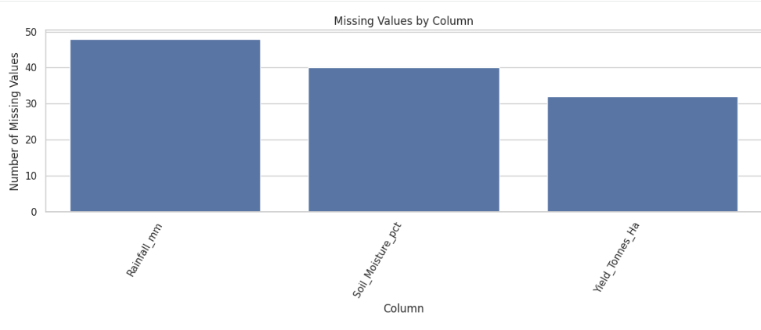
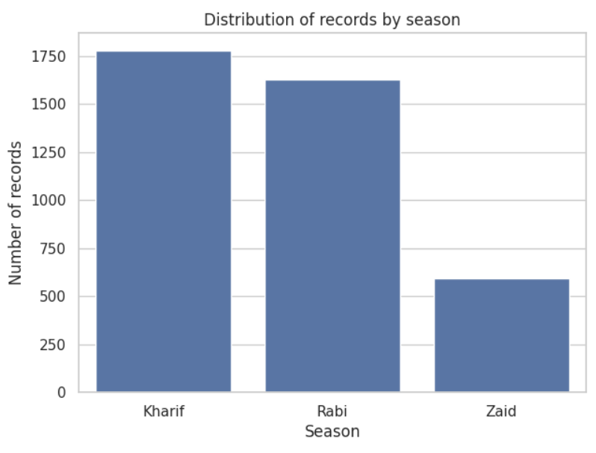
RESULTS
The bar chart shows missing data across three agricultural features: Rainfall_mm has the highest count at nearly 48 missing values, followed by Soil_Moisture_pct with 40, and Yield_Tonnes_Ha with approximately 32.
This bar chart shows the distribution of records across agricultural seasons, with Kharif having the highest count at around 1,770 records, followed by Rabi at approximately 1,620, and Zaid with the lowest count near 580 records.

Slide 7
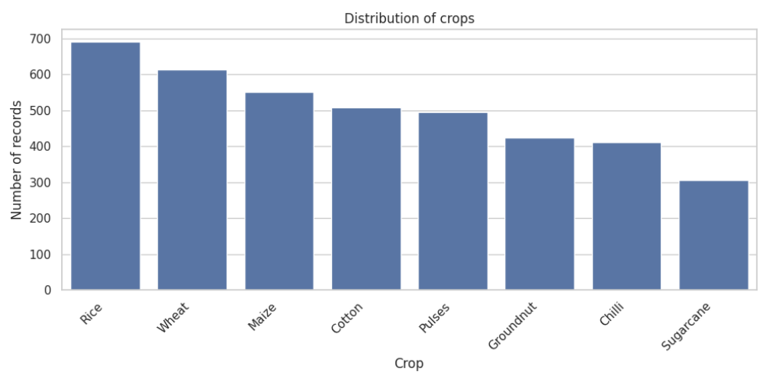
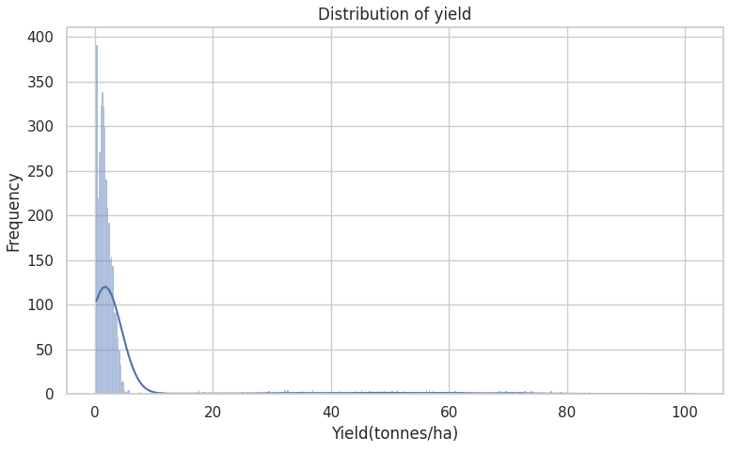
RESULTS
The bar chart shows the distribution of records across various crops, with Rice accounting for the highest count at nearly 690 records, followed by Wheat (~610), Maize (~550), Cotton (~505), and Pulses (~495), while Groundnut (~420), Chilli (~410), and Sugarcane (~305) make up the lower end of the distribution.
The histogram shows a strongly right-skewed distribution of crop yield, with the vast majority of records heavily concentrated between 0 and 5 tonnes/ha (peaking near 390 in frequency). A very long, sparse tail extends all the way up to 100 tonnes/ha, indicating potential outliers or specialized high-yield crops.

Slide 8
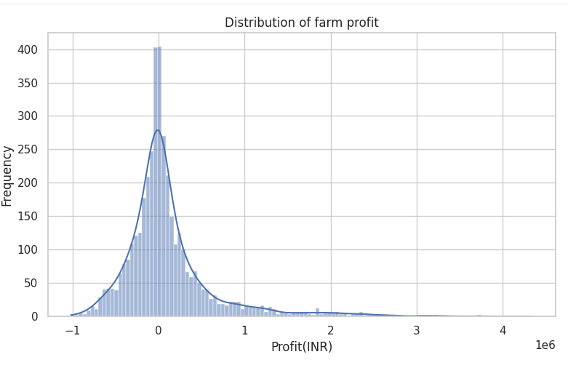
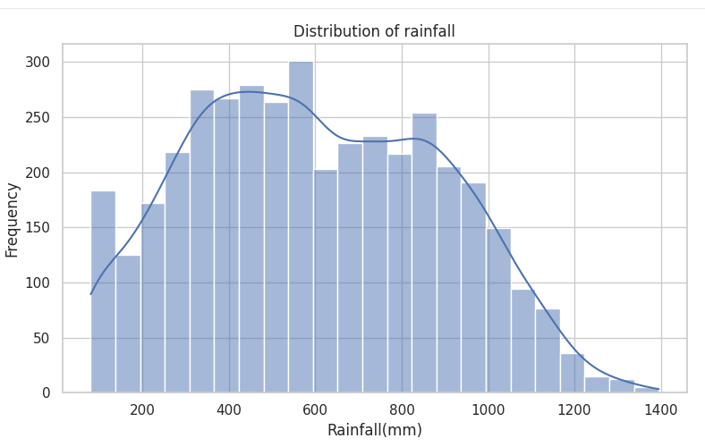
RESULTS
This histogram shows a sharply peaked, right-skewed distribution of farm profit, centered around 0 INR with a major frequency spike above 400. While the vast majority of farms cluster between -0.5 million and 0.5 million INR, a notable long tail extends into negative values down to -1 million INR and stretches far to the right, reaching up to 4 million INR.
This histogram shows a moderately right-skewed, slightly bimodal distribution of rainfall, with the highest concentration of values between 300 mm and 600 mm (peaking at 300 in frequency near 550 mm) and a secondary peak around 850 mm. The values taper off gradually above 1,000 mm, extending up to approximately 1,400 mm.

Slide 9
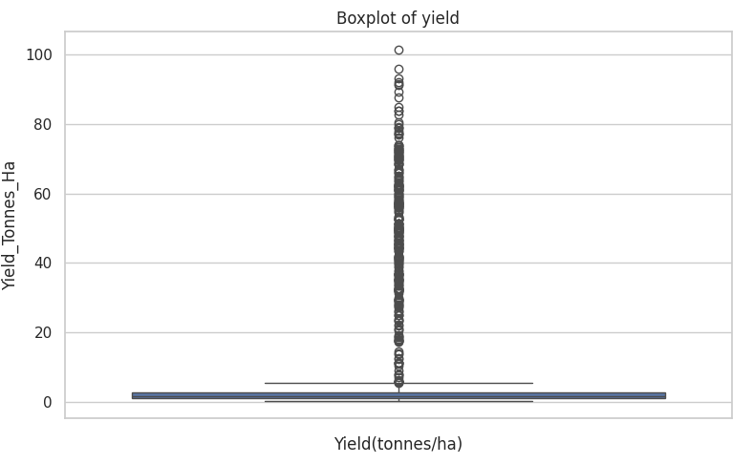
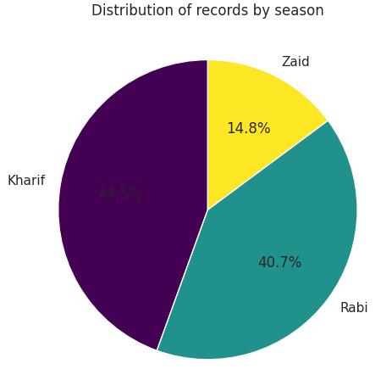
RESULTS
This boxplot reveals a highly compressed interquartile range concentrated near 0 to 5 tonnes/ha, accompanied by a dense trail of upper outliers that stretch all the way up to approximately 100 tonnes/ha.
This pie chart shows the percentage distribution of records across seasons, with Kharif comprising the largest share at 44.5%, followed closely by Rabi at 40.7%, while Zaid accounts for the remaining 14.8%.

Slide 10
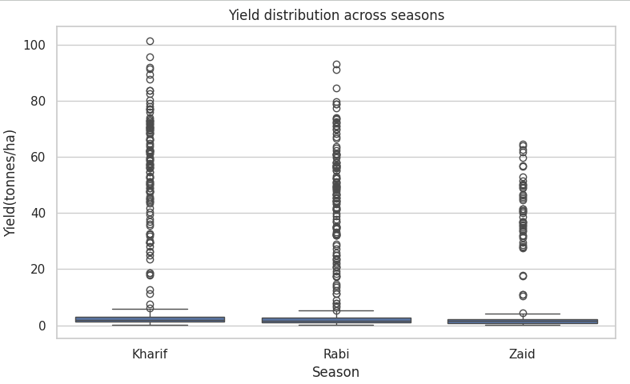
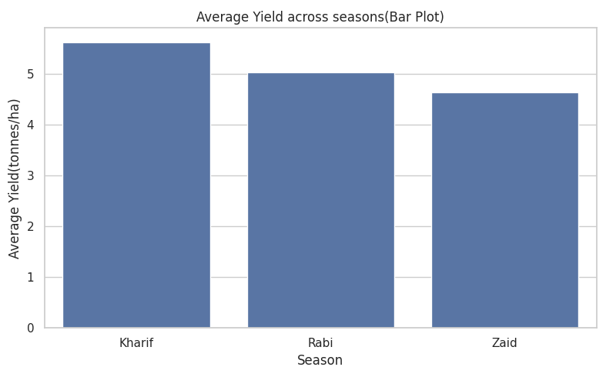
RESULTS
This boxplot compares yield distributions across seasons, showing that while median yields remain low and consistent (between 0 and 5 tonnes/ha) for all three, Kharif features the highest top-end outliers reaching up to ~100 tonnes/ha, followed by Rabi (~93 tonnes/ha), and Zaid with a lower peak (~65 tonnes/ha).
This bar chart shows the average yield across agricultural seasons, with Kharif recording the highest mean yield at approximately 5.6 tonnes/ha, followed by Rabi at around 5.0 tonnes/ha, and Zaid with the lowest average yield near 4.6 tonnes/ha.

Slide 11
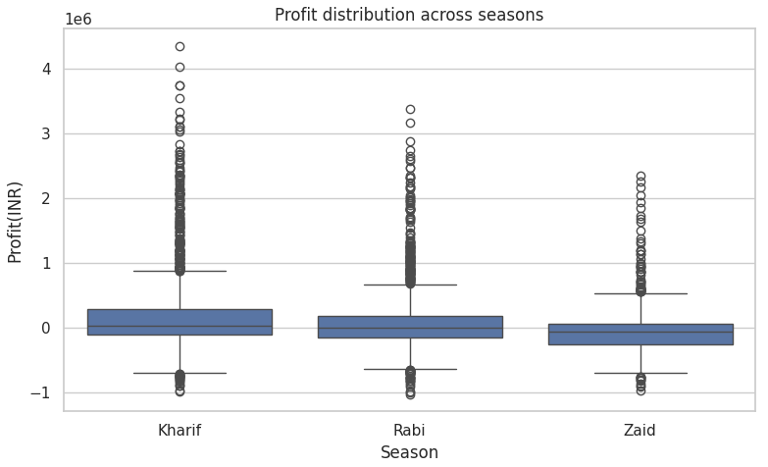
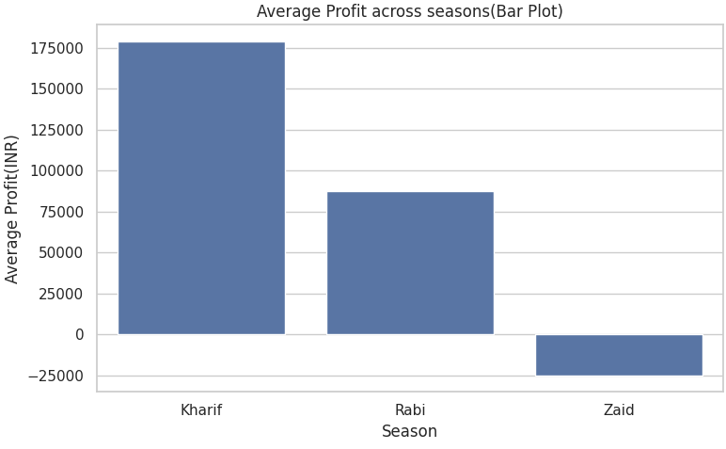
RESULTS
This boxplot illustrates profit distribution across seasons: median profits stay near zero for all three, but Kharif generates the highest positive outliers up to ~4.3 million INR, followed by Rabi reaching ~3.4 million INR, and Zaid topping out around 2.4 million INR, while all seasons experience similar loss extremes down to -1.0 million INR.
This bar chart shows the average profit across agricultural seasons, with Kharif yielding the highest mean profit at approximately 178,000 INR, followed by Rabi at around 87,000 INR, while Zaid experiences a negative average profit of roughly -25,000 INR.

Slide 12
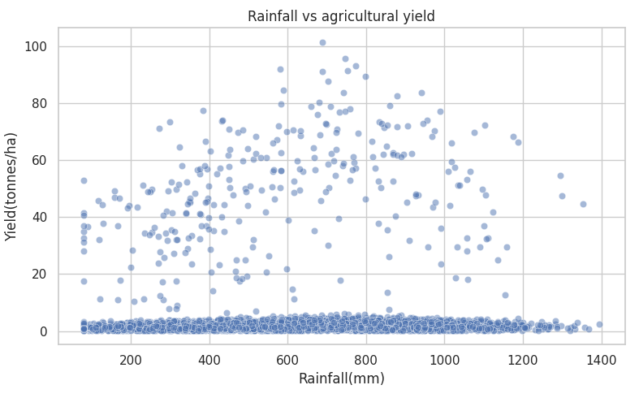
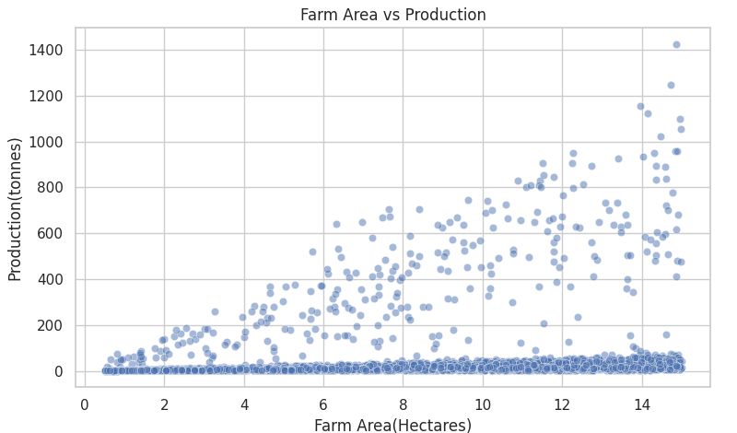
RESULTS
This scatter plot illustrates the relationship between rainfall and agricultural yield: most data points form a dense baseline cluster under 5 tonnes/ha across all rainfall levels (100–1,400 mm), while high-yield outliers (up to 100 tonnes/ha) peak primarily between 600 mm and 900 mm of rainfall before thinning out at extreme high and low precipitation levels.
This scatter plot depicts a positive correlation between farm area and total production, showing that as land size increases up to 15 hectares, maximum production capacity fan-shapes upward toward 1,400 tonnes—though a heavy baseline concentration remains under 100 tonnes across all farm sizes.

Slide 13
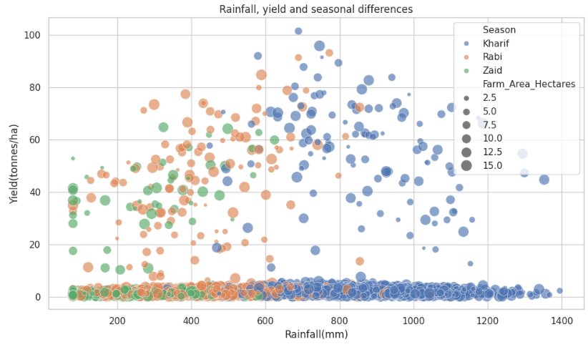
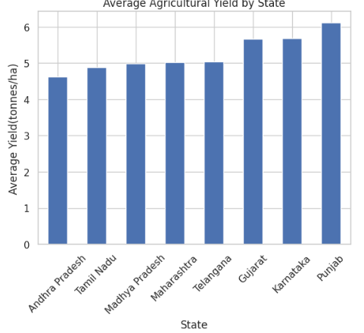
RESULTS
This bubble plot highlights seasonal clusters along the rainfall axis: Zaid crops concentrate at lower rainfall levels (100–600 mm), Rabi spans moderate rainfall (200–850 mm), and Kharif dominates higher rainfall ranges (400–1,400 mm) where the highest yields (up to 100 tonnes/ha) occur, with bubble sizes indicating larger farm areas distributed across all seasons.
This bar chart shows the average agricultural yield across Indian states, with Punjab recording the highest mean yield at approximately 6.1 tonnes/ha, followed by Gujarat and Karnataka at around 5.7 tonnes/ha, while Andhra Pradesh has the lowest among the group at roughly 4.6 tonnes/ha.

Slide 14
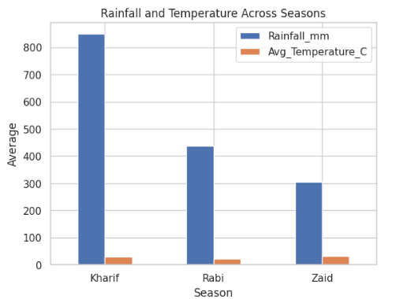
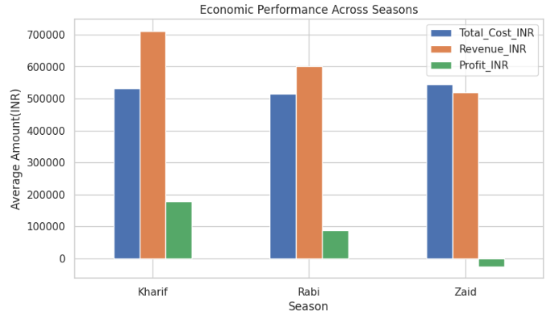
RESULTS
This grouped bar chart compares average rainfall and temperature across agricultural seasons: Kharif experiences the highest average rainfall at roughly 840 mm alongside an average temperature near 28°C, Rabi receives moderate rainfall around 435 mm with the coolest average temperature near 20°C, and Zaid records the lowest rainfall at approximately 305 mm with the highest average temperature near 30°C.
This grouped bar chart compares the average economic performance across agricultural seasons: Kharif generates the highest average revenue (~710,000 INR) against a total cost of ~530,000 INR, resulting in the highest average profit (~178,000 INR); Rabi follows with moderate revenue (~600,000 INR) and cost (~510,000 INR) to yield a profit of ~87,000 INR; while Zaid operates at a loss (~ -25,000 INR) as average costs (~540,000 INR) exceed total revenue (~515,000 INR).

Slide 15
FUTURE SCOPE
The analysis can be expanded to include more regions, crops, and seasons.
Additional agricultural factors such as soil quality, fertilizer usage, and irrigation methods can be analyzed in greater detail.
More historical agricultural data can be included to study long-term seasonal trends.
An interactive dashboard can be developed for easier visualization and comparison.
The project can be extended to support better resource management and seasonal agricultural planning.
Future studies can integrate more detailed weather and market data for deeper analysis.

Slide 16
GITHUB LINK
https://github.com/Shriraksha08/Seasonal-Agricultural-Performance-Analysis.git

Slide 17

VOIS COURSE COMPLETION CERTIFICATE-
COURSE NAME- DATA VISUALIZATION

Slide 18
THANK YOU
.
.

