Slide 1

Business Data Management Project
Viva Finale
OPTIMIZING CASH FLOW AND STAGGERED CREDIT SALES SYSTEM FOR A B2B TEXTILE COMPANY
R.G. Nagappa Mudaliar And Sons
Shriram G
21f2000668
September Term
Cycle III

Slide 2
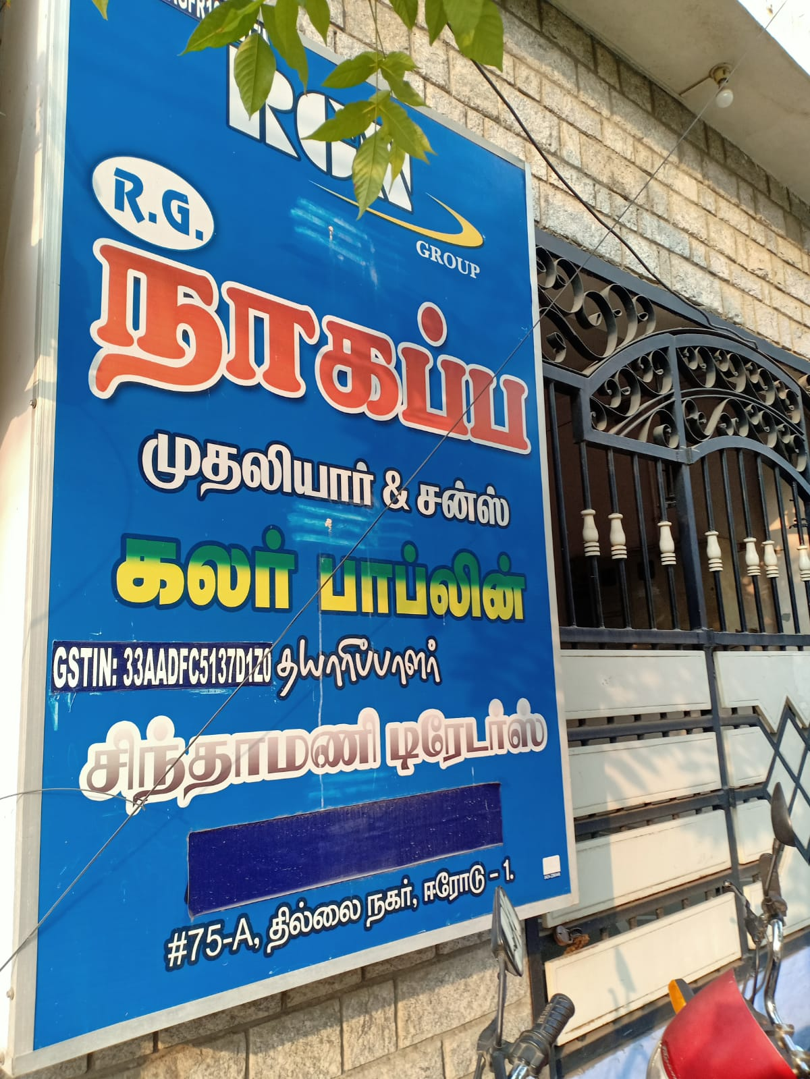
Organization And Problem Statement
Decades old business -> facing multiple systemic issues
Has turnover in crores
Various factors influence performance months in advance
Complex interrelationships exist between factors
Need a unified framework to maintain the business with predicitive analytics
Need a unified framework for setting up a Decision Making Process
Primary Objectives :
1) Optimizing Cash Flow
2) Staggered Sale In Credit For Bad Debt Management

Slide 3
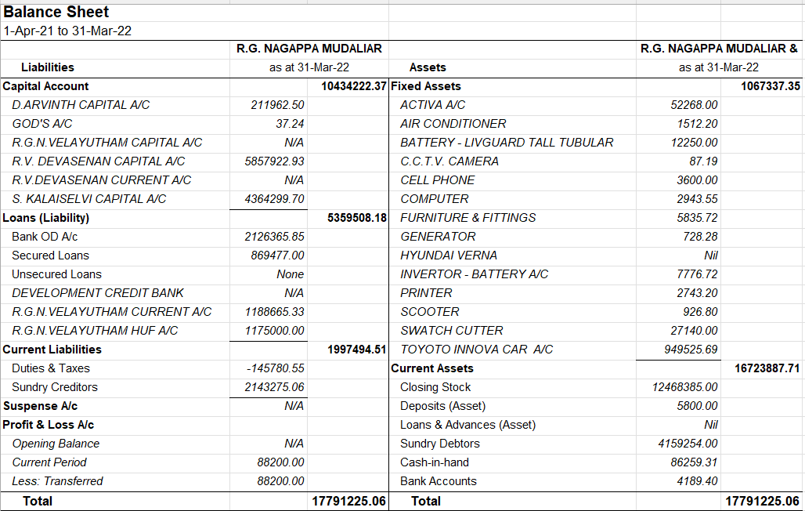
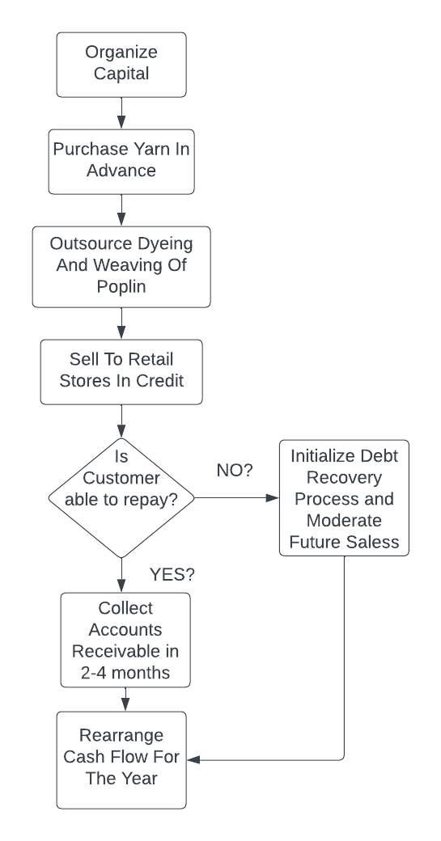
Workflow And Factors
Glance At Balance Sheet
Business Model
Factors Affecting The Business Are :
Yarn Purchase Price
Procurement Time And Delay In Processing
The Rise Of Bad Debt
And Hence The Disturbances The Arise In Cash Flow

Slide 4
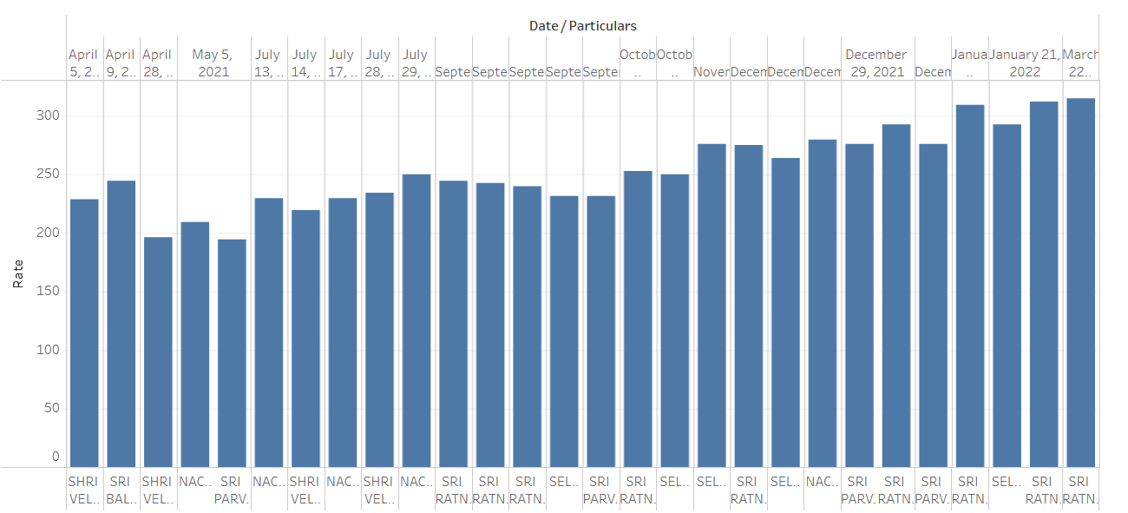
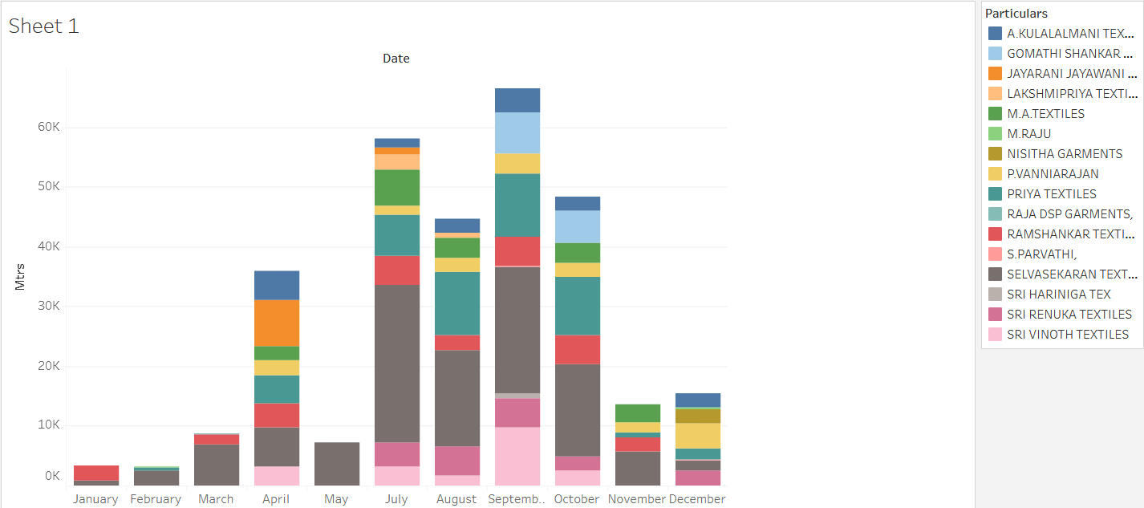
Requirement Of Business Owner
Create A Model Comprising Entire Business System
Establish A Justified System For Sale In Credit To Regular Retailers And Defaulters.
At A Glance : Yarn Purchase Trend And Sales Trend Across a Year

Slide 5

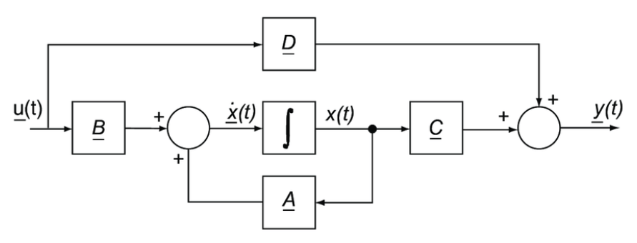
State-Space Analysis
A Complex System Modelling Approach Is Required
Concepts State Space Analysis For Financial System Engineering Is Implemented
Equation
Block Diagram Representation
State Variables Vector :
Yarn Price
Expected Sales
Losses Accumulated At Time ‘T’

Slide 6

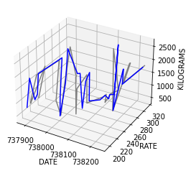
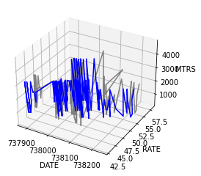
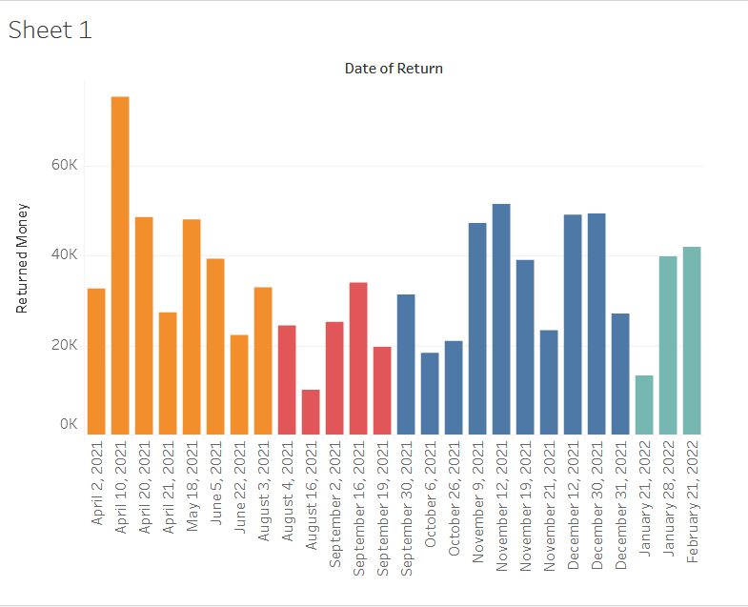
Data available to us is discrete
Smoothing Is Done Before Training The State Space System
Regression Analysis Used For Smoothed Curve Representation
Sales Data
Debtors Return Patterns
Yarn Purchase

Slide 7

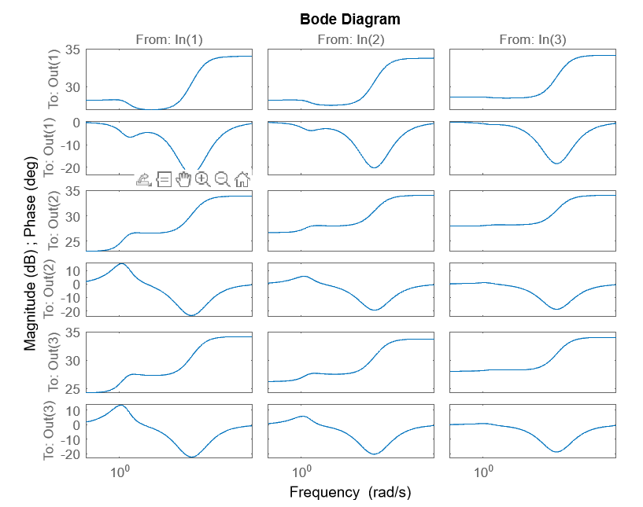
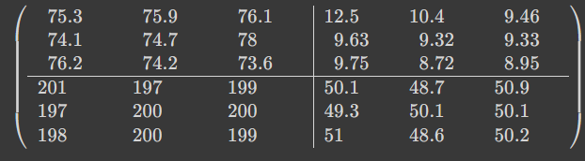
State Space Analysis Results
Bode Diagram And Derived State Space Matrices

Slide 8



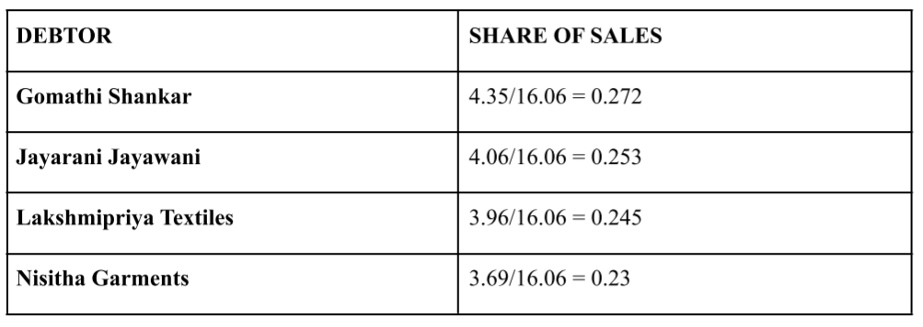
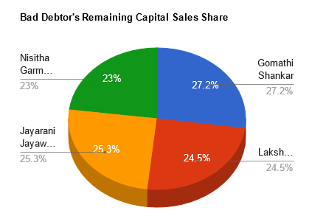
Debtor’s Credit Scoring System

Slide 9
PITFALLS
RECOMMENDATIONS
FUTURE SCOPE

Slide 10
THANK YOU

