Slide 1

Business Data Management Project
Viva Finale
OPTIMIZING CASH FLOW AND STAGGERED CREDIT SALES SYSTEM FOR A B2B TEXTILE COMPANY
R.G. Nagappa Mudaliar And Sons
Shriram G
21f2000668
September Term
Cycle III

Slide 2
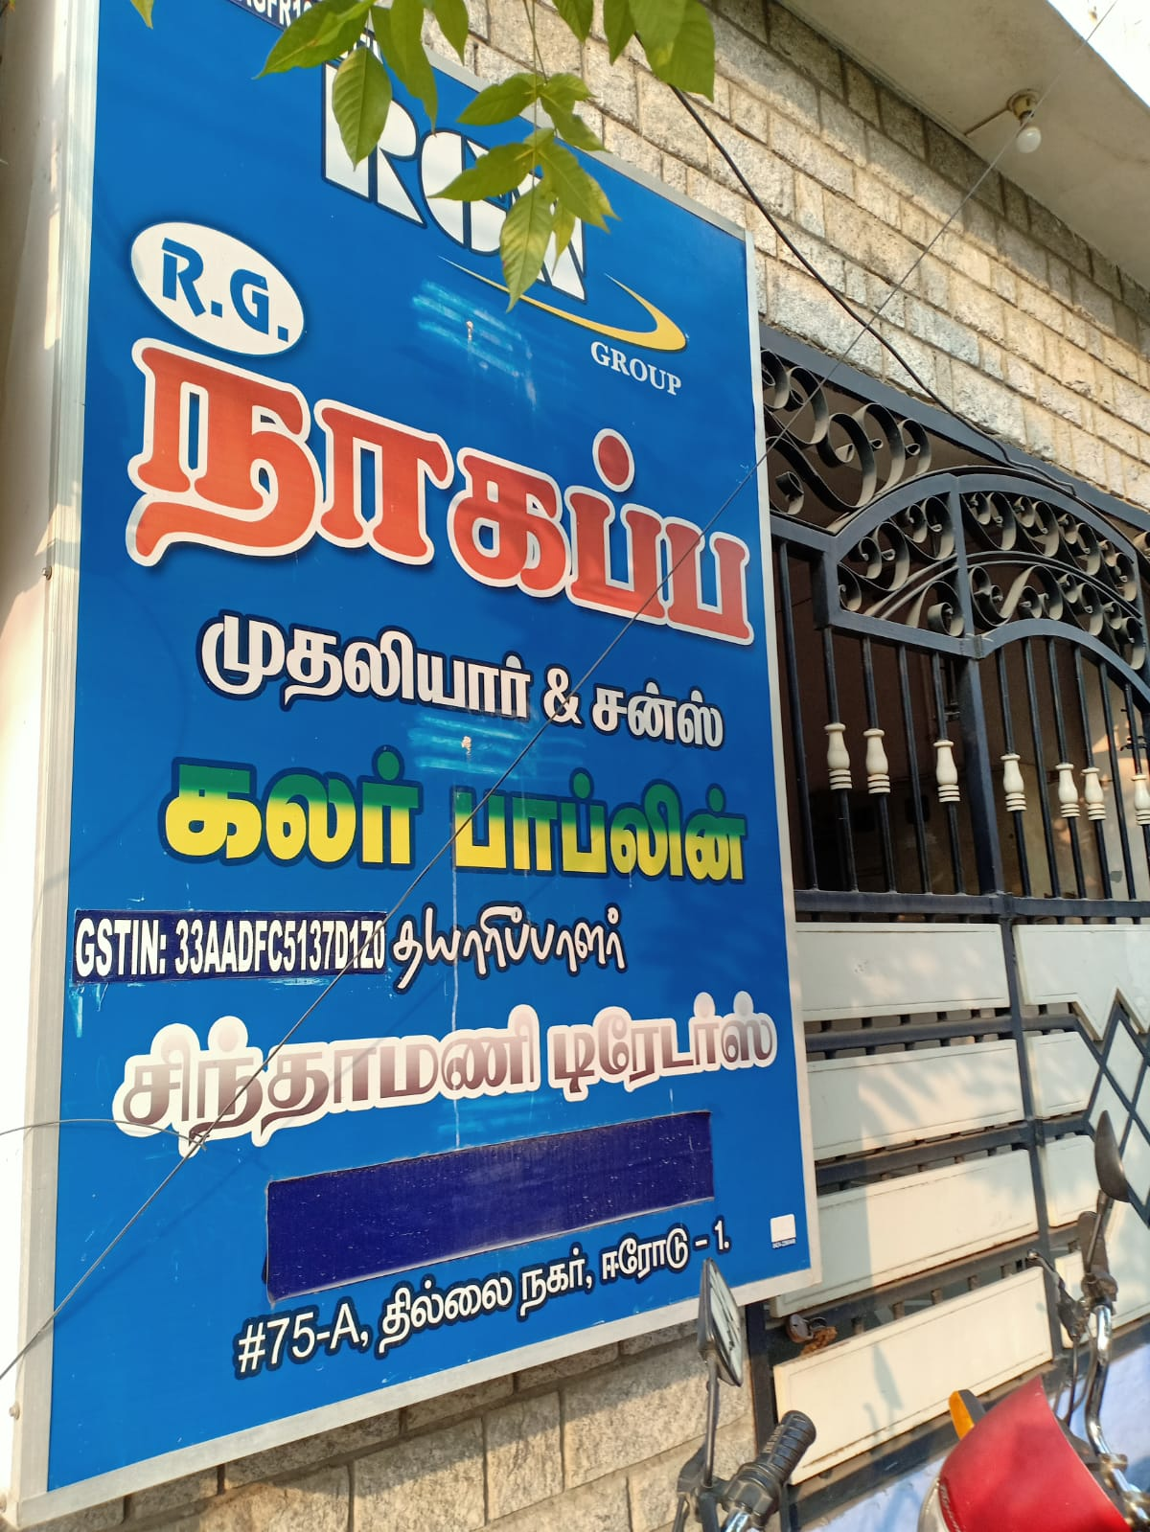
Organization And Problem Statement
Decades old business -> facing multiple systemic issues

