Slide 1
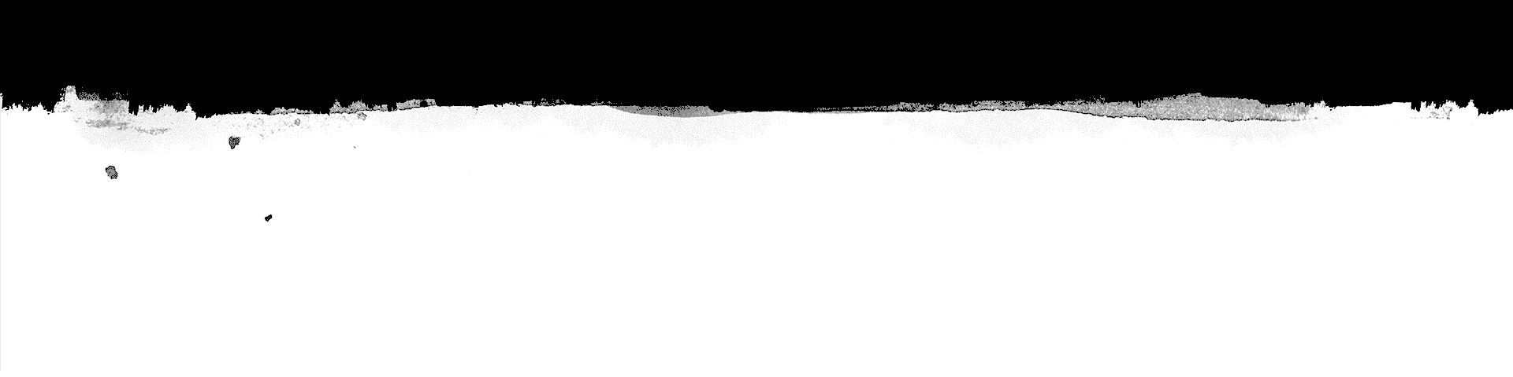
Text Generator using LSTMs
Neural Networks project

Slide 2
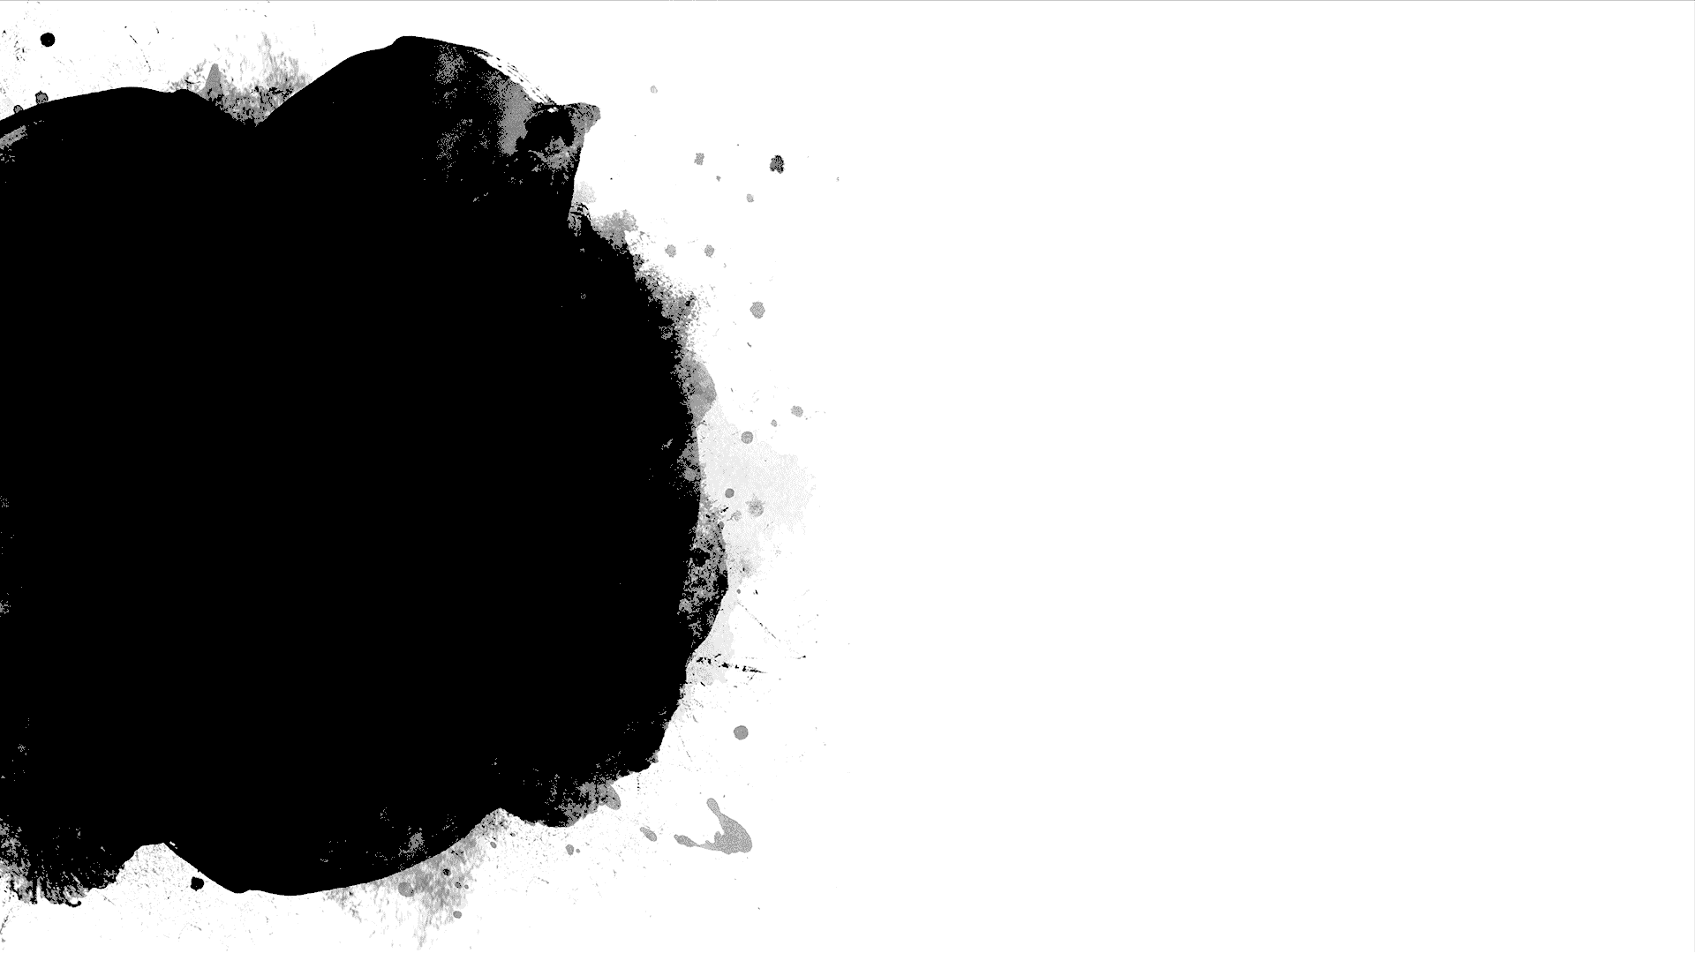
What is text generation?
A model when trained on a dataset being able to generate meaningful text without being explicitly programmed to do so.
Generative models like this are useful not only to study how well a model has learned a problem, but to learn more about the problem domain itself.

Slide 3
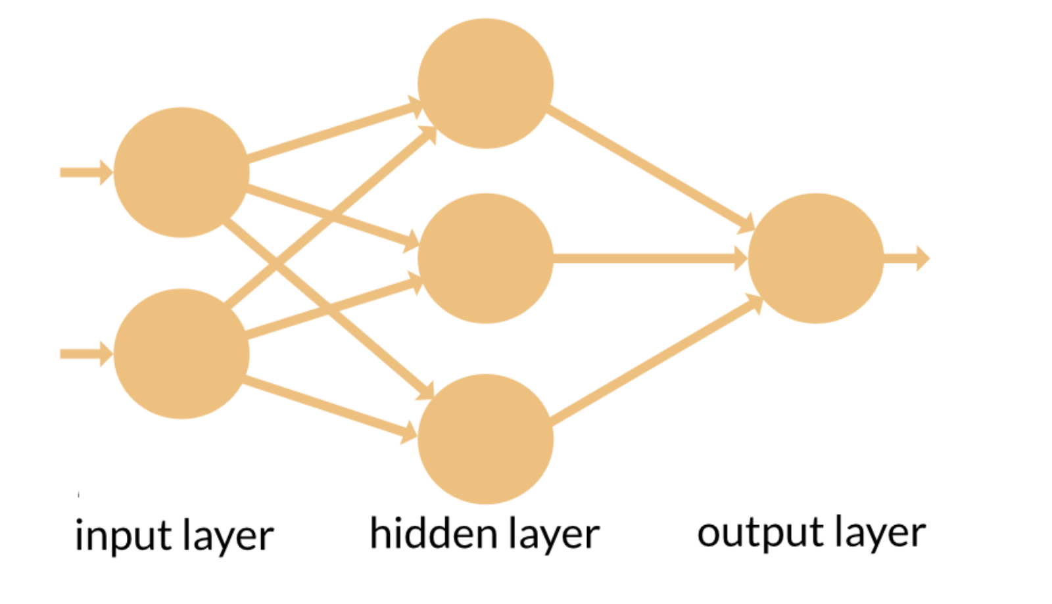
Feedforward Neural networks

Slide 4
Recurrent Neural Networks
Recurrent Neural Networks (RNN) are a powerful and robust type of neural networks and belong to the most promising algorithms out there at the moment because they are the only ones with an internal memory.

Slide 5
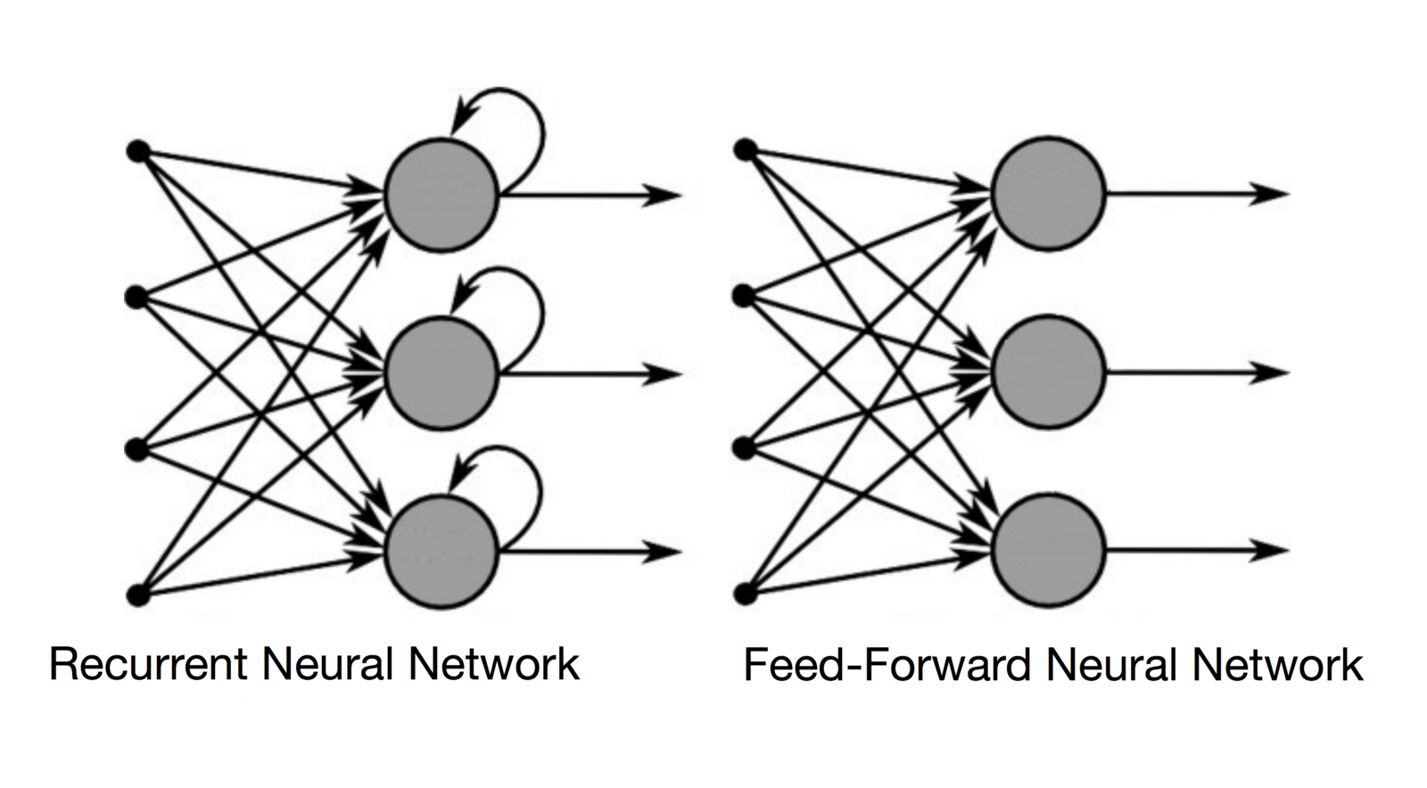
RNN

Slide 6
Long short term memory
Long Short-Term Memory (LSTM) networks are an extension for recurrent neural networks, which basically extends their memory. Therefore it is well suited to learn from important experiences that have very long time lags in between.

Slide 7
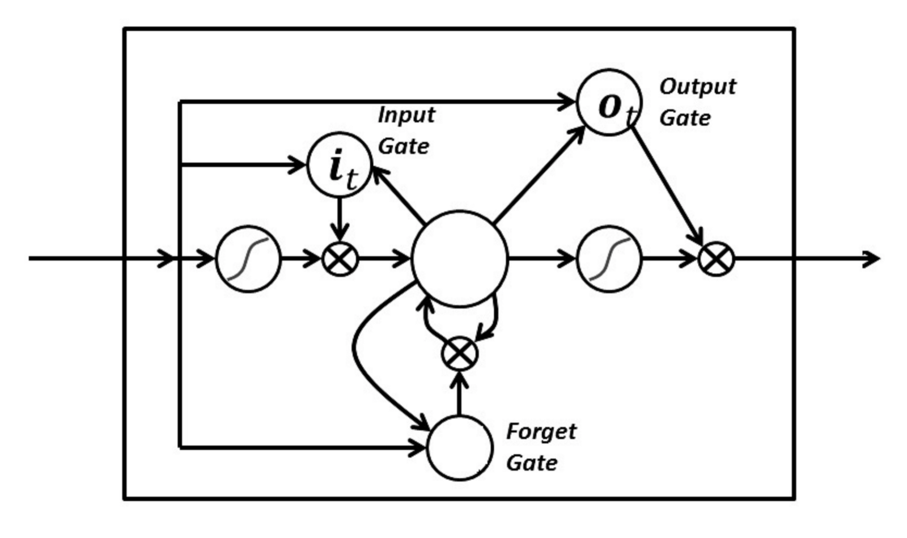
Architecture

Slide 8
Why LSTMs
LSTM’s enable RNN’s to remember their inputs over a long period of time. This is because LSTM’s contain their information in a memory, that is much like the memory of a computer because the LSTM can read, write and delete information from its memory.

Slide 9
Dataset
Can be trained on storybooks
Articles
Lyrics of artists

Slide 10
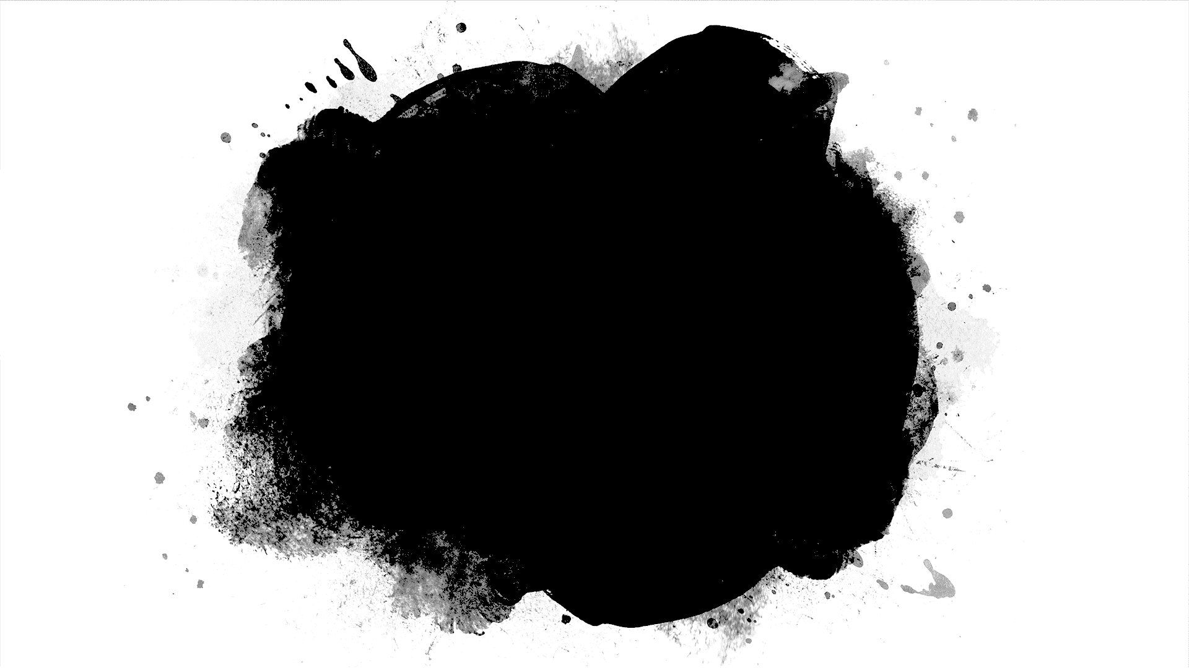
Implementation

Slide 11


Slide 12
To be implemented on python.
Using keras libraries.
Tensorflow backend.
Data to be optimised and pre processed before fitting into model.

Slide 13
References
https://arxiv.org/abs/1508.01745
https://arxiv.org/abs/1506.01057
The above are two references for generating texts using LSTMs

Slide 14
Industrial Applications
Text suggestions on keyboards.
Scemantic approach to Natural Language Processing.
Auto fillers for ease.
Automated email generation systems
Chatbots
Etc…..

