Slide 1






Project on
BookVerse Retail
Business Intelligence & Sales Analytics
MySQL-Based Retail Sales, Customer & Inventory Analysis
Shriram A. Giri
Batch : 530

Slide 2



About me
Education
B.A. (Economics) (Completed in 2024) from SRTMU, Nanded(MH)
P.G.D.M (Marketing) (Pursuing) from MIT-SDE, Pune(MH)
Why Data Analysis?
Coming from an Economics background, I developed a strong interest in working with data, identifying trends, and solving business problems through analysis. To build my technical skills and transition into the analytics field
Contact
LinkedIn
+91 90218 71581
GitHub

Slide 3
Why did I choose this project???
I specifically chose this project because a bookstore gives me multiple dimensions to analyze at the same time - Sales, Customers, Products, Orders and Inventory. So instead of looking at only sales numbers, I could use SQL to connect different business areas and understand how they relate to each other.
For example, I can identify which books and genres generate revenue, which customers are more engaged, which books have high stock but low sales, and where sales demand and inventory don't match.
So I chose BookVerse because it gave me an opportunity to demonstrate the complete data-analysis process - starting from a relational database, validating the data, writing SQL queries, performing analysis, and finally converting the results into business insights and recommendations.
* I chose BookVerse because it gave me multiple interconnected business areas → which required relational data → which allowed me to demonstrate SQL → which ultimately helped convert data into business insights.

Slide 4





BUSINESS UNDERSTANDING
Understanding the BookVerse Business
BookVerse Retail is a growing online and offline bookstore selling across genres such as Fiction, Fantasy, Biography, Mystery, Romance, Science Fiction and Non-Fiction.
The business runs on three core operations: book catalog management, customer management, and order & sales management.
To grow profitably, BookVerse needs a data-driven understanding of its sales, customers, product demand and inventory position.
CORE BUSINESS OPERATIONS
Book Catalog
Management
→
Customer
Management
→
Order & Sales
Management
KEY BUSINESS DECISION AREAS
Sales
Performance
Customer
Behaviour
Product & Genre
Performance
Inventory
Position
Sales + Inventory
Opportunities
BookVerse Retail - Business Intelligence & Sales Analytics
1 / 16
Notes:
Frame BookVerse as a realistic retail business before touching any SQL. The three operations map directly to the three tables in the database (Books, Customers, Orders). The five decision areas on this slide are the lens the rest of the deck is organized around, and they reappear as section headers later. Keep this slide business-language only — no SQL yet.

Slide 5
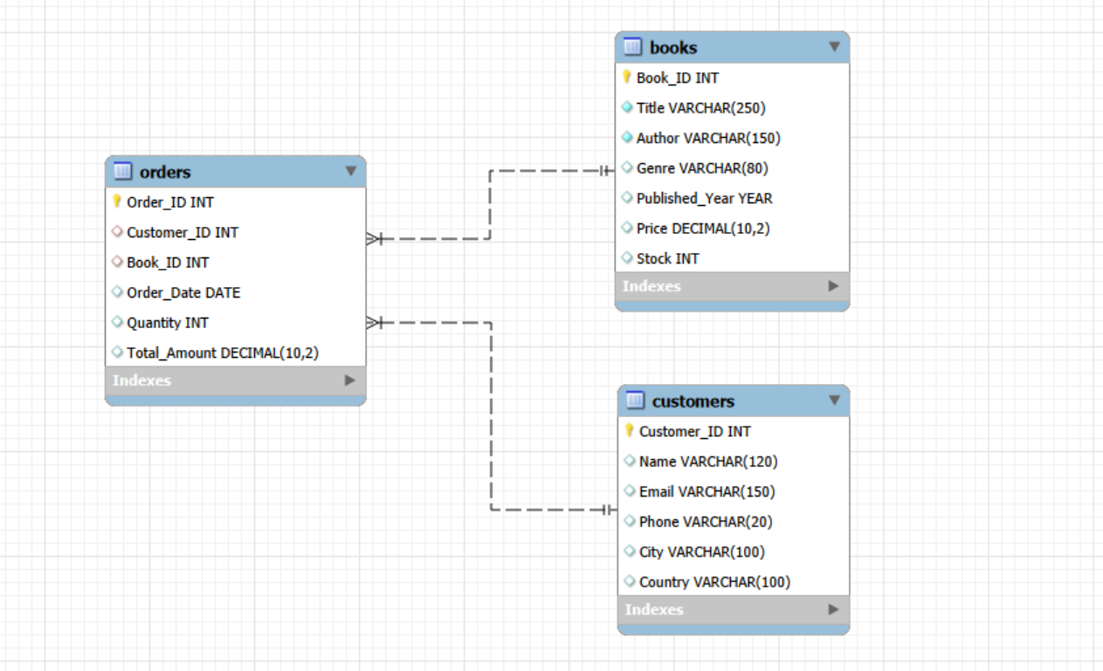
DATABASE DESIGN
BookVerse : the Relational Database (ER Diagram)
HOW THE TABLES CONNECT ???
The architecture maps real-world retail activity through specific database rules:
One-to-Many Connections: One customer can make multiple distinct purchases over time, and one single book catalog option can be sold across many separate customer bills.
The Connecting Table: The orders table serves as a bridge/junction table between the other two. It pulls the unique primary keys (Customer_ID and Book_ID) from their origin tables and houses them as Foreign Keys. This link effectively maps an infinite string of dynamic purchases between any single customer and any single book title without causing data redundancy.
In Short -
Customers can place multiple orders (one customer → many orders).
Books can appear in multiple orders (one book → many orders).
Orders is the connecting table linking customers and books together.
BookVerse Retail - Business Intelligence & Sales Analytics
2 / 16
Notes:
Walk through the schema exactly as implemented in Workbench: three tables, Orders sitting between Customers and Books as the junction table. Point out the PK/FK/UNIQUE tags — these are the actual constraints from the CREATE TABLE statements, not assumptions. This relational structure is what makes every later JOIN-based query possible.

Slide 6


DATABASE IMPLEMENTATION
MySQL Database Setup & Data Validation
IMPLEMENTATION STEPS (WORKBENCH)
DATA VALIDATION CHECKS PERFORMED
1. CREATE DATABASE BookVerse_DB
2. CREATE TABLE Books, Customers and Orders
3. Primary keys defined on Book_ID, Customer_ID and Order_ID
4. UNIQUE constraint applied to Customers.Email
5. Foreign keys: Orders.Customer_ID → Customers, Orders.Book_ID → Books
6. DESCRIBE run on each table to confirm structure
Record counts confirmed for Books, Customers and Orders
Duplicate primary keys checked (GROUP BY + HAVING COUNT(*) > 1)
Missing values checked across every column in all three tables
Orphan Orders* checked via LEFT JOIN against Customers and Books
This steps is important because before doing any analysis, we need to make sure that the data is reliable.”
*Orphan Orders (orders that reference a customer or a book that no longer exists in the database)
*LEFT JOIN + NULL check = Find missing matches
BookVerse Retail - Business Intelligence & Sales Analytics
3 / 16
Notes:
This slide shows the build-then-verify discipline behind the database: schema first, then four categories of validation before any analysis is trusted. The record counts, duplicate checks, missing-value checks and foreign-key checks all come directly from queries already written in the Workbench file — only the actual returned numbers still need to be dropped in.

Slide 7


DATA EXPLORATION
Initial Data Exploration
TOTAL BOOKS
TOTAL CUSTOMERS
TOTAL ORDERS
GENRES AVAILABLE
[ 500 ]
[ 1,000 ]
[ 2,500 ]
[ 07 ]
TOTAL COUNTRIES SERVED
TOTAL UNITS SOLD
TOTAL REVENUE
AVG ORDER VALUE
[ 120 ]
[ 8,750 ]
[ $ 1,250,450.00 ]
[ 500.18 ]
Note: These KPI cards mirror the exact exploration queries in the Workbench file. Replace every placeholder with the actual value returned before presenting – do not estimate or invent figures.
COUNT(*)
DISTINCT Genre
DISTINCT Country
SUM(Quantity)
SUM(Total_Amount)
AVG(Total_Amount)
BookVerse Retail - Business Intelligence & Sales Analytics
4 / 16
Notes:
This is the 'get to know the data' step before any business analysis. Every card corresponds to a real query already written in Workbench — COUNT for volumes, DISTINCT for genre/country coverage, SUM and AVG for the revenue baseline. Run each query and drop the returned number into the placeholder before presenting; never estimate these.

Slide 8

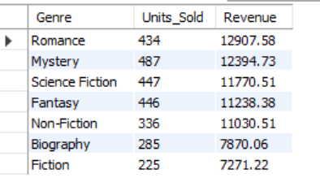
SALES ANALYSIS
Sales Performance Analysis
“The Sales team wants to understand overall sales performance and identify the books, authors, and genres that contribute most to revenue.”
WORKBENCH ANALYSIS COVERS
REPRESENTATIVE QUERY - GENRE + REVENUE
SELECT
b.Genre,
SUM(o.Quantity) AS Units_Sold,
ROUND(SUM(o.Total_Amount), 2) AS Revenue
FROM Books b
JOIN Orders o
ON b.Book_ID = o.Book_ID
GROUP BY b.Genre
ORDER BY Revenue DESC;
Romance is the highest revenue generator ($12,907.58) despite selling fewer units than Mystery. This points to a higher average item value or stronger pricing power in this genre.
Mystery yields the highest volume (487 units) but ranks second in total revenue due to a lower average price point per book.
BookVerse Retail - Business Intelligence & Sales Analytics
5 / 16
Notes:
This is the core of the sales analysis: everything here rolls up Orders against Books using JOIN, then GROUP BY book, author or genre, aggregating with SUM and presenting cleanly with ROUND and ORDER BY. The genre-revenue query shown is copied directly from the Workbench file so the audience sees real, working SQL rather than a mocked-up example.

Slide 9
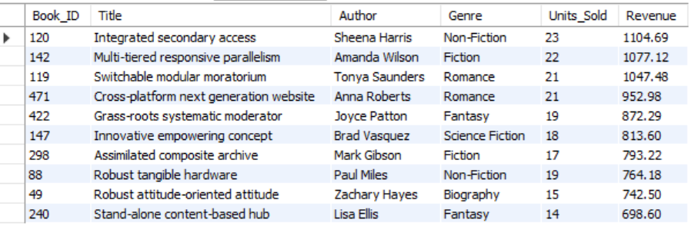
Sales Analysis From Question to Insight
1
“The Sales team wants to identify which books have sold the highest number of copies. Which table and columns would you need?”
WORKBENCH ANALYSIS COVERS
REPRESENTATIVE QUERY - BOOK SALE
SELECT
b.Book_ID,
b.Title,
b.Author,
SUM(o.Quantity) AS Units_Sold,
ROUND(SUM(o.Total_Amount), 2) AS Revenue
FROM Books b
JOIN Orders o
ON b.Book_ID = o.Book_ID
GROUP BY
b.Book_ID,
b.Title,
b.Author
ORDER BY Revenue DESC
LIMIT 10;
Top Revenue Generator: "Integrated secondary access" by Sheena Harris is the most successful book overall, generating $1,104.69 in revenue and selling the highest volume with 23 units sold.
Most Efficient Revenue Earner: "Robust tangible hardware" by Paul Miles shows strong pricing leverage. It generated $764.18 with only 19 units sold, outperforming "Innovative empowering concept" ($813.60 from 18 units) in raw volume but yielding higher revenue per book compared to others lower on the list like "Stand-alone content-based hub" ($698.60 from 14 units).
BookVerse Retail - Business Intelligence & Sales Analytics
6 / 19
Notes:
These three business situations are taken directly from the project manual, not invented. For each one, walk left to right: the tables and columns needed, the SQL construct that answers it, and the business use of the result. No figures are shown here — this slide is about method, not results.

Slide 10
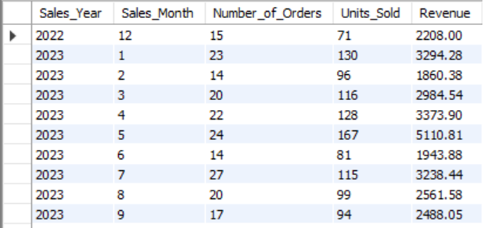
3
“The Sales team wants to compare sales performance across different years and months. What information would you need?”
WORKBENCH ANALYSIS COVERS
REPRESENTATIVE QUERY - SALES BY MONTH + YEAR
SELECT
YEAR(Order_Date) AS Sales_Year,
MONTH(Order_Date) AS Sales_Month,
COUNT(Order_ID) AS Number_of_Orders,
SUM(Quantity) AS Units_Sold,
ROUND(SUM(Total_Amount), 2) AS Revenue
FROM Orders
GROUP BY
YEAR(Order_Date),
MONTH(Order_Date)
ORDER BY
Sales_Year,
Sales_Month;
High Efficiency in January 2023: January recorded 23 orders and $3,294.28 in revenue. Compared to May (which had 24 orders but $5,110.81 in revenue), January had a lower average order value, meaning customers bought cheaper items or smaller quantities per order.
Stable Baseline: Aside from the dramatic spikes in May and dips in February/June, the business maintains a steady baseline of roughly 15 to 20 orders and $2,200 to $2,500 per month (as seen in late 2022 and late 2023).
BookVerse Retail - Business Intelligence & Sales Analytics
7 / 19

Slide 11
CUSTOMER ANALYTICS
Customer Purchasing Behaviour
+
+
→
Customer Behaviour Profile
Customers
Orders
Books
orders × spending × geography × genre mix
WORKBENCH ANALYSIS COVERS
Number of orders placed per customer
Total spending per customer
Repeat customers - more than one order placed
Customer activity broken down by country
Average spending per customer across the platform
Customers who purchased across multiple genres
Customer purchase timeline - first order to most recent order
TYPICAL VISUAL PAIRINGS
Customer → Orders
Customer → Spending
Country → Revenue
Customer → Genres
BookVerse Retail - Business Intelligence & Sales Analytics
8 / 19
Notes:
Customer behaviour comes from joining Customers, Orders and Books together — without that three-way join you can't see spending by geography or genre mix, only order counts. The four pairings at the bottom are the chart types this analysis naturally produces once real results are available.

Slide 12
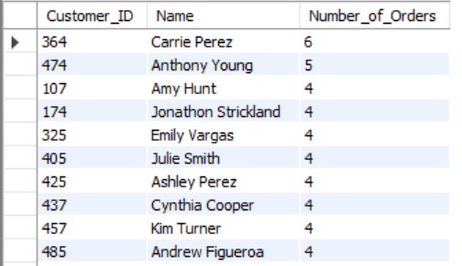
Customer Analysis - Required Business Questions to Insights
1
“Management wants to identify customers who have placed multiple orders. What information would you need?”
WORKBENCH ANALYSIS COVERS
REPRESENTATIVE QUERY - ORDERS BY CUSTOMERS
SELECT
c.Customer_ID,
c.Name,
COUNT(o.Order_ID) AS Number_of_Orders
FROM Customers c
JOIN Orders o
ON c.Customer_ID = o.Customer_ID
GROUP BY
c.Customer_ID,
c.Name
ORDER BY Number_of_Orders DESC
LIMIT 10;
Top Customer Value: Carrie Perez (ID: 364) is the most active customer with 6 total orders.
High-Value Loyalty Segment: There is a strong cluster of highly engaged repeat buyers. Anthony Young (ID: 474) follows closely with 5 orders, while 8 additional customers are tied with exactly 4 orders each.
Targeted Marketing Opportunity: These 10 individuals represent a proven segment of loyal customers. Management can target this specific group for exclusive loyalty rewards, early product releases, or feedback surveys.
BookVerse Retail - Business Intelligence & Sales Analytics
9 / 19
Notes:
Four manual questions, each mapped to the tables, columns and SQL construct that answers it. Note the last one needs all three tables joined together — Customers, Orders and Books — because 'genre' only exists on Books, so you must traverse Orders to connect a customer to a genre at all.

Slide 13
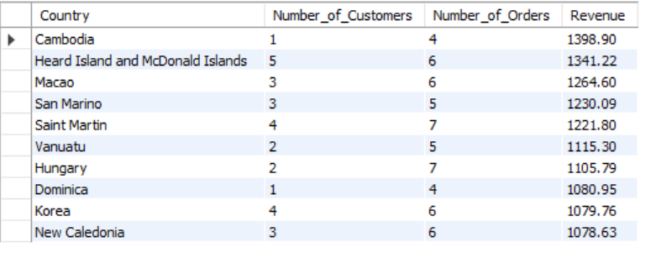
3
“The Marketing team wants to compare customer purchasing behaviour across different countries. What information would you need?”
WORKBENCH ANALYSIS COVERS
REPRESENTATIVE QUERY - NO.CUSTOMERS + COUNTRIES
SELECT
c.Country,
COUNT(DISTINCT c.Customer_ID) AS Number_of_Customers,
COUNT(o.Order_ID) AS Number_of_Orders,
ROUND(SUM(o.Total_Amount), 2) AS Revenue
FROM Customers c
JOIN Orders o
ON c.Customer_ID = o.Customer_ID
GROUP BY c.Country
ORDER BY Revenue DESC
LIMIT 10;
Macao ($1,264.60) and New Caledonia ($1,078.63) both have 3 customers who placed exactly 6 orders (averaging 2 orders per customer).
San Marino ($1,230.09) and Korea ($1,079.76) show highly stable purchasing structures with 5-6 orders spread across 3-4 customers.
Insight: These countries represent predictable, healthy mid-tier markets with repeatable buying habits. They are good candidates for steady, localized email marketing campaigns.
BookVerse Retail - Business Intelligence & Sales Analytics
10 / 19

Slide 14
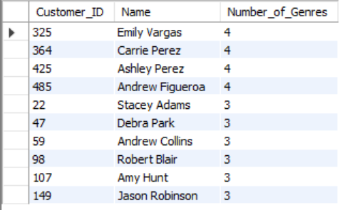
4
“Management wants to identify customers who have purchased books from multiple genres. Which tables and relationships would be required?”
WORKBENCH ANALYSIS COVERS
REPRESENTATIVE QUERY - CUSTOMERS + ORDERS + GENERS
SELECT
c.Customer_ID,
c.Name,
COUNT(DISTINCT b.Genre) AS Number_of_Genres
FROM Customers c
JOIN Orders o
ON c.Customer_ID = o.Customer_ID
JOIN Books b
ON o.Book_ID = b.Book_ID
GROUP BY
c.Customer_ID,
c.Name
HAVING COUNT(DISTINCT b.Genre) > 1
ORDER BY Number_of_Genres DESC
LIMIT 10;
High Cross-Genre Engagement: The top-performing customers are highly diversified readers. The highest-ranked individuals (Emily Vargas, Carrie Perez, Ashley Perez, and Andrew Figueroa) have each purchased books spanning 4 distinct genres.
Concentration of Top Buyers: There is a solid cluster of active readers just below the top tier. The remaining visible customers on the leaderboard (6 out of 10) have all purchased from 3 distinct genres, showing that multi-genre purchasing is a consistent trend among your most active customer base.
Target Audience for Bundles: These specific 10 individuals represent your highest-value prospects for multi-genre marketing campaigns, mixed-genre book bundles, or personalized recommendation engines.
BookVerse Retail - Business Intelligence & Sales Analytics
11 / 19

Slide 15
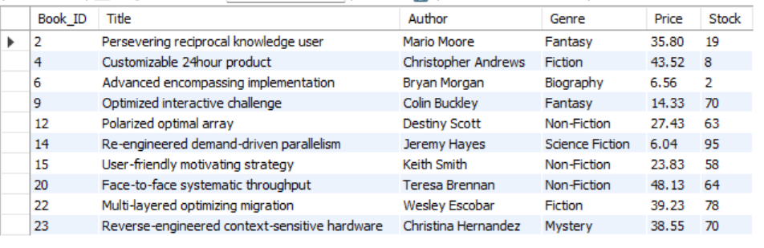
PRODUCT & GENRE PERFORMANCE
Product & Genre Performance
WORKBENCH ANALYSIS COVERS
REPRESENTATIVE QUERY - BOOKS WITH ZERO SALES
SELECT
b.Book_ID, b.Title, b.Author,
b.Genre, b.Price, b.Stock
FROM Books b
LEFT JOIN Orders o
ON b.Book_ID = o.Book_ID
WHERE o.Book_ID IS NULL
LIMIT 10;
The Largest Financial Risk is Non-Fiction: The Non-Fiction category accounts for $6,190.55 (roughly 42.5%) of the total stagnant financial value. This is driven heavily by high retail prices across the genre, such as Face-to-face systematic throughput priced at $48.13 per unit (the highest-priced book in the dataset).
Science Fiction has a Bulk Volume Issue: Re-engineered demand-driven parallelism holds the highest individual unit risk with 95 copies in stock, even though its lower price point ($6.04) limits its overall budget damage.
BookVerse Retail - Business Intelligence & Sales Analytics
12 / 19
Notes:
Product and genre performance both reuse the same Books-to-Orders relationship, but with a LEFT JOIN instead of an inner JOIN. That single change is what lets the query surface books with zero matching orders — an inner JOIN would simply drop them and hide the never-ordered titles entirely.

Slide 16
INVENTORY ANALYSIS
Inventory Position Analysis
WORKBENCH ANALYSIS COVERS
Current stock levels for every book
Low-stock identification (Stock < 20)
Inventory value by author (Price × Stock)
High-stock identification (Stock ≥ 80)
Inventory Value Formula
Price × Stock
Computed per book to value the catalog currently sitting on the shelf.
LOW STOCK
HIGH STOCK
Stock < 20
Stock ≥ 80
Flagged for replenishment review.
Monitor for slow-moving inventory.
*Business purpose: identify products that may require attention before the next procurement cycle.
BookVerse Retail - Business Intelligence & Sales Analytics
13 / 19
Notes:
Two fixed thresholds drive every inventory flag in this project — Stock under 20 for low stock, Stock 80 or above for high stock — and they stay exactly as implemented in Workbench throughout the deck. Inventory value (Price × Stock) gives a rupee figure to prioritize which low or high stock items matter most.

Slide 17
SALES + INVENTORY
Connecting Sales Performance with Inventory
SALES DEMAND + CURRENT STOCK = BUSINESS OPPORTUNITY
HIGH SALES + LOW STOCK
Healthy demand relative to stock on hand.
Units Sold ≥ 10 AND Stock < 20
→ Replenishment priority
UNITS SOLD (Low → High)
Low turnover, low stock - low priority.
HIGH STOCK + LOW SALES
Stock ≥ 50 AND Units Sold ≤ 5
→ Promotion candidate
STOCK LEVEL (Low → High)
NEVER ORDERED + STOCK > 0
Books with zero matching Orders records, but Stock greater than zero → potential promotional or catalog-review opportunity.
BookVerse Retail - Business Intelligence & Sales Analytics
14 / 19
Notes:
This slide connects two things already built separately: sales demand from the Orders side and stock position from the Books side. The two shaded zones use the exact HAVING thresholds from the Workbench file — nothing here is a new rule, it's the same conditions visualized as a quadrant. The never-ordered category sits outside the quadrant because it isn't a sales-volume comparison, it's a zero-sales flag.

Slide 18
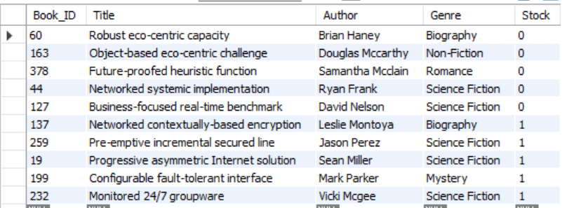
Inventory & Operations Questions and Insights
1
“The Inventory team wants to identify books with low stock levels. Where would you find this information?”
WORKBENCH ANALYSIS COVERS
REPRESENTATIVE QUERY - LOW STOCK BOOKS
SELECT
Book_ID,
Title,
Author,
Genre,
Stock
FROM Books
WHERE Stock < 20
ORDER BY Stock ASC
LIMIT 10;
Severe Out-of-Stock Risk: Half of the top 10 low-stock books (5 out of 10) are completely out of stock with a value of 0. This requires immediate reordering to prevent lost sales.
Science Fiction is a High-Velocity Genre: Out of the 10 lowest-stock books shown, 50% belong to the Science Fiction genre. This indicates either exceptionally high demand or under-ordering for this category.
Biography Popularity: The Biography genre has multiple entries near the top of the low-stock list (including a book completely out of stock and another with just 1 unit remaining), marking it as another key area needing inventory attention.
BookVerse Retail - Business Intelligence & Sales Analytics
15 / 19
Notes:
Three manual questions from the Inventory & Operations area. Questions 1 and 3 map directly onto queries already written in the Workbench file — the low-stock filter and the LEFT JOIN for never-ordered books. Question 2 is presented at the planning level: the genre-wise sales query and the stock-by-author query already exist separately in Workbench, so combining stock and sales at the genre level is a natural next query to add, not a result already produced — be upfront about that distinction if asked.

Slide 19
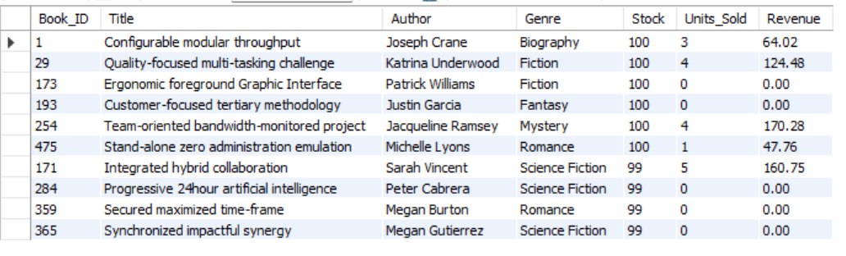
3
“Management wants to identify books that have never been purchased. Which tables would you need to compare?”
WORKBENCH ANALYSIS COVERS
REPRESENTATIVE QUERY - NEVER PURCHASED BOOKS (DEAD STOCK)
SELECT
b.Book_ID,
b.Title,
b.Author,
b.Genre,
b.Price,
b.Stock,
ROUND(b.Price * b.Stock, 2) AS Inventory_Value
FROM Books b
LEFT JOIN Orders o
ON b.Book_ID = o.Book_ID
WHERE o.Book_ID IS NULL
AND b.Stock > 0
ORDER BY Inventory_Value DESC
LIMIT 10;
High Risk / Dead Stock: Titles like "Ergonomic foreground Graphic Interface" (Fiction) and "Customer-focused tertiary methodology" (Fantasy) each have 100 units in stock but have generated zero sales.
Genre Breakdown: The unpurchased list contains a mix of Fiction, Fantasy, Romance, and Science Fiction. Science Fiction appears multiple times at the bottom of the list (e.g., "Progressive 24hour artificial intelligence" and "Synchronized impactful synergy").
BookVerse Retail - Business Intelligence & Sales Analytics
16 / 19

Slide 20

INSIGHTS & RECOMMENDATIONS
Business Insights & Recommendations
INSIGHTS
RECOMMENDATIONS
Highest Revenue by Gener i.e. Romance - $12907.58
Top-selling book - Realigned multi-tasking installation (28)
Highest-spending customer - Kim Turner ($1398.90)
Country with highest revenue - Cambodia ($1398.90)
Number of repeat customers - 138
Number of never-ordered books - 182
Number of high-demand / low-stock books - 25
1. Replenish high-demand books with low stock.
2. Promote books with high stock and low sales.
3. Review books that have never been ordered.
4. Monitor high-revenue genres for inventory availability.
5. Identify and engage high-value, repeat customers.
6. Use country-level customer behaviour to support targeted marketing.
*Recommendations are based on the SQL analysis framework built in Workbench and should be finalized once the actual query results above are inserted.
BookVerse Retail - Business Intelligence & Sales Analytics
17 / 19
Notes:
Two halves, deliberately different in style: insights are placeholders because they depend entirely on the numbers your queries return — do not fill these in from memory or estimation, copy them from the actual Workbench output. Recommendations, on the right, follow logically from the analysis framework itself and hold regardless of the exact figures, though their priority order may shift once real numbers are in.

Slide 21
Data Checklist - MySQL Workbench Insights
Validation
Basic Exploration
Sales Performance
Record counts - Books, Customers, Orders
Duplicate primary key check results
Missing-value check results (all columns)
Orphan-order check results (FK consistency)
Total Books, Customers, Orders
Distinct Genres list
Distinct Countries list
Total Quantity Sold
Total Revenue, Average Order Value
Top 10 books by units sold
Top 10 books by revenue
Revenue by author and by genre
Monthly and yearly sales figures
Highest-priced books; high-volume books (≥20)
Customer Behaviour
Product & Inventory
Sales + Inventory
Top 10 customers by spending
Repeat customer count
Country-level order count and revenue
Average customer spending
Customers who bought multiple genres
Genre-wise units sold and revenue
Never-ordered books list
Author-wise performance
Low-stock list (Stock < 20)
High-stock list (Stock ≥ 80)
Inventory value by author
High Sales + Low Stock book list
High Stock + Low Sales book list
Never Ordered + Stock > 0 list
Values needed for Slide 14 insights
BookVerse Retail - Business Intelligence & Sales Analytics
*Orphan Orders (orders that reference a customer or a book that no longer exists in the database)
18 / 19
Notes:
A working checklist, not a presentation talking point — run every query grouped here in Workbench, copy the actual output into the corresponding slide, and only then treat the deck as presentation-ready. Nothing on this slide is a result; it is the list of results still required.

Slide 22


CONCLUSION
From Raw Data to Business Decisions
→
→
→
→
→
→
→
→
Business
Understanding
Relational
Database
Data
Validation
SQL
Exploration
Sales
Analysis
Customer
Analysis
Product &
Inventory
Business
Opportunities
Management
Recommendations
“BookVerse can use SQL-driven Business Intelligence to understand sales, customers, product demand and inventory position, enabling more informed decisions around sales, marketing and procurement.”
BookVerse Retail - Business Intelligence & Sales Analytics
19 / 19
Notes:
Close by retracing the nine-stage journey across the top of the slide — from business understanding all the way to management recommendations — and land on the closing statement. This is the moment to emphasize that every step was grounded in the actual Workbench SQL, not assumed data, which is the core credibility point of the whole project.

Slide 23


THANK YOU

