Slide 1

FUELING THE FUTURE

Slide 2






Meet the team
Shrirang S. Rajguru – The Business Guy
Sandhya G. Subramanian – The Guidance Guru
Papa Yama Ndiaye – The Gaslight Officer
Nusrat Jahan – The Moral Support
Rinith Roy – The Power Pioneer

Slide 3
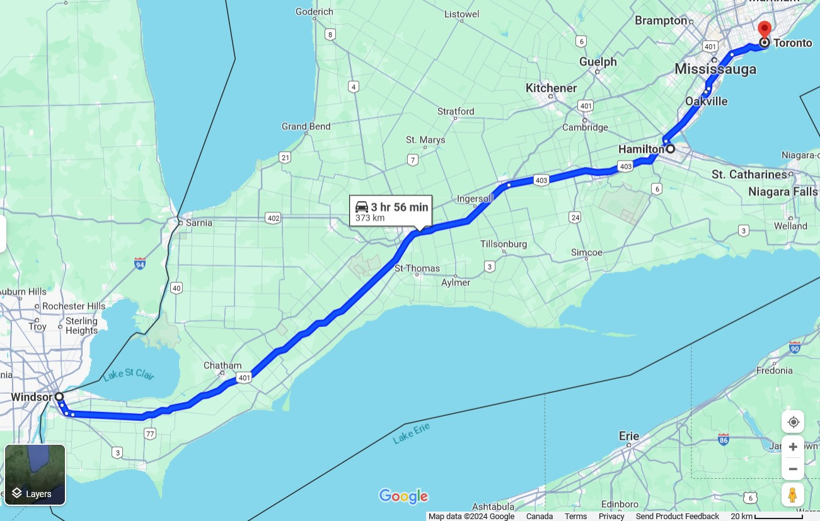

The PROBLEM

Slide 4
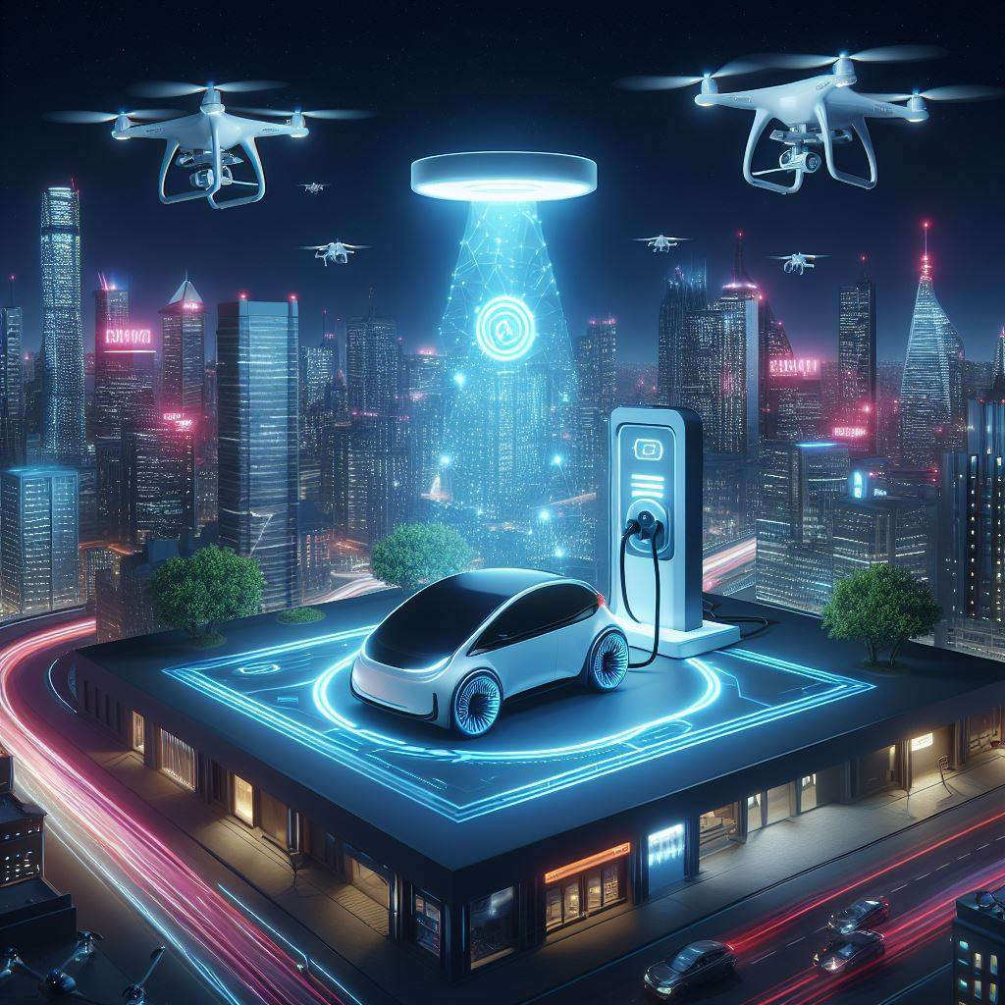
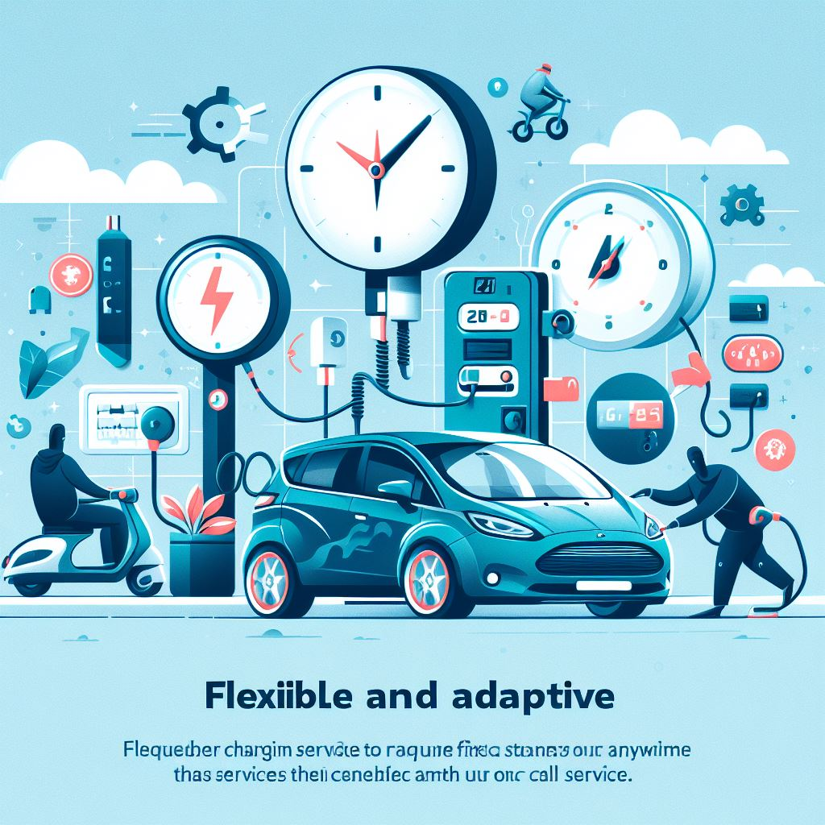
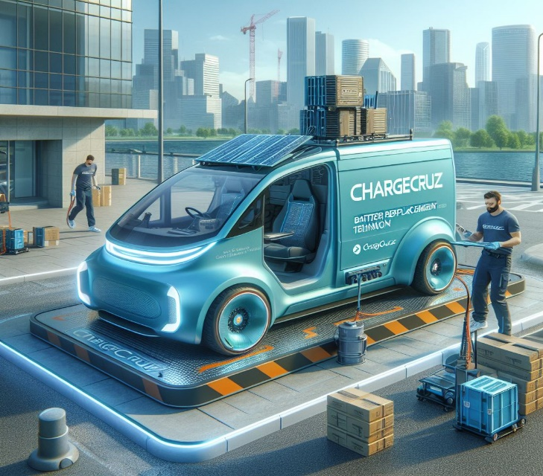
The SOLUTION
On-demand charging
Flexible and adaptive
Future forward innovation

Slide 5


OUR CUSTOMERS
B2C
Frequent Commuters
Eco Tourists
B2B
Car Dealerships
CAA -> CEVA
Event Planners
Shipping Businesses

Slide 6

UNLEASH THE POWER OF MOBILITY - CHARGECRUZ
Accessible 24/7
Customized Services (Different plans for businesses and customers)
Convenient and Cost-effective

Slide 7
But HOW?
Direct approach (1-1 for businesses and consumers)
Partnerships
Social media
Webapp and Subscriptions ($30/year)
Operational centers

Slide 8
COSTS
Capital Costs | Operational Costs
EV Charging Truck | Marketing
Charging Equipment | Electric Expenditures
Technology and R&D | Salaries payable
Lease for Operational Centres | Vehicle Maintenance
Licensing, Trademarks or Copyrights | Training
 | Insurance and Customer Support
$5 Million CAD (approx.)

Slide 9
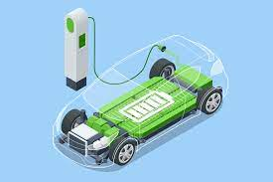

FUTURE NEXT STEPS
Battery Replacement
Wireless Charging Systems
Smart Mini Drone Chargers
Expansion of Business

Slide 10


