Slide 1
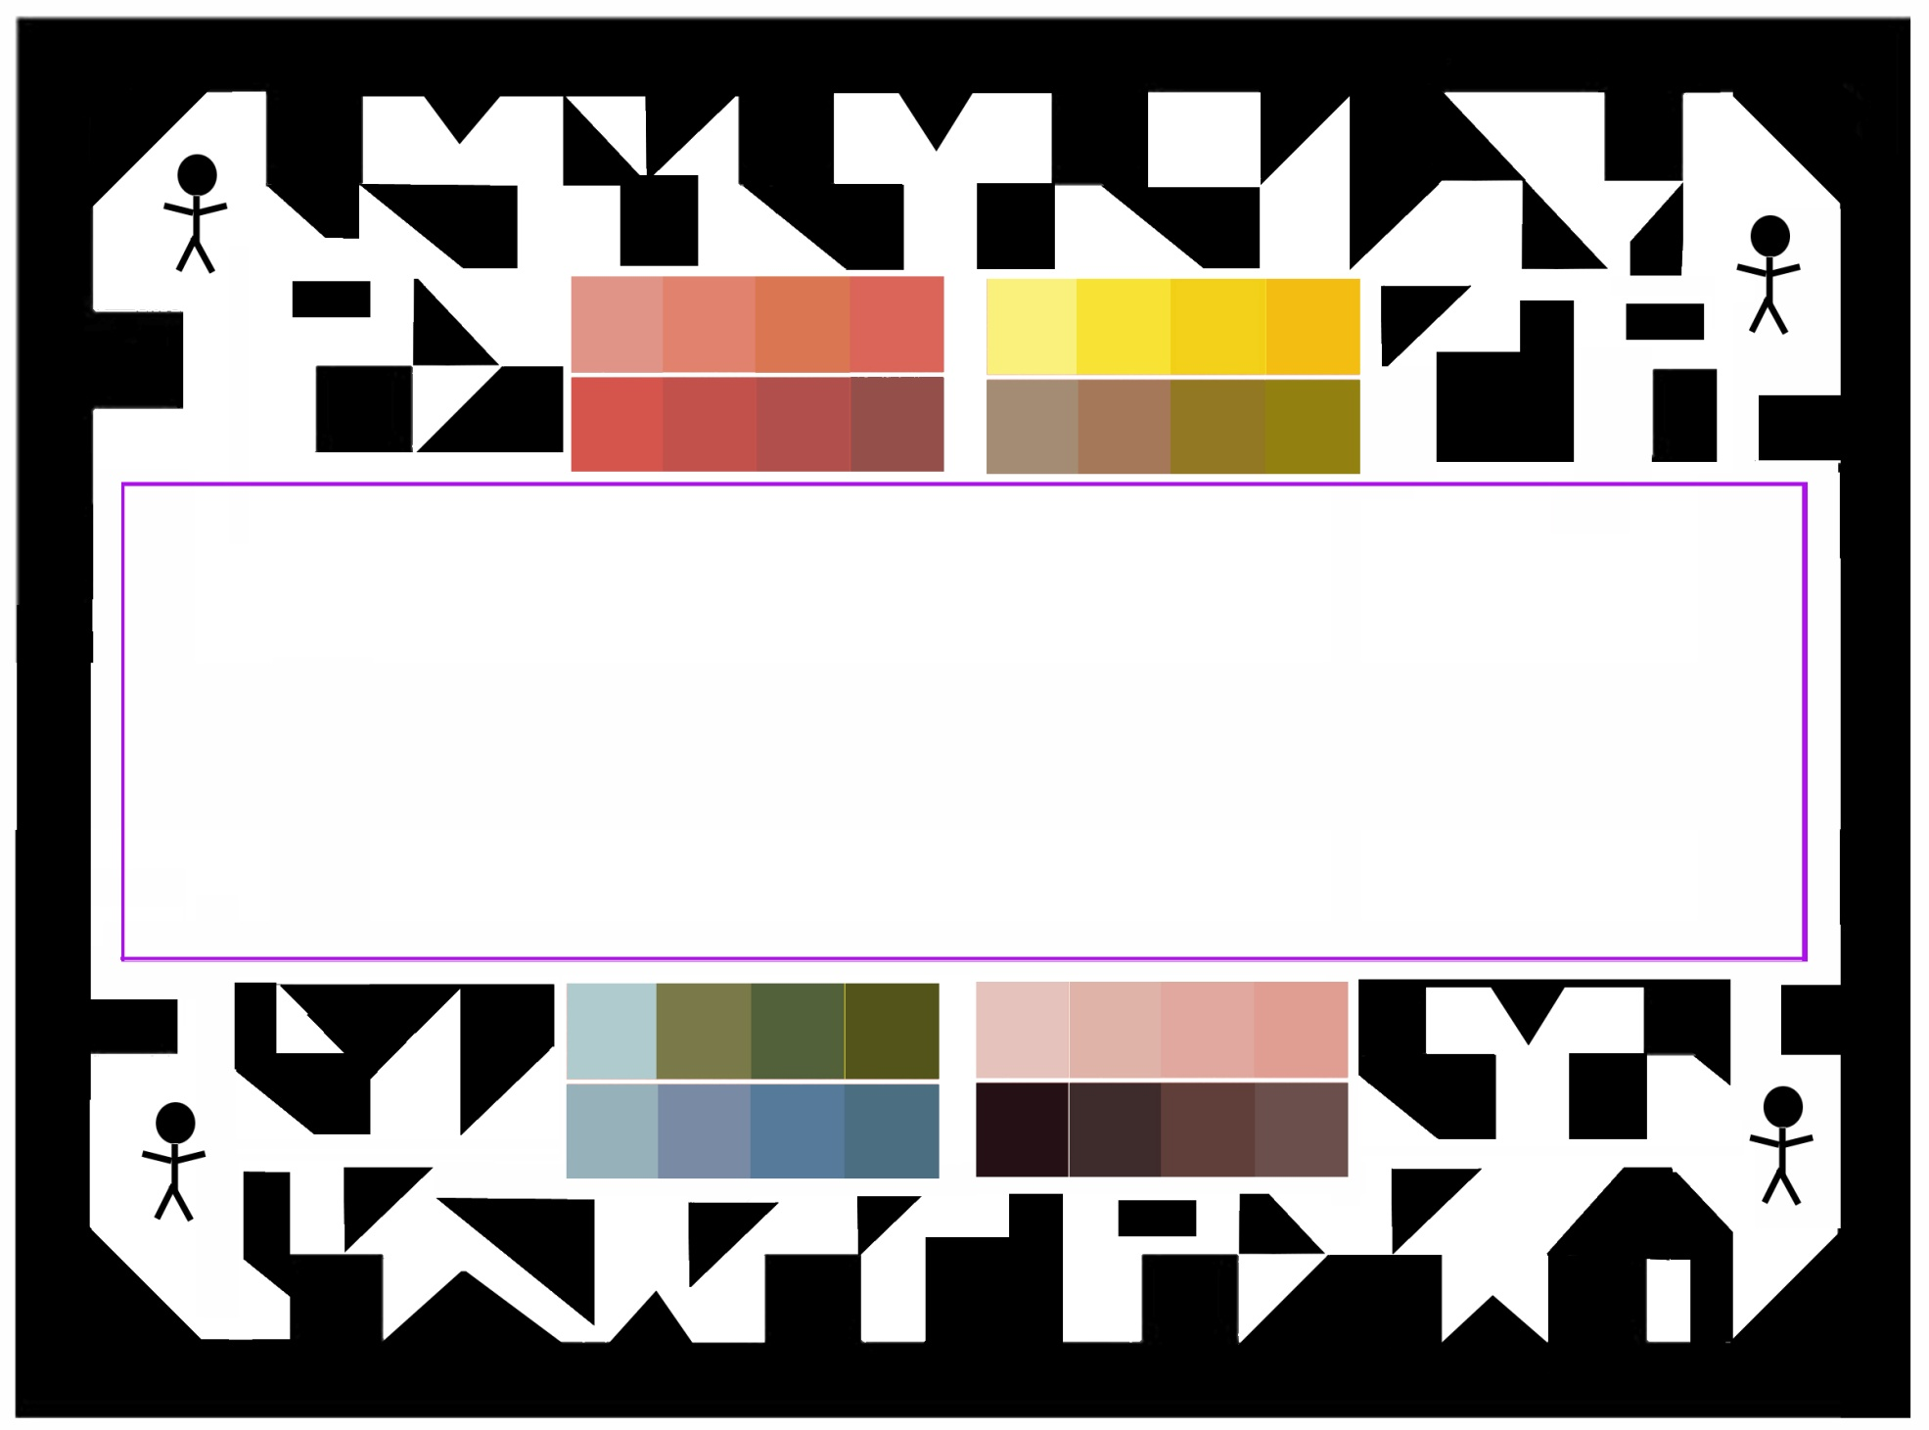
Rwanda Infection Prediction Project, Surgical drape, v8
Sept. 30, 2019, R. Fletcher, MIT

